Slide 1


PRESENTATION:
SEA TURTLE INVESTIGATION
Notes:
Copyright: All photos and diagrams used in this flipbook are copyright of the Great Barrier Reef Marine Park Authority.
Equipment and Set up:
6 x turtle mats (average female nesting size) - A cleared classroom, undercover or flat grassy area (3x3m) is ideal. Lay out the mats in numerical order.
6 x identification keys - One for each mat or group.
6 x diet discs (in a bag) - Place each of the six diet discs on the correct mat e.g. Disc 1 on Turtle mat 1.
6 x measuring tapes (non-metal) - One for each mat or group.
Student task sheet - to record data. Educator to print.
Pencils and Clip boards - for task sheet completion. Educator to provide.
Possible Role badges - Students could take on roles within the group such as measurer, scribe, key identifier, or ecologist (diet) etc. (Optional - Educator to coordinate).

Slide 2
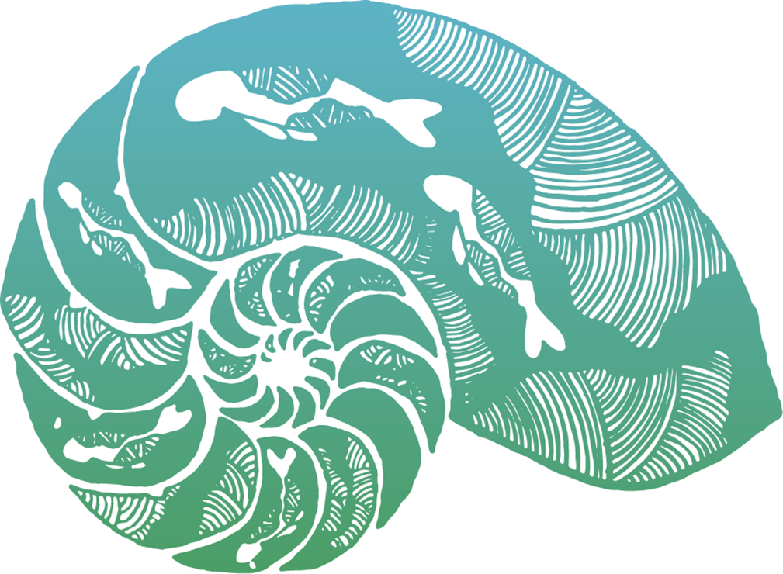
Acknowledgment of Country
We acknowledge the expertise, wisdom, and enduring connections that have informed the guardianship of the Reef for millennia.
We pay our respects to the Traditional Owners as the first managers of this Land and Sea Country, and value their traditional knowledge, which continues to inform the current management and stewardship of the Reef for future generations.
Notes:
Possibility to include your own local Acknowledgment of Country.

Slide 3

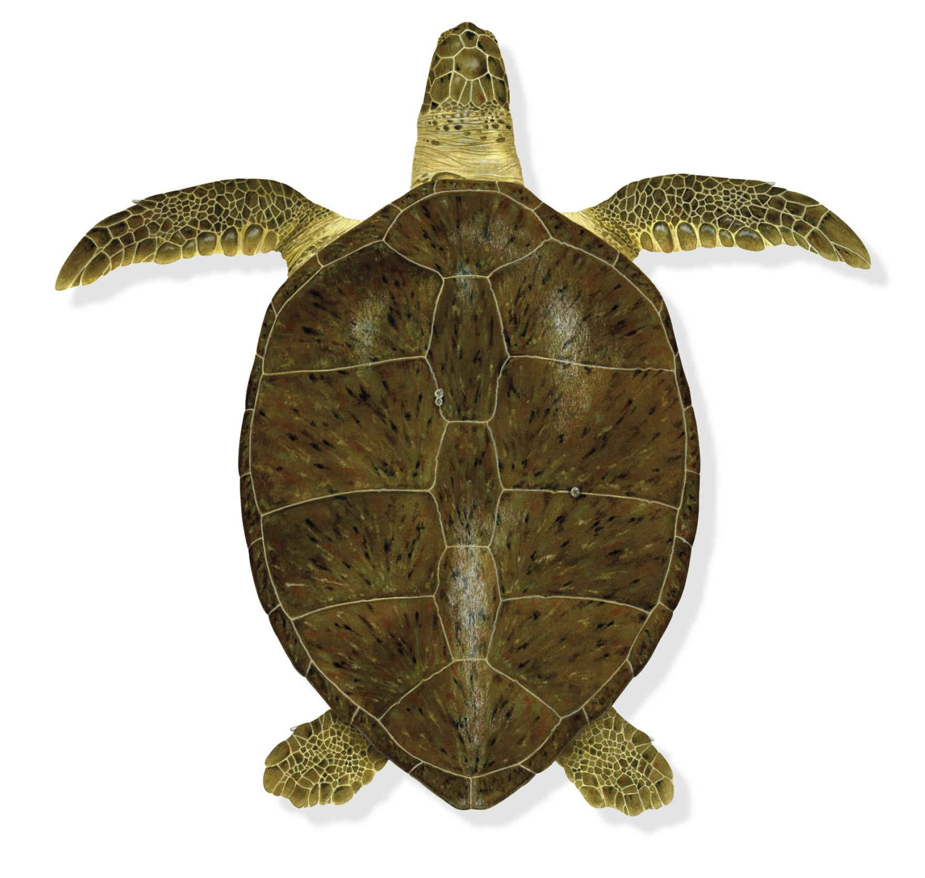
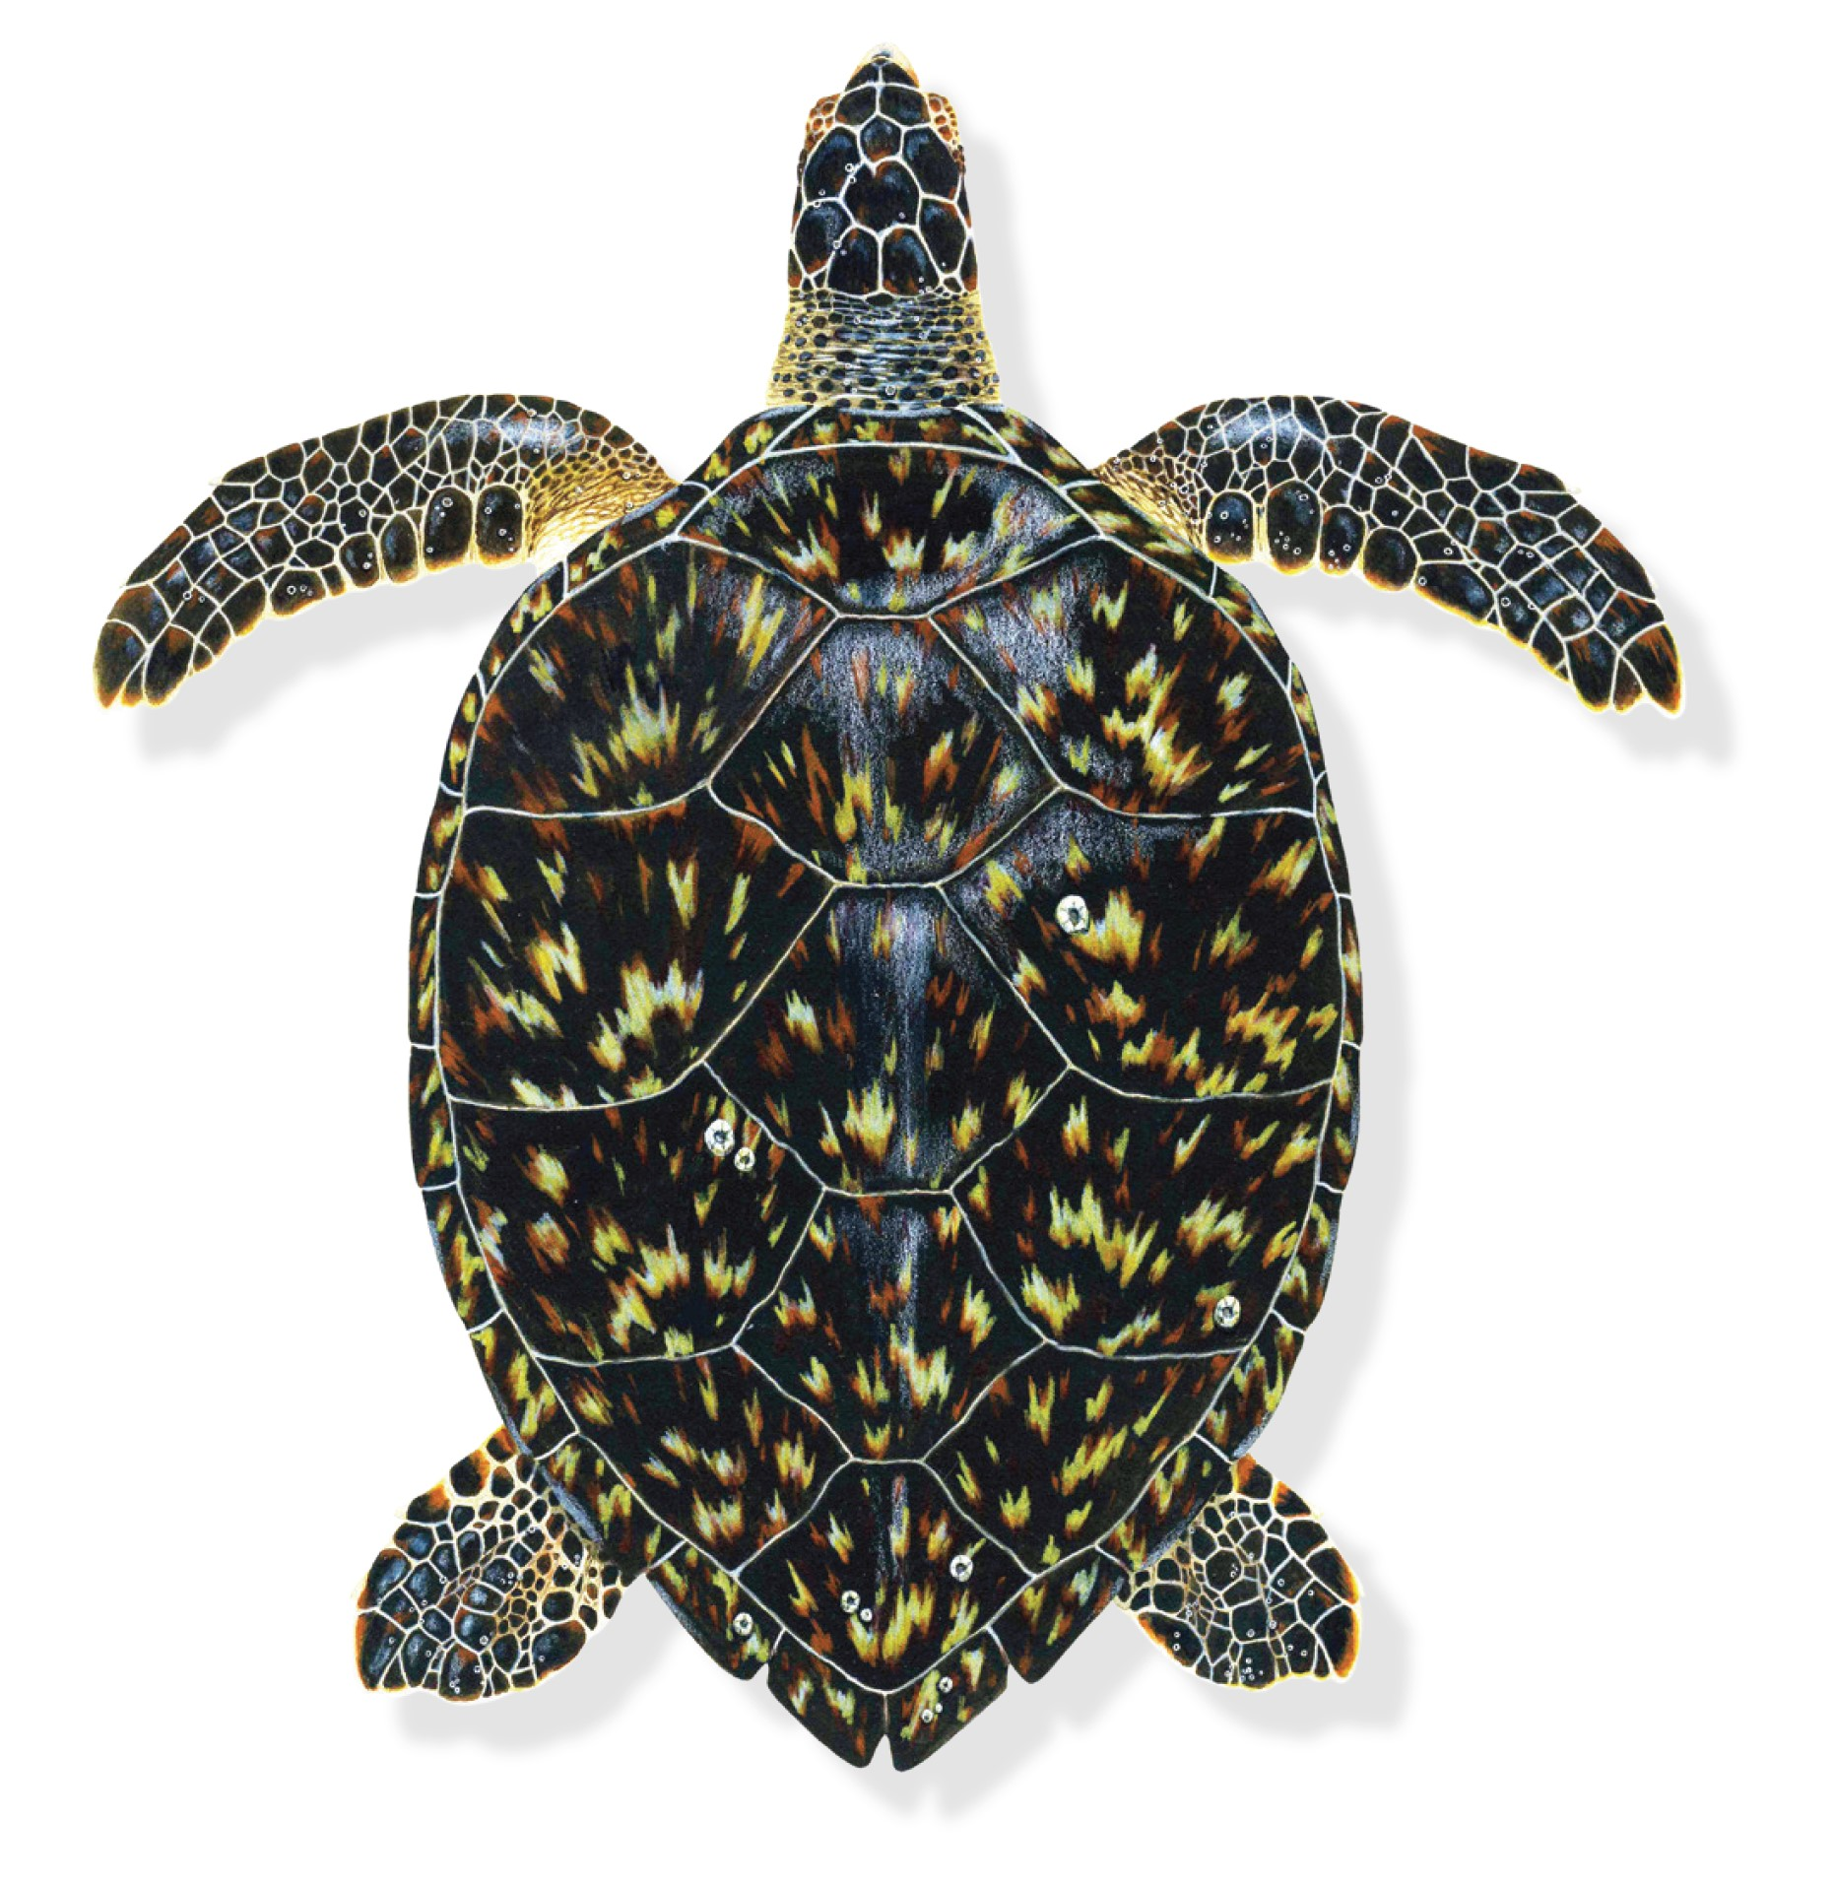
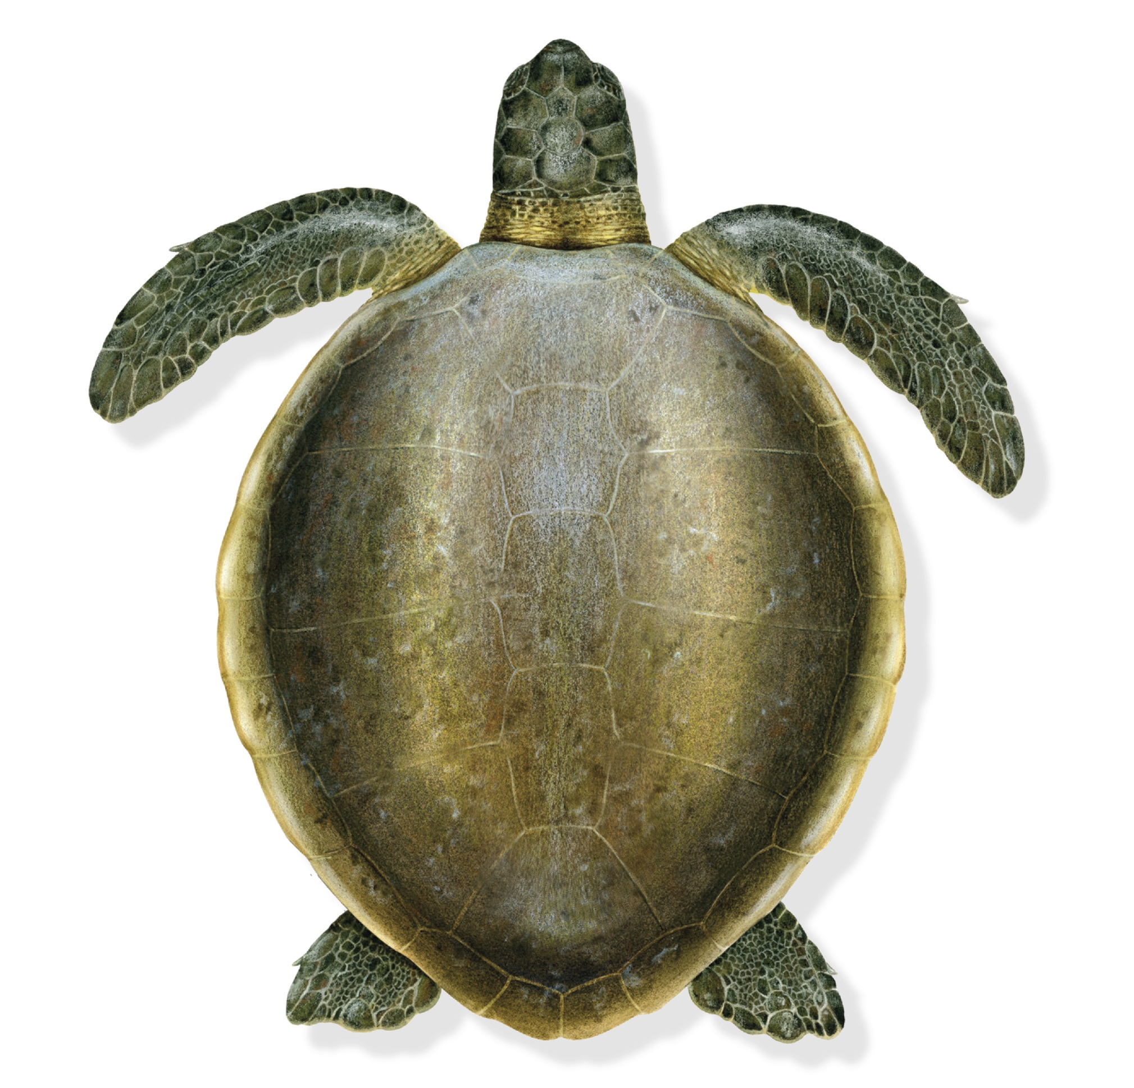
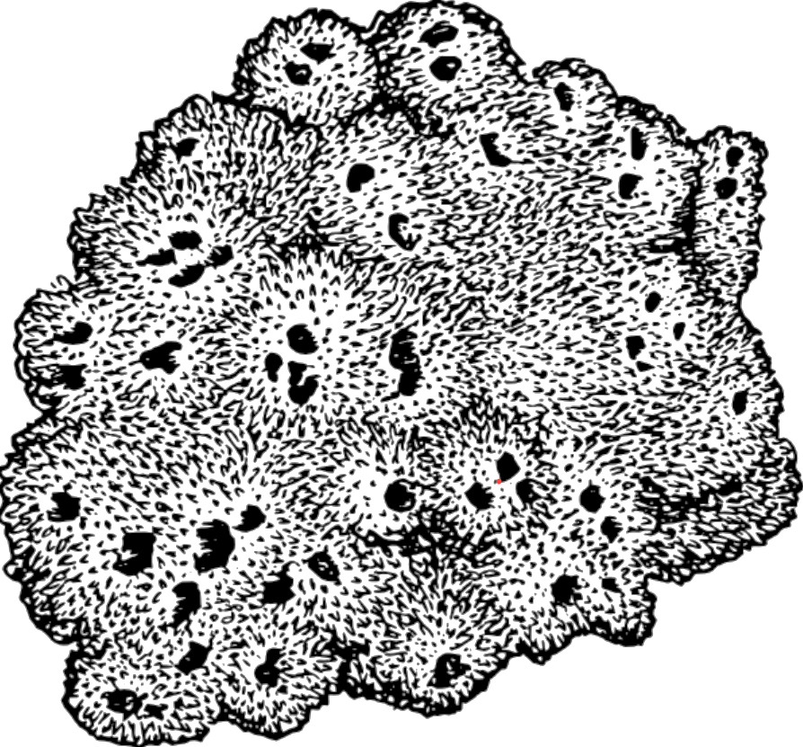
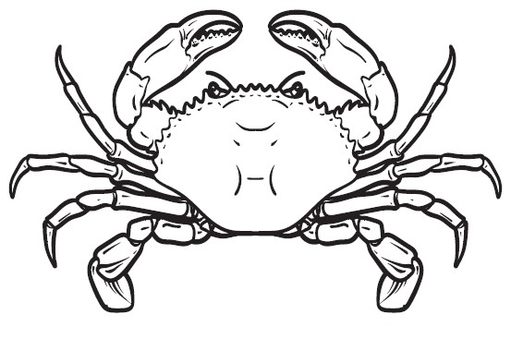

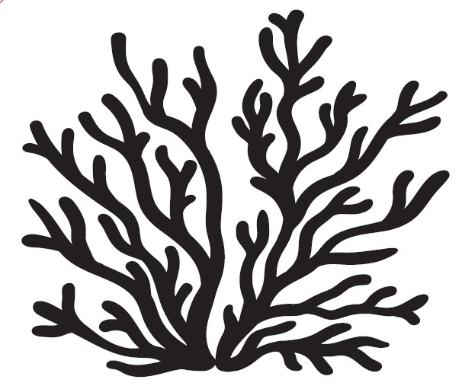
Turtle Investigation Activity
Name:___________________
Complete the following: - Identify and record the name using the identification key supplied.
- Measure and record the carapace length (cm) from the life size turtle mat.
- Circle the diet items identified on the diet discs.
Turtle 1.
Name _______________________
Turtle 2.
Name _______________________
Turtle 3.
Name _______________________
Carapace Length
_____ cm
Carapace Length
_____ cm
Carapace Length
_____ cm
Diet:
Diet:
Diet:
Sponges
Jellyfish
Crustaceans
Molluscs
Sponges
Jellyfish
Crustaceans
Molluscs
Sponges
Jellyfish
Crustaceans
Molluscs
Sea urchins
Soft corals
Sea
cucumbers
Algae &
Seagrass
Sea urchins
Soft corals
Sea
cucumbers
Algae &
Seagrass
Sea urchins
Soft corals
Sea
cucumbers
Algae &
Seagrass
Notes:
Copy of page 1 (front page) of the Turtle Investigation Activity task sheet – please print out double sided including page 2 of the task sheet on the next slide.

Slide 4
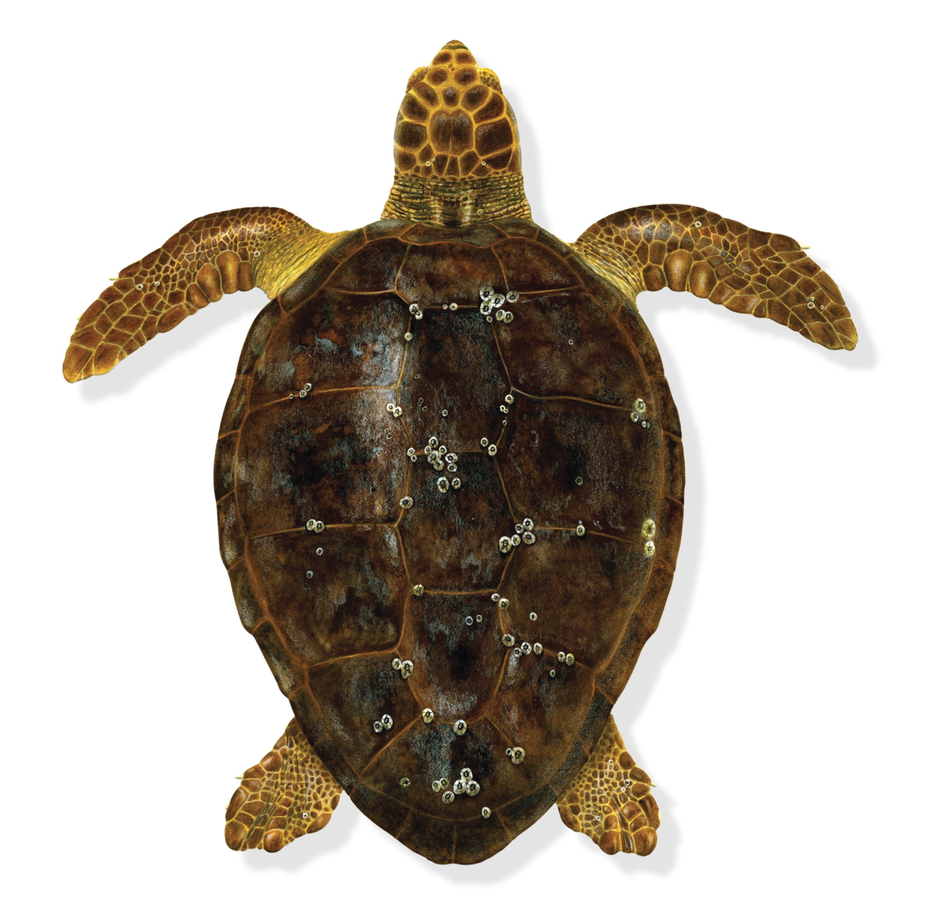
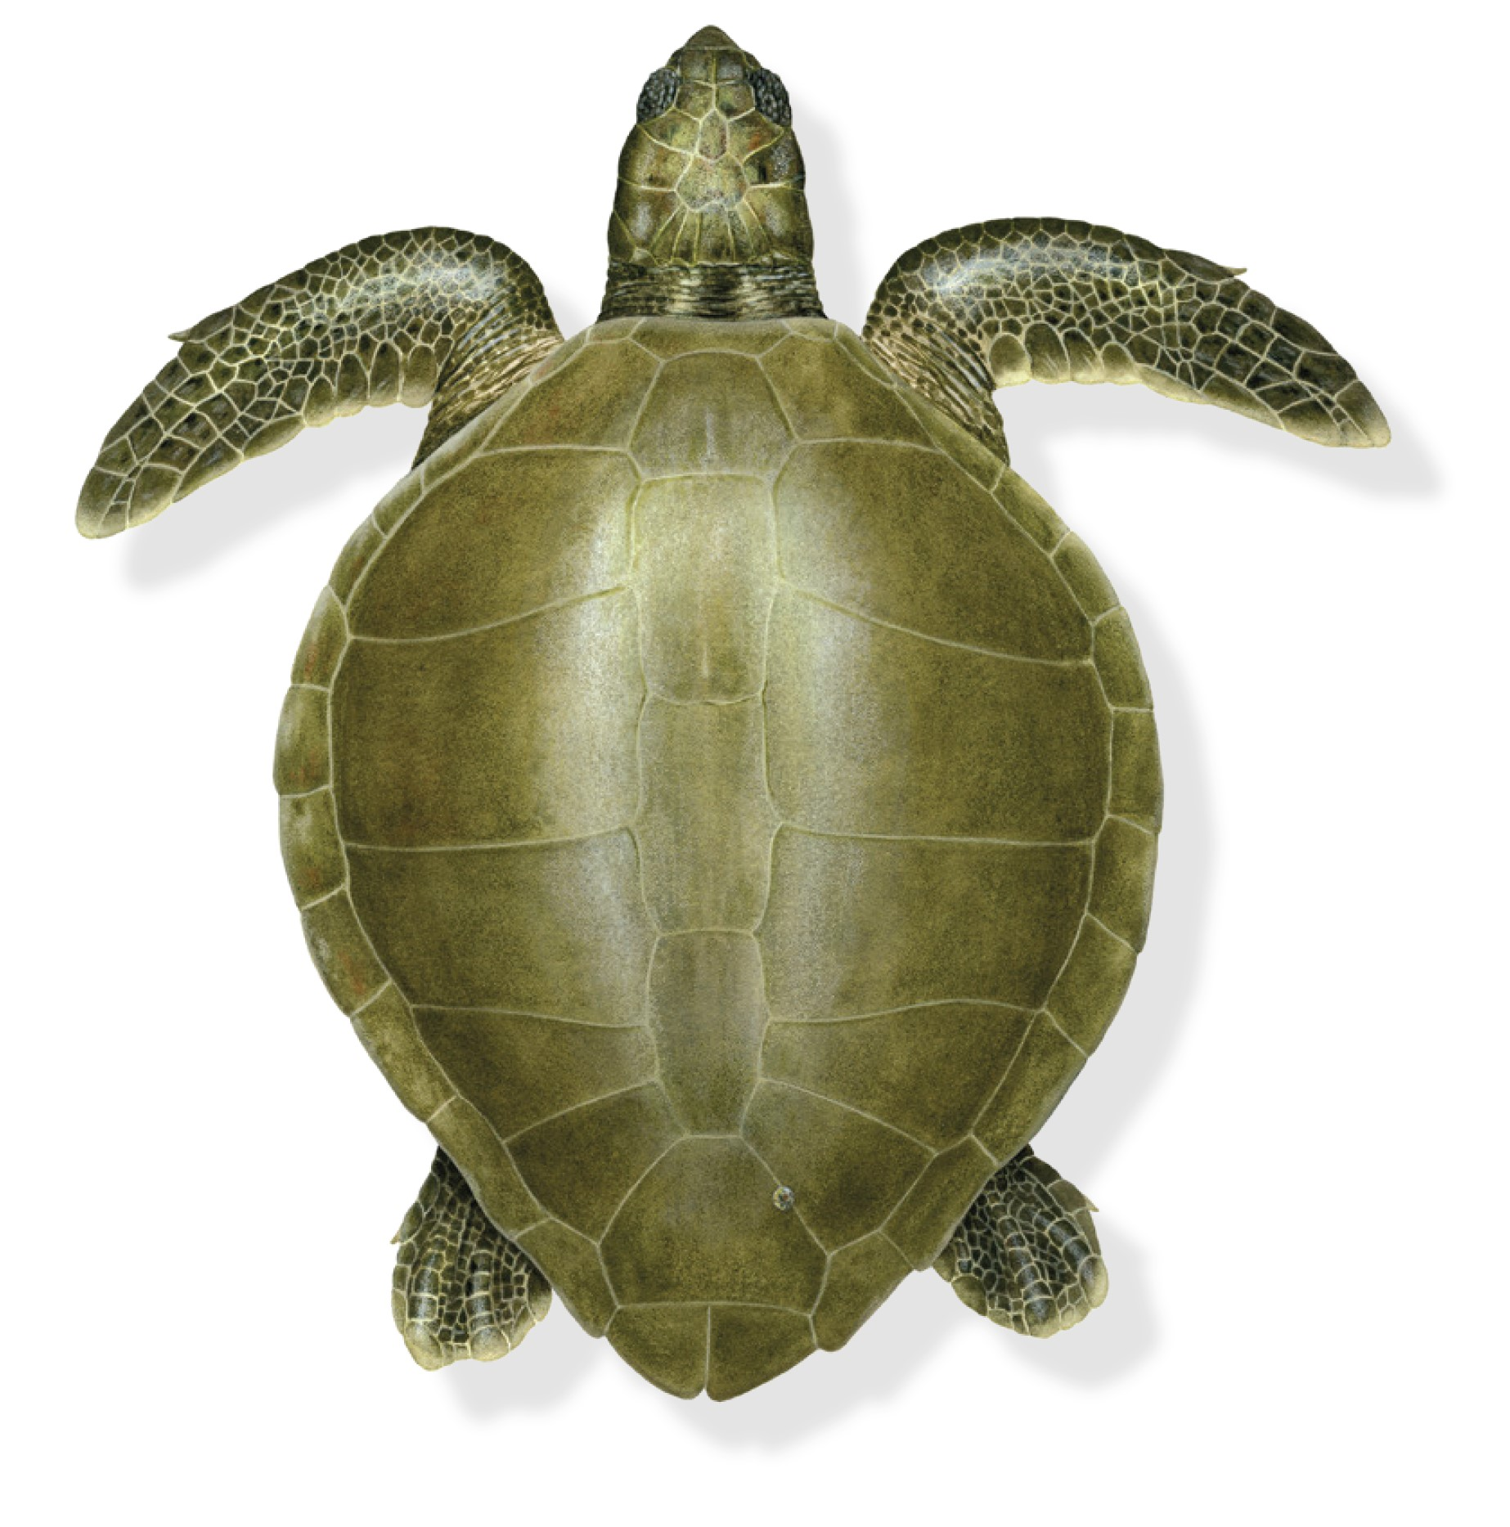
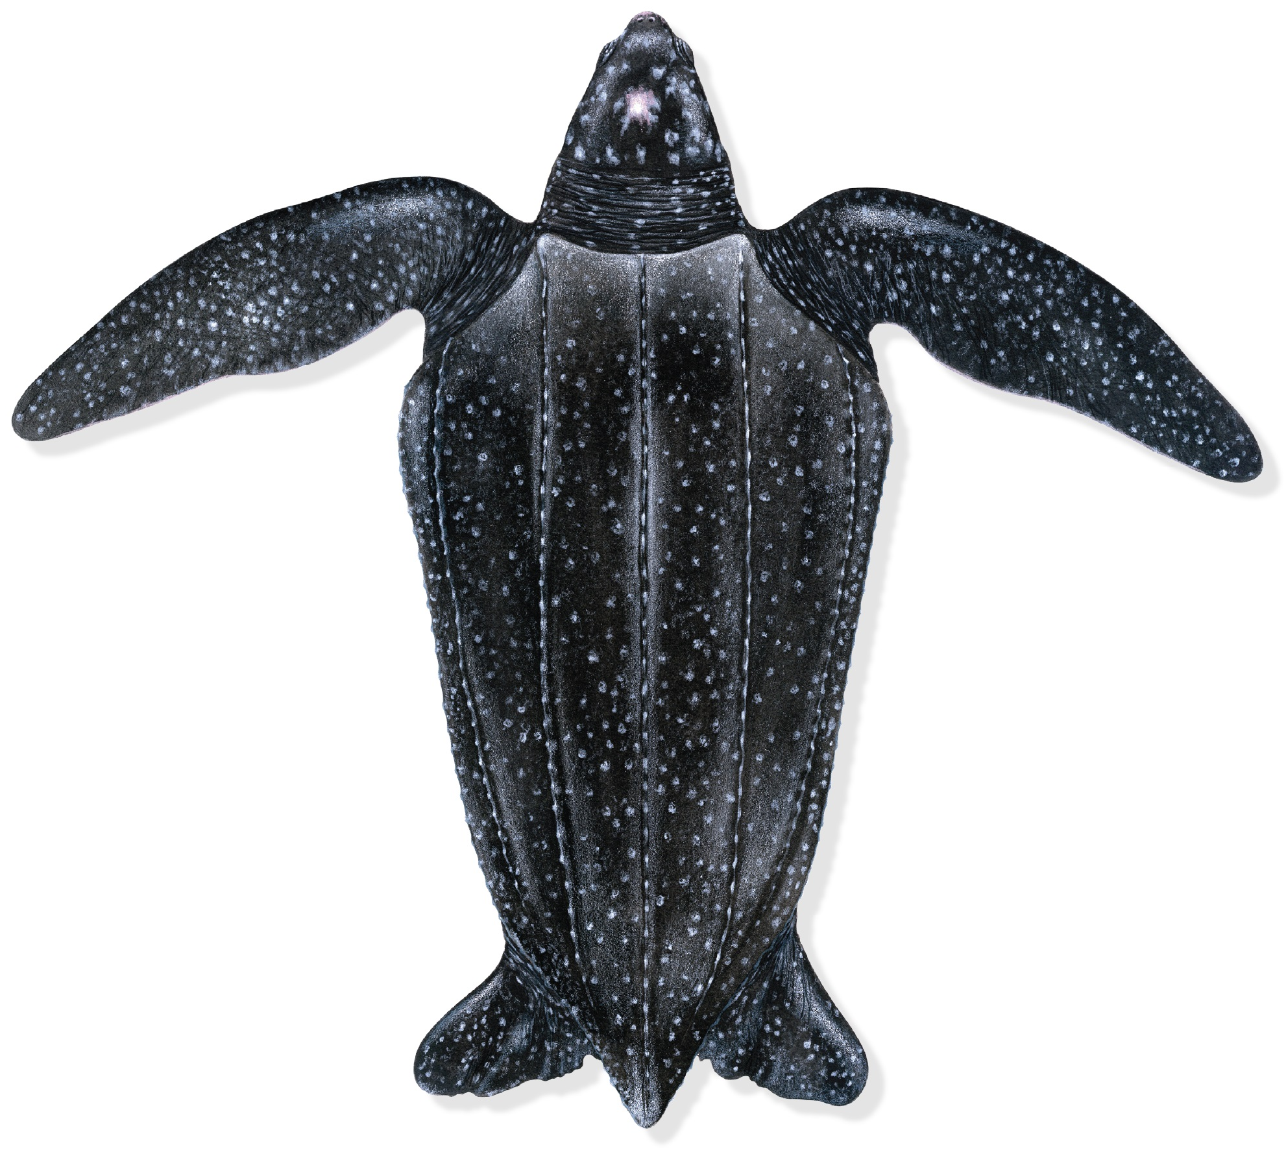
Turtle Investigation Activity
Turtle 4.
Name _______________________
Turtle 5.
Name_______________________
Turtle 6.
Name _______________________
Carapace Length
_____ cm
Carapace Length
______cm
Carapace Length
______cm
Diet:
Diet:
Diet:
Sponges
Jellyfish
Crustaceans
Molluscs
Sponges
Jellyfish
Crustaceans
Molluscs
Sponges
Jellyfish
Crustaceans
Molluscs
Sea urchins
Soft corals
Sea
cucumbers
Algae &
Seagrass
Sea urchins
Soft corals
Sea
cucumbers
Algae &
Seagrass
Sea urchins
Soft corals
Sea
cucumbers
Algae &
Seagrass
DID YOU KNOW? The turtle mats are printed at the average female nesting size for each species.
DID YOU KNOW? Depending on species, age and condition, female turtles may lay between 2 – 8 clutches of eggs each nesting season.
Notes:
Copy of page 2 (back page) of the Turtle Investigation Activity task sheet – please print out double sided including page 1 of the task sheet on the preceding slide.

Slide 5
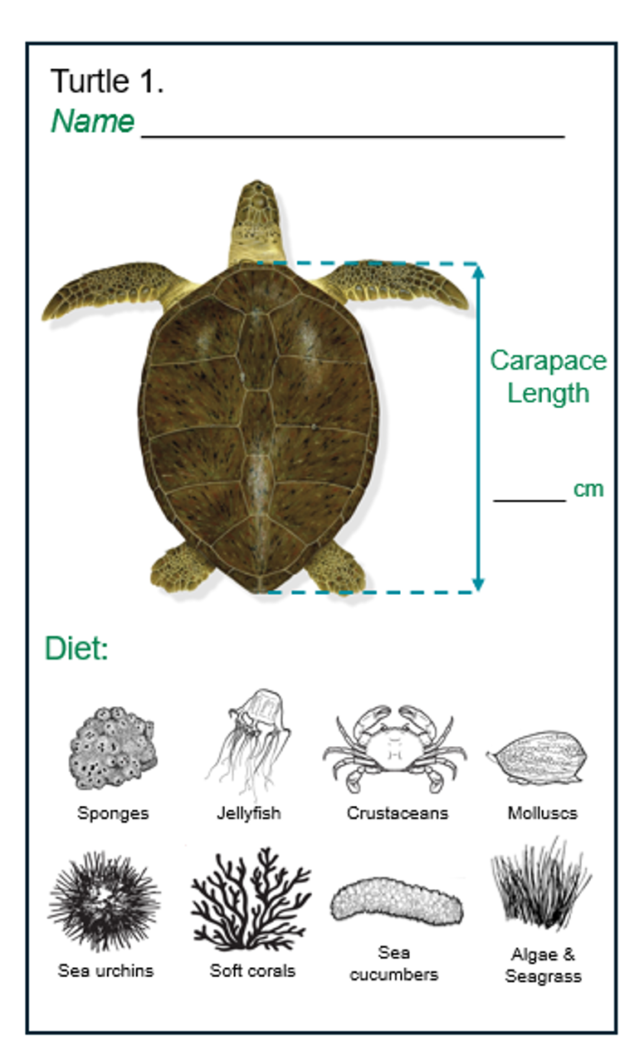
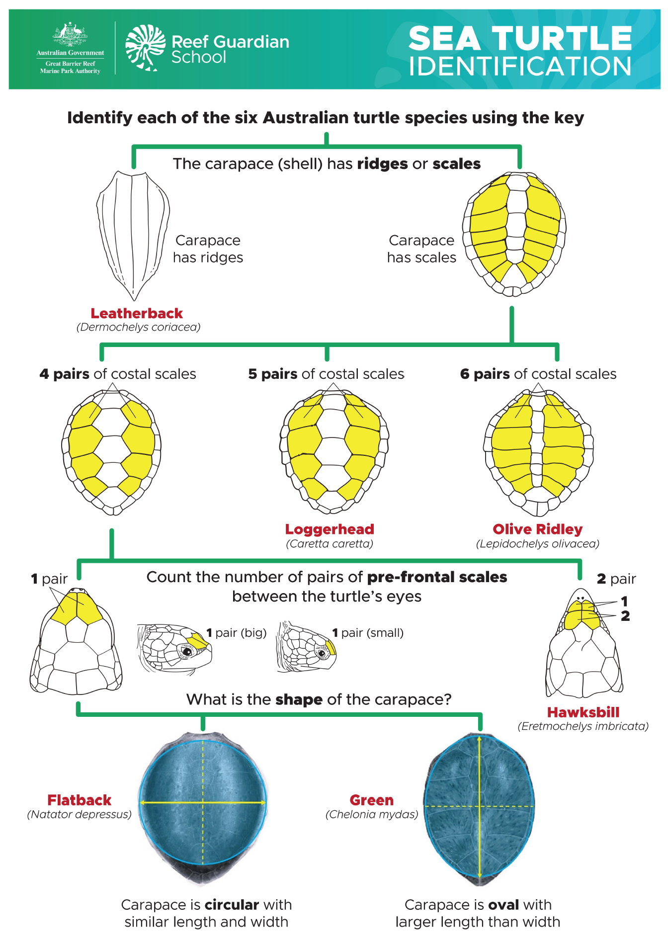
LEARNING INTENT:
Investigate the morphology (physical features), diets and identification of six species of Australian sea turtles.
SUCCESS CRITERIA:
For each turtle:
1. Identify species.
2. Measure carapace (shell) in cm.
3. Identify the diet.
4. Record results on task sheet.
Notes:
Welcome to the Sea Turtle Investigation Activity.
Today we will investigate the morphology (physical) features, diets and identification of six species of Australian sea turtles.
By the end of this lesson, you should be able to:
Identify the six species of sea turtles using an identification key.
Measure the length of a carapace (shell) in centimetres.
Identify the diet of each species.
Record your findings onto your task sheet.
Today six turtle mats have been laid out. These mats represent the average size of a nesting turtle (female).
So let us begin by investigating the six species found in Australian waters.
Question: Can anyone name a species of sea turtle that is found in Australia? (Brainstorm/discuss).

Slide 6
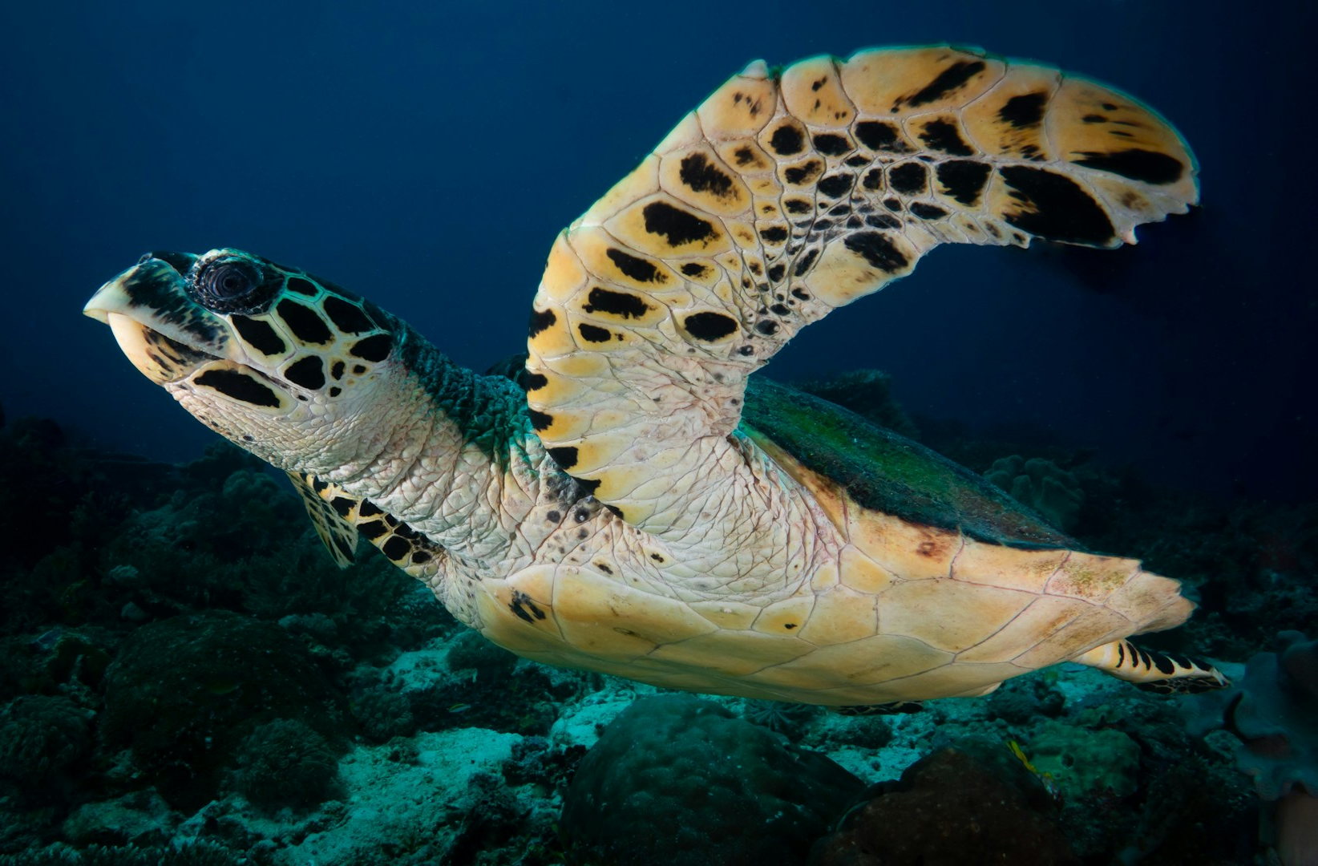
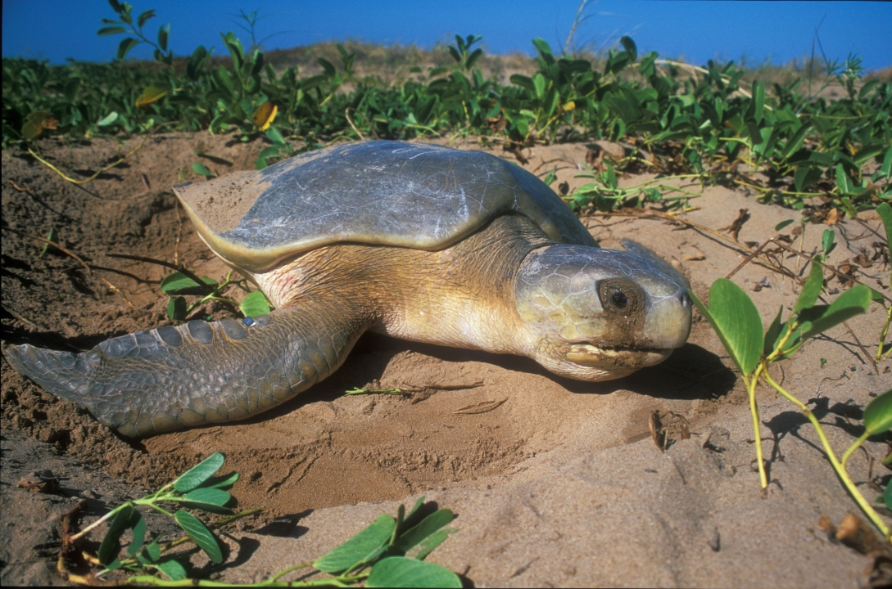
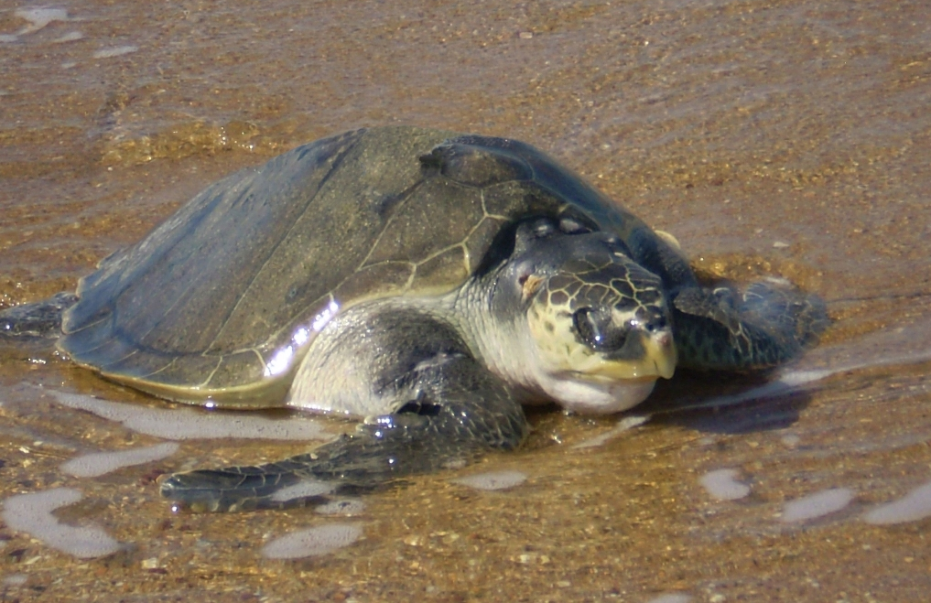
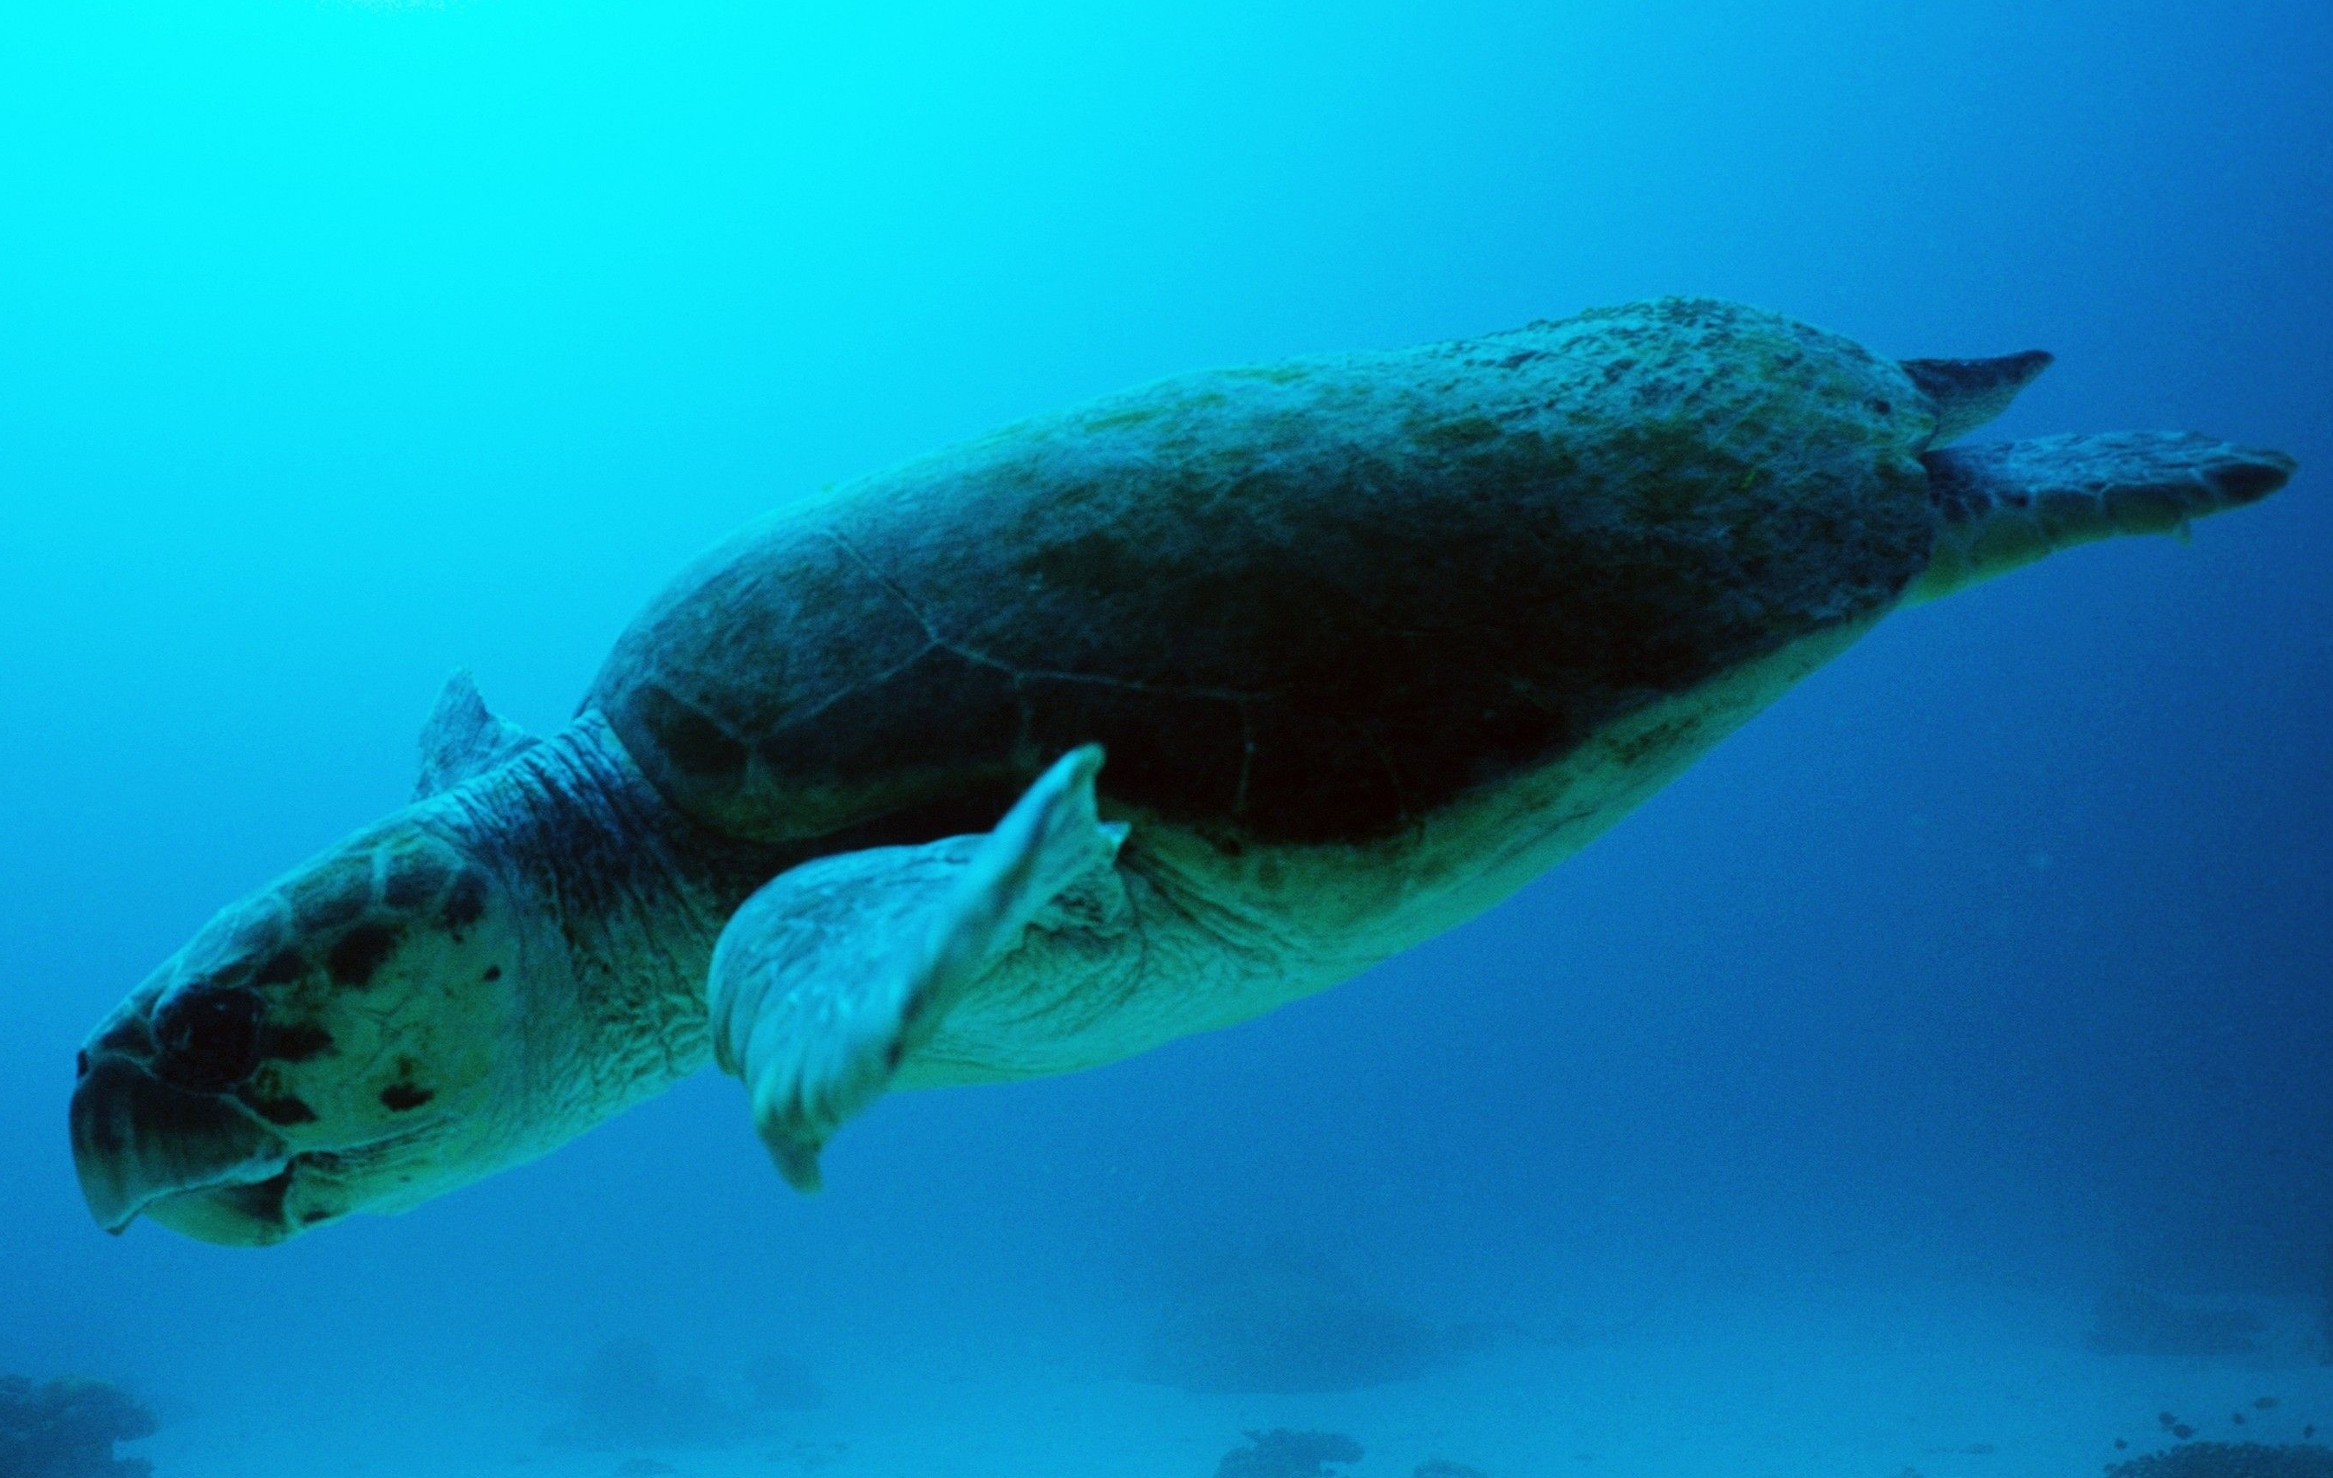
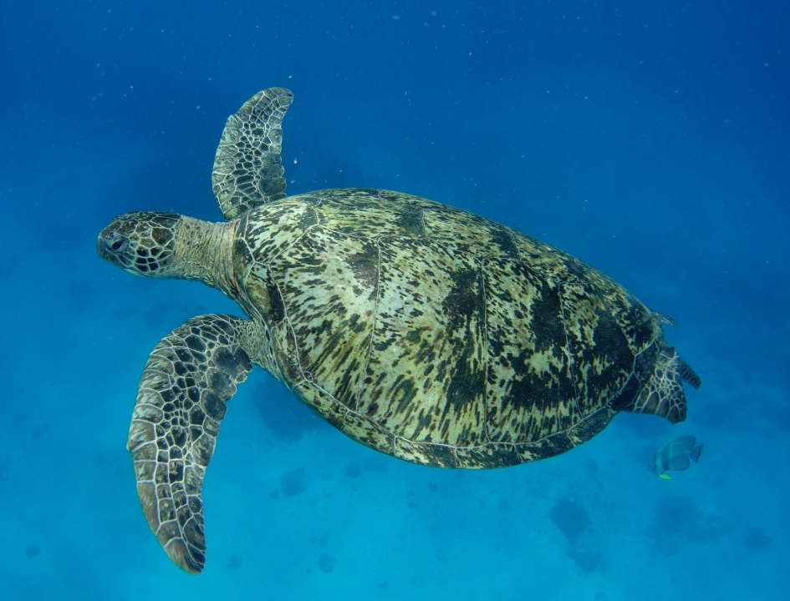
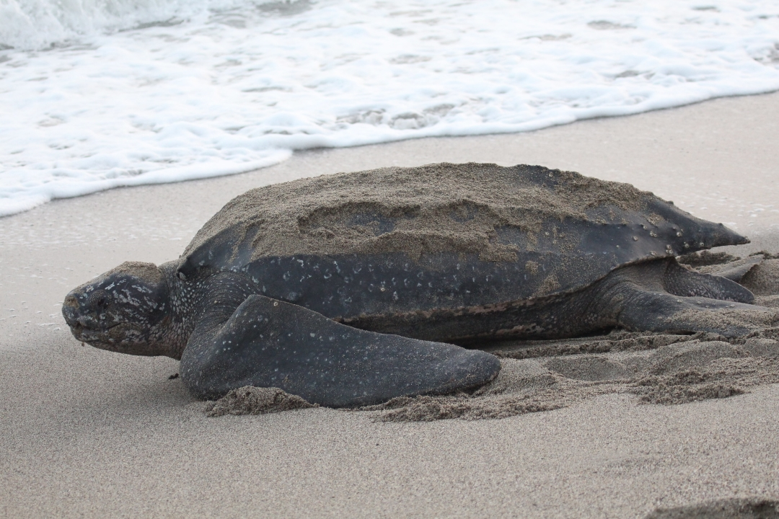
THE SIX SEA TURTLE SPECIES IN AUSTRALIAN WATERS
Common name | Scientific name (Genus species)
Green | Chelonia mydas
Hawksbill | Eretmochelys imbricata
Leatherback | Dermochelys coriacea
Olive Ridley | Lepidochelys olivacea
Loggerhead | Caretta caretta
Flatback | Natator depressus
Notes:
Six of the world’s seven species of sea turtles are found in Australian waters. The common names of these six turtles are shown in the left column. A common name is a local, everyday name that can vary by people, region and language. A scientific name is a standardised, universal name that is Latin based and is written in italics, with the Genus name (capital letter) and species name (lowercase).
The six species found in Australian waters are:
Green Turtle - Chelonia mydas
Hawksbill Turtle - Eretmochelys imbricata
Leatherback Turtle - Dermochelys coriacea
Olive Ridley Turtle- Lepidochelys olivacea
Loggerhead Turtle - Caretta caretta
Flatback Turtle - Natator depressus
The seventh species is the Kemp’s Ridley turtle (Lepidochelys kempii) and is found in the Northern Hemisphere (Gulf of Mexico and Atlantic Ocean).
Matching the turtles on the screen with the correct names, can be hard. Whilst we could take a guess, today we are going to learn how real scientists name and study sea turtles.

Slide 7
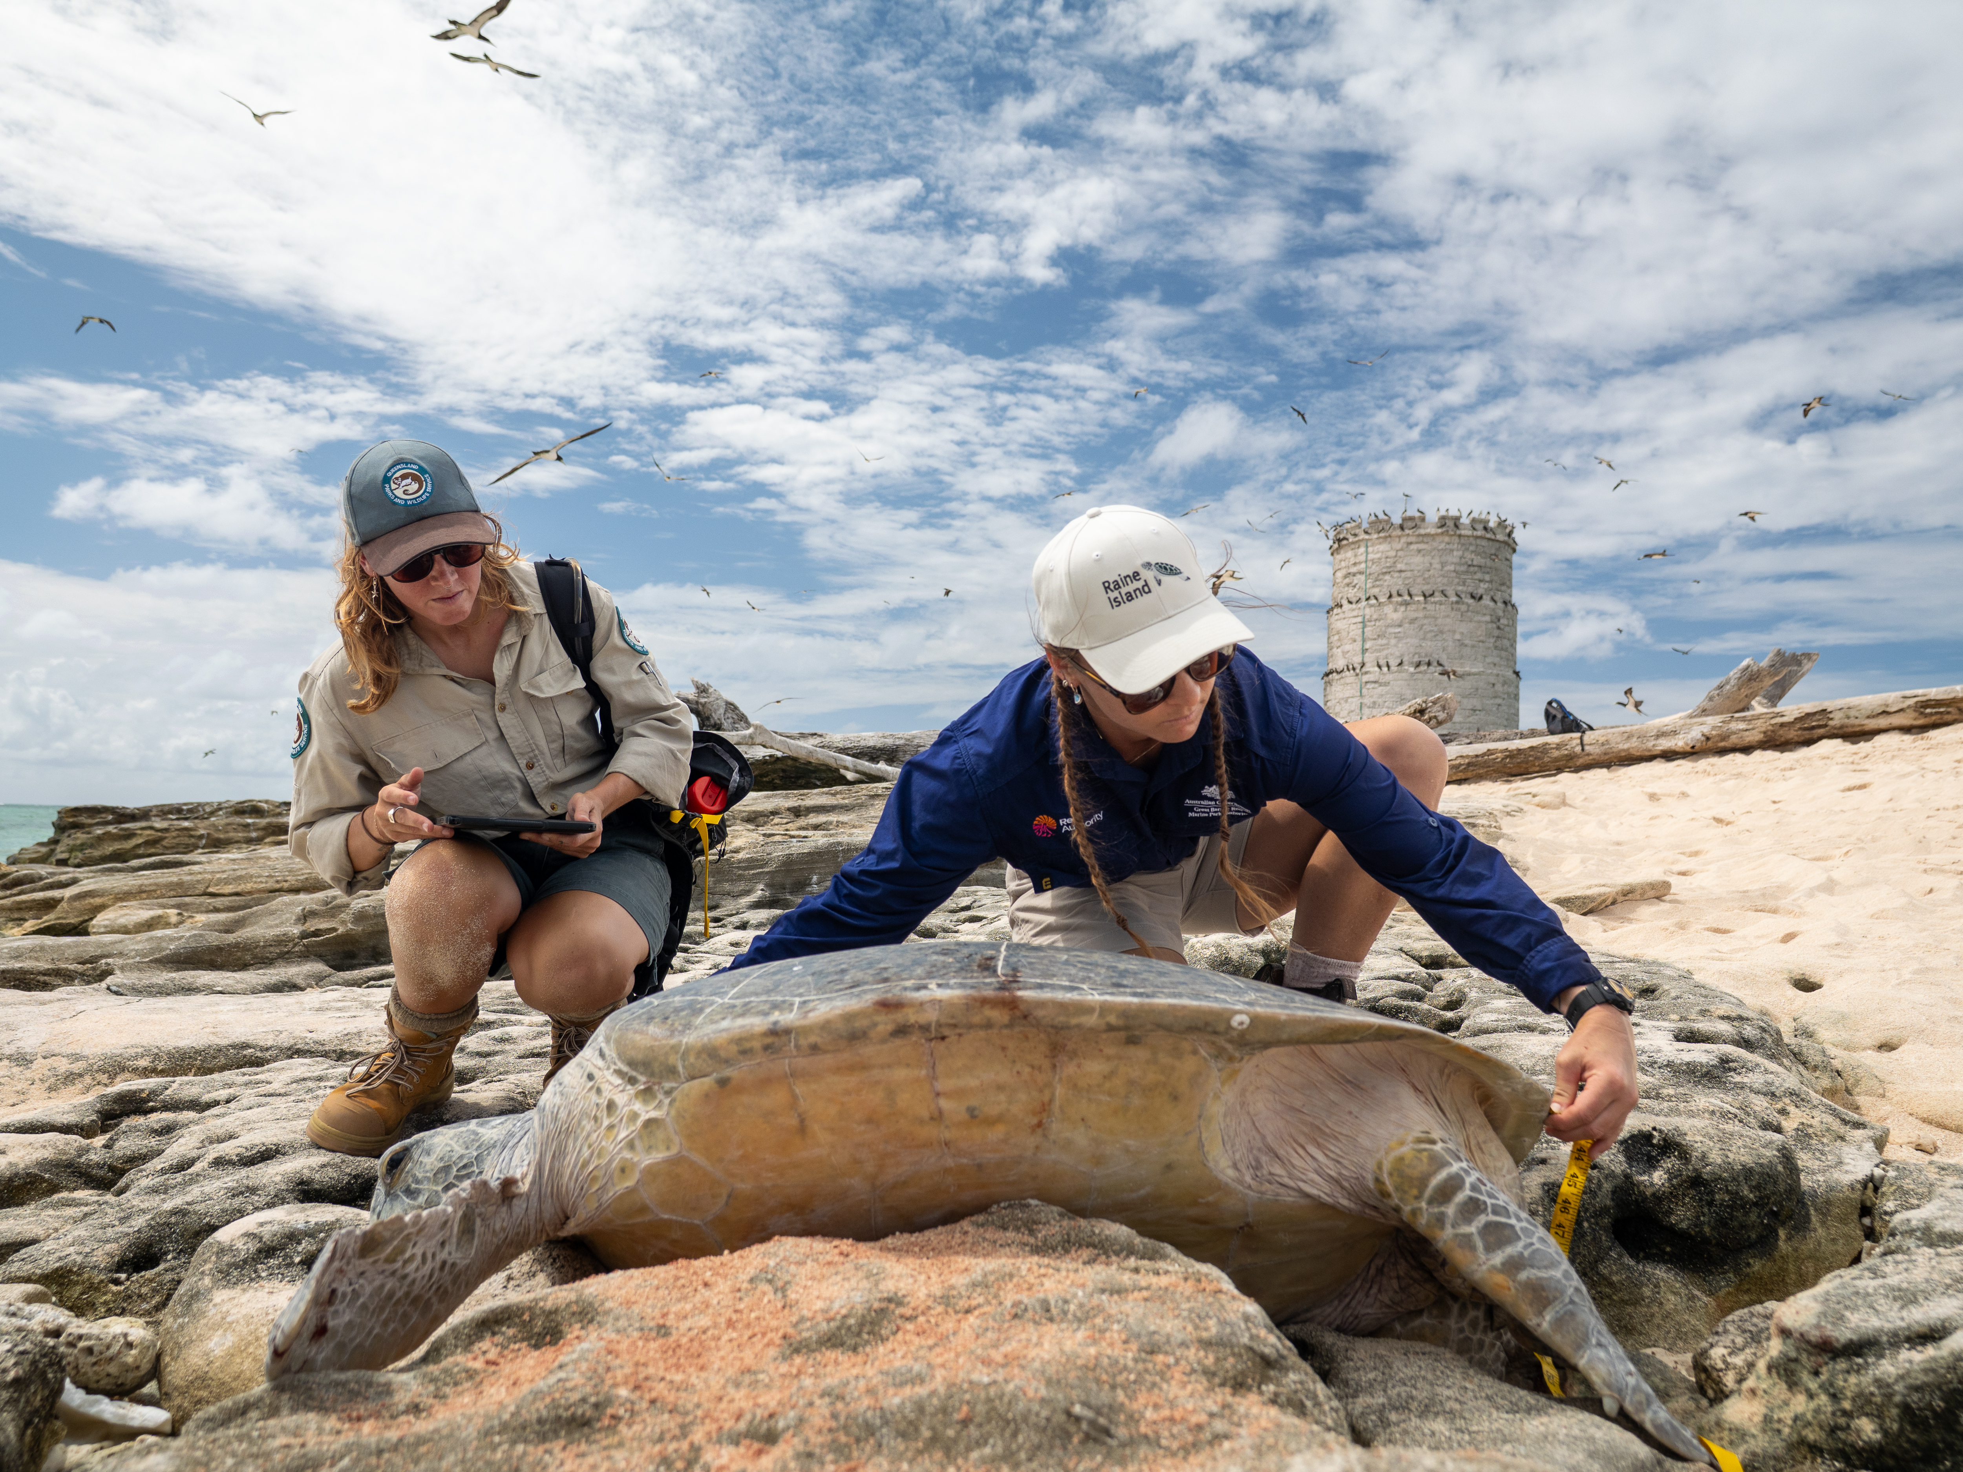
SEA TURTLE RESEARCH
To help understand turtle populations, researchers may record information such as;
Identification
Diet
Carapace (shell) length
Can you collate the data today?
Notes:
Scientists record data of sea turtles to help support decisions on how to best manage, conserve and protect turtle populations and habitats. Today, we will learn to complete three tasks like turtle scientists.
Species Identification – scientists use an identification key to determine the species of turtle.
Diet – scientists study the diets of sea turtles to understand ecological roles, to manage and protect food sources, and monitor the health of the marine environment such as seagrass beds or coral reefs.
Carapace (shell) length – is measured by scientists to assess a sea turtle’s growth rate, age, health or breeding status. Carapace length data can be combined with weight data to compare length to weight relationships. This can in turn be used to determine if a turtle is healthy or underweight. Carapace length is often recorded for female sea turtles as it is easier to measure them on nesting beaches.
Turtle scientists may also record:
Eggs - the number is counted to understand breeding success.
Movement and distribution - scientists study movement, migrations and habitat use to identify areas that are important for turtle conservation.
Internal and external features - of sea turtles.

Slide 8
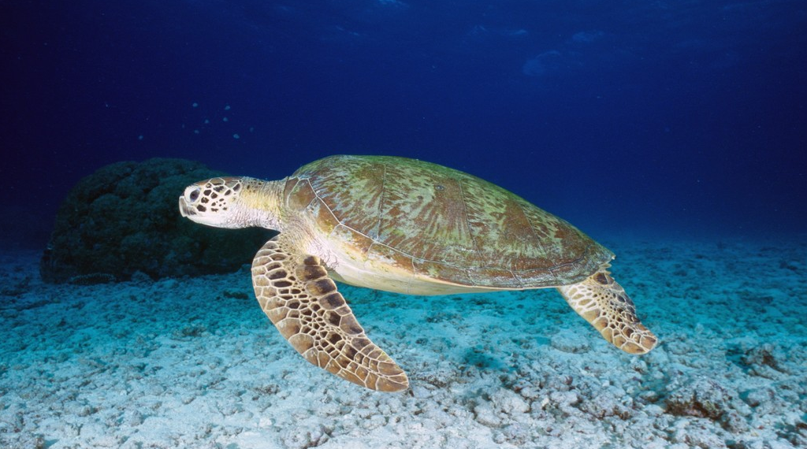
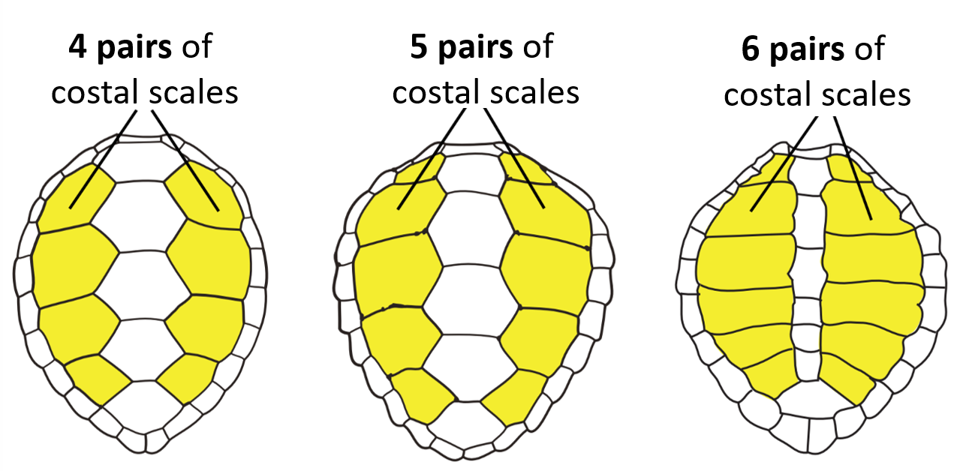
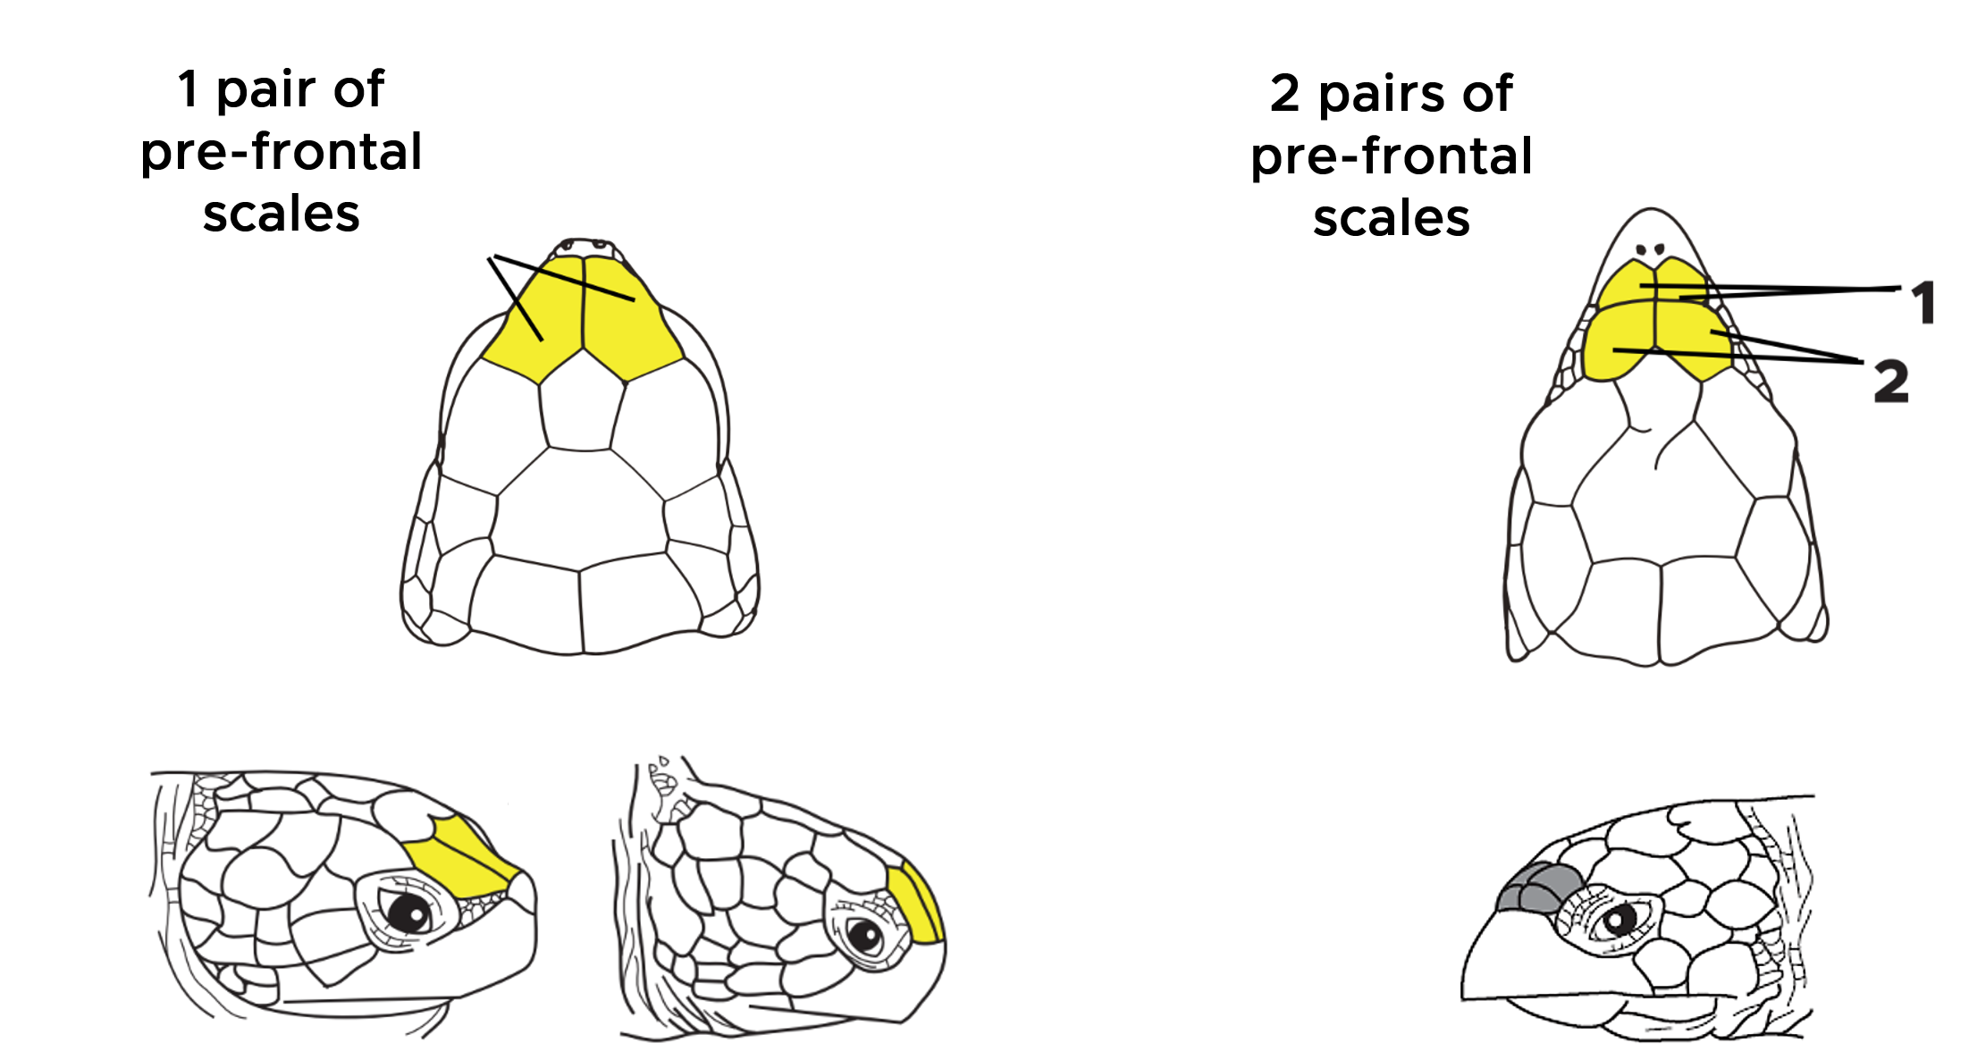
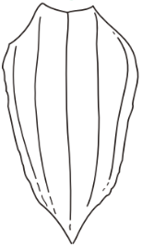
MORPHOLOGICAL (EXTERNAL) FEATURES
Costal scale
Ridges
Pre-frontal scales
Carapace
(shell)
Eyes
(salt glands)
Costal scale
Nostrils
Tail
Beak
Plastron
Rear flippers
Front flippers
Notes:
Before we can collate data like scientists, we should stop for a minute to talk about the morphological (external) features of sea turtles. To use the key and identify the turtles in today's activity, you'll need to count two types of scales.
Pre-frontal Scales - Located between the eyes, above the nostrils. Some turtles have one pair, while others have two pairs. Knowing how to locate and count the pairs of pre-frontal scales is important to identify the turtle. There are either one large pair (2) or two pairs (4) of smaller pre-frontal scales.
Costal Scales -These are large lateral scales, on the carapace (upper shell) that are counted in pairs. The top right image shows how the costal scales are counted in pairs on the carapace. You can try and stretch your fingers out like the hand image then count the pairs moving down.
Today, you will measure the length of the carapace for each turtle.
The Carapace - is the upper shell and is made from vertebrate, flattened rib bones and is covered in scales. The carapace increases in size as the turtle grows and gains weight. Different species have different shell shapes, sizes and patterns.
Other physical features of a sea turtle are:
Tail - An extension of the spine that helps with balance and movement. Male adult turtles have longer tails than females.
Rear Flipper - Used for steering while swimming. Female turtles also use flippers to dig nests for their eggs.
Plastron - The protective underside made from interlocking bones and covered in scales.
Front Flippers - Used for swimming. Small claws on the flippers can help hold or break up food.
Beak - Used for cutting, tearing and crushing food. Different species have different beak shapes depending on what they eat.
Nostrils - Located at the top of the beak. Used for breathing and smell. Sea turtles must surface to breathe but can reduce their heart rate to stay underwater for a long rest.
Eyes - Sea turtles have excellent underwater vision to help find food and avoid predators.
Salt Glands - Located behind the eyes. These glands remove extra salt from the body and on land they appear as tears.
Question: Can you recall which three morphological features you will investigate today? Answer: The carapace length (cm), the number of pairs of costal and pre-frontal scales.
Question: What physical features make a sea turtle well adapted to life in the ocean? Answer: Flippers for swimming, shell for protection, beak instead of teeth to grab, tear and crush food underwater, excellent underwater vision, streamlined bodies.
Did you know? Turtles have magnetite crystals in their brain to detect the Earth’s magnetic field. They use this to help them navigate between their feeding and nesting grounds, with females coming ashore to lay eggs on a beach within their natal (birth) region.

Slide 9

SEA TURTLE DIET
Diets can vary or be very specific.
Sponges
Crustaceans
Sea cucumbers
Sea urchins
Porifera
Arthropoda
Echinodermata
Echinodermata
Seagrass & Algae
Molluscs
Soft corals
Jellyfish
NOT food!
Angiospermae & Protista
Mollusca
Cnidaria
Cnidaria
Notes:
So far, we have learnt that we need to count pairs of pre-frontal and costal scales to identify each turtle species and that we need to measure the carapace to record its length.
Scientists also study the diet of sea turtles which may include seagrass, algae, sponges, molluscs, crustaceans, sea cucumbers, sea urchins, soft corals, and jellyfish. The diet varies by species. Some species eat a variety of food, while others eat only a few types of food.
Question: Which item is not turtle food? Answer: A plastic bag - which can enter the ocean through wind, drains and waterways. Turtles may mistake plastic for food, such as jellyfish. Eating plastic can cause a turtle’s stomach to block up or even death. You can help with proper rubbish disposal, saying no to plastic and cleaning up local water ways.
Extension exercise: Classification - Scientists group and organise living things into different taxonomic Phyla, based on their shared characteristics. As a class, you could discuss the physical characteristics of each food source based on their Phylum. You could discuss the link between jellyfish and coral. Or the link between sea cucumbers and sea urchins. How are species categorised into Phyla?

Slide 10
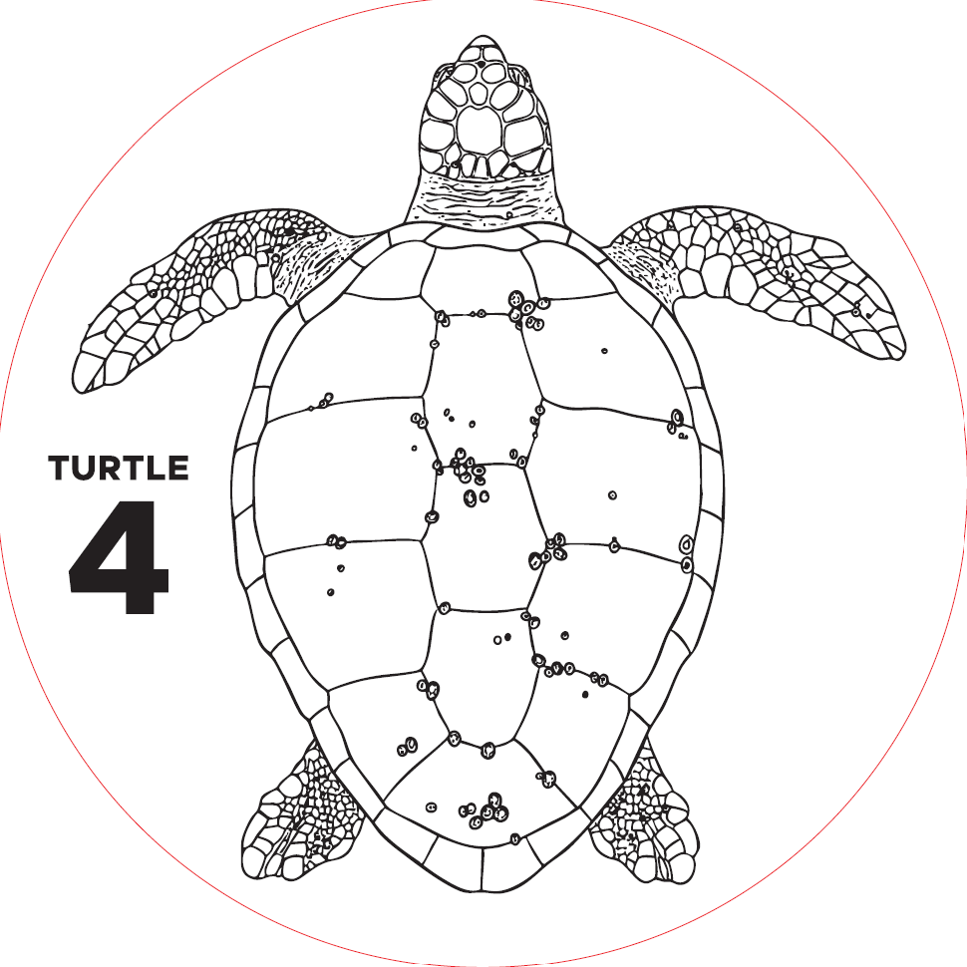
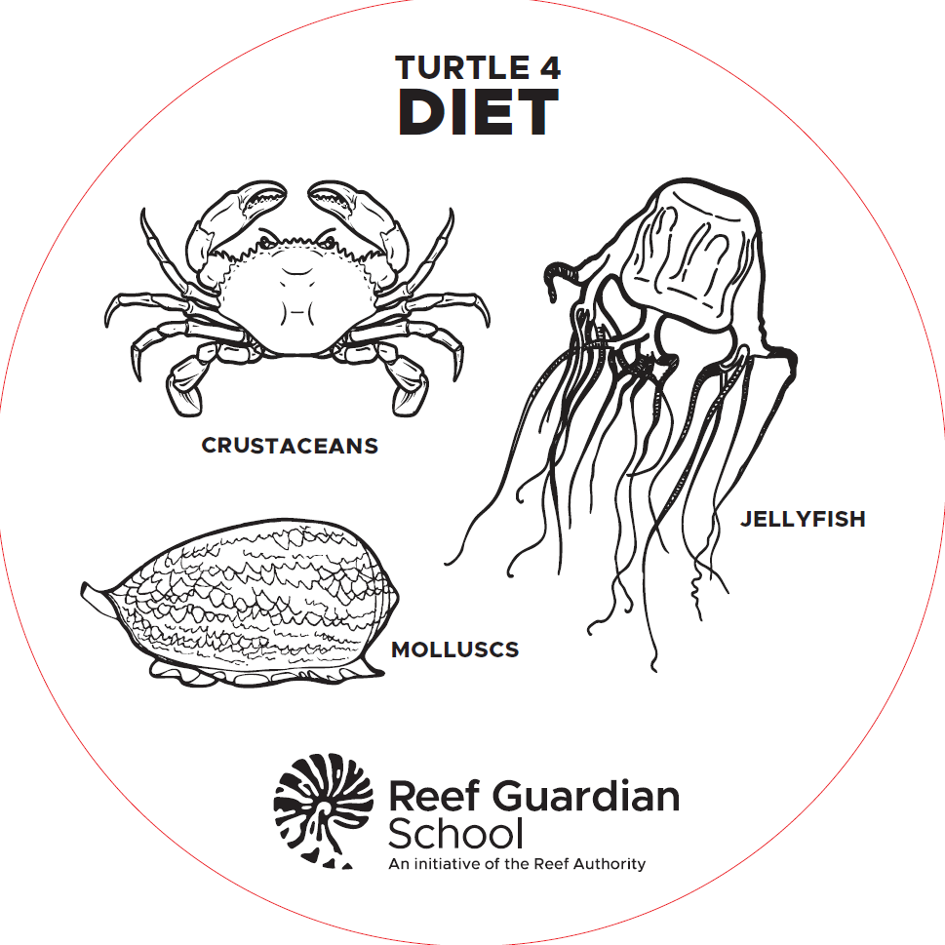
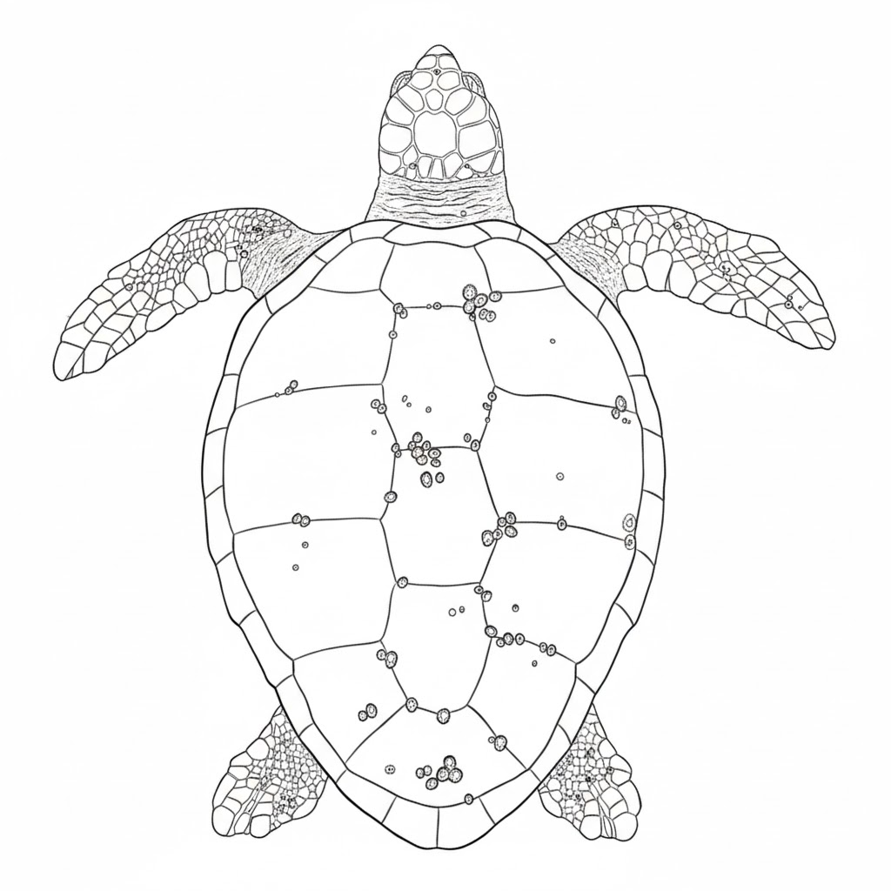
TASK: INVESTIGATE TURTLE DIETS
#
Turtle #
Name
#
Front
Back
Diet:
Circle the diet items from the disc onto your task sheet.
Sponges
Jellyfish
Crustaceans
Molluscs
Sea urchins
Soft corals
Sea
cucumbers
Algae &
Seagrass
Notes:
One of the tasks you will need to complete is to identify the diet of each sea turtle. At each of the six mats you will find a sea turtle diet disc. (You could demonstrate or pass a diet disc around).
Please ensure the disc number matches the turtle mat number before recording your data. The back of the disc contains images of its diet. At each turtle mat, circle the corresponding diet items for that turtle on your task sheet. Please ensure when you have finished at each mat that the turtle diet discs stays with the matching numbered mat. This will avoid the next person using the wrong disc at that mat.

Slide 11
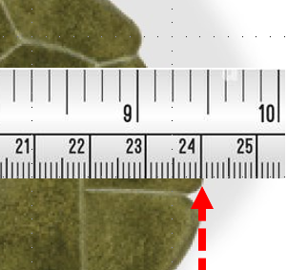
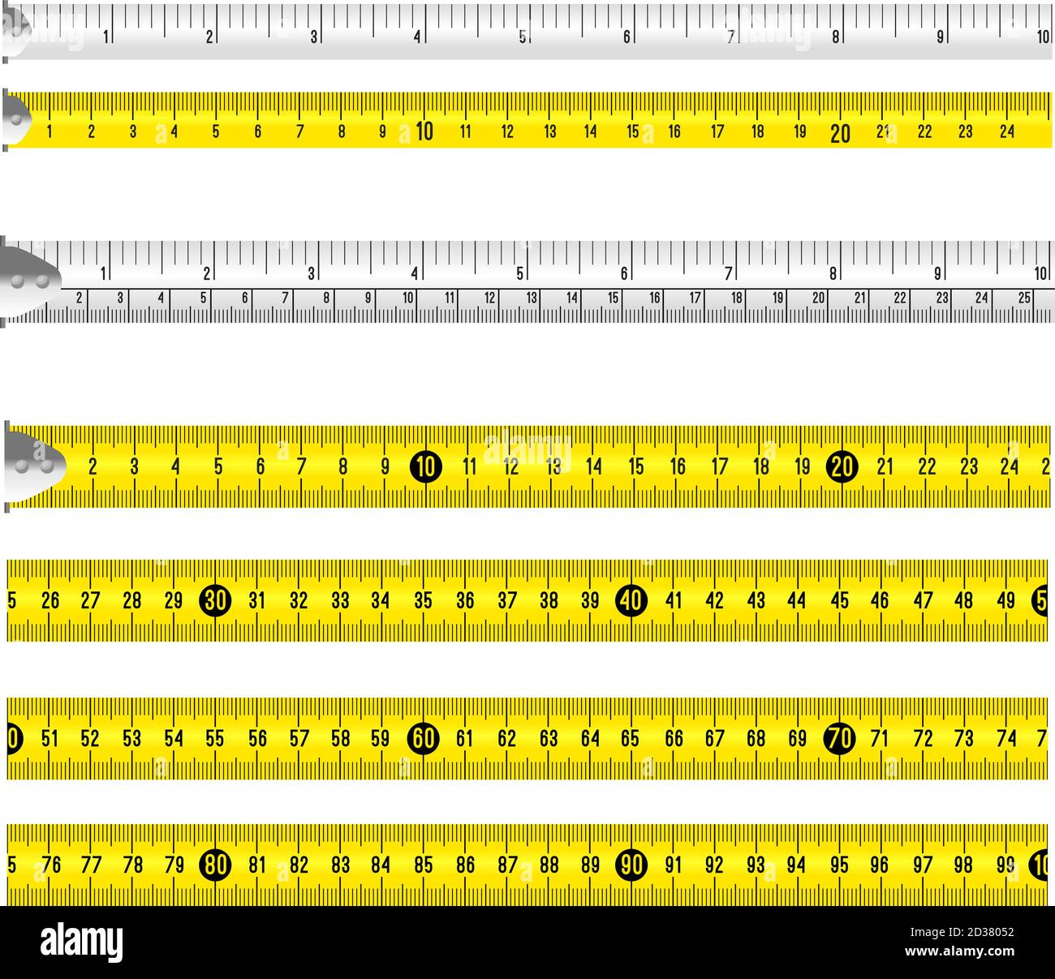

TASK: MEASURE THE CARAPACE
Measure from the base of the neck to the end of the carapace - straight along its longest length.
Read and record the measurement in centimetres.
X
inches
cm
How long is this carapace?
Notes:
For the measurement task you will need a measuring tape to determine the length of the sea turtle’s carapace in centimetres. (You could demonstrate the steps below on a turtle mat with a measuring tape).
Steps:
Place the start of the tape measure (0 cm) in the centre of the turtle’s neck where it meets the carapace (shell).
Hold the tape straight along the length of the turtle’s back. If the turtle’s carapace is longer than the measuring tape, you will have to take two measurements and add them together to find the carapace length.
Write the length measurement for each turtle next to the corresponding turtle number on your task sheet in centimetres.
Question: How long is the turtle carapace in this image? Answer: 24cm.

Slide 12
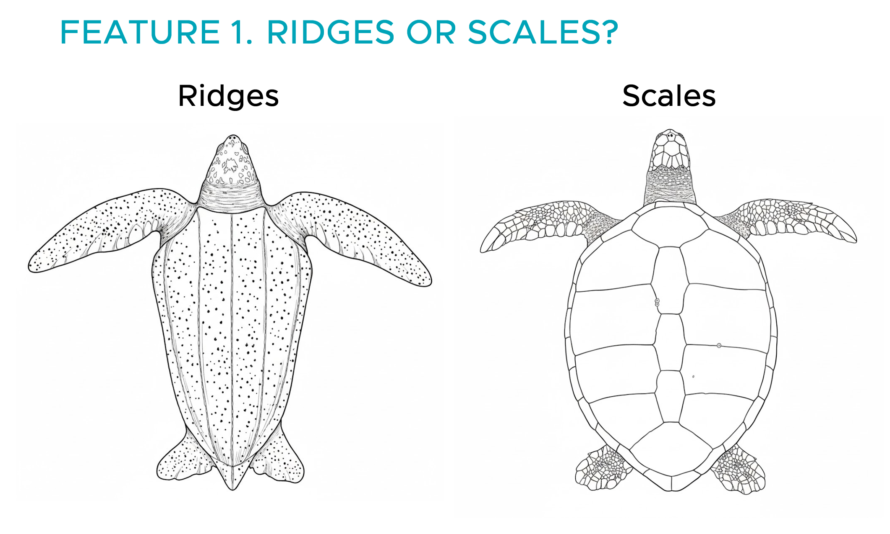

TASK: IDENTIFY THE SEA TURTLE
Step 1: Does the carapace have Costal Scales or Ridges?
Notes:
The identification task requires a key to complete and record the name of each of the six turtles. (We recommend passing a copy of the identification key for this section, where participants can point to the 4 key steps and follow the green lines).
Let’s work through the identification together in 4 steps. Starting at the top of the key.
Step 1: Does the carapace have ridges or costal scales?
Look at a turtle mat and decide whether the turtle carapace (shell) has ridge lines or costal scales. Let us say the turtle does NOT have scales, but it has ridges. Using your finger, trace along the green line to the image with ridges. Look beneath the image. There is a name written in red. You now can write the name in the numbered box matching the turtle mat number on your task sheet.
Let's do another example but let us say this time the turtle mat you are standing in front of has coastal scales NOT ridges. Run you finger along the green line until you come to the image with scales. Is there a red name underneath? If there is no name written in red and the green line keeps going, it means you will have to go Step 2. Get your hand (thumb and little finger) ready to count costal scales as there could be 4, 5 or 6 pairs to count.

Slide 13
TASK: IDENTIFY THE SEA TURTLE
Step 2: Count the pairs of costal scales.
Notes:
Step 2 - Count the pairs of costal scales. Let's do some practice counting the 4, 5, or 6 pairs of costal scales on the slide. Have your two fingers ready to count the pairs of lateral (side) costal scales highlighted in yellow.
Once you know how to count pairs of costal scales you will need to use this skill at five of the turtle mats. At a mat count the pairs of costal scales. Follow the green line until you find the correct numbered paired scales image. Look to see if it has a red name underneath, and if it does STOP. This is the end and you have identified the turtle species. If you count 5 or 6 pairs of coastal scales, you write this name in the numbered box on your task sheet that corresponds with the turtle mat number.
If the turtle mat has 4 pairs of coastal scales, the key indicates that you must proceed to Step 3.

Slide 14
TASK: IDENTIFY THE SEA TURTLE
Step 3: Count the number of pairs of pre-frontal scales.
One LARGE pre-frontal scale pair (2 large scales)
Two SMALL pre-frontal scale pairs (4 small scales)
Notes:
Step 3: Count the number of pairs of pre-frontal scales. (You can use the image on the slide to demonstrate how to count one or two pairs of pre-frontal scales).
Look at the turtle's beak and directly above the nostrils lies the pre-frontal scales. Count if there are 2 LARGE (one pair) or 4 SMALL (two pairs) of pre-frontal scales.
This step can be tricky as it can be hard to tell if it is 2 large ones or 4 smaller ones compressed together. A hint is the size. It is one pair of large pre-frontal scales (2 big scales) or 2 pairs of four smaller prefrontal scales.
Using the key, can anyone tell me what to do if you count TWO PAIRS of pre-frontal scales? Do we STOP and write the name or do we keep going? (Stop and write name in task sheet box that corresponds to mat number).
What happens if you count ONE PAIR of prefrontal scales? There is no name in red but a green line. So, this indicates that we need to go to the final step, which is step 4.

Slide 15
TASK: IDENTIFY THE SEA TURTLE
Step 4: Examine the shape and length of the carapace.
Notes:
Step 4. Examine the shape of the carapace and decide whether it is more round or oval shape. Hint - this can be tricky so use your tape measure to look at the diameter. A circular carapace will have similar width and length. The oval carapace with have a longer length than width.
Is the carapace oval? Is it much longer than it is wide? Once decided, write the name in red in the correct turtle box on your task sheet.
If you are not sure of the shape, another hint is to look at the colour:
The circular carapace is a flat light grey-brown colour.
The oval carapace has dark brown patterned scales.

Slide 16

COMPLETING YOUR TASK SHEET
Student name
Match your results to your turtle mat number.
3. Record the carapace (shell) length in cm here.
Turtle name
1. Use the identification key to write in the name here.
2. Match the mat and diet disc numbers, then circle the diet items on your sheet.
Notes:
Now it will be your turn to be a turtle scientist. Here is your task sheet and because there are 6 turtle mats you will find 6 boxes to record your data. Make sure you write the information in the correct box. For example, turtle mat 6 data is to be written in turtle 6 box. Or, if standing at turtle mat 3 then data would be recorded for on the task sheet box labelled turtle 3. On the slide, turtle 1 box is circled in green. To record data in this box on your task sheet you should locate turtle mat 1 to complete.
At each of the turtle mats, complete the three tasks in ANY order before moving to the next mat:
1. Identify the turtle - Use the identification key and write the turtle’s name inside the box. (Common name or scientific name – Educator to decide).
2. Record the diet - Locate the diet disc on the mat and circle the diet images on your task sheet that match the turtle diet disc. Check that the mat number, diet disc number, and task sheet box number all match to avoid making mistakes. Leave the diet disc on the matching numbered mat.
3. Measure the carapace - Use the measuring tape, measure the carapace length and record the answer in cm.
You may work individually or in teams. (Educator to decide). Record your results carefully in the correct numbered box.
Please write your name at the top of the task sheet not in inside each box.
Any questions before we start?
Make sure you have: a task sheet, identification key, measuring tape and pencil (Educators could assign group roles such as scribe, measurer etc. that can be swapped around at each mat).
You will have X minutes to complete the investigation. (We recommended 30 minutes, which allows 5 minutes at each of the six turtle mats).

Slide 17
ANSWERS: SEA TURTLES 1 - 3
Turtle 1.
Name Green
Turtle 2.
Name Hawksbill
Turtle 3.
Name Flatback
Carapace Length
107 cm
Carapace Length
82 cm
Carapace Length
94 cm
Diet:
Diet:
Diet:
Sponges
Jellyfish
Crustaceans
Molluscs
Sponges
Jellyfish
Crustaceans
Molluscs
Sponges
Jellyfish
Crustaceans
Molluscs
Sea urchins
Soft corals
Sea
cucumbers
Algae &
Seagrass
Sea urchins
Soft corals
Sea
cucumbers
Algae &
Seagrass
Sea urchins
Soft corals
Sea
cucumbers
Algae &
Seagrass
Notes:
It is now time to mark your work on your task sheet. The first 3 turtle answers are shown. Remember to mark the name, length and diets. Please note that carapace length can be marked correct if the number is +-2cm to the answer listed here.
Turtle 1: Green sea turtle - Chelonia mydas. Carapace length: 107cm. Diet: Jellyfish, algae and seagrass.
Fun fact: Green sea turtles are not green in colour. They are named green turtles because the fat inside their body is stained green from the seagrass and algae that they eat.
Turtle 2: Hawksbill sea turtle - Eretmochelys imbricata. Carapace length: 82cm. Diet: Sponges, jellyfish, soft corals and sea cucumbers.
Fun fact: The Hawksbill sea turtle has a hooked beak, and narrow head which is ideal for tearing at sponges and removing animals from crevices.
Turtle 3: Flatback sea turtle - Natator depressus. Carapace length: 94cm. Diet: Jellyfish, crustaceans, molluscs, sea urchins, soft corals, sea cucumbers, algae and seagrasses.
Fun fact: The Flatback sea turtle is considered an Australian species as it only nests on beaches on the Australian continental shelf.

Slide 18
ANSWERS: SEA TURTLES 4 - 6
Turtle 4.
Name Loggerhead
Turtle 5.
Name Olive Ridley
Turtle 6.
Name Leatherback
Carapace Length
96 cm
Carapace Length
68 cm
Carapace Length
183 cm
Diet:
Diet:
Diet:
Sponges
Jellyfish
Crustaceans
Molluscs
Sponges
Jellyfish
Crustaceans
Molluscs
Sponges
Jellyfish
Crustaceans
Molluscs
Sea urchins
Soft corals
Sea
cucumbers
Algae &
Seagrass
Sea urchins
Soft corals
Sea
cucumbers
Algae &
Seagrass
Sea urchins
Soft corals
Sea
cucumbers
Algae &
Seagrass
Notes:
Please continue to mark your work. Answers for turtles 4 - 6 are shown. Remember to mark the name, length (+-2cm) and diets.
Turtle 4: Loggerhead sea turtle - Caretta caretta. Carapace length: 96cm. Diet: Jellyfish, crustaceans and molluscs.
Fun fact: Loggerhead sea turtles have a large skull and a vice-like jaw for crushing hard-shelled prey like clams, snails and crabs.
Turtle 5: Olive Ridley sea turtle - Lepidochelys olivacea. Carapace length: 68cm. Diet: Jellyfish, crustaceans, molluscs, sea urchins, algae and seagrass. Fun fact: The Olive Ridley sea turtle is Australia’s smallest sea turtle species. Hatchlings average 4cm in length.
Turtle 6: Leatherback sea turtle - Dermochelys coriacea. Carapace length: 183cm. Diet: Jellyfish
Fun fact: The throat of a Leatherback sea turtle is lined with backward pointing spines called papillae, which trap prey and protect the turtle from jellyfish stings.
Investigation Summary Questions: (Can answer as a group discussion or ask students to move to the mat that reflects their answer).
Which is the largest species of sea turtle? Answer: Leatherback
What was its carapace length? Answer: 183cm
Which is the smallest species of sea turtle? Answer: Olive Ridley
What was its carapace length? Answer: 68cm
What is the difference in cm between the largest 183cm and the smallest 68cm length turtle? Answer: 115cm
Which turtle is the closet in length to 115cm. Answer: Green
Which species eats only one type of food? Answer: Leatherback
What does it eat? Answer: Jellyfish
Which species has the most varied diet? Answer: Flatback
What does it eat? Answer: Jellyfish, crustaceans, molluscs, sea urchins, soft corals, sea cucumbers, algae and seagrasses.

Slide 19
INVESTIGATION WRAP UP
Today we:
Investigated the morphology (physical features), diets and identification of six species of Australian sea turtles.
Hands up who can:
Use a key to identify each sea turtle species.
Identify the diet of each sea turtle species.
Measure the length of each sea turtle carapace in centimetres.
Congratulations!
Notes:
Congratulations on completing your investigation. Recap Lesson Intent and Success Criteria on the slide.
Hands up who can tell me something you have learnt?
Who enjoyed this activity?
Who can define the word carapace?
Who can describe what costal scales are and how they are used by scientists?
What where some things the turtles had in common? Answer: (morphology and all eat jellyfish)
Go back to the slide on morphological features, or, get the students to point to the features on a turtle mat. Who can point out some external (morphological) features of the turtle? Answer: nostril, beak, flippers, carapace, pre-frontal scales, eyes.
Why were some of the mats large and some small? Answer: variation in turtle size based on species and mats are average breeding size of females.
How can we make sure that we help turtles to survive? Answer: Care for habitats, reduce marine debris, go slow when boating, stay away from nest sights, turn lights off, reduce carbon footprint.

Slide 20
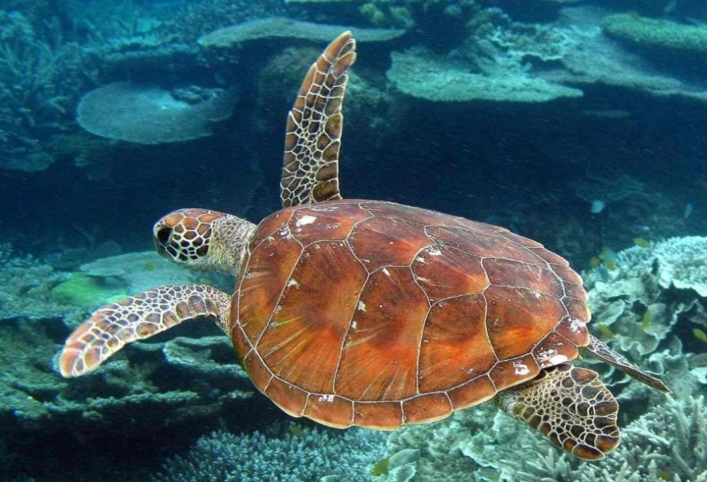
THANK YOU
reefguardians@gbrmpa.gov.au
WWW.REEFED.EDU.AU
Notes:
We hope that you have enjoyed this sea turtle investigation. For more educational resources visit the Reef Guardian School Portal at www.reefed.edu.au or email reefguardians@gbrmpa.gov.au

Slide 21
AUSTRALIAN CURRICULUM LINKS (ACARA V9)
ACARA V9.0 | F | 1 | 2 | 3 | 4 | 5 | 6 | 7 | 8 | 9 | 10
Science | AC9SFU01 AC9SFU02 AC9SFH01 AC9SFI02 AC9SFI03 AC9SFI04 AC9SFI05 | AC9S1U01 AC9S1H01 AC9S1I03 AC9S1I04 AC9S1I06 | AC9S2H01 AC9S2I03 AC9S2I04 AC9S2I06 | AC9S3H01 AC9S3H02 AC9S3I01 AC9S3I03 AC9S3I05 AC9S3I06 | AC9S4U01 AC9S4I01 AC9S4I03 AC9S4I05 AC9S4I06 | AC9S5U01 AC9S5I01 AC9S5I03 AC9S5I05 AC9S5I06 | AC9S6H02 AC9S6I01 AC9S6I03 AC9S6I05 AC9S6I06 | AC9S7U01 AC9S7H02 AC9S7I03 AC9S7I06 AC9S7I08 | AC9S8H02 AC9S8I03 AC9S8I06 AC9S8I08 | AC9S9U02 AC9S9U05 AC9S9H02 AC9S9I03 AC9S9I06 AC9S9I08 | AC9S10U01 AC9S10U02 AC9S10H02 AC9S10I03 AC9S10I06 AC9S9I08
Maths | AC9MFN01 AC9MFN03 AC9MFN04 AC9MFA01 AC9MFM01 | AC9M1N01 AC9M1N05 AC9M1A01 AC9M1M01 AC9M1M02 | AC9M2N01 AC9M2N06 AC9M2A01 AC9M2A02 AC9M2M01 | AC9M3N01 AC9M3N03 AC9M3N06 AC9M3A02 AC9M3M01 AC9M3M02 | AC9M4N01 AC9M4N03 AC9M4N08 AC9M4M01 | AC9M5N01 AC9M5N09 AC9M5M01 | AC9M6N04 AC9M6N06 AC9M6N09 AC9M6M01 | AC9M7N03 AC9M7N05 AC9M7N06 AC9M7N08 AC9M7M03 AC9M7M06 | AC9M8N03 AC9M8M03 AC9M8M05 AC9M8M07 | AC9M9N01 AC9M9M05 | AC9M10N01 AC9M10M04 AC9M10M05
Notes:
This sea turtle investigation activity aligns to the Australian Curriculum (ACARA Version 9 2026). For updated curriculum alignments please visit online the relevant educational curriculum body to your region.
The activity can be scaffolded by educators to meet learner needs. It could be completed with focus on one task rather than all three e.g. only the diet task is completed. Furthermore, the carapace measurement could be scaffolded and incorporate arbitrary measurement techniques of hand increments rather than use of a tape measure.
Links to the Science and Maths curriculum for Foundation through to Year 10 are in the table.

Slide 22
RESOURCE LINKS
Additional resources on sea turtles including videos, activity sheets and units of work are available for free on the Reef Guardian School Portal www.reefed.edu. Go to Reef Guardian School - Turtle Resources.
Units of Work:
Endangered species – Marine Turtles. https://www.reefed.edu.au/resources/marine-turtles
Wildlife Express - A design and technology unit of work using a case study of Green sea turtles for students to explore wildlife transportation – https://www.reefed.edu.au/resources/wildlife-emergency-express-presentation
Videos:
How Lucky the Turtle Got Her Name – a video of a puppet show about a young turtle growing up and finding her name. https://www.reefed.edu.au/resources/how-lucky-turtle-got-her-name
Green turtles and the Torres Strait – a video showcasing Traditional Owners and Western Science call to preserve sea turtle populations. https://www.reefed.edu.au/resources/green-turtles-and-torres-strait
The marine turtle’s journey of prehistoric proportions – an interview with Dr Mark Read about green sea turtles. https://www.reefed.edu.au/resources/interview-marine-turtles-journey-prehistoric-proportions
Posters:
Ancient reptiles of the sea. https://www.reefed.edu.au/sites/default/files/2026-08/Poster7-Ancient-reptiles-of-the-sea.pdf
Notes:
There are additional resources on sea turtles including videos, activity sheets and units of work available for free on the Reef Guardian School Portal www.reefed.edu. Search the term ‘turtle’ in the search bar or click on the link in the slide Reef Guardian School - Turtle Resources.
Direct links to the resources are in the slide. They can be accessed for free by registering to the Reef Guardian School Portal www.reefed.edu.au
Units of Work:
Endangered species – Marine Turtles.
Wildlife Express - A design and technology unit of work using a case study of Green sea turtles for students to explore wildlife transportation. It includes three resources, a PowerPoint, Student Workbook and Teacher Guide.
Videos:
How Lucky the Turtle Got Her Name – a video of a puppet show about a young turtle growing up and finding her name.
Green turtles and the Torres Strait – a video showcasing Traditional Owners and Western Science call to preserve sea turtle populations.
The marine turtle’s journey of prehistoric proportions – an interview with Dr Mark Read about green sea turtles.
Posters:
Ancient reptiles of the sea.

Slide 23
RESOURCE LINKS continued.
Activity Sheets:
Anatomy of a sea turtle - label the sea turtle. https://www.reefed.edu.au/resources/label-sea-turtle
Turtle life cycle wheel - craft activity. https://www.reefed.edu.au/resources/turtle-life-cycle-wheel
Turtle life cycle comprehension activity - fill in the missing words. https://www.reefed.edu.au/resources/turtle-life-cycle-comprehension-activity
Ozobot challenge – help the turtle find the jellyfish – use as part of an ozobot coding activity. https://www.reefed.edu.au/resources/ozobot-challenge-help-turtle-find-jellyfish
Lucky Turtle Puppet Show colouring sheet – use in conjunction with Lucky Turtle Puppet Show video. https://www.reefed.edu.au/resources/lucky-turtle-puppet-show-colouring-sheet
Lucky Turtle Puppet Show Diet and Threats – use in conjunction with Lucky Turtle Puppet Show video. https://www.reefed.edu.au/resources/lucky-turtle-puppet-show-diet-and-threats
Virtual Learning Experience:
All about sea turtles – during this virtual session delivered by the Reef Guardian School team, students will gain an understanding of the biology and adaptations of sea turtles, including their life cycles, breeding migrations and feeding adaptations. https://www.reefed.edu.au/resources/turtle-connections-flyer Contact reefguardians@gbrmpa.gov.au to book your session.
For general information about sea turtles on the Great Barrier Reef, visit Marine turtles | Reef Authority.
Notes:
Direct links to the resources are in the slide. They can be accessed for free by registering to the Reef Guardian School Portal www.reefed.edu.au.
Activity sheets:
Anatomy of a sea turtle – label the sea turtle.
Turtle life cycle wheel - craft activity.
Turtle life cycle comprehension activity - fill in the missing words.
Ozobot challenge – help the turtle find the jellyfish – use as part of an ozobot coding activity.
Lucky Turtle Puppet Show colouring sheet – use in conjunction with the video of the Lucky Turtle Puppet Show.
Lucky Turtle Puppet Show Diet and Threats – use in conjunction with the video of the Lucky Turtle Puppet Show.
Virtual Learning Experience:
All about sea turtles – during this virtual session delivered by the Reef Guardian School team, students will gain an understanding of the biology and adaptations of sea turtles, including their life cycles, breeding migrations and feeding adaptations. Contact reefguardians@gbrmpa.gov.au to book your session.
General information
For general information about sea turtles on the Great Barrier Reef, visit Marine turtles | Reef Authority (www2.gbrmpa.gov.au/learn/animals/marine-turtles).

