Slide 1


Eye on the Reef
Rapid Monitoring
Notes:
Rapid Monitoring and Be a Marine Biologist for a Day (BAMBFAD)
Aligned with the Australian Curriculum and scaffolded for different year levels.
Primary & middle school: typically complete the timed swim component (BAMBFAD single indicator species tally)
Senior students (15+): usually undertake the full Rapid Monitoring survey (11 indicator species timed swim, benthic and coral impacts) .
While working through the presentation students / guests should have:
a Rapid Monitoring Survey slate - Rapid Monitoring [snorkel slate]
or a Be a Marine Biologist for a Day (BAMBFAD) slate - Rapid Monitoring: be a marine biologist for a day [snorkel slate]
or a paper version of a slate

Slide 2

The Reef Guardian School Program acknowledges the expertise, wisdom, and enduring connections that have informed the guardianship of the Reef for millennia. We pay our respects to the Traditional Owners as the first managers of this Land and Sea Country, and value their traditional knowledge which continues to inform the current management and stewardship of the Reef for future generations.
Notes:
Acknowledgment of Country
(You are welcome to use your own wording).

Slide 3
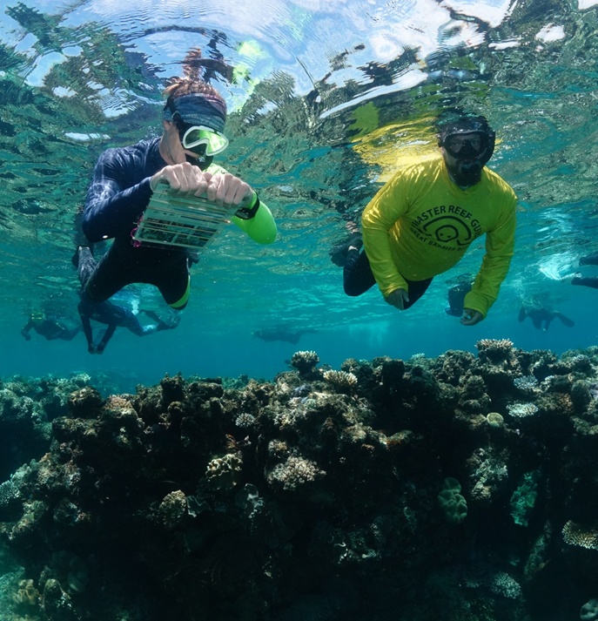
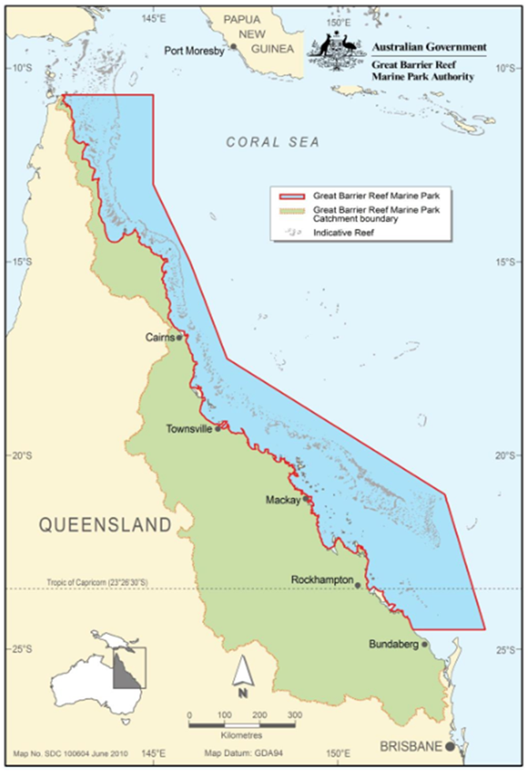
This survey is made for everyone — no science background needed! Whether you complete one section or the whole thing, every bit of data helps. Just remember to upload what you collect to the EOTR dashboard.
Rapid Monitoring empowers the public to contribute Citizen Science data, supporting reef health snapshots, early detection of threats like bleaching and crown-of-thorns starfish (COTS), and improved management of the Great Barrier Reef.
Notes:
The purpose of the Rapid Monitoring survey is to collect Citizen science data about:
reef health indicators,
protected and iconic species,
emerging reef health issues.
It is designed for the use by the public and you do not have to be a scientist to complete. To ensure you engage in citizen science the data should be entered into the Eye on the Reef system.

Slide 4
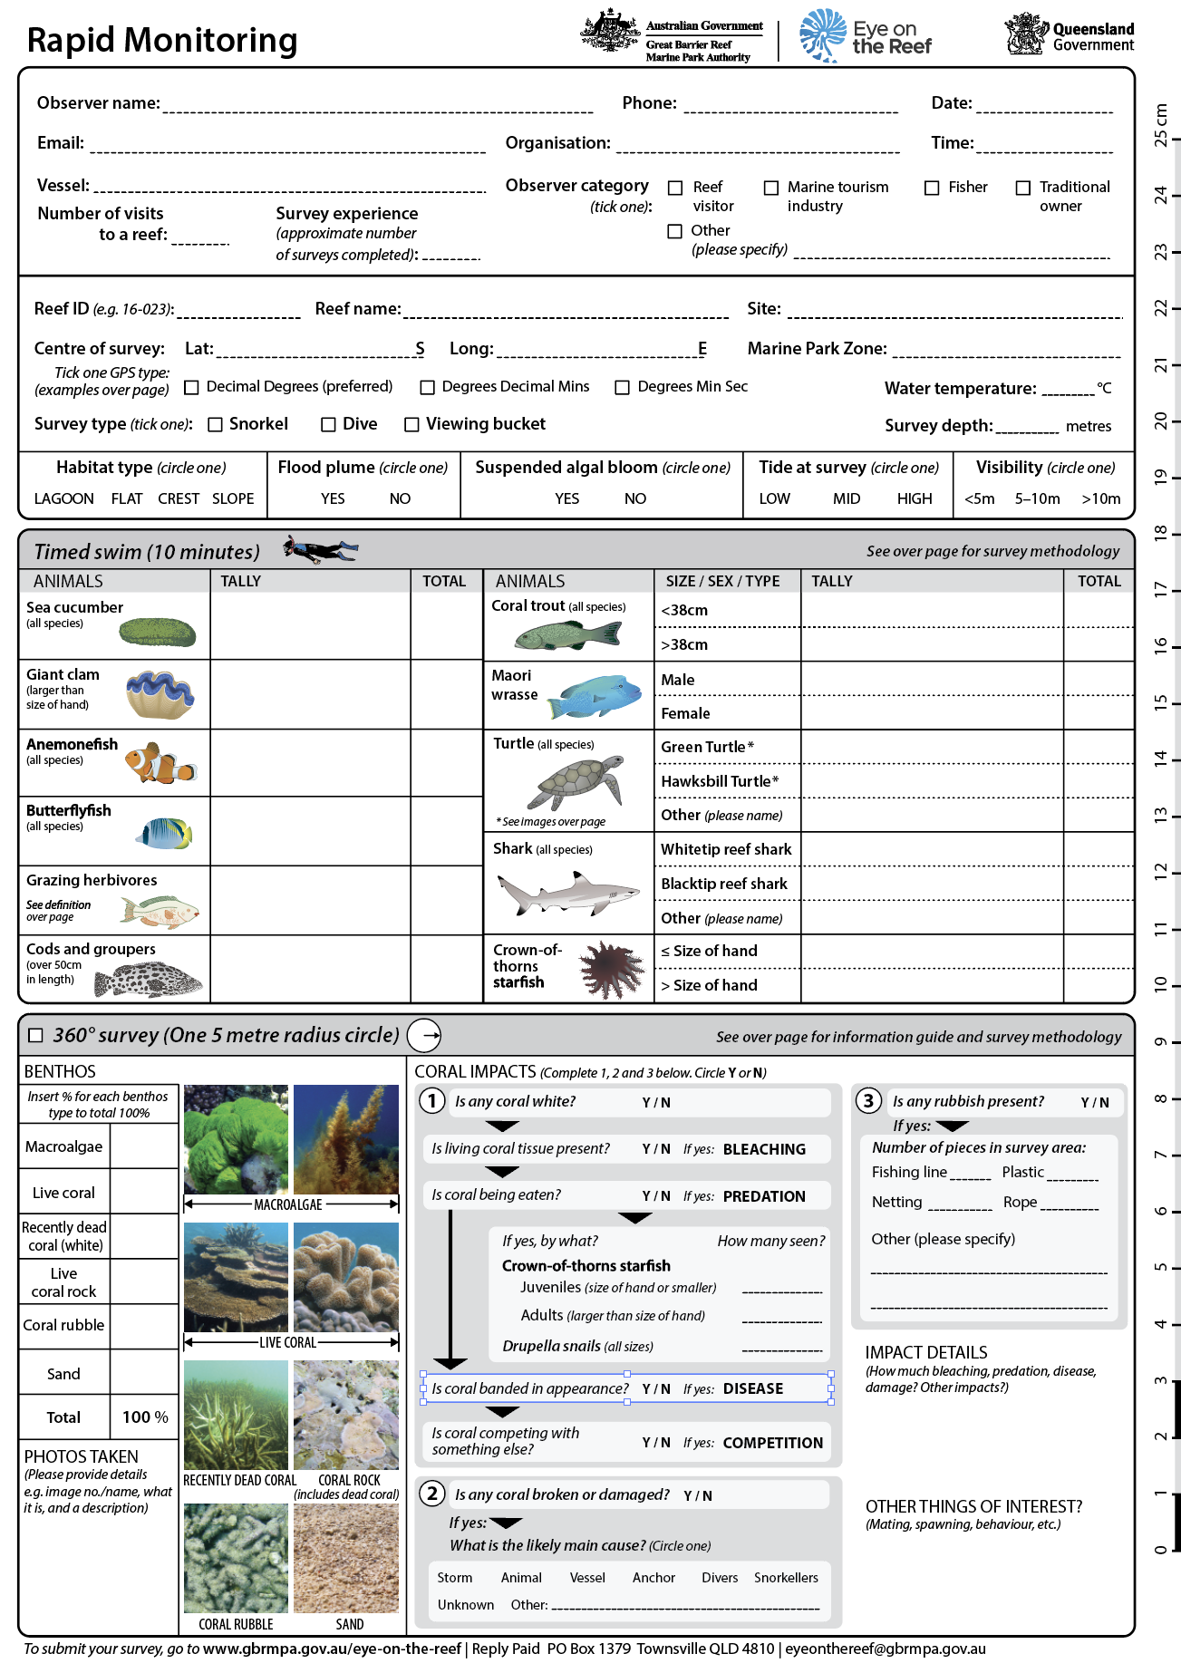
Rapid Monitoring has 5 components:
1. Location on the reef
2. Timed 10 minute indicator species snorkel
3. Benthic 360⁰ survey estimating percentages of the reef floor composition
4. Impacts
Notes:
RAPID MONITORING SURVEY
The Rapid Monitoring survey includes several sections:
Surveyor and site information.
A 10-minute timed swim.
A 360^{O} benthic survey.
Coral impacts and other items of interest.
The first part to complete is the observer and site information. Fill out information about:
Observer (yourself), organisation (if applicable) and your survey experience. The reef and site you are surveying, and the environmental conditions at the site.
PART TWO: 10-MINUTE TIME SWIM
During the timed swim you will record the presence of target species by tallying how many you see in 10 minutes.
There are simplified survey slates for Be a Marine Biologist for a Day (BAMBFAD).
Young primary students: record one target species per group using the BAMBFAD single-species slate. Combine class results to capture all indicator species.
Older primary & middle school: record all target species using the full BAMBFAD slate.
PART THREE: 360 Benthic Senior students (15+ years): record all target species and complete the 360° benthic survey using the Rapid Monitoring slate.
PART FOUR- Coral Impacts.

Slide 5
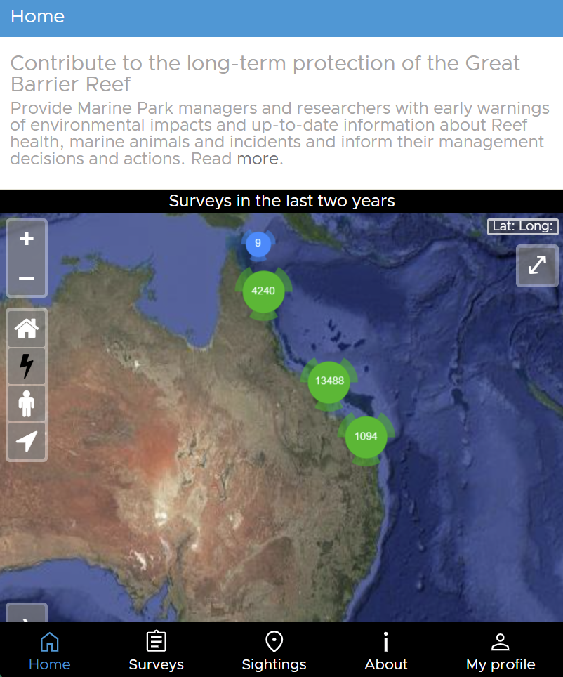
Rapid Monitoring has 5 components:
5. Entry of data into Eye on the Reef (EOTR) dashboard.
Notes:
ENTER DATA INTO EYE ON THE REEF
New users will need to register for an account.
From home toggle across to Surveys then add Survey on top right corner
Add Rapid Monitoring Survey
Sign into your account.
Eye on the Reef is also available on desktop (preferred way of submitting your data).
Additional information:
This is arguably the most important component.
The data you collect and contribute can be used to inform how the Great Barrier Reef is managed.
The data goes into the Eye on the Reef system, the official Reef management system for the Great Barrier Reef Marine Park Authority.
Based on reviews, data entry scores high for value, well-being, and sense of contribution.
The difference between Primary and Citizen Science data is how it is shared. Citizen Science data is entered into a collective dashboard, whilst Primary data is not.

Slide 6
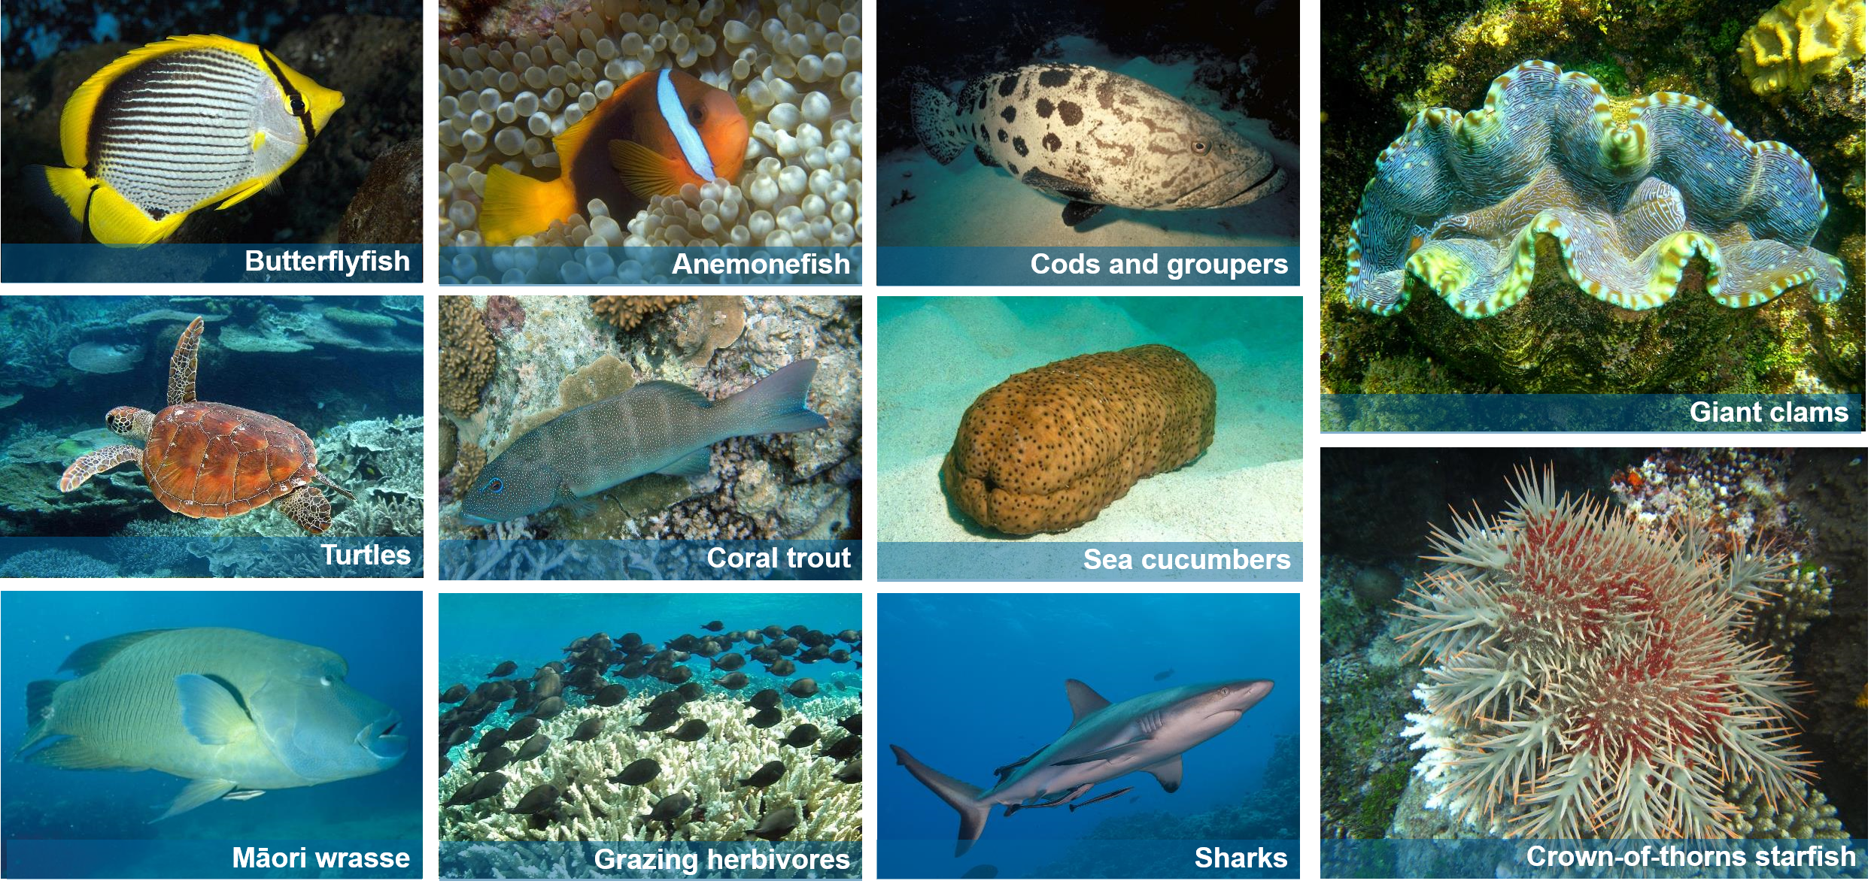
The 11 indicator species
Notes:
These are the indicator species that we record during the10-minute timed swim:
Butterflyfish
Anemonefish
Cods and groupers
Giant clams
Turtles
Coral trout
Sea cucumbers
Māori wrasse
Grazing herbivores
Sharks
Crown-of-thorns starfish
You are unlikely to see all 11 target species during the 10-minute timed swim.
You may only observe a few of the indicator groups.
Do not include animals seen after the timed swim in your count.
Record these sightings in the “Other Items of Interest” section at the bottom of the survey.
Why do we count these species?
Reef health indicators.
Endangered status.
Contribute to reef health.
Iconic species.
Commercial value.
Popular with tourists.

Slide 7
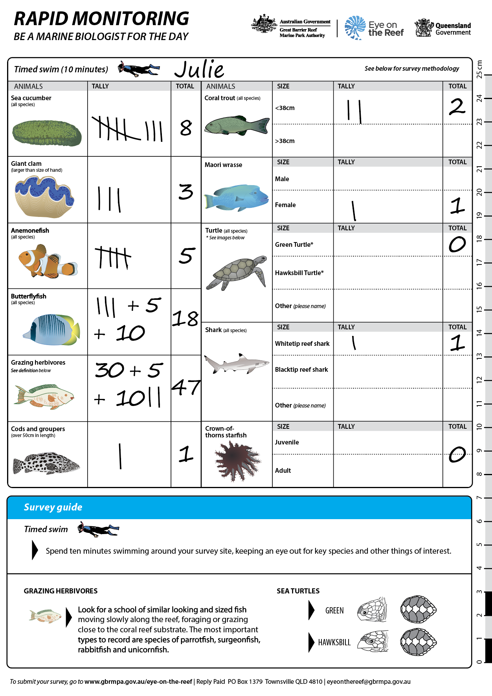
How to count indicator species
Snorkel slowly for 10 minutes in one direction
Be as quiet as possible.
Tally how many you see in 10 minutes.
For large schools of fish- estimate how many you see.
Keep an eye out for other animals.
Do not touch the animals.
Total your tally at the end.
Notes:
CONDUCTING THE 10-MINUTE TIMED SWIM
Use a timer, or someone with a watch, to start timing the 10 minutes.
Swim slowly in one direction (no backtracking); look up occasionally so you know where you are.
Stay on one habitat type (reef flat, lagoon, crest, slope).
Use tally system to record what you see, (four lines + diagonal = 5).
After the 10 minutes, total the numbers for each target species.
This can be done back on the boat.
For large schools of fish, estimate numbers.
Record numbers as accurately as possible.
If you’re not sure, point it out and ask, take a photo or don’t record it.
Move quietly and slowly to avoid scaring animals.
Talk quietly, use hand signals, and avoid splashing.
Only record what you see during the 10-minute survey.
If you see something interesting outside of this time, you can record it in the other items of interest section at the bottom of the form.
Do not touch the animals.
Additional information:
Complete safety, buddy, and equipment checks before entering the water.
Some groups may only do the timed swim component.

Slide 8
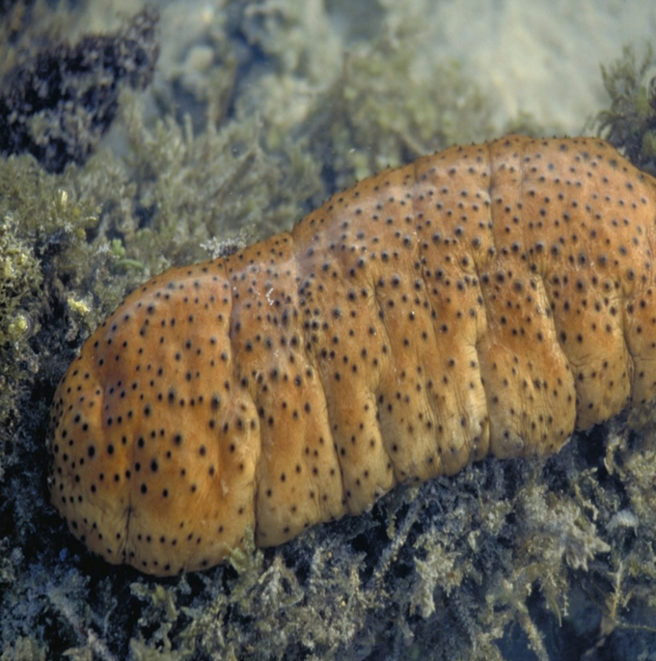
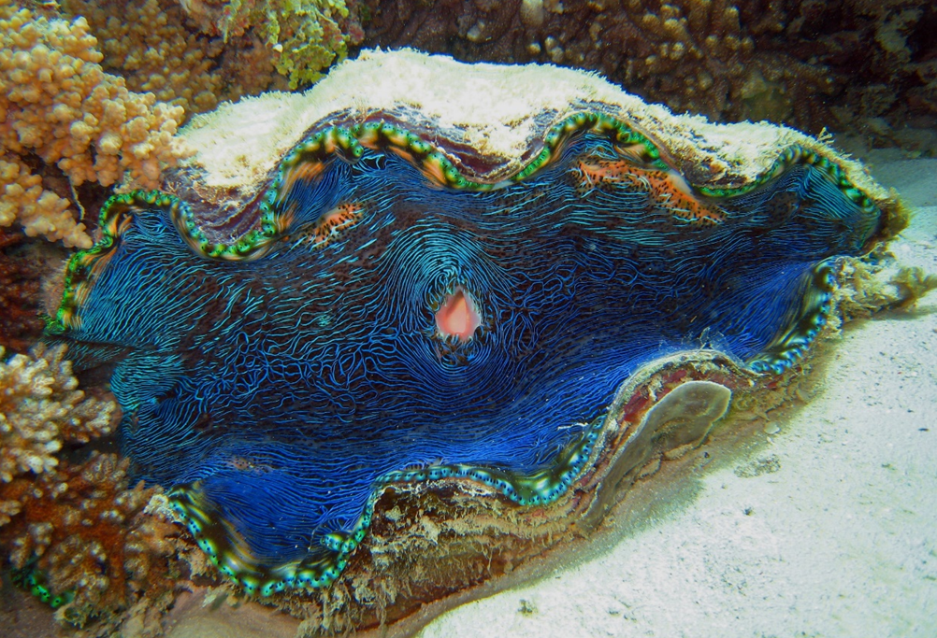
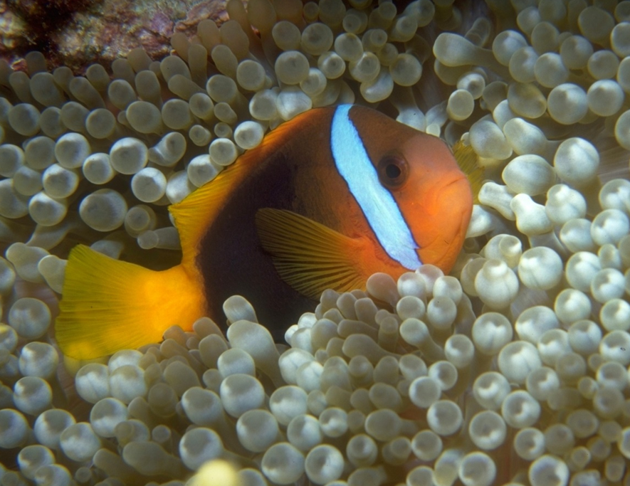
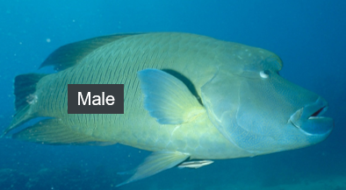
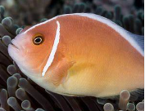
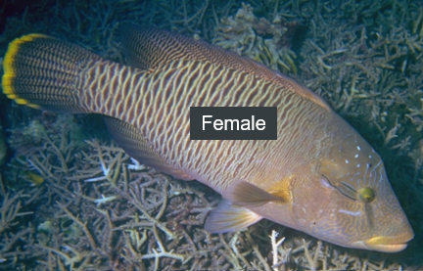
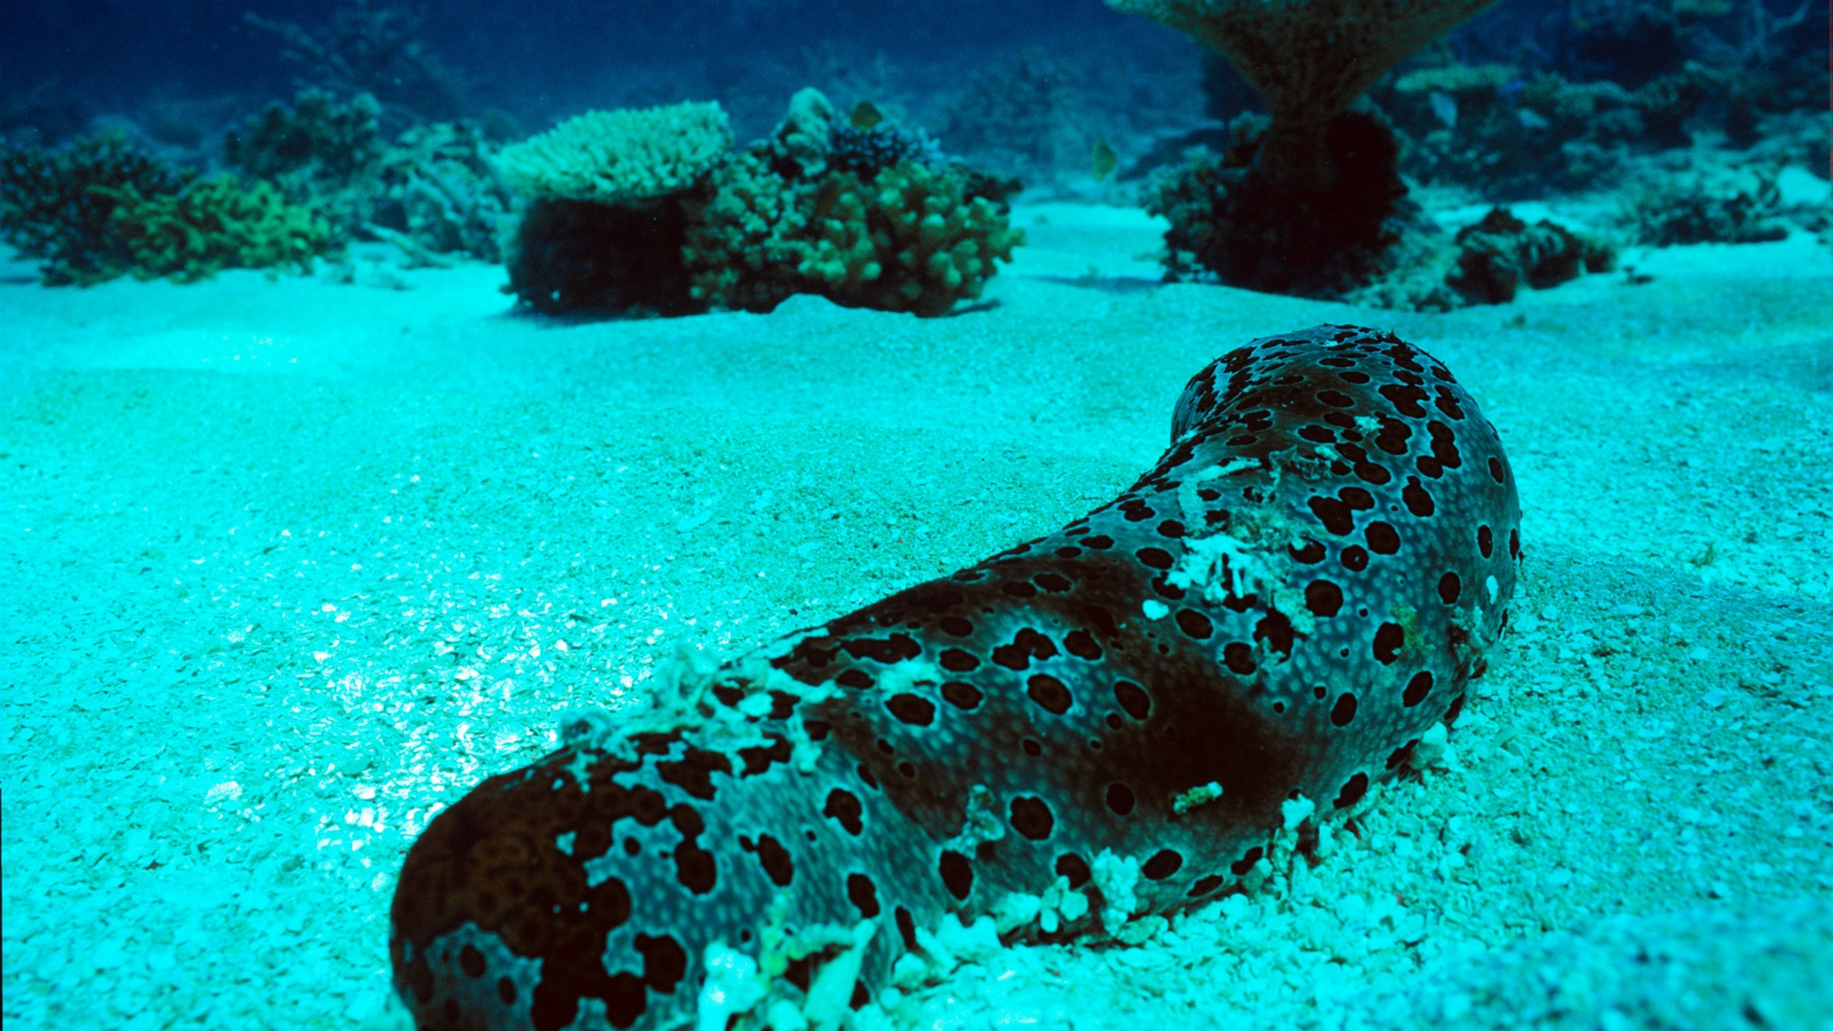
Rapid Indicator species
Sea Cucumbers
Giant clams (>30cm)
Anemone Fish
Māori Wrasse
Vacuum cleaners = clean sand = healthy reef
Vulnerable status-Iconic- sessile and can bleach.
6 types- Iconic- Anemone sessile and can bleach.
Endangered- prey on COTS- Iconic.
Notes:
Sea cucumbers act like the vacuum cleaners of the sea. They digest organic matter from sand, helping remove nutrients and keep the seabed clean.
Giant clams are protected and iconic reef species. They filter water and remove excess nutrients, helping limit algal growth. Giant Clams can bleach when stressed. Because they are long-lived and don’t move, declines may indicate reef health issues. Empty shells can signal past stress events such as bleaching, flood plumes or extreme weather.
Anemonefish only live in sea anemones. They are an iconic reef fish (e.g. Nemo from Finding Nemo). Anemones are long-lived and are susceptible to bleaching. If anemones die, anemonefish will have nowhere to live. Seeing anemonefish can be a sign that the reef is not heavily impacted by human activity or environmental stressors.
Māori wrasse are listed as endangered.​ Once overfished, they are now protected on the Reef and are iconic and popular with tourists.​ They help corals by feeding on Crown-of-thorns starfish.​ Recording males and females separately can be used as an indicator of recruitment.

Slide 9
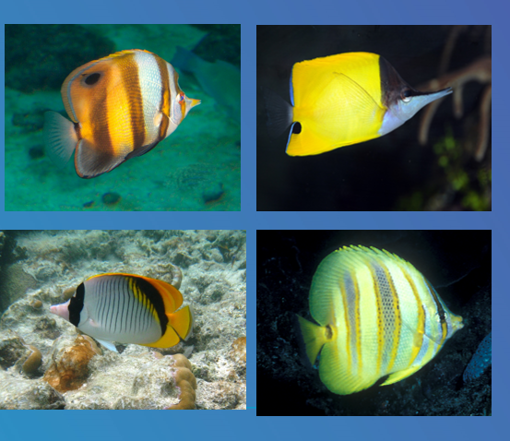
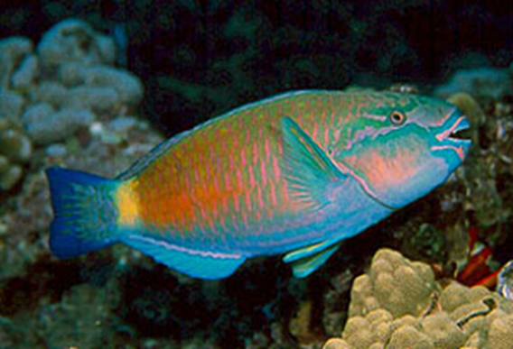
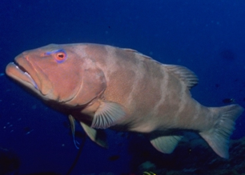
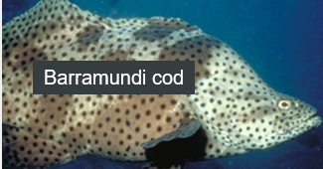
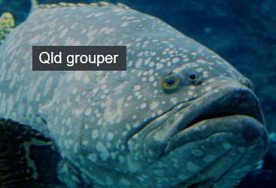
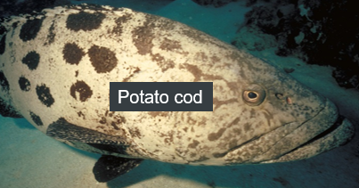
Rapid Indicator species
Butterflyfish
Grazing herbivore
Coral Trout
Cods and Groupers
Disc like shape with black band on eye or spot- corallivores – live on coral more coral cover more likely to see rare ones.
Lawn mowers of the reef- keep macroalgae in check allowing space for new coral growth. Parrot- Surgeon- Rabbit fish.
Count Larger and smaller than 38cm- fisheries stock counts and commercial
Over 50cm- iconic- long life
Notes:
Most butterflyfish eat coral (corallivores). High butterflyfish diversity can indicate high coral diversity. Look for pairs or small groups, swimming close to or feeding on coral. They are easy to identify - flat disc-shaped bodies, a pointed nose and small mouth. Most are black, white and yellow with a variety of stripes and patterns. Often have a black stripe over the eye and/or a black spot near the tail.
Grazing herbivores act like the Reef’s lawnmowers by grazing on algae, helping to keep it under control. They reduce algae-coral competition, such as algae overgrowth, to keep reefs healthy and resilient. By removing algae, they increase the availability of space and light for coral growth and recruitment. Often seen face down, grazing, scraping and biting at algae growing on the coral rock. They include Parrotfish (Labridae / Scarinae), Rabbitfish (Siganidae) and Surgeonfish (Acanthuridae).
Cods and Groupers are protected slow growing and long lived species. They are important predators that help maintain balanced food webs.

Slide 10
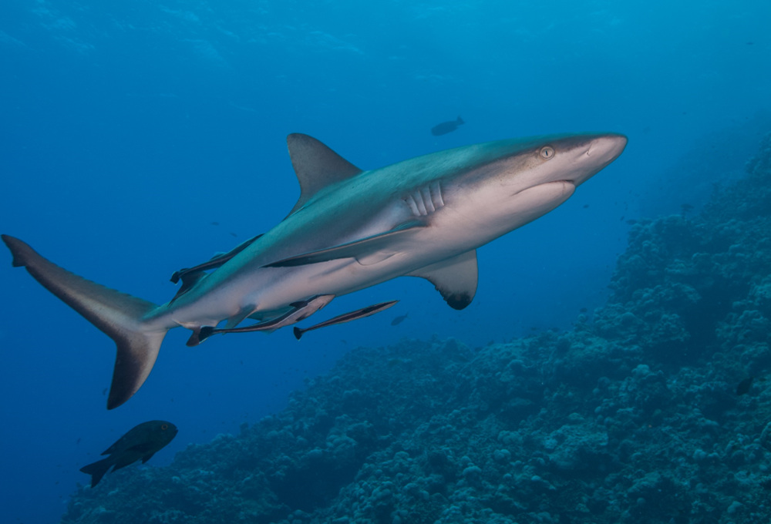
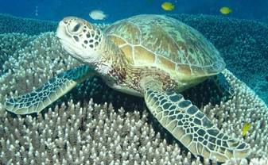
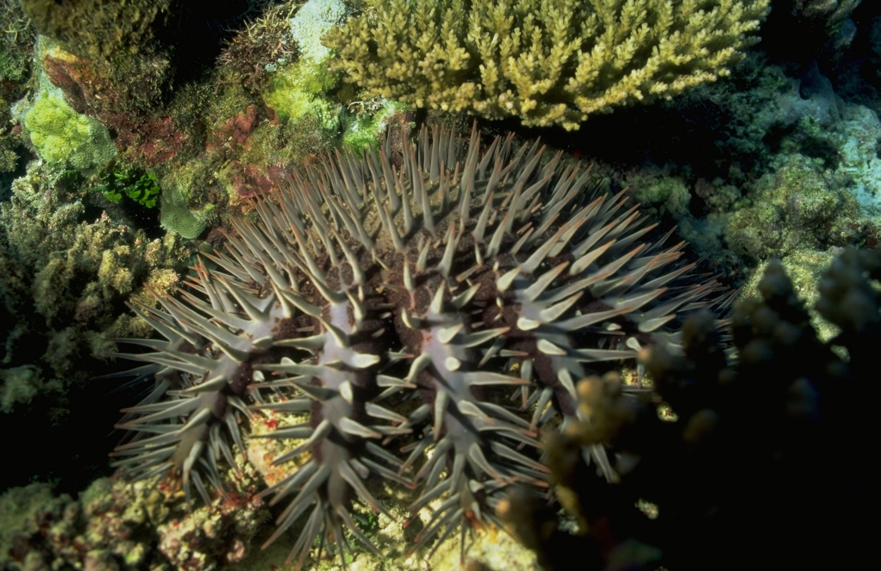
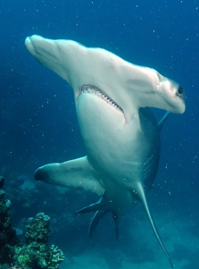
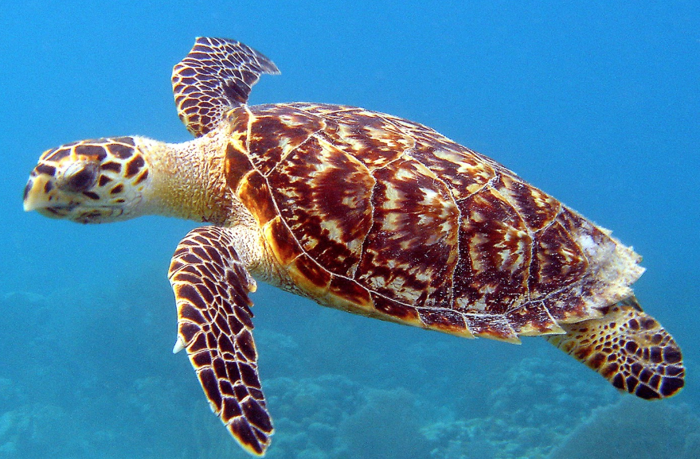
Rapid Indicator species
Sharks
Turtles
COTS
Apex predators- Balance food webs- Vulnerable to critically endangered.
6 in GBR – count hawksbill and green separately. Venerable to endangered.- Iconic.
Plagues are a real reef threat. One is ok but more than three could indicate an outbreak could occur. Juveniles smaller than hand - nocturnal- do not touch
Notes:
Sharks are apex predators that are a keystone species that help regulate prey numbers and maintain ecological balance. Without sharks, food webs quickly become unbalanced. Many shark species are endangered. Sharks are iconic species and important to tourism.
All sea turtle species are protected in Australia. Their numbers have declined due to climate change, marine debris, hunting and habitat loss. They are threatened species and iconic. Count all sea turtles that you see. But record Green and Hawksbill turtles separately.
Crown-of-thorns starfish (COTS) are natural predators of coral. In high numbers (during outbreaks), they can eat coral faster than it can grow. All COTS sightings are recorded to monitor outbreaks.

Slide 11
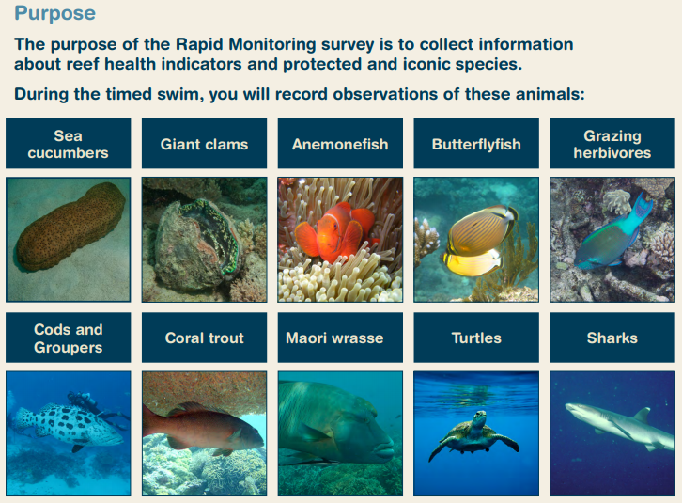
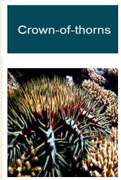
Timed 10 minute Snorkel
How many 11 indicator species can you name?
Notes:
QUIZ

Slide 12
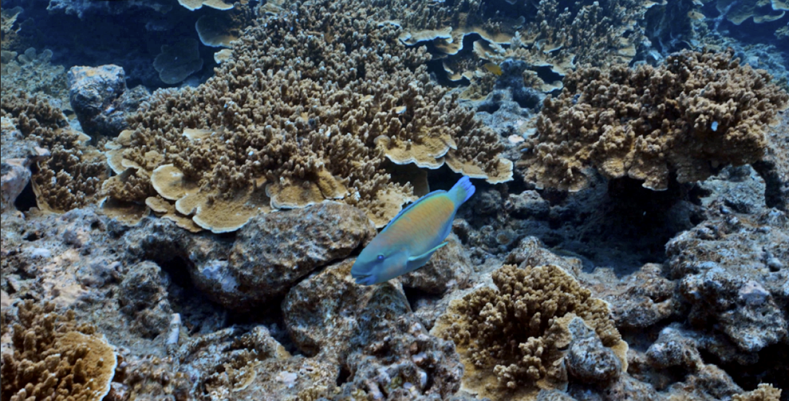
Simulated Activity Guided Timed Swim # 1
Video Link # 1 https://youtu.be/I4WJArULv1A
Notes:
Have students practice identification and tally of species on rapid slate or printed sheet https://youtu.be/I4WJArULv1A
Herbivorous fish = 8
Sea anemone= 3
Sea cucumber= 1
Butterfly fish = 4
There are 3 videos that get progressively harder for students.

Slide 13
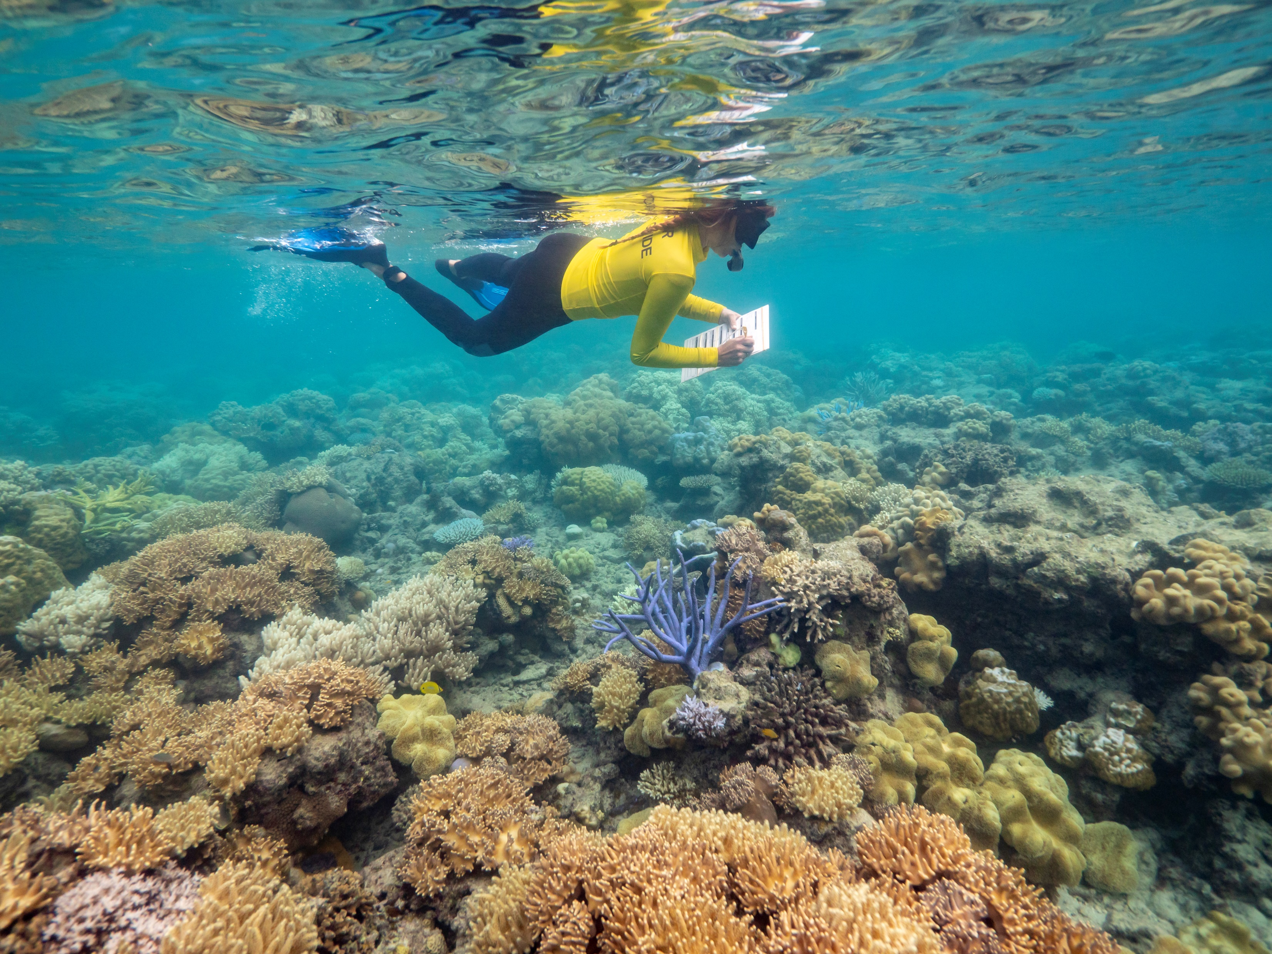
Simulated Activity Guided Timed Swim # 2
Video Link # 2 https://youtu.be/nA19RYOKHDs
Notes:
Have students practice identification and tally of species on rapid slate or printed sheet using Video transect 2 https://youtu.be/nA19RYOKHDs

Slide 14
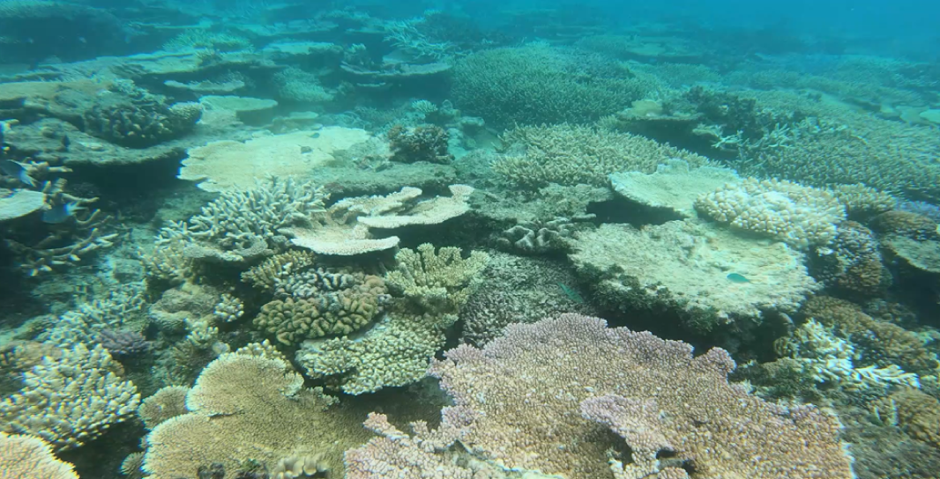
Simulated Activity Guided Timed Swim # 3
Video Link # 3 https://youtu.be/WFYbmwfXQLA
Notes:
Have students practice identification and tally of species on rapid slate or printed sheet using Video transect 3 https://youtu.be/WFYbmwfXQLA

Slide 15
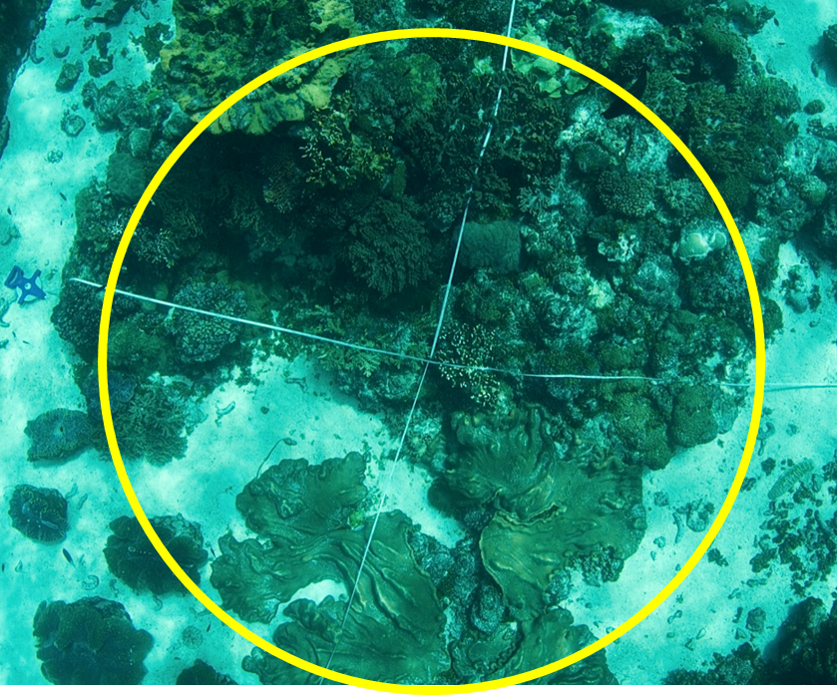
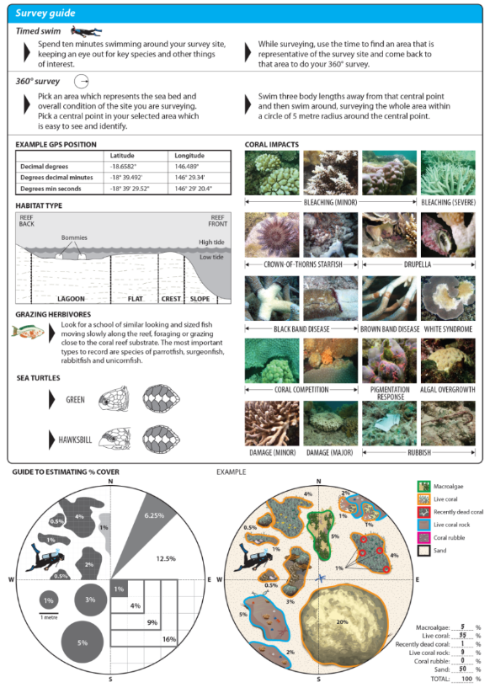
360⁰ Benthic Survey- an estimate of % cover
Perform a quick presence/absence check to eliminate categories that are not present
Identify and quantify the biggest/most obvious benthos first and work your way to the smallest/least obvious benthos
Only use whole numbers (i.e. 10% not 10.5%).
Take time at the end to swim around the area and adjust numbers as necessary.
Notes:
The 360º benthic survey is an estimate of what the benthos (bottom of the seafloor) is made up of.
Swim around the site to choose a representative area.
Remember this needs to be representative of the site, not just a ‘best bit’.
Use a 5 m radius circle for the survey. Use your body length to help you estimate 5 metres.
Do a quick presence / absence check.
Mark down anything that you don’t see as zero.
Record the largest / most obvious category first, down to the smallest.
Use whole numbers only (e.g., 10%, not 10.5%).
Do a final swim-around to adjust estimates.
Benthic categories must total 100% across the six (6) categories.

Slide 16
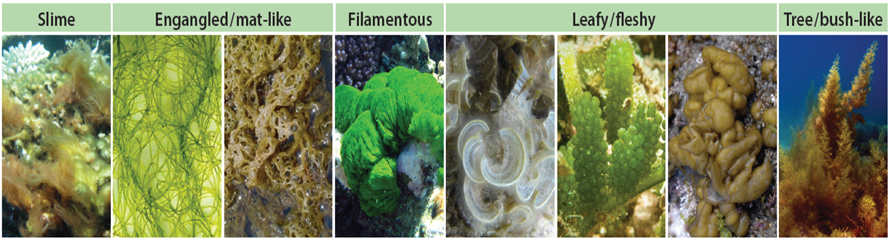
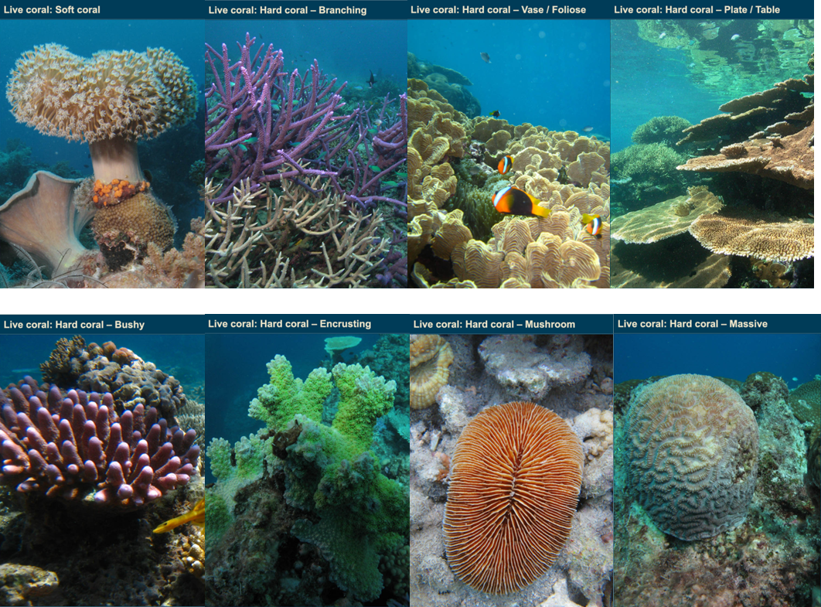
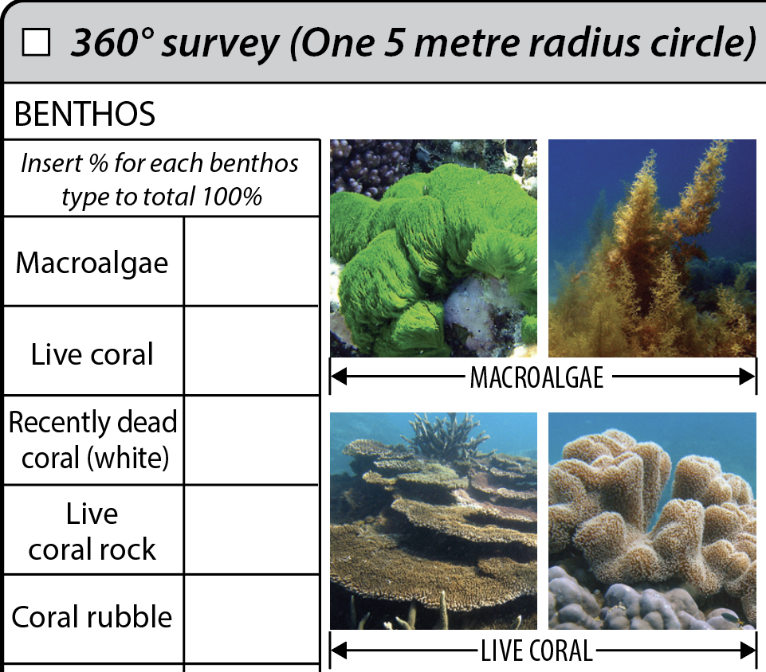
Macroalgae
Live Coral
Notes:
Macroalgae are photosynthetic organisms in the phylum Protista. They are not plants. Common colours include green, brown and red. They are naturally found on reefs, attached to the substrate. Their presence and abundance can indicate water quality and overall reef health. Macroalgae General rule: algae longer than your thumbnail.
Live Coral create the physical reef framework. Provide shelter and food for reef species. Support biodiversity and healthy ecosystems. Help protect coastlines from waves and storms.

Slide 17
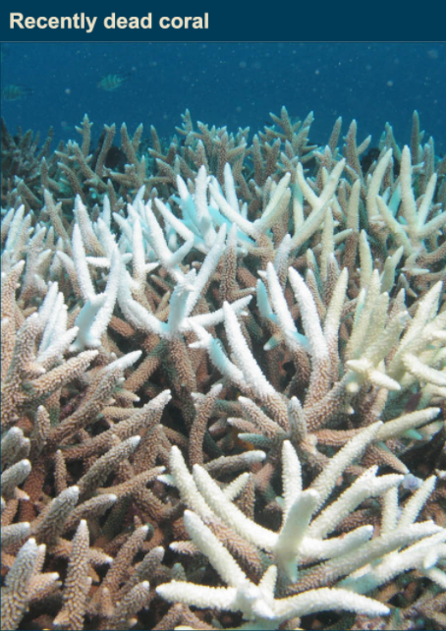
Recently Dead Coral
Recently dead coral gradually becomes green or brown as algae grows
When the detailed structure of the coral skeleton is still visible under a light covering of algae, classify as Recently Dead Coral
Recently Dead Coral may be an early warning sign!

Slide 18
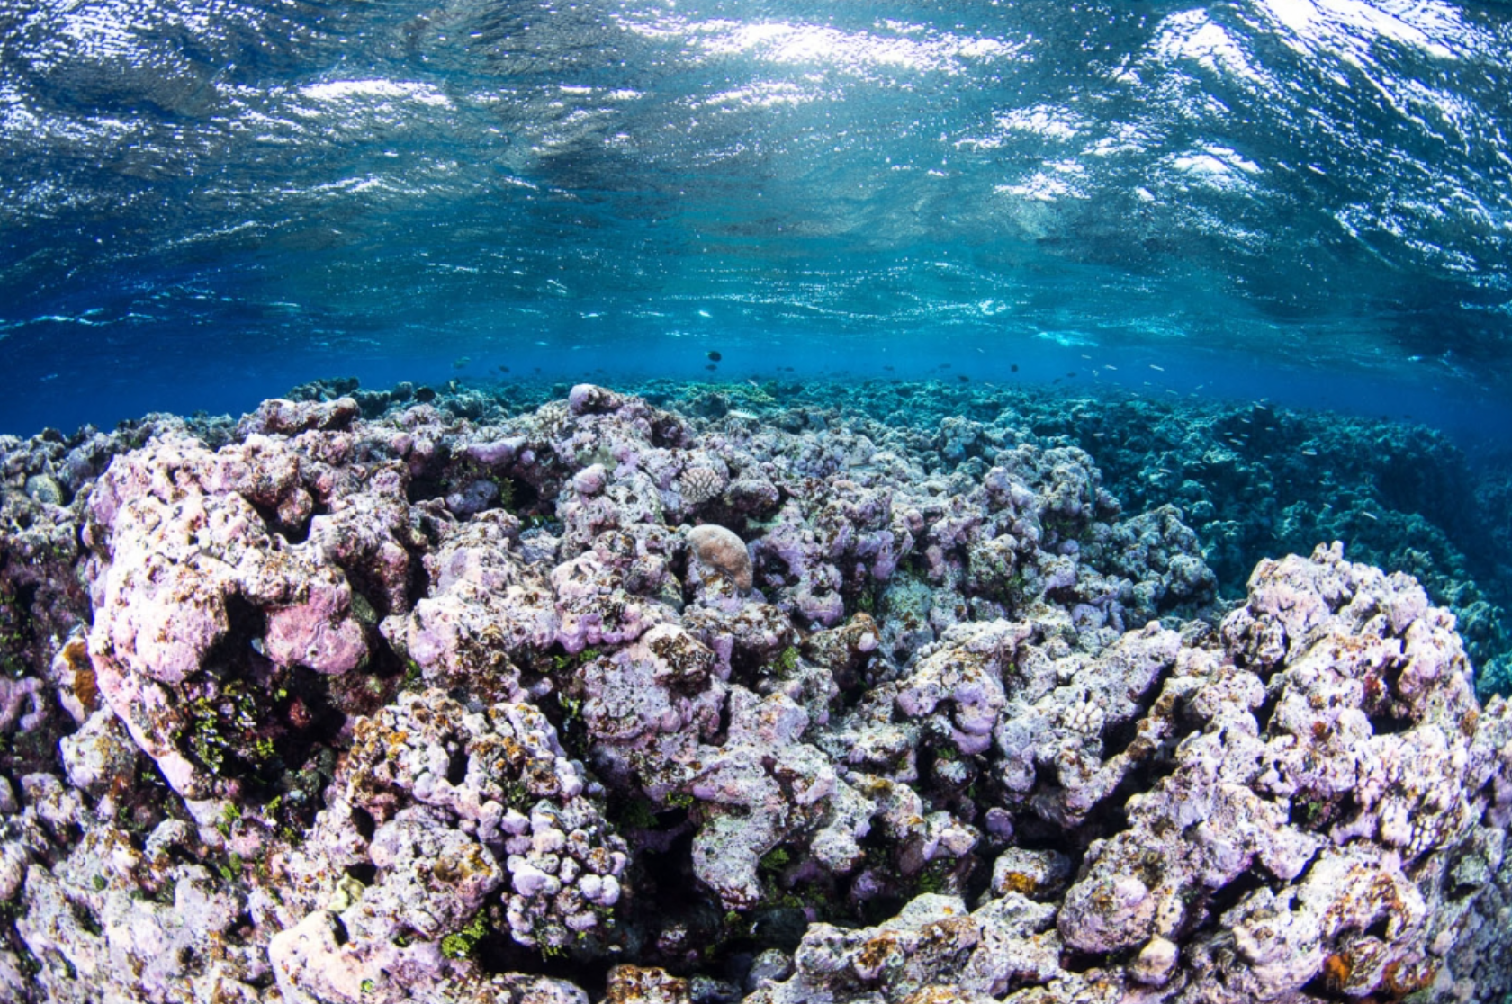
Live coral rock
Any solid substrate which is stable (inc. bare rock, coral skeletons and rubble cemented together)
Live Coral Rock is used to determine if there is substrate available for coral recruitment
Tip - if algae is shorter than your thumbnail, it can be classed as Live Coral Rock. If it is longer, classify as Macroalgae
Notes:
How to identify Live Coral Rock:
Solid, hard substrate made of ancient coral skeleton.
Mostly bare rock with limited algae cover.
May have small patches of live coral, sponges, or encrusting life.
May have a covering of short, fuzzy algae.
Natural texture: holes, grooves, and rough surfaces.
Why monitoring Live Coral Rock is important:
Provides stable habitat for corals, algae, and invertebrates.
Acts as a foundation for new coral growth and reef recovery.
Supports biodiversity through cracks, holes, and surfaces used by reef species.
Indicates healthy reef structure and resilience after disturbance.
Helps track shifts in benthic cover (e.g., coral vs. algae dominance).
Tip
If algae is shorter than your thumbnail, record it as live coral rock.
If algae is longer than your thumbnail, record it as macroalgae.

Slide 19
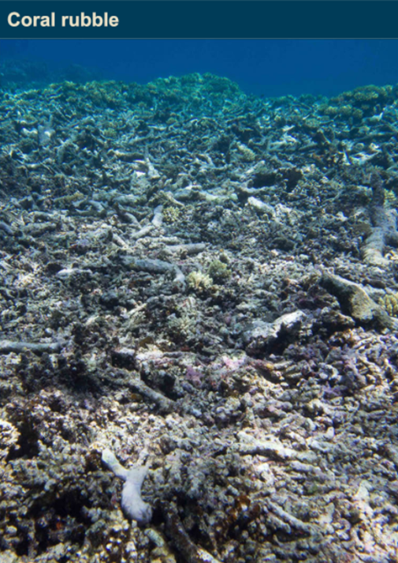
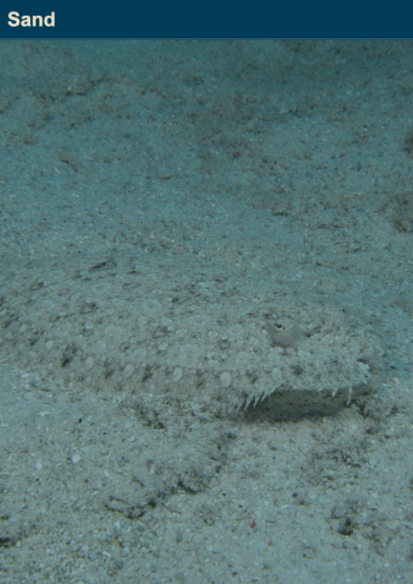
Coral rubble
Dead coral, or gravel-sized material, that is loose and can be moved by wave action
Coral Rubble is natural. Just like the branches of trees on the forest floor.
Tip - When Coral Rubble is cemented together with calcareous algae, it is categorized as Live Coral Rock
Sand
Notes:
How to identify Coral Rubble:
Loose, broken pieces of dead coral lying on the seafloor.
Fragments are moveable, not attached or cemented together.
Shapes resemble old coral skeleton but are worn or irregular.
Often piled or scattered, not forming a solid reef structure.
May have light algae, but the structure looks broken rather than intact.
How to identify Sand:
Loose, fine grains that move easily with currents.
Light-coloured, usually white or pale beige.
Lacks structure: no hard surface, no coral shapes.
Found in pools, channels, and between reef structures.
Does not support coral tissue and is easily displaced when touched.

Slide 20
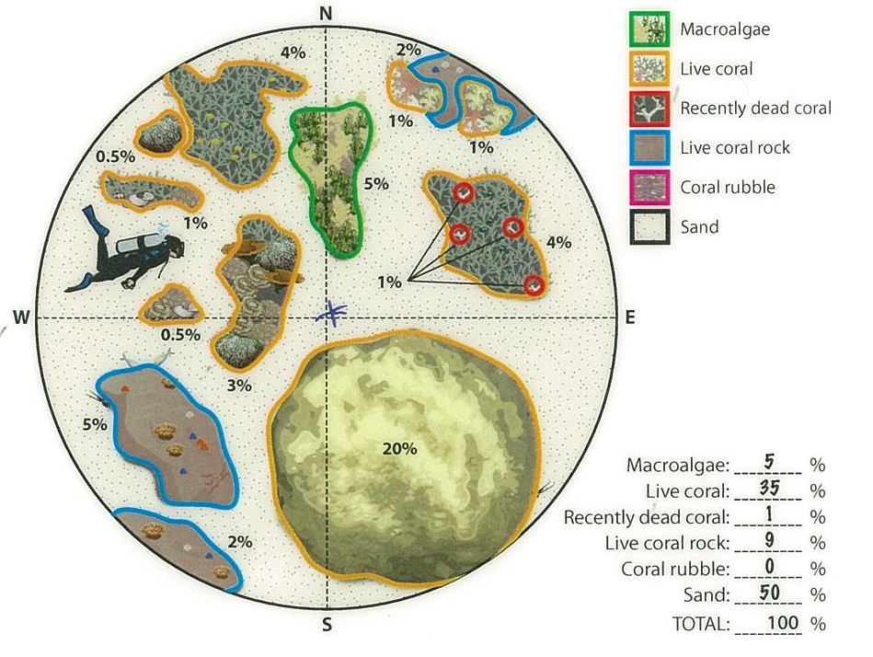
360º survey -
an estimate % cover
Notes:
Ask students to complete and then in presentation mode the answers come up- highlight a range is ok- exact answers are not necessary as it is a guesstimation. Discuss the answers and highlight that a difference (+/-) of 5% is ok.
Coral rubble 0%
Sand 50%
Live coral 35%
Live coral rock 9%
Macroalgae 5%
Recently dead 1%
Remember: the total must add up to 100%

Slide 21
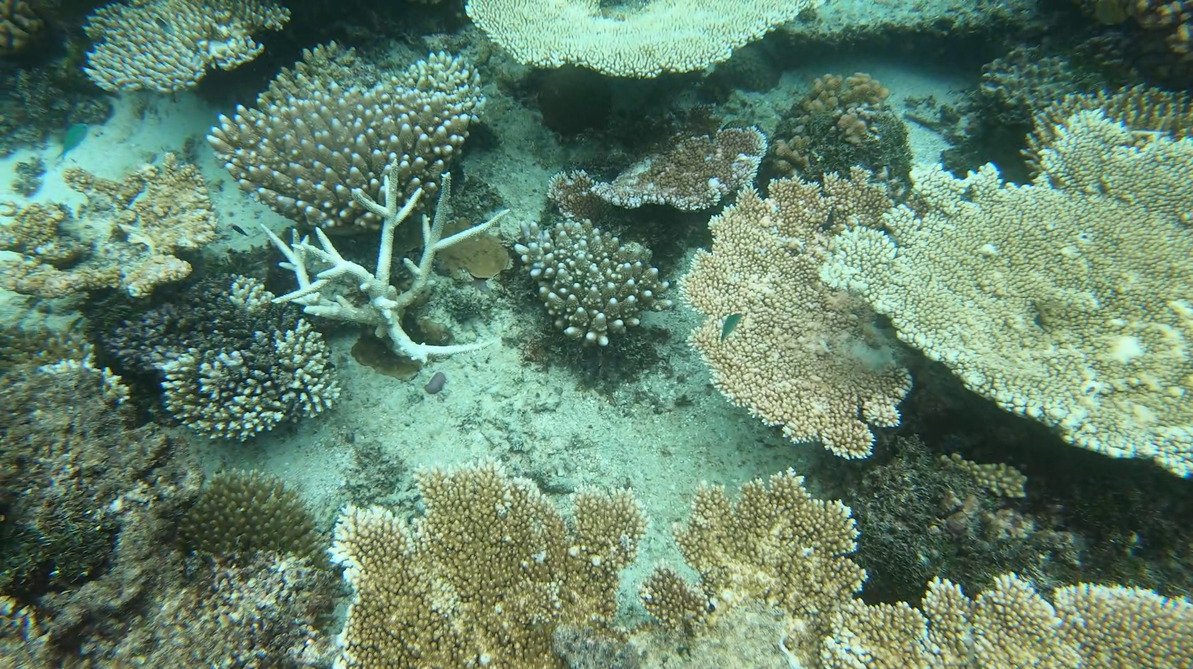
Notes:
Talk about the 6 categories Coral Rubble, Sand, Live Coral, Macro algae and Dead coral.

Slide 22
Coral Rubble %
Sand %
Live Coral %
Live Coral Rock %
Macroalgae %
Dead Coral %
Total %
Notes:
Talk about percentages- ask students to add in %

Slide 23
Coral Rubble 0%
Sand 25%
Live Coral 48%
Live Coral Rock 17%
Macroalgae 10%
Dead Coral 0%
Total 100%
Notes:
Answers in presentation mode- discuss there is variance so if we put answer as 5% it ok to have a range between 1- 10% as long as it all adds up to 100% at the end.

Slide 24
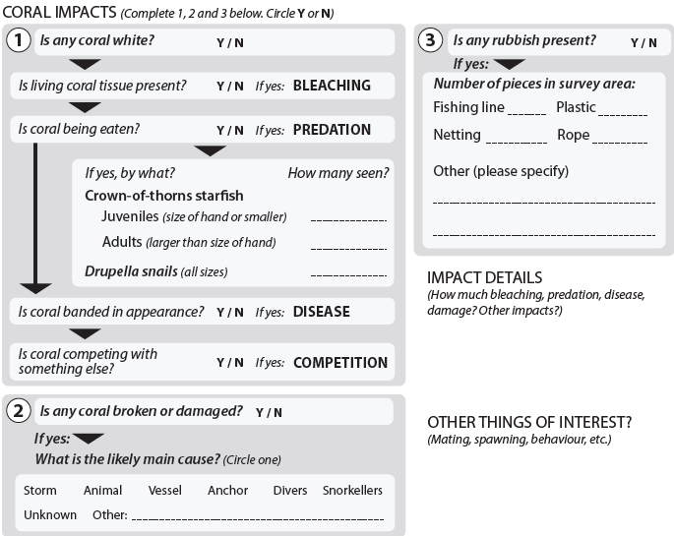
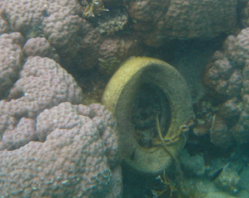
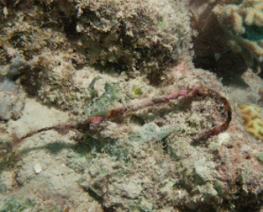
Coral impacts
Record any bleaching, predation, disease, competition, damage, marine debris and any other positive or negative impacts.
Notes:
Main items for students is bleaching, debris and damage. It is ok to leave blank if students are unsure.

Slide 25
reefed.edu.au

