Slide 1
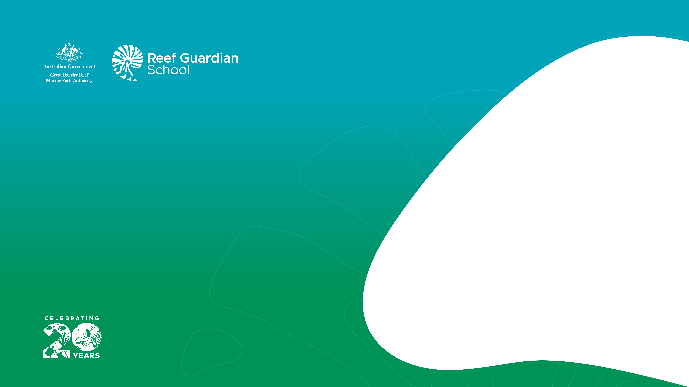


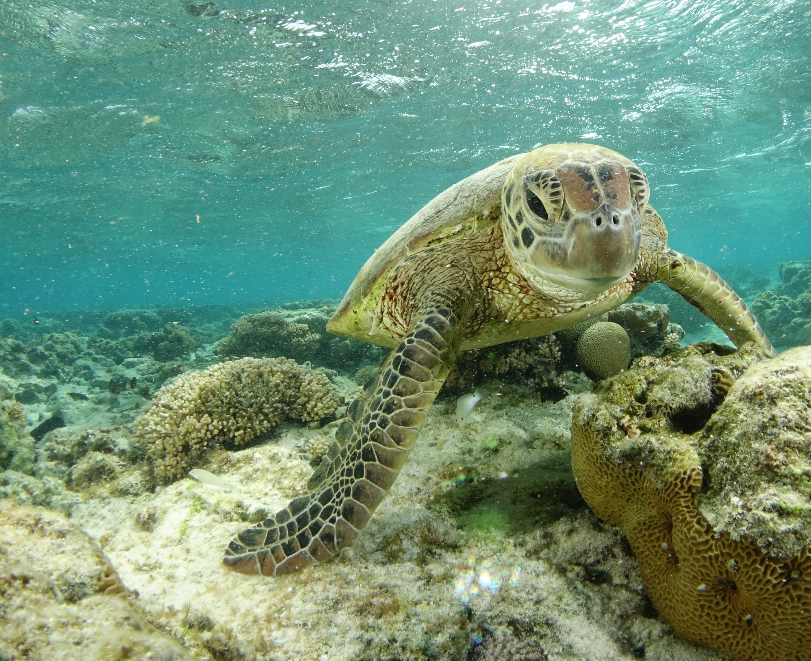
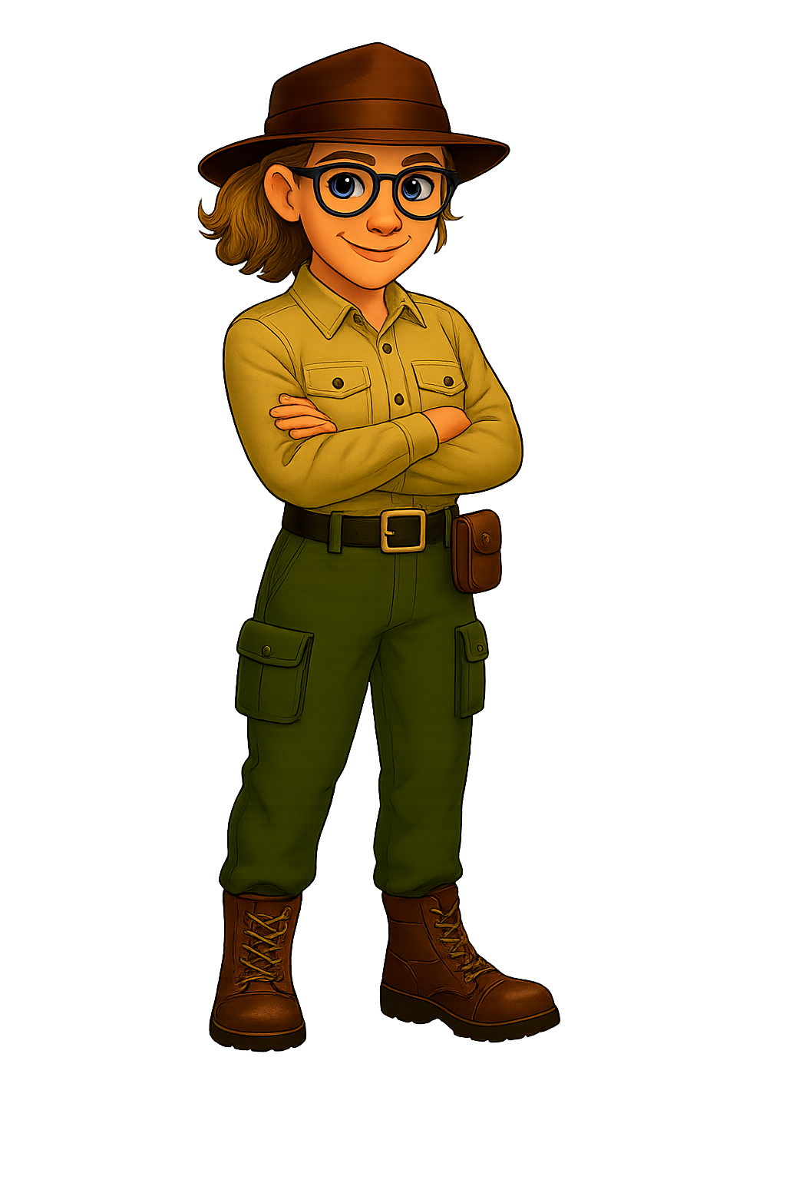
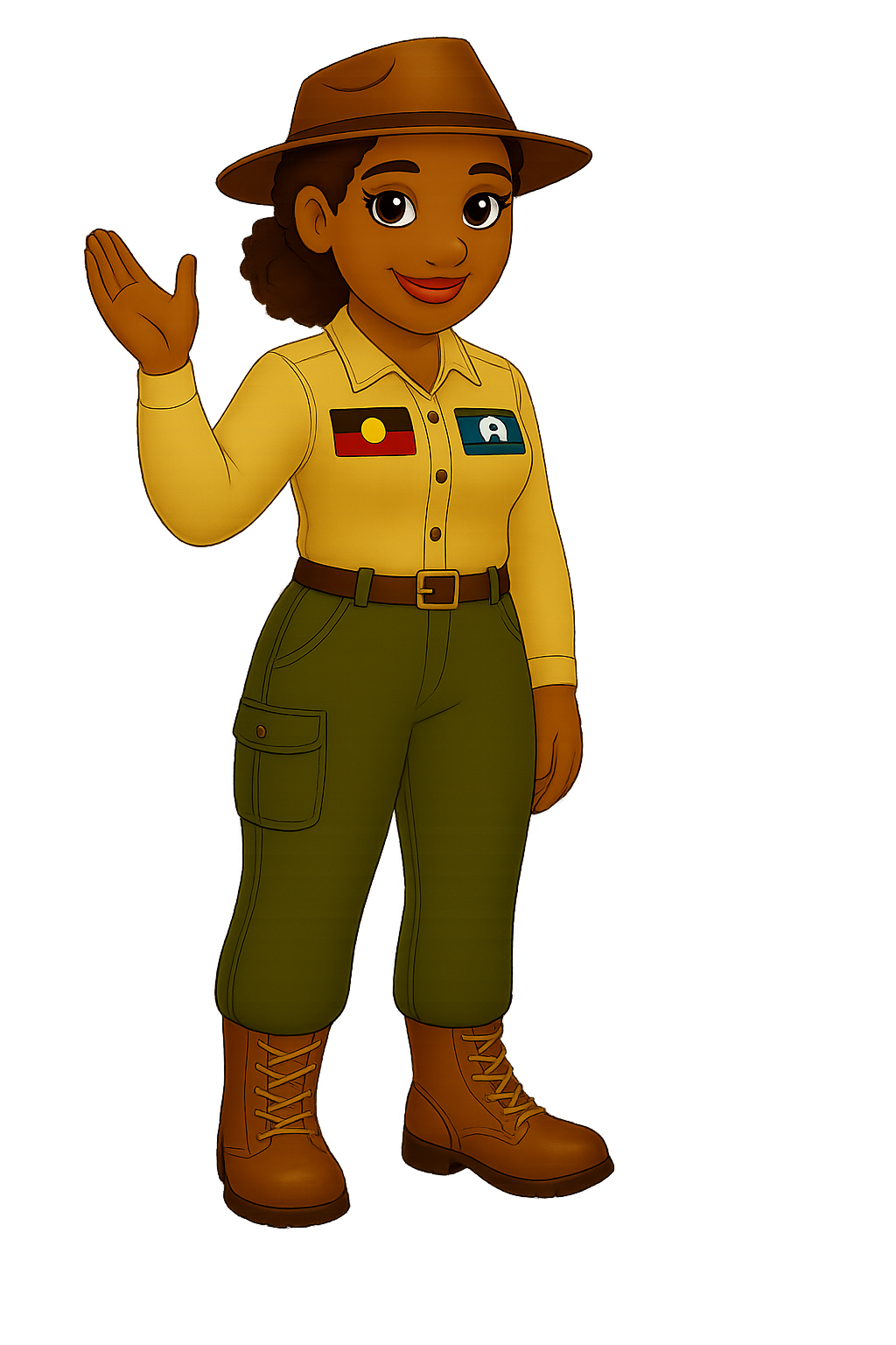

“How would you
transport me safely?
WILDLIFE EMERGENCY EXPRESS
LESSON ONE -TECHNOLOGY UNIT
We need to work smart to lift a 200kg sea turtle, Bev!
This one looks pretty heavy, Marcia!
Notes:
Note: any italic notes are additional teacher notes.
You can use this wording if you students will be designing and developing a new method of transporting a local or chosen wildlife species:
Today we are going to begin our new design unit. Throughout this unit we are going to brainstorm and design a new method of transporting one of our local wildlife species. Before we begin designing our own devices, we are going to have a look at a case study of one well known species, the Green Sea Turtle and investigate why and how some animals sometimes need transporting.
Alternate wording for if students will be redesigning or improving an already existing method of transporting the Green Sea Turtle:
Today we are going to begin our new design unit. Throughout this unit we are going to redesign and improve an existing method of transporting the Green Sea Turtle. Before we begin, we are going to learn a bit more about the Green Sea Turtle and investigate why they might need to be transported and what methods are currently used to transport the Green Sea Turtle.
If you haven’t already the Teacher Resource Guide and the Student Planning Workbook can be downloaded from the resource page buy clicking the arrow on the slide

Slide 2
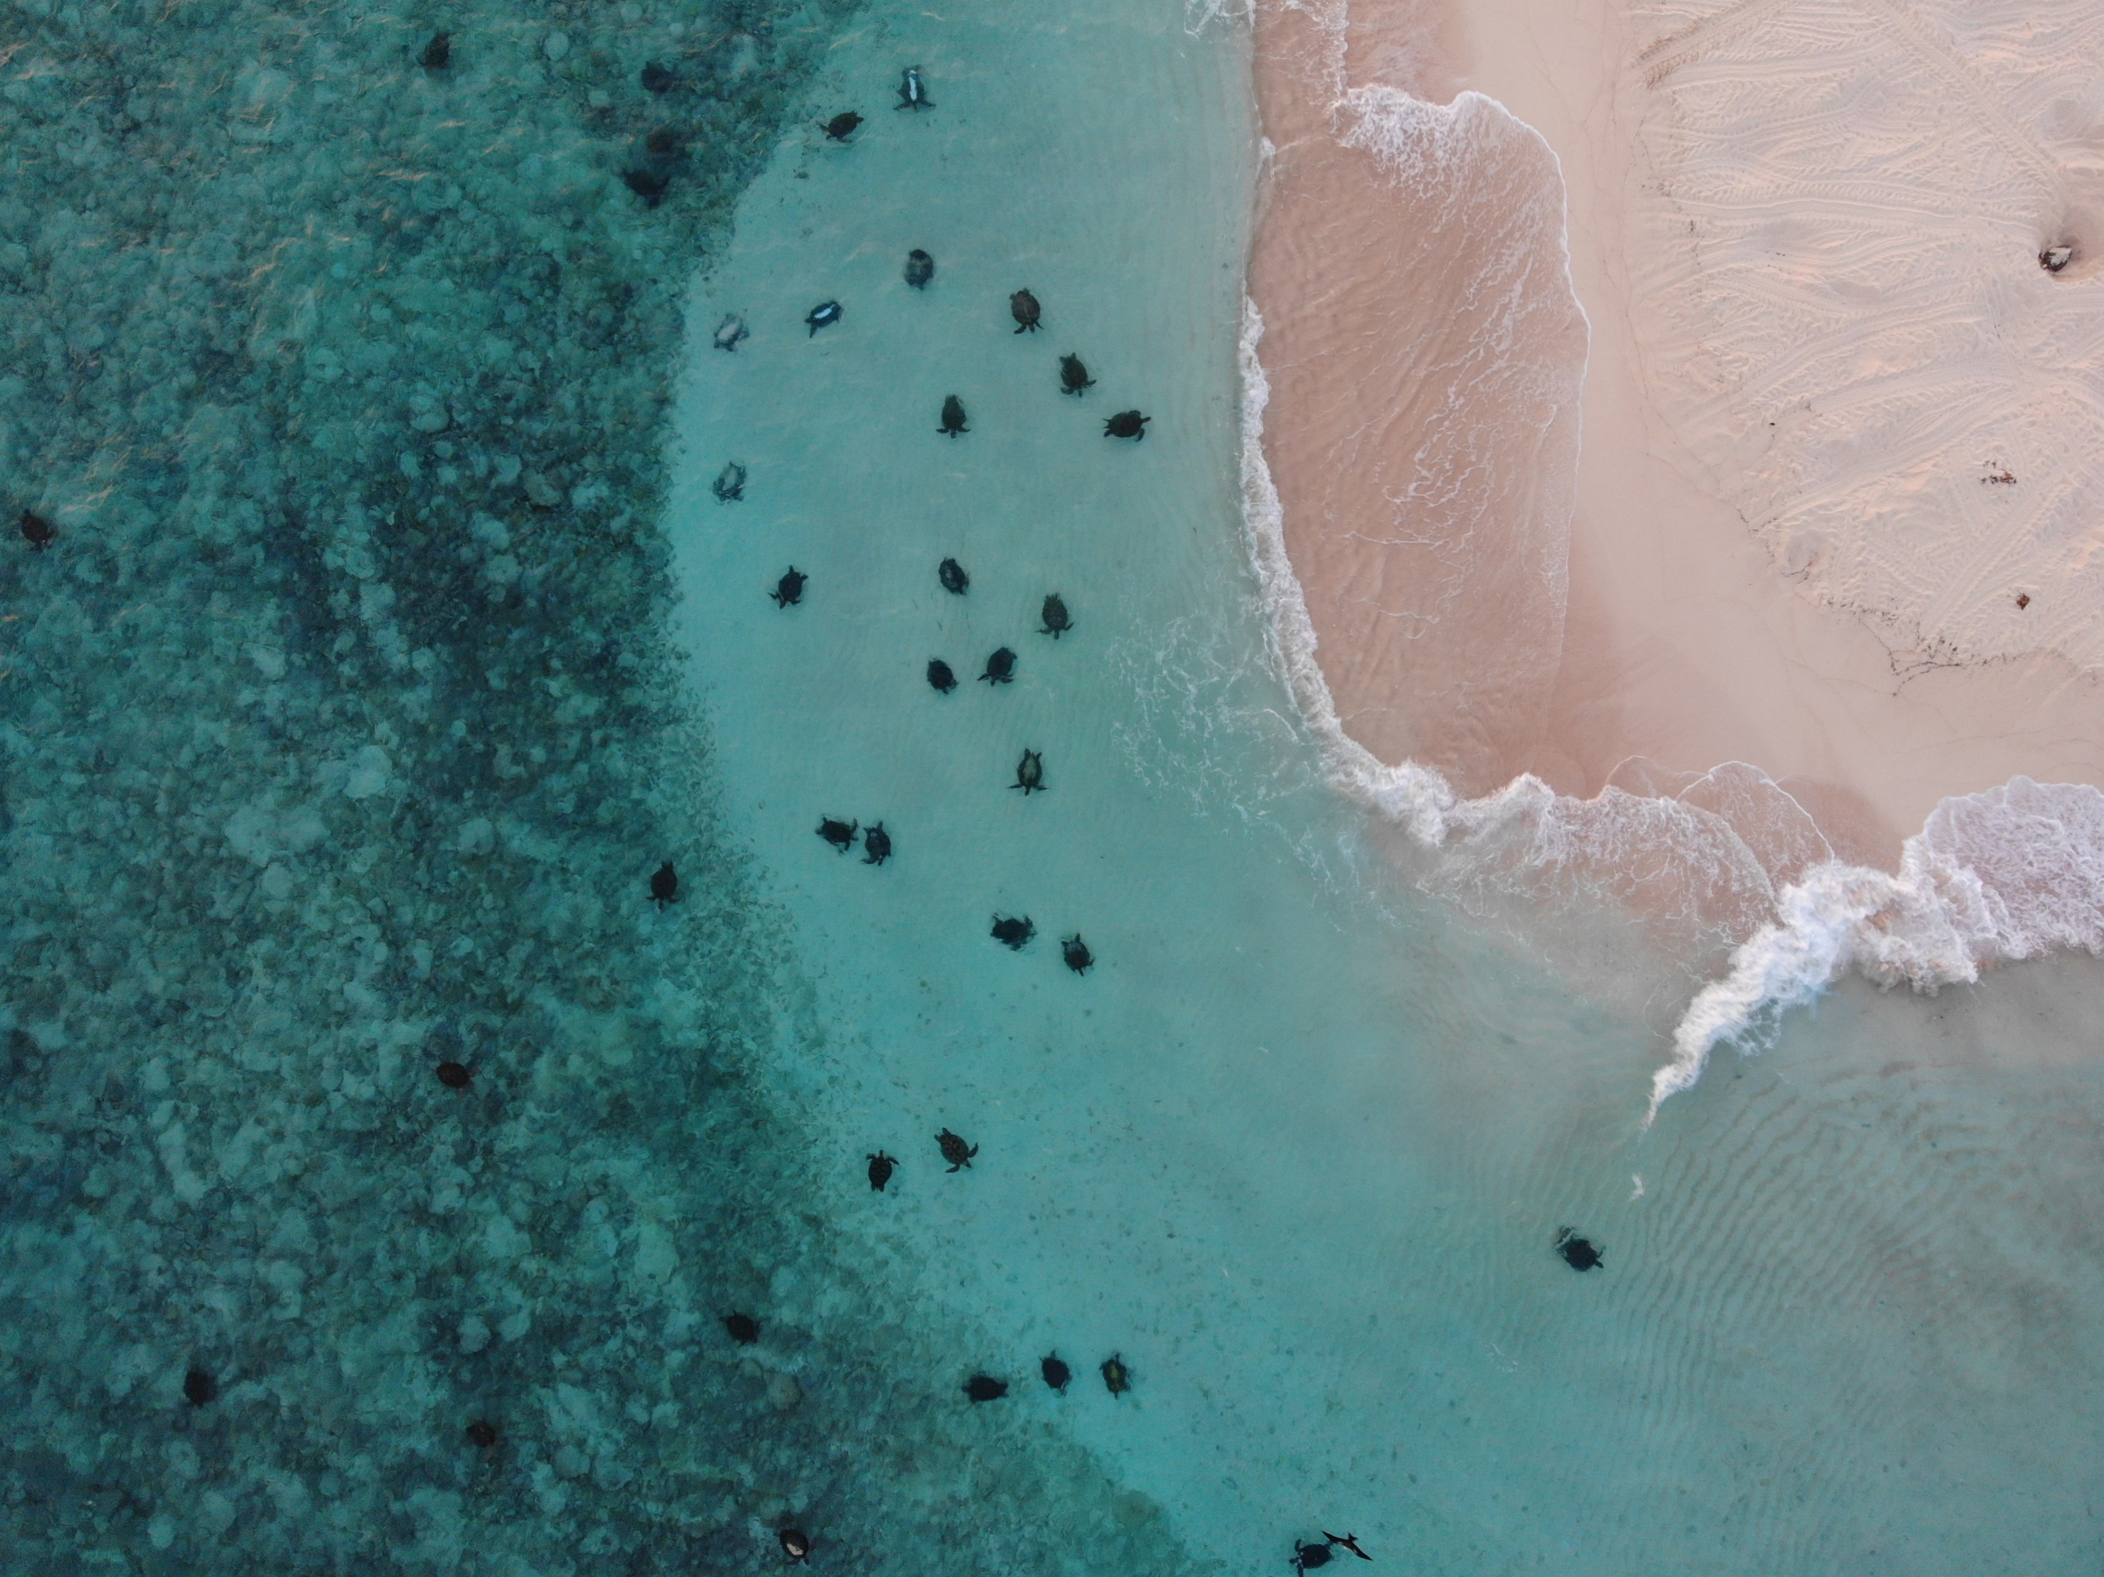
Learning Intention:
To explore how and why Green Sea
Turtles would need transporting.
Success Criteria
I can recall a fun fact about Green Sea Turtles.
I can identify more than one reason that
Green Sea Turtles would need transportation.
I can list at least one method used to transport
Green Sea Turtles.
Green Sea Turtles gather near Raine
Island in preparation for nesting.
2
Notes:
By the end of today’s lesson, you should have explored how and why Green Sea
Turtles would need transporting. You should be able to recall a fun facts about the Green Sea Turtle, identify why Green Sea Turtles would need transporting and list a method currently utilised to relocate turtles.
You will use this information to either improve Green Sea Turtle transportation or choose a different local species and design a new transportation method.
Please take notes throughout this presentation (book, laptop, learning wall) to help you remember some of the information that we will cover.

Slide 3
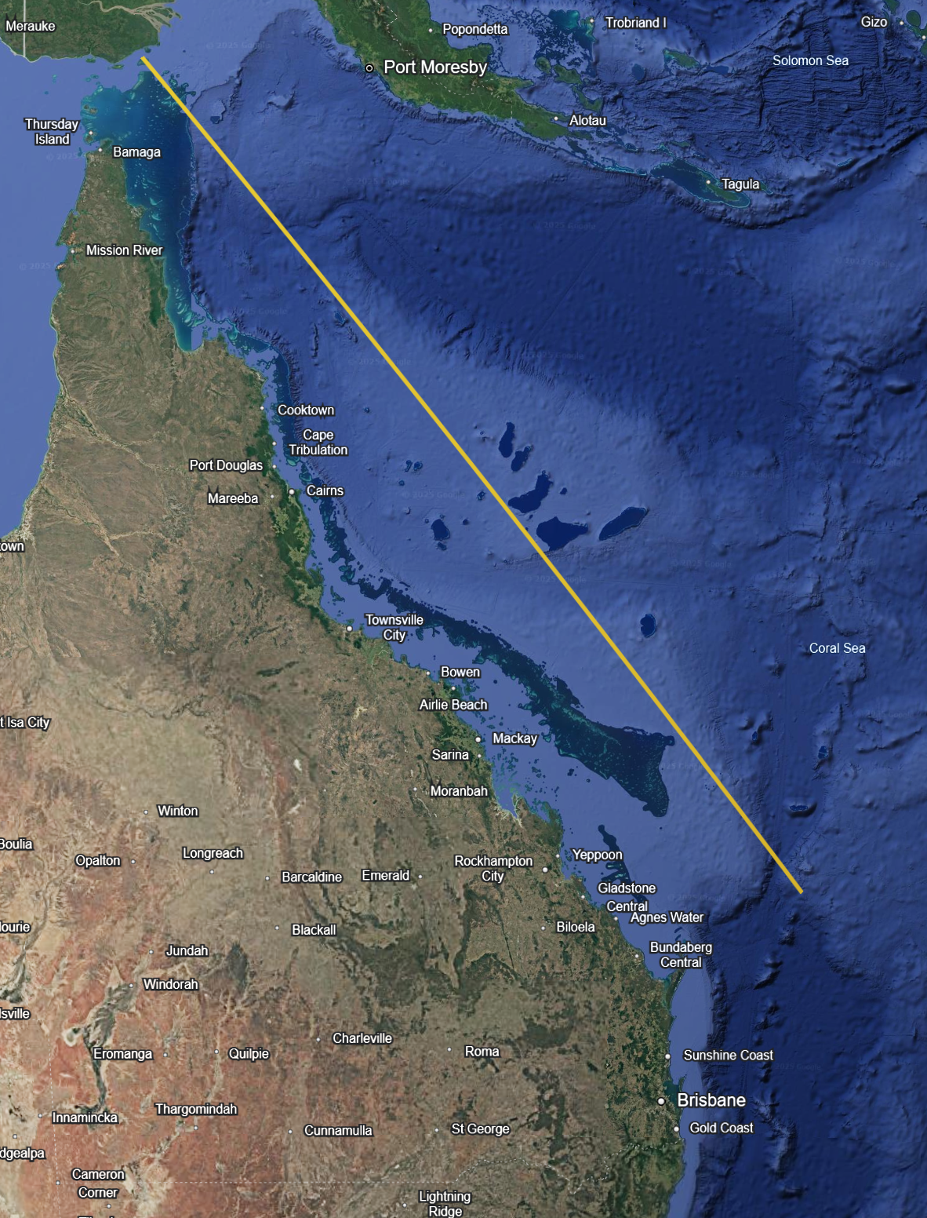
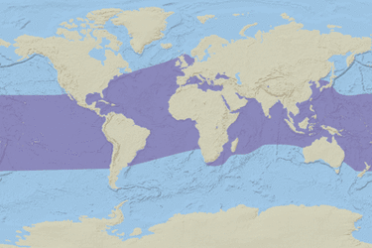
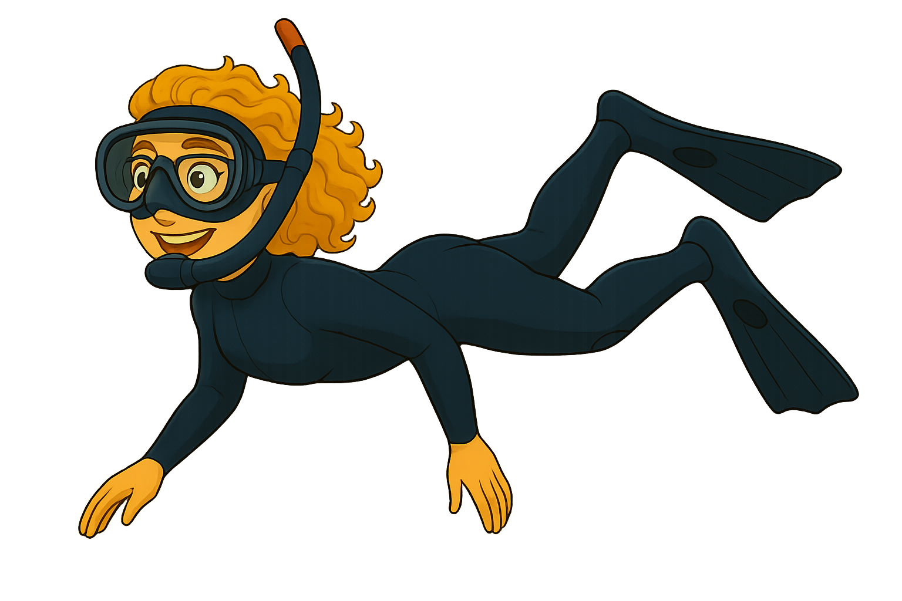
Green Sea Turtles
(Chelonia mydas)
Torres Strait
Coral Sea
Magnetic Island
Green Sea Turtle Geographic Range
Length of the
Great Barrier Reef
= 2300km
Notes:
Green Sea Turtles can be found in oceans around much of the world, including the Coral Sea and all along the Great Barrier Reef. The Great Barrier Reef is the largest coral reef system in the world, stretching over 2,300 kilometres and made up of more than 3,000 individual reefs. It is recognised as a World Heritage Area and is so large that it can even be seen from space!
Green Sea Turtles are just one of six species of marine turtle that call the Great Barrier Reef home. They rely on the reef for feeding, reproducing and nesting. These turtles can travel vast distances across the reef and beyond. In fact, their feeding and breeding grounds are often in completely different locations, sometimes thousands of kilometres apart.
Did you know that turtles use the Earth’s magnetic field to navigate through the ocean? This incredible ability helps them find their way back to the same area where they were born to lay their own eggs, even if they have not returned there for 30 years.
Marine turtles, including the Green Sea Turtle, also hold deep cultural significance for many Traditional Owners. Different Traditional Owner groups across Australia have their own names and stories for the Green Sea Turtle, reflecting their long-standing connection with these remarkable animals. The Traditional name for Green Sea turtles in our area is (you may need to look up the traditional name for Green Sea Turtles for your local Traditional Owner Group)
In the Eastern Torres Strait (Meriam Mir), Green Sea Turtles are known as Nam. In the Central Torres Strait, they are called Kulkalgul, and in the Western Torres Strait, they are known as Waru. In the Townsville region, turtles are known as Angugan in the Wulgurukaba language.

Slide 4
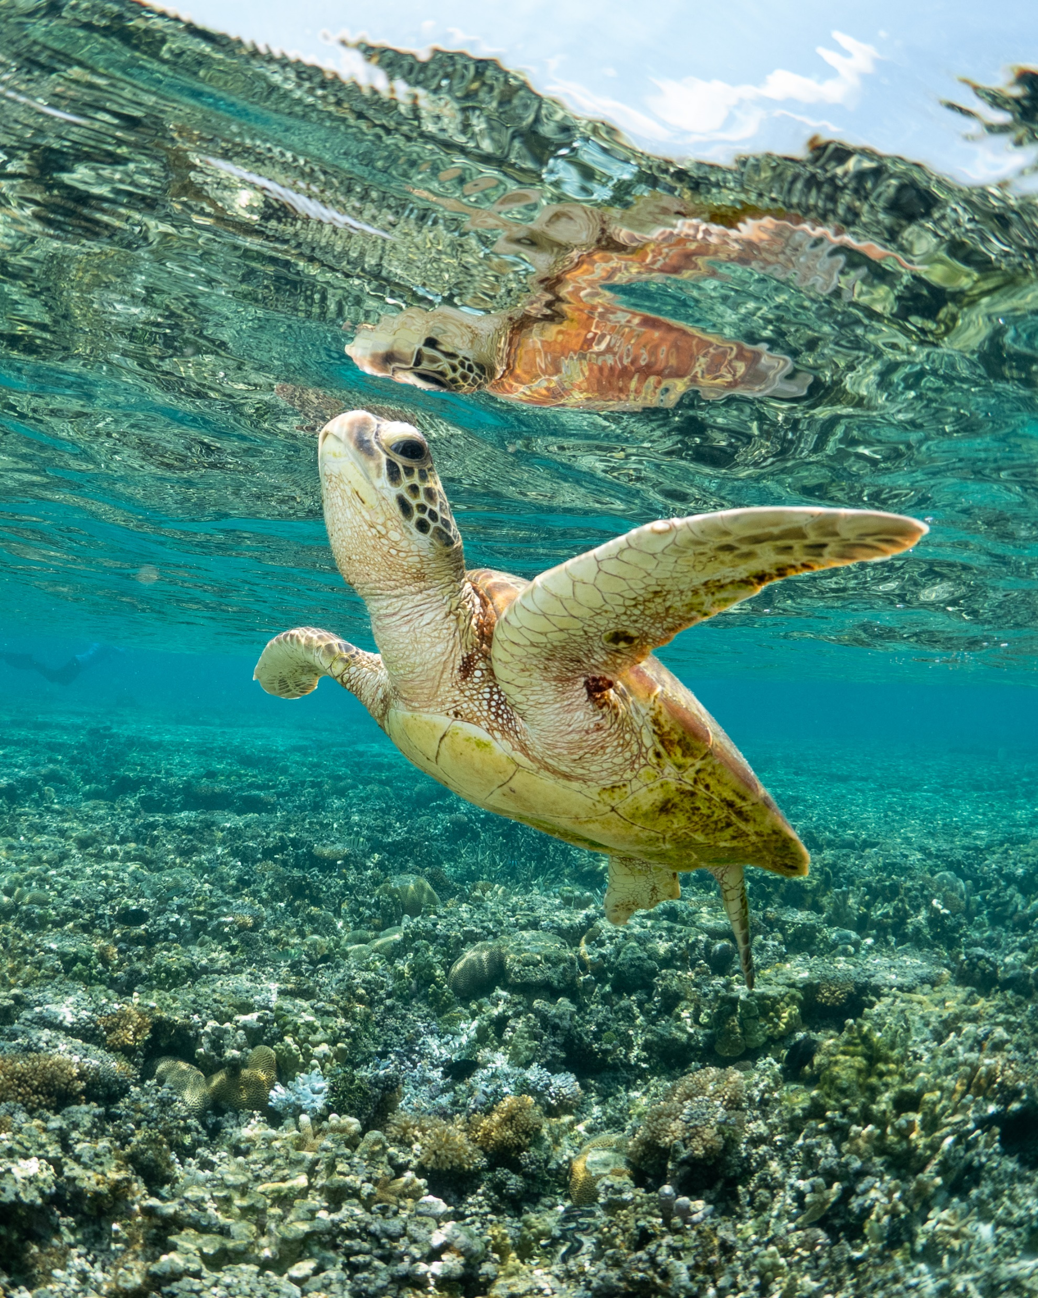
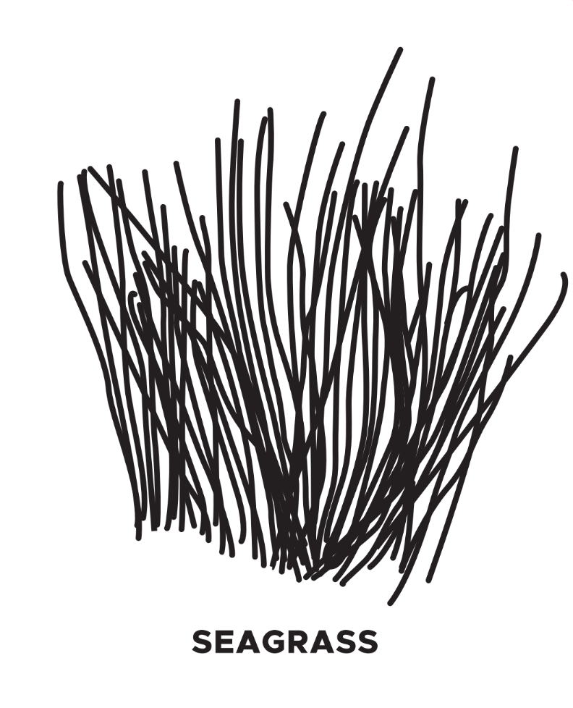
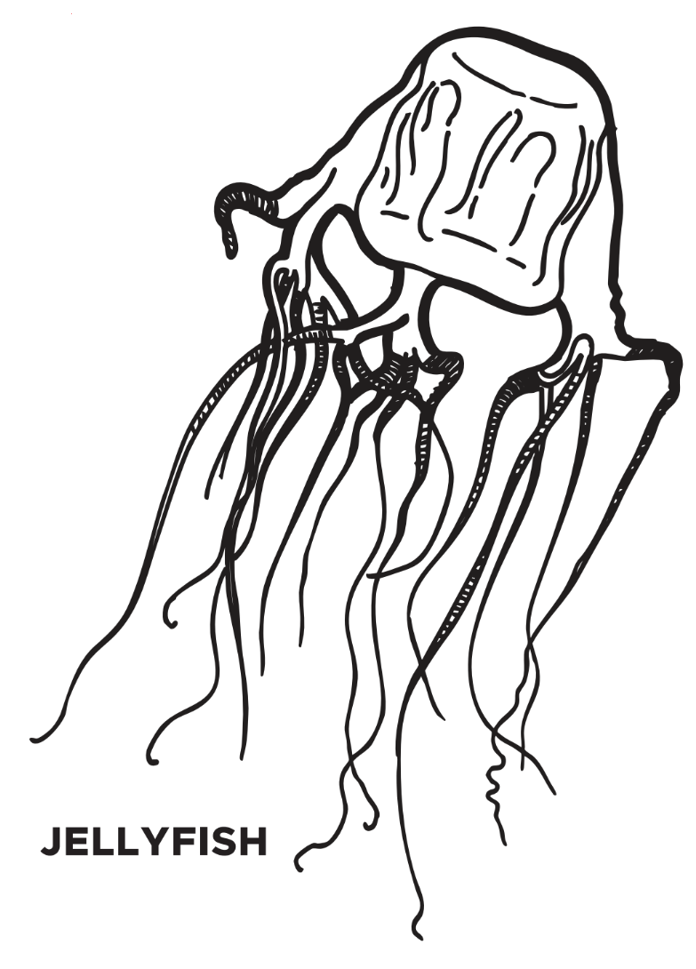
FUN FACTS
about green sea turtles
Did you know that eating sea grass and algae turns my fat green?
Feeding grounds may be thousands of kilometres away.
Juveniles spend 8-15 years in open water.
Green Sea Turtles eat jellyfish, algae and seagrasses.
Notes:
When turtles first hatch, they are often only about the size of the palm of your hand. Because they are so small and vulnerable, they quickly make their way to deep open water to escape predators. They usually stay in the open ocean until they are around 8–15 years old.
Can you think of some animals that might prey on baby turtles?
Possible answers include:
- Birds
- Crabs
- Large fish
- Sharks
Once turtles have grown bigger and reached a safer size, about the size of a large dinner plate, they return to shallower coastal waters, such as coral reefs, where they can find a wider variety of food.
While living in the deep open ocean, young turtles often eat small plankton. When they move into shallower waters, their diet changes to larger foods such as jellyfish, algae and seagrass. Because they eat both plant and animal matter, they are considered omnivores.
The Green Sea Turtle has a hard shell called a carapace, which is usually brown in colour. So why is it called a Green Sea Turtle?
Answer - The name actually comes from the colour of the turtle’s fat. Because they eat so much algae and seagrass, their body fat develops a greenish colour.

Slide 5
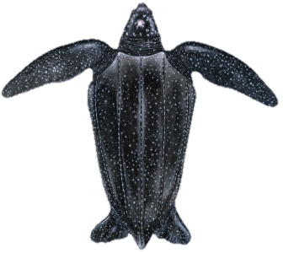
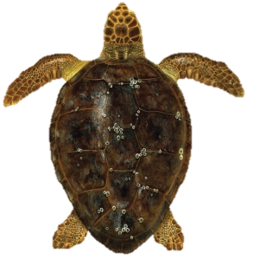
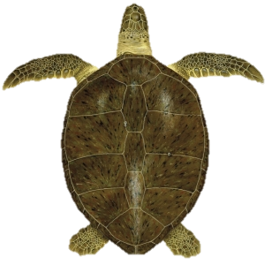
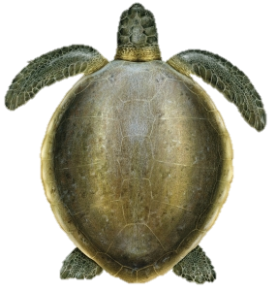
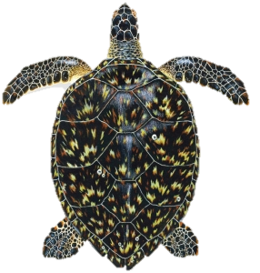
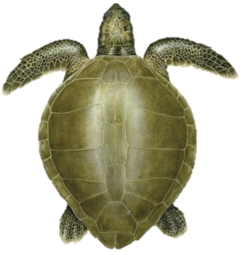
FUN FACTS
Did you know?
Green Sea Turtles are the second largest turtle in Australian waters.
Are you taller than a Green Sea Turtle?
Olive Ridley (0.68 m)
Hawksbill (0.82 m)
Flatback (0.94 m)
Loggerhead (0.96 m)
Green (1.07 m)
Leatherback (1.83 m)
5
Notes:
There are only seven species of sea turtle found in the world. Australia and the Great Barrier Reef are incredibly lucky, as six of these seven species call Australian waters home.
The Green Sea Turtle is the second largest sea turtle species, both in Australia and worldwide. Adult Green Sea Turtles can have a carapace (shell) length of over one metre, making them an impressive sight in the ocean.
The only sea turtle species not found in Australian waters is the Kemp’s Ridley Sea Turtle. This is the smallest of all sea turtles and is found mainly in the Gulf of Mexico and parts of the Atlantic Ocean.
Note: The measurements for each species on this slide are for the average adult nesting carapace (shell) size.

Slide 6
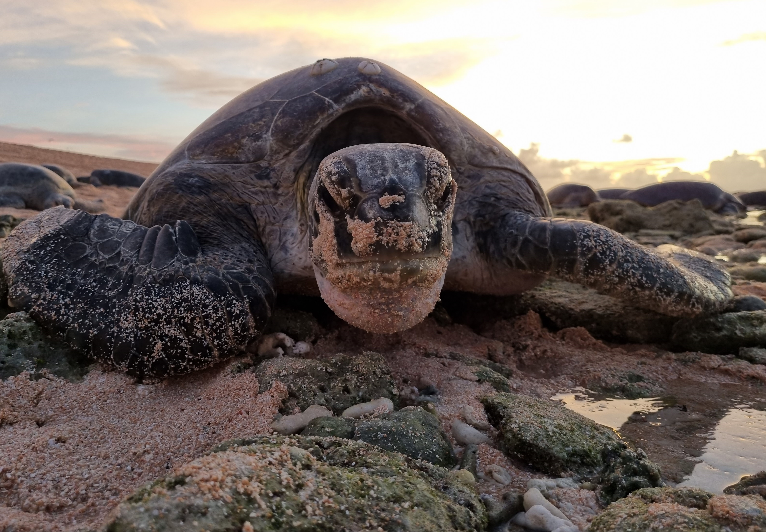
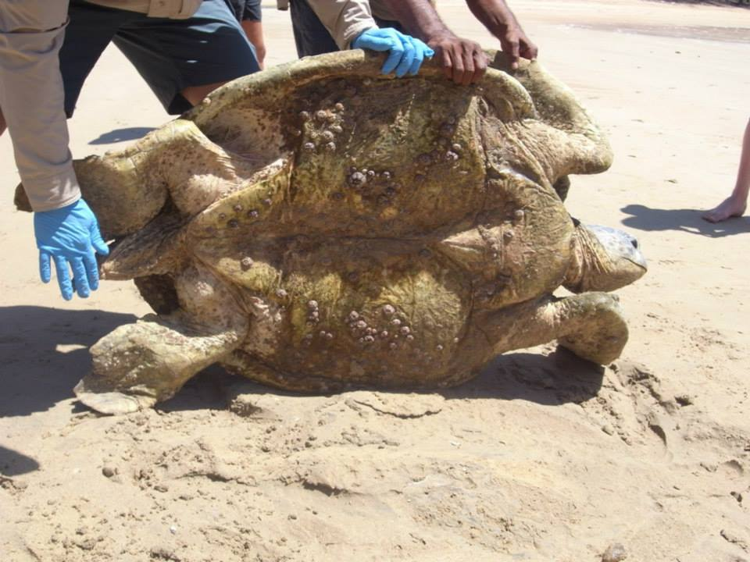
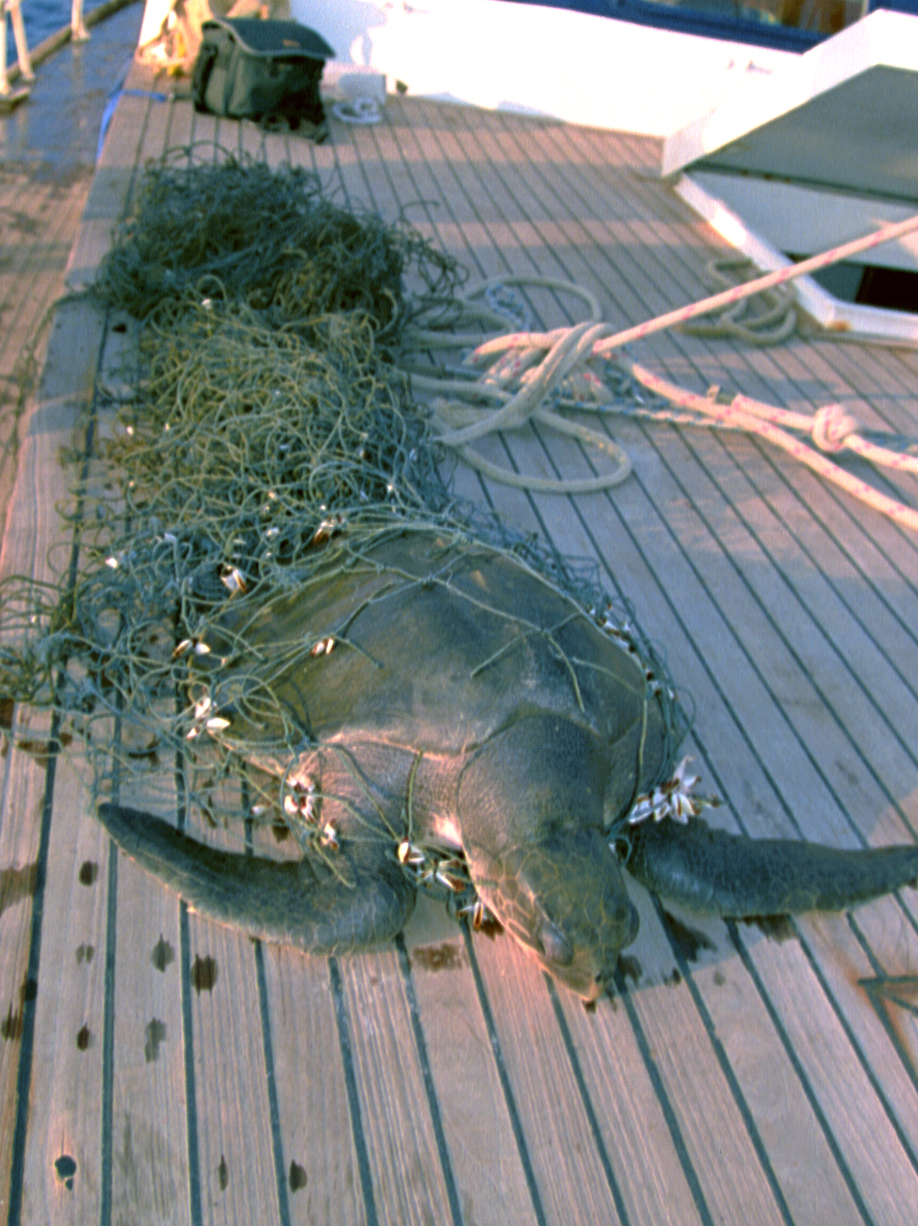
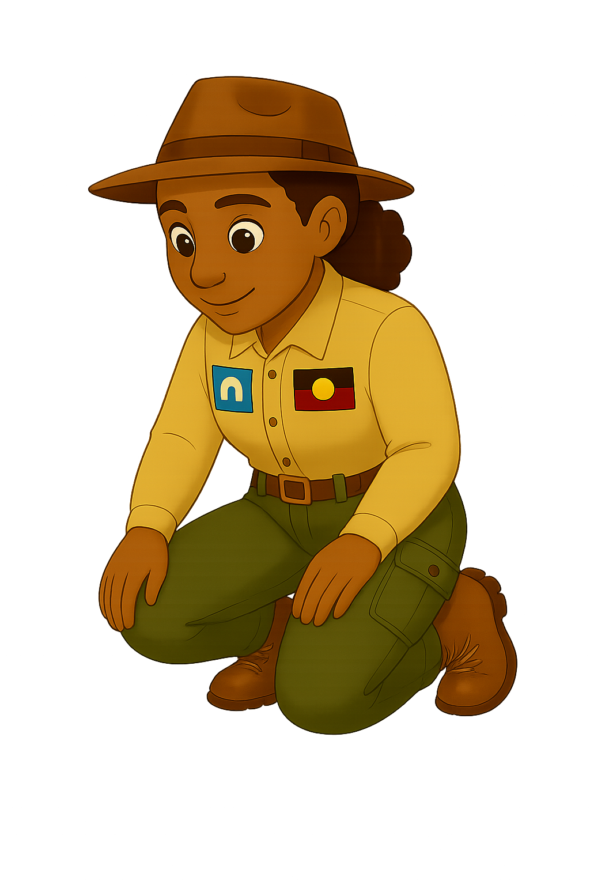
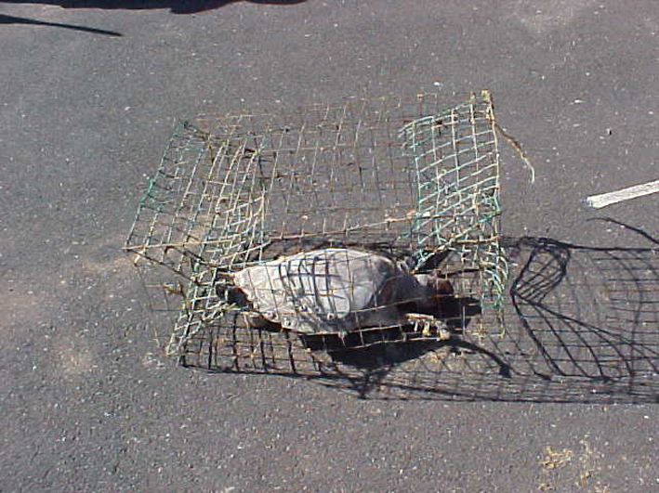
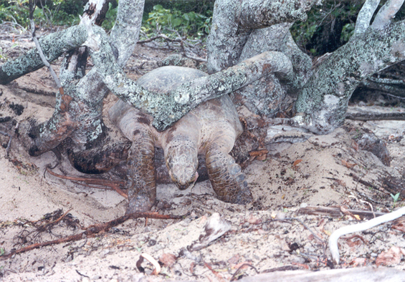
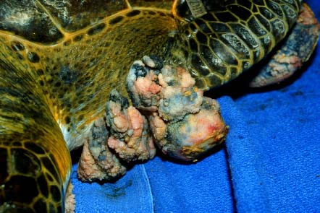
When do turtles need transporting?
1
4
Which of these
need transporting?
2
6
Images of turtles that were assessed by a marine strandings team
3
5
Notes:
Sometimes Green Sea Turtles need transport from the water or the beach. For example, to receive help or to be moved to a safer location.
Looking at the images on the screen, Can you think of some reasons why turtles would need transporting?
Answers:
Turtle found washed up the beach in an emaciated (starving) state - Can you see how the underside of the turtle has sunken in, that is the sign of a starving, underweight turtle.
Turtle stuck in crab pot – If turtles get stuck in a crab pot sometimes they are unable to get to the surface of the water to breath.
Nesting Turtle became stuck on tree branch whilst trying to return to the water.
Turtle found trapped in fishing net – If turtles get entangled in fishing net it can slow them down or even stop them getting the to surface to breath.
Turtle with Fibropapilloma tumours around the front flipper – these tumours are often found growing on turtles living in poor water quality.
This turtle did NOT need transporting – this is an adult female turtle who had come ashore to dig a nest and lay her eggs. Sometimes even healthy turtles may need transporting for scientific reasons, such as tagging or measuring.
Photo credits: Great Barrier Reef Aquarium and Magnetic Island Network for Turtles

Slide 7
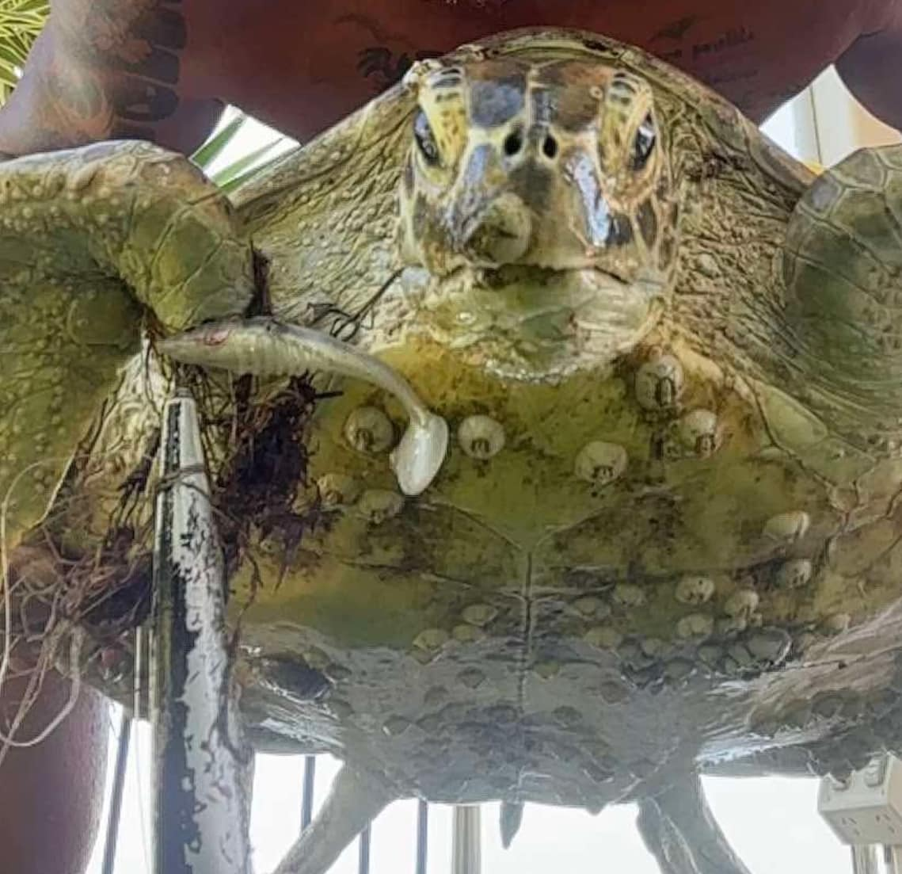
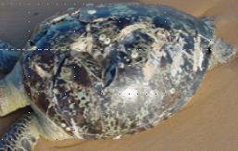
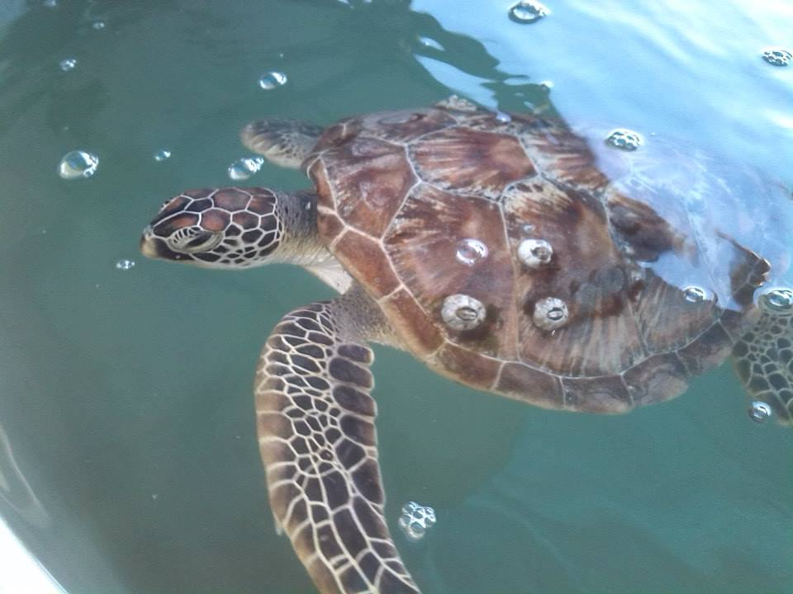
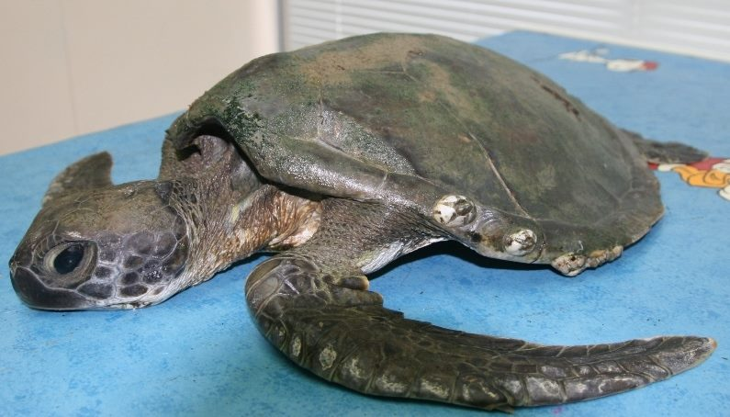
Reasons green sea turtles need transporting:
Marine debris
Boat strikes
Floating syndrome
Natural disasters
1
2
3
4
Notes:
Let’s take a look at some of the main reasons why Green Sea Turtles may need help and, in some cases, transportation for treatment and rehabilitation.
In the first image, we can see the impact of marine debris. Items such as plastic, fishing line, and nets can cause serious internal and external injuries. For example, the fishing line wrapped around this turtle’s front flipper can restrict its movement and lead to long-term injury.
In image two, we can see the effects of a boat strike. Collisions with boats can crack or cut a turtle’s shell, known as the carapace. Because a turtle’s spine and ribs are fused to its shell, damage here can also affect the spine, making it difficult—or even impossible—for the turtle to swim properly.
In image three, this turtle is experiencing what is known as floating syndrome. This condition is often caused by ingesting debris or internal injuries, which lead to a build-up of gas in the body. As a result, the turtle is unable to dive properly, affecting its ability to find food, rest safely underwater, and even clean its shell.
Finally, in the fourth image , we can see the effects of natural disasters and environmental impacts. Events such as cyclones, flooding, and poor water quality can destroy important food sources like seagrass and coral. This can lead to starvation. You may notice how thin this turtle appears around its neck and flippers, which is a clear sign of poor health.
Sometimes Green Sea Turtles need to be moved or transported, for rescue, medical treatment, recovery, rehabilitation, or even for scientific research.
Luckily, there are teams of people whose job it is to help these turtles. But before they can do that, they first need to figure out the safest way to transport them.
Photo credits: Great Barrier Reef Aquarium and Magnetic Island Network for Turtles

Slide 8
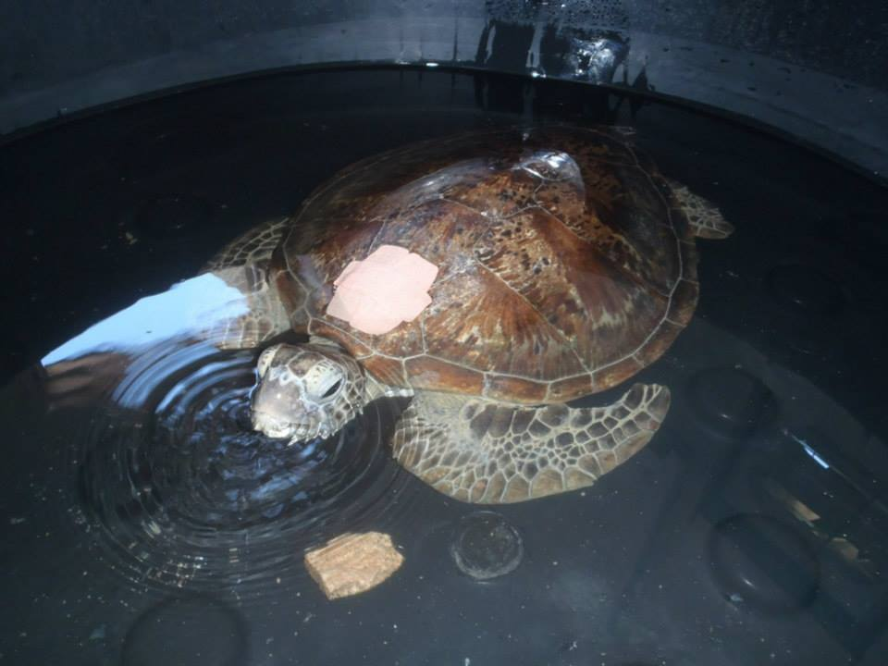
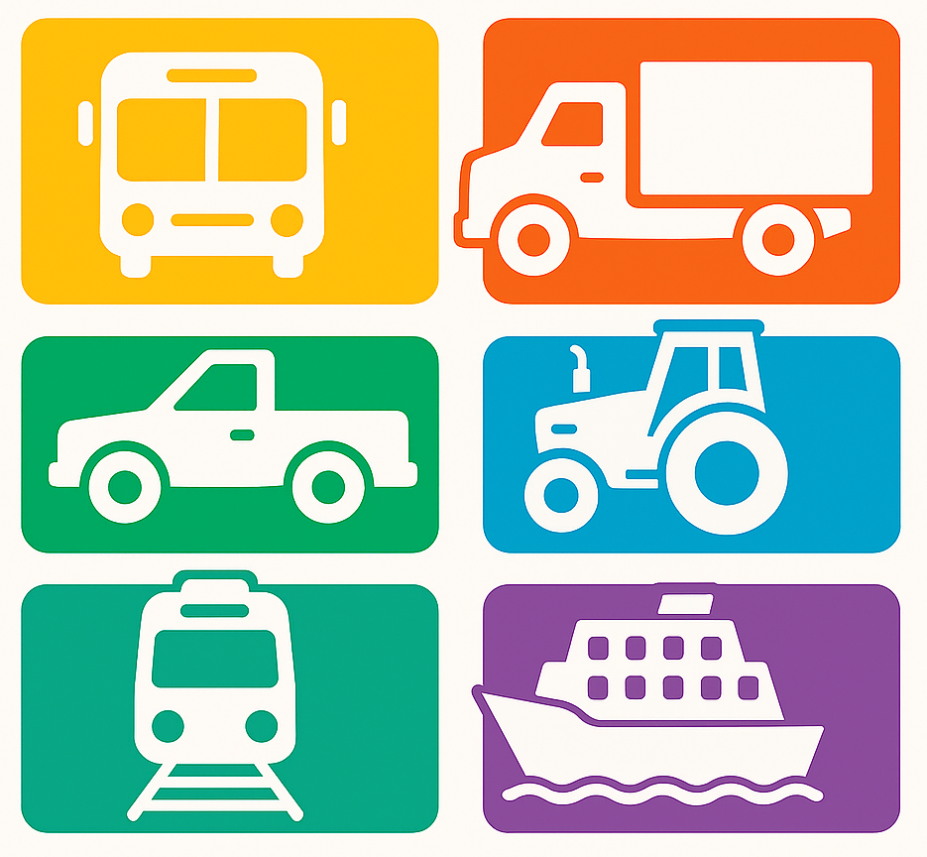
You have an appointment
at the vet’s at 2pm!
How to transport a sea turtle
How are you going to move me?
8
Notes:
We have learnt some of the reasons why turtles might need to be transported, but what about how they are transported.
Adult Green Sea Turtles can weigh over 200 kilos and be more than a metre long.
So, what do you think? How would you move something as big as a Green Sea Turtle safely?
Anyone want to have a guess?
Notes:
You could involve students prior to providing answers in next slide.
Some prompting questions to spark discussion could be:
Do you think that you could just pick up a 200kg turtle by yourself?
What might you need to do instead?
What kind of resources might you need to use to transport such a large animal?

Slide 9
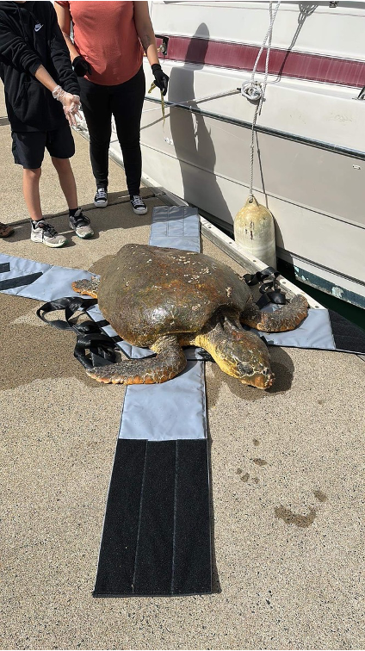
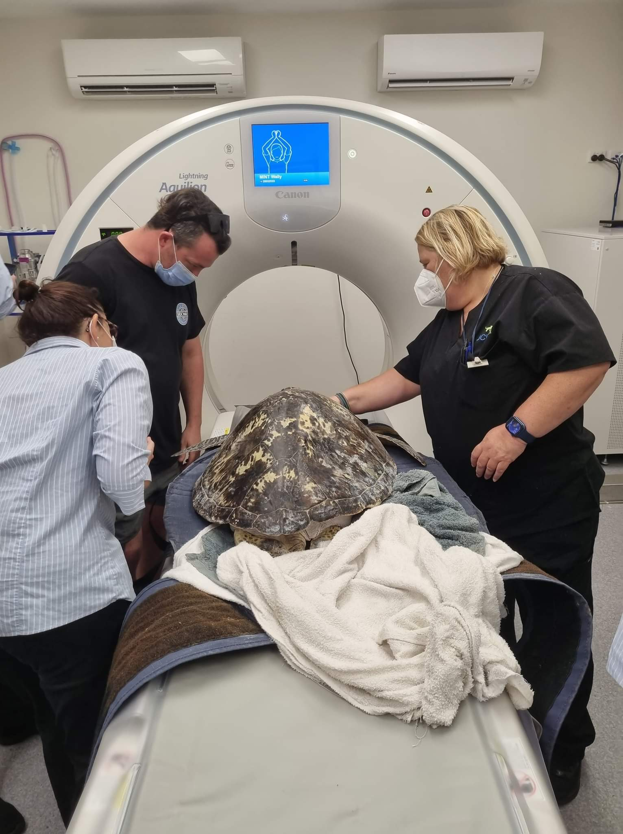
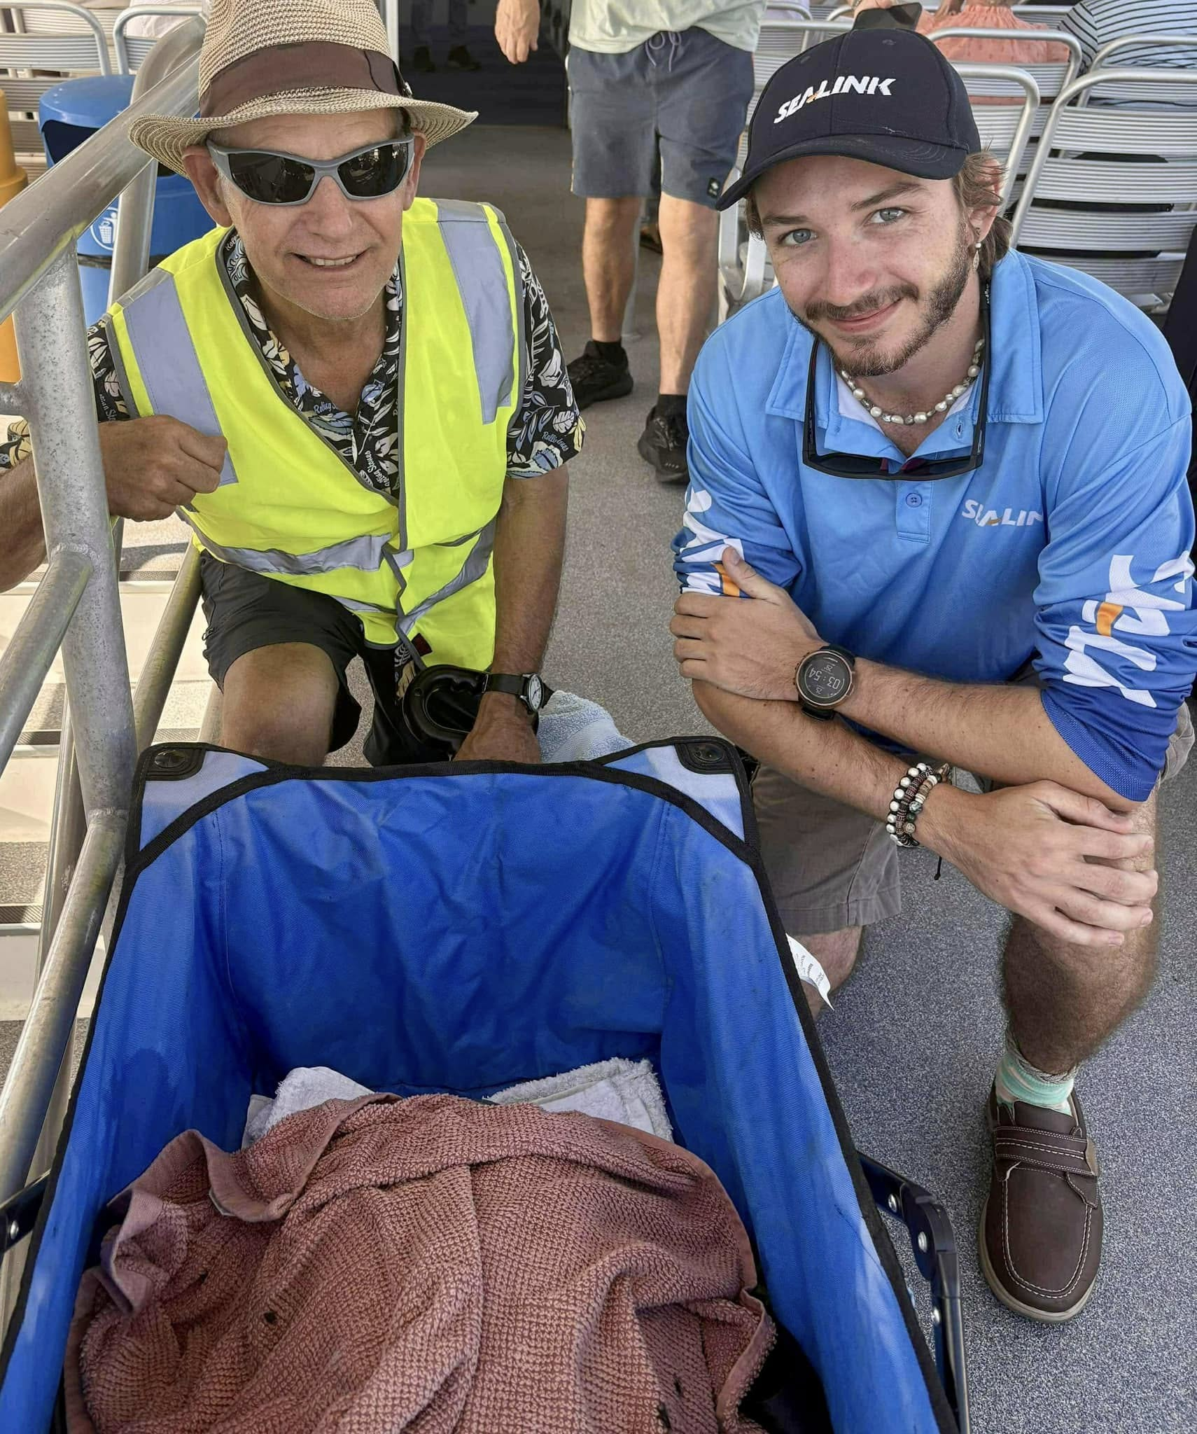
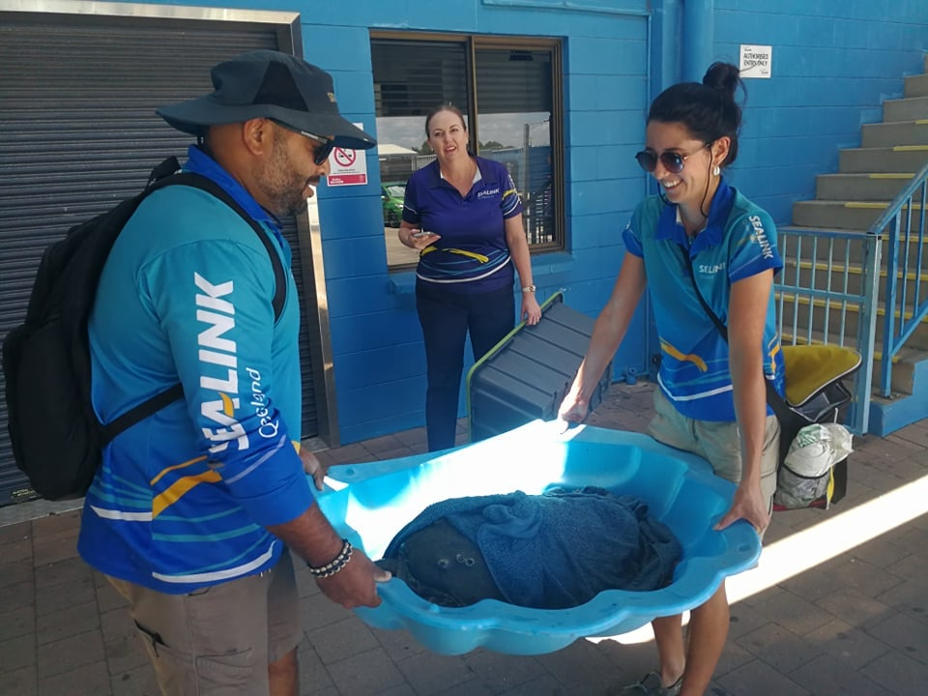
Challenges of transporting sea turtles?
Teams need to solve the challenge of safely moving turtles whilst utalising various modes transport.
1
4
2
3
9
Notes:
There are a variety of methods that have been developed to safely transport turtles of all sizes.
In Image 1, you can see a four-way Velcro harness, which is a commonly used device for transporting turtles. The four straps help secure the turtle and keep its flippers tucked in, reducing the risk of injury to both the turtle and the rescue team. The harness also includes multiple handles, making it easier to lift and carry. In fact, did you know it can sometimes take four to six people to lift and carry a single turtle?
Because green sea turtles can be very heavy, additional equipment is sometimes needed.
In Image 2, a beach cart is used to transport a turtle over longer distances that would be too difficult to carry by hand.
In Image 3, a medium-sized turtle is placed inside a sandpit clam and carefully carried. Even though this turtle is not fully grown, it still requires two people to lift and move it safely.
In Image 4, you can see a specialised hospital trolley, which allows turtles to be transported safely and efficiently around a veterinary hospital for tests.
If you look closely at Images 2 and 3, you may notice that the turtles are covered with towels. Towels are often placed over a turtle’s eyes during transport to help keep them calm. They can also help regulate the turtle’s temperature. Although turtles breathe air and do not need to be transported in water, they still need to be kept cool—especially in warm conditions—so damp towels are often used for this purpose.
Photo Credits: Magnetic Island Network for Turtles

Slide 10
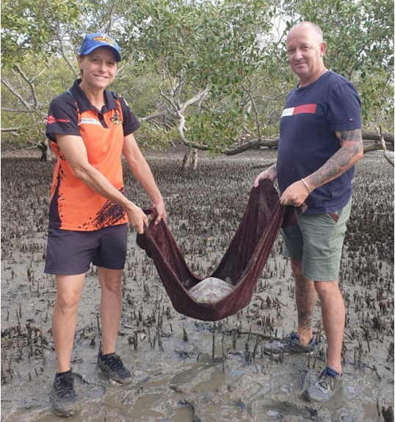
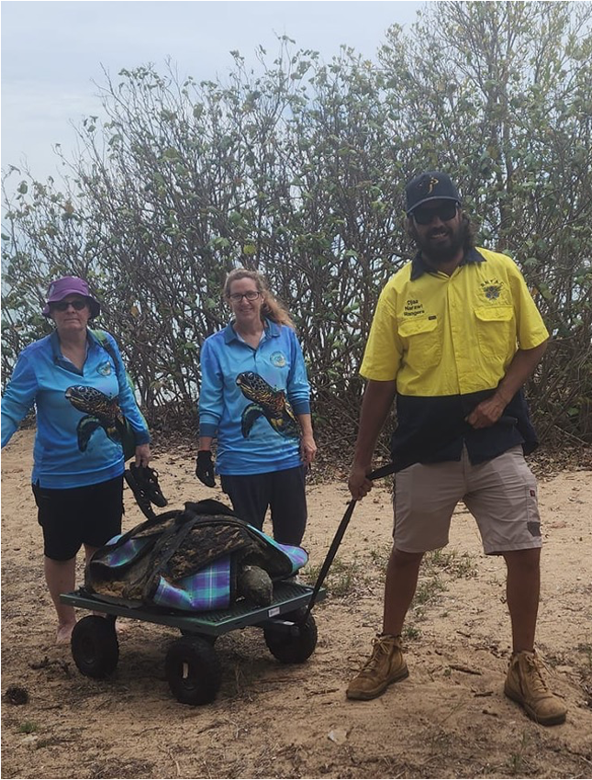
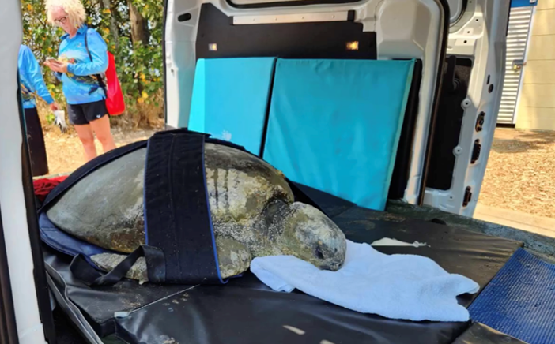
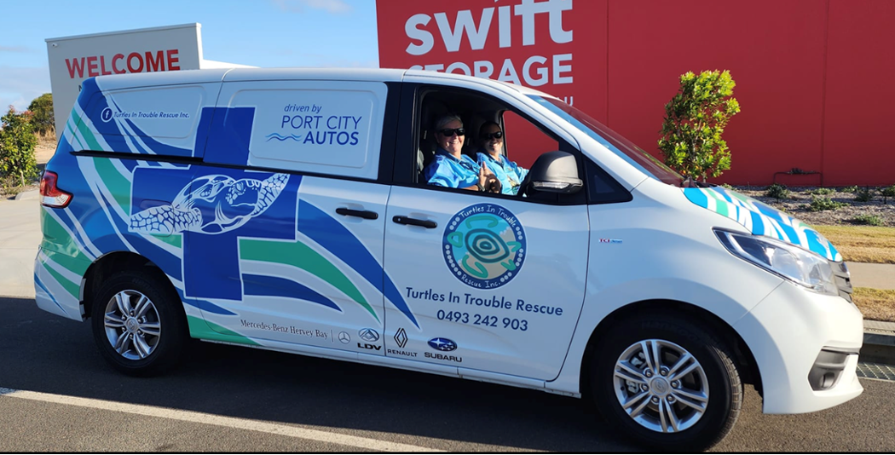
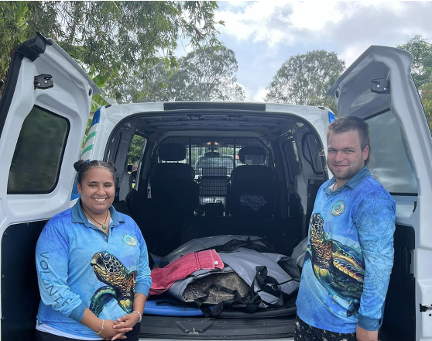
Transporting different sized turtles
Different transport strategies are used for different sized turtles, ensuring both the humans and turtles are kept safe.
1
2
3
4
4
10
Images from Turtles in Trouble
Notes:
The way a turtle is transported can depend on a few important factors, including how far and how quickly it needs to be moved. Rescue teams also need to consider the turtle’s size, such as how wide, long, and heavy it is, as well as the resources available at the time. They also have to make sure the transport method keeps both the turtle and the people handling it safe.
The images you can see here were taken in Hervey Bay, where the Turtles in Trouble team use a variety of transport methods.
In image 1, a smaller turtle is carefully moved using a beach towel, with support from two members of the Marine Strandings Team.
In image 2, a medium-sized turtle is transported using a picnic blanket and a flat trolley. This method is particularly useful for moving the turtle across soft, sandy areas, where carrying it by hand would be more difficult and tiring.
In image 3, a larger turtle is secured in a Velcro harness and placed on a sliding trolley. Because of the size of this Loggerhead turtle’s head, a pillow is also used to provide extra support when it is out of the water.
Finally, in image 4, you can see a dedicated turtle ambulance. Most larger turtles are transported using this specialised vehicle to ensure they can be moved safely and efficiently.
Photo credits: Turtles in Trouble

Slide 11
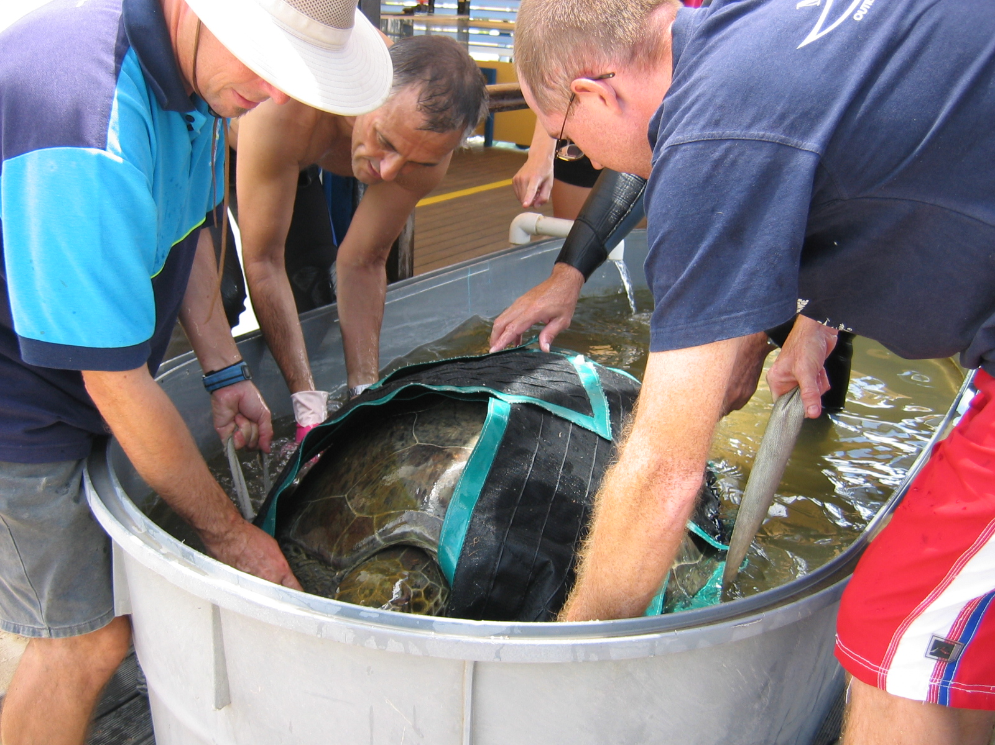
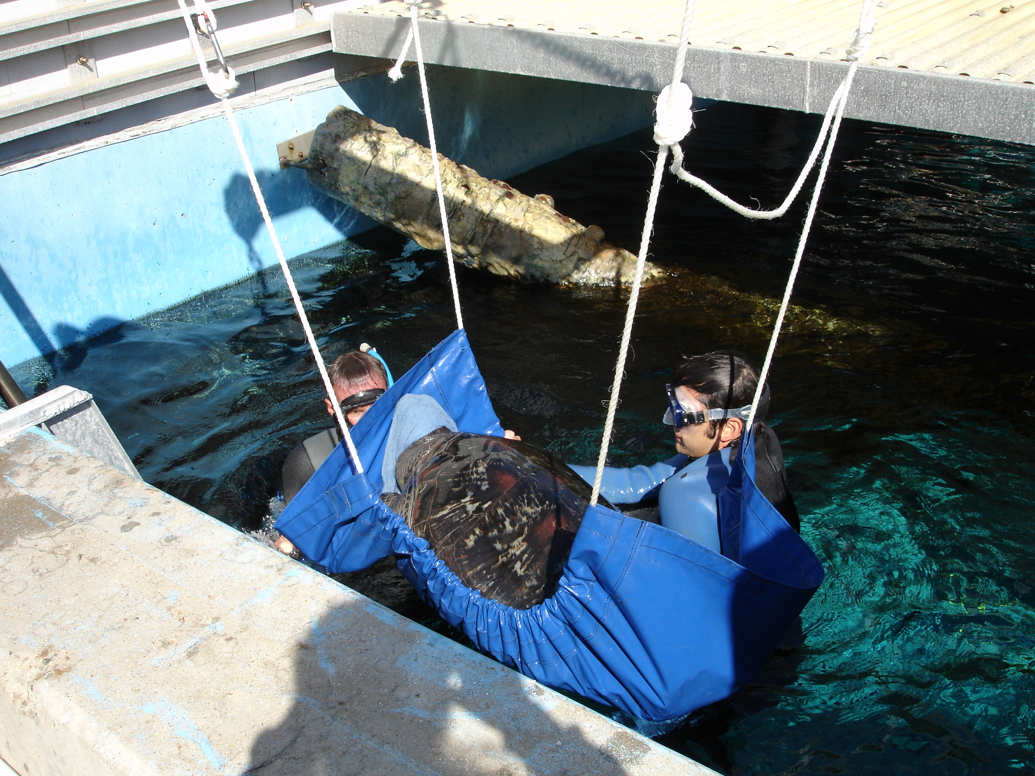
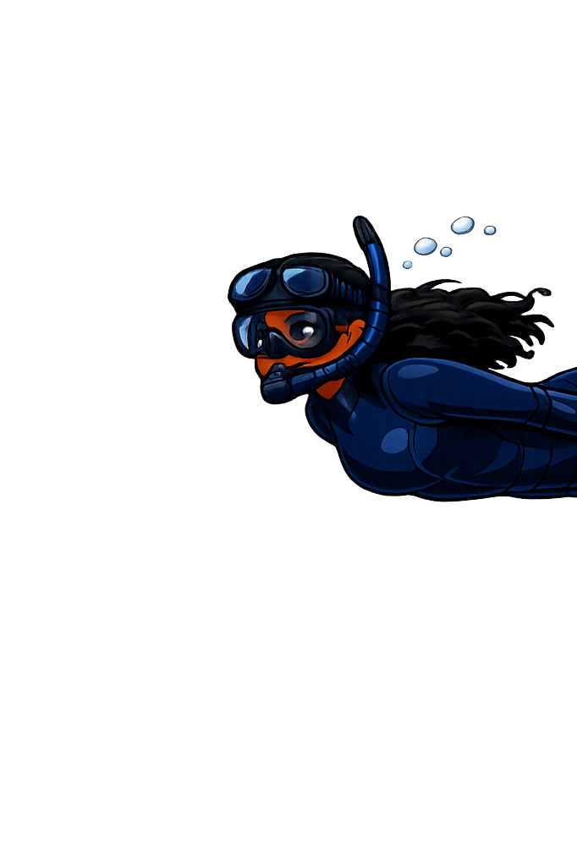
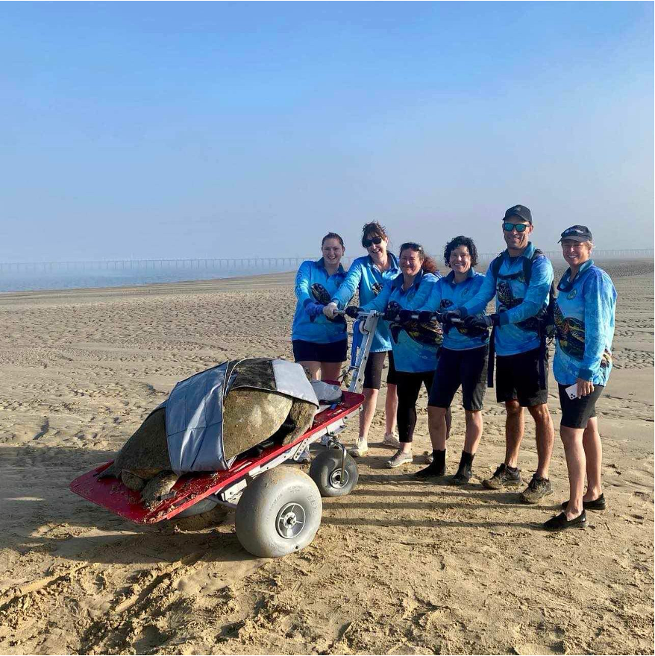
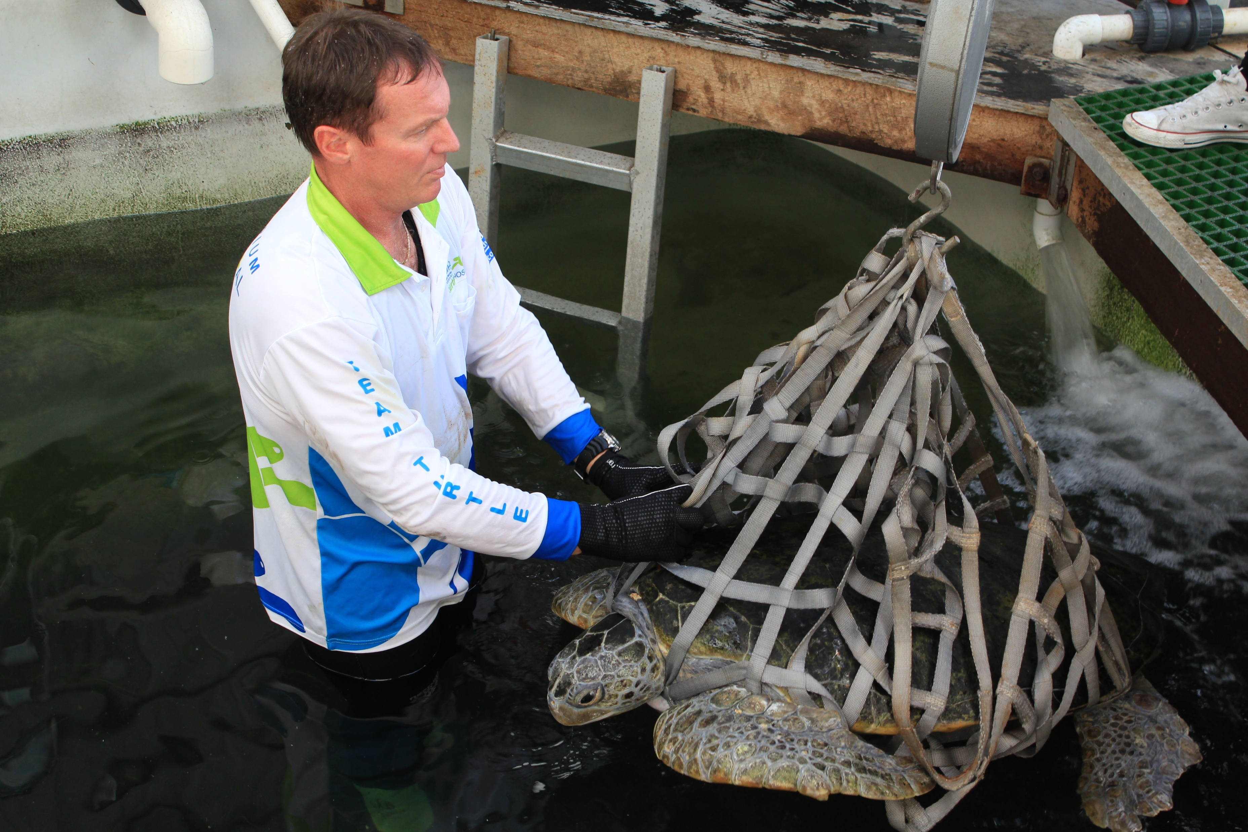
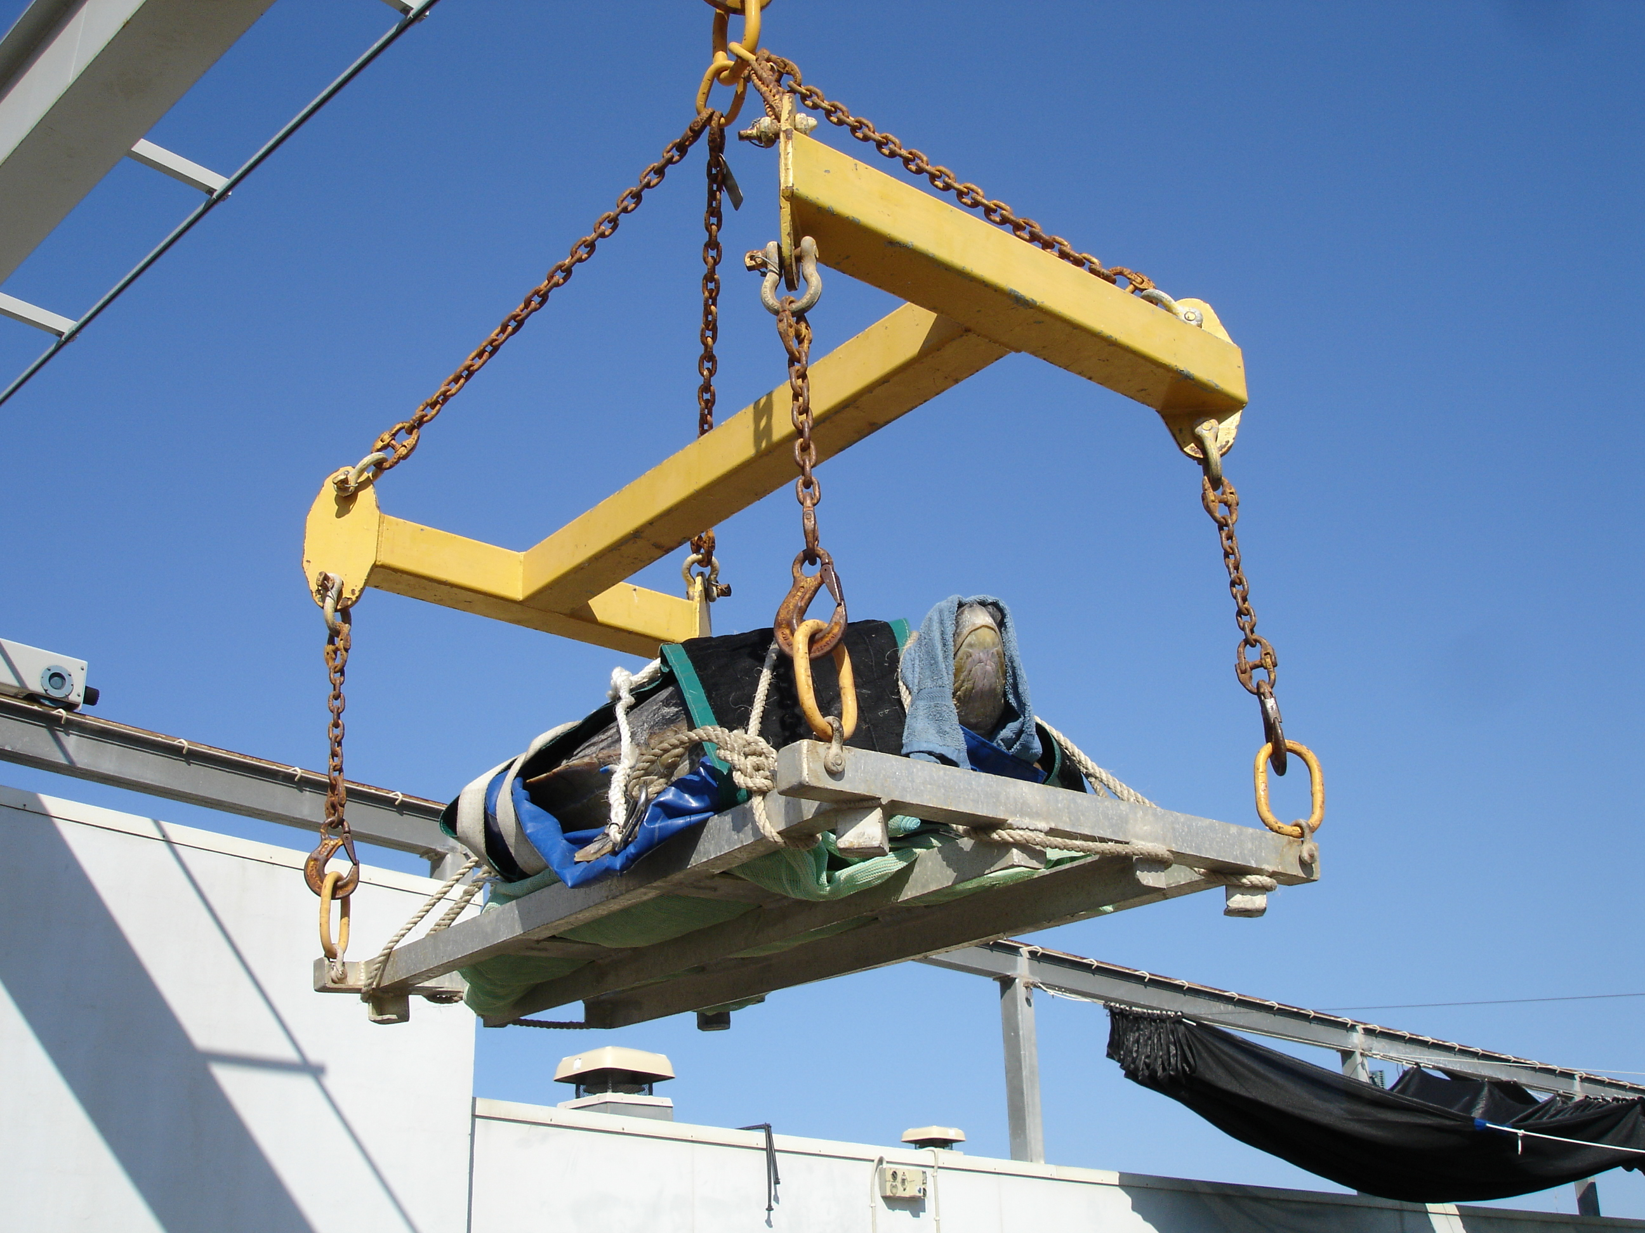
Super sized!
Some situations call for specialised equipment – but there are no shops that stock turtle specific lifting devices.
2.
4.
1.
3.
5.
Notes:
When it comes to moving very large, stranded turtles, rescue teams often need to get creative.
A range of different methods have been trialed to safely lift and move these turtles onto transport vehicles.
All of the images on this slide show different types of slings or harnesses. As you look at each one, notice how the lifting method changes depending on the situation and the equipment available.
In the first image, the Turtles in Trouble team used a three-wheeled beach cart combined with a four-way Velcro harness to help move this turtle over the soft beach sand.
In image 2, the team at Reef HQ used a four-way Velcro harness supported by four people to carefully list and manoeuvre the turtle.
In image 3, Reef HQ Turtle Hospital team used a mesh sling along with a hydraulic hoist, allowing the turtle to be lifted more easily with mechanical support.
In image 4, The Reef HQ team used a canvas sling and ropes attached to a hoist to lift and move the turtle.
Finally, in image 5, this very large turtle required a specially constructed platform and a crane to safely move it onto a transport vehicle.
As you look at these different methods, think about what makes each one effective.
Which do you think is the most successful?
And can you think of any other ways this could be done?
Photo credits: Turtles in Trouble and Great Barrier Reef Aquarium

Slide 12
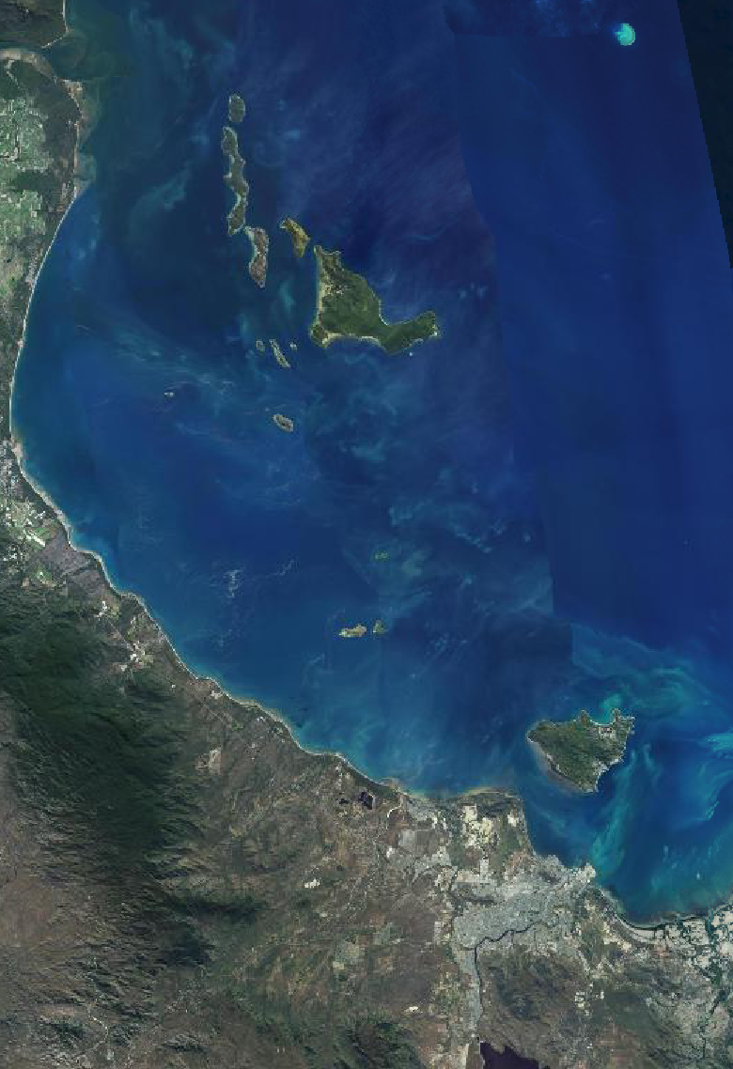
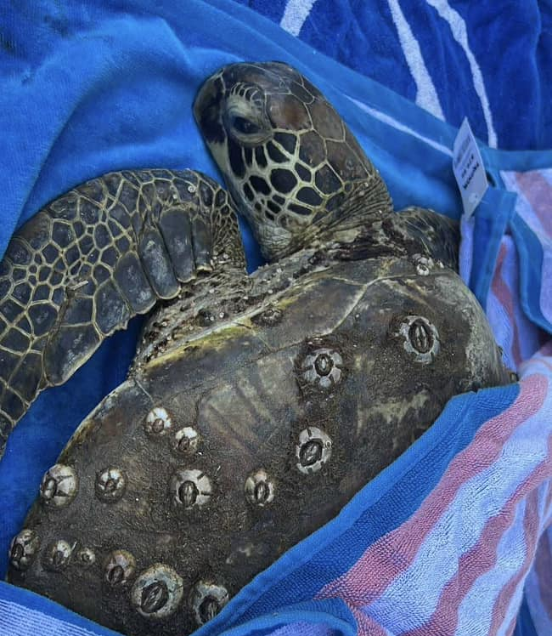
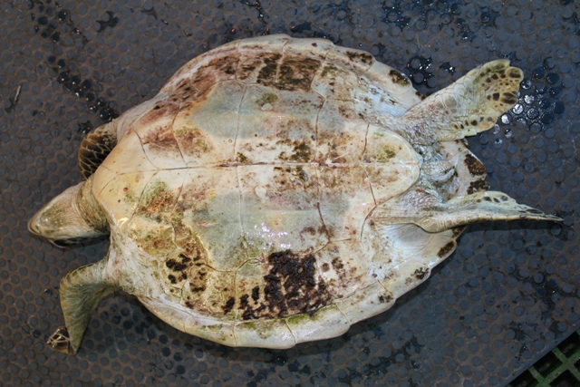
STRANDED:
GREEN SEA TURTLE - STACEY SUNSHINE
Goolboddi Island
TOWNSVILLE
Veterinary Hospital
Stacey how she was found, upside down and underweight
Stacey – before treatment
Map of Stacey’s major moves
Notes:
Now, let’s take a closer look at a real Green Sea Turtle rescue story.
This turtle was named Stacey Sunshine by her rescuers.
Stacey was found on Goolboddi, also known as Orpheus Island, after becoming stranded and in serious need of help.
When rescuers came across her, she was in very poor condition, she was exhausted, very underweight, had been flipped upside down, and had been washed up onto the shore by the tide.
Her shell was also covered in barnacles. Now, that might not sound like a big deal, but it actually tells us something important. A healthy turtle will usually rub against rocks to keep its shell clean, so this was a clear sign that Stacey hadn’t been able to do that for quite some time.
Because she needed urgent care, Stacey had to be transported to the mainland. And this wasn’t simple, it involved a small boat, a ferry and a utility vehicle, before she finally arrived at a veterinary hospital in Townsville.
Photo credits: Great Barrier Reef Aquarium

Slide 13
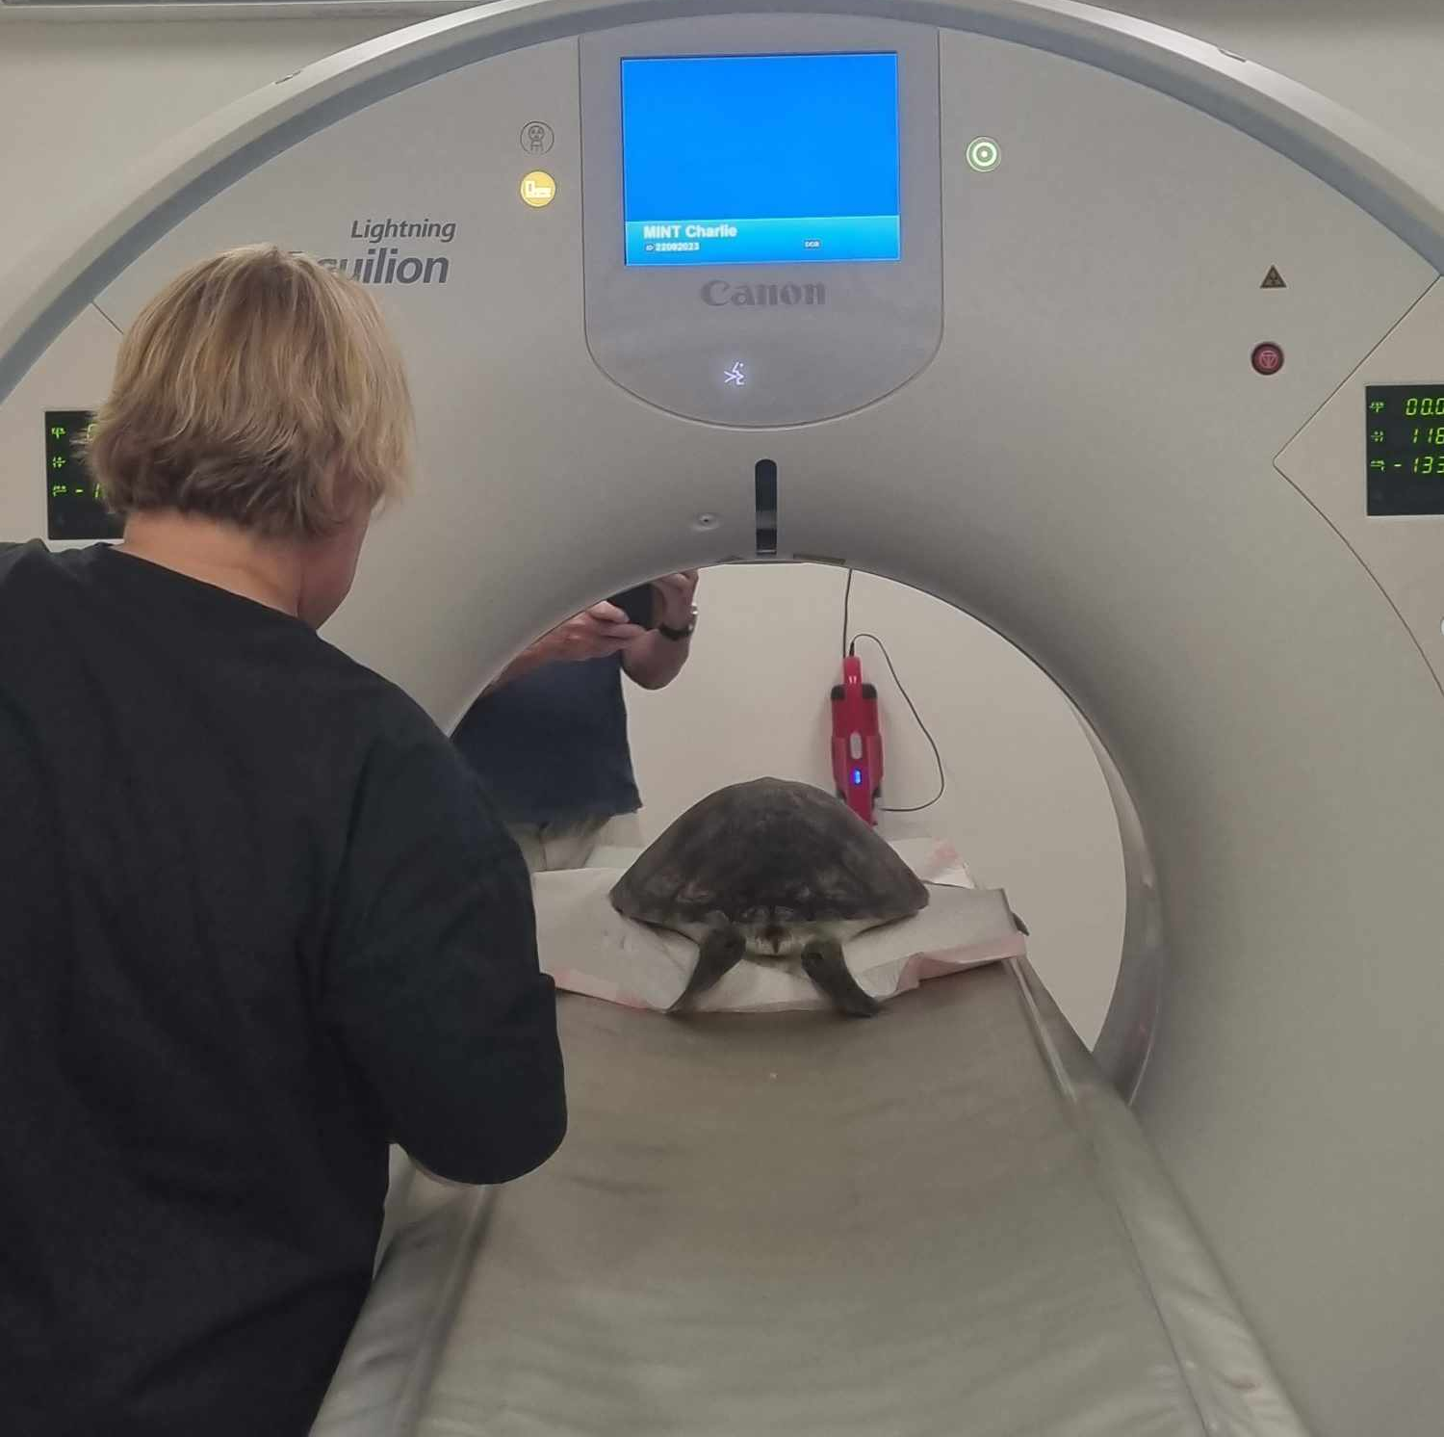
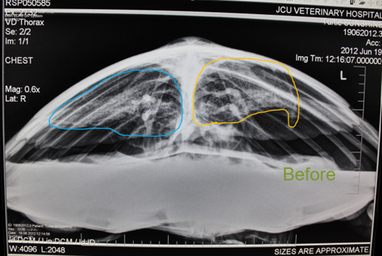


Stacey Sunshine
X-rays and blood tests showed:
  Collapsed lung
  Infection
  Leading to floating syndrome
Turtle undertaking veterinary scans
Stacey Sunshine initial x-ray – showing her collapsed lungs
Stacey Sunshine while recovering at the Great Barrier Reef Aquarium – this specalised platform was used to allow her to rest at the surface.
Stacey Sunshine chest x-ray shortly before her release – showing healthy lungs
Notes:
Once Stacey arrived at the vet, she was transported with a veterinary trolley, to allow the team carried out scans and began treatment.
These scans showed that she had a collapsed lung and an infection. This caused something called floating syndrome, which meant she couldn’t dive properly.
And if a turtle can’t dive, it can’t hunt for food, rest safely underwater, or stay healthy, which explains why she was in such poor condition.
After her initial treatment, Stacey was transferred to the Great Barrier Reef Aquarium Turtle Hospital, via utility vehicle, for rehabilitation, where she stayed for six months.
During this time, she was given a healthy diet to help her regain strength and body weight, along with antibiotics to treat the infection.
The goal the whole time was to make sure she was strong enough to survive on her own again and be able to dive, find food, and seek shelter in the wild.
Photo credits: Great Barrier Reef Aquarium and Magnetic Island Network for Turtles

Slide 14



Stacey Sunshine release
Stacey went from a hungry 8.8kg turtle
to a healthy 12.6kg turtle, after 6 months
in care, Stacey was finally released back
on Goolboddi (Orpheus) Island where she
was originally stranded.
Stacey Sunshine shortly before her release from the Great Barrier Reef Aquarium Turtle Hospital
The Great Barrier Reef Aquarium Turtle Hospital Ute, used to transport turtles for release
Notes:
After months of care and rehabilitation, Stacey had finally regained her strength and reached a healthy weight.
She was able to dive properly again, find food, and behave like a healthy turtle, everything she needed to survive back in the wild.
Once the vets were confident in her recovery and gave her full clearance, it was time for Stacey to go home.
She was carefully transported back to where she was originally found on Goolboddi (Orpheus Island). This journey involved a utility vehicle, a ferry, and a small boat to reach the island.
And finally, after everything she had been through, Stacey was successfully released back into the ocean.
Photo credits: Great Barrier Reef Aquarium

Slide 15






Celebrate a green turtle release!
1
2
3
4
5
15
Notes:
When turtles like Stacey Sunshine have fully recovered, they undergo final health checks before being transported and returned to the beach where they were originally found.
At the release site, the turtles are given time to rest on the beach. This allows them time to reset their internal navigation system, which uses the Earth’s magnetic field and helps them orient themselves before heading back into the ocean.
If you click on the triangle above, you can watch a short video of the Magnetic Island Network for Turtles celebrating the release of another Green Sea Turtle named Honey. It’s a great example of what a successful rehabilitation journey can look like.
Turtle rescue groups and rehabilitation hospitals play a vital role in protecting marine turtles.
Recently, Green Sea Turtles have been removed from the IUCN Red List for endangered species, with their status downgraded from Endangered to Least Concern. This is a powerful example of how conservation efforts and rehabilitation programs are making a real and positive difference. However, these programs would not be successful without the devices and methods available to safely transport turtles to and from care and medical treatment.
Images:
Turtle undergoing final health checks, including measuring carapace length, before release at the Great Barrier Reef Aquarium Turtle Hospital.
Turtle named “Big Girl” released with a radio tracker to monitor her movements in the wild.
Stacey Sunshine on her journey back out to sea at Orpheus Island.
Turtle being carefully released by Great Barrier Reef Aquarium Turtle Hospital staff.
Turtle being released back into the wild on Magnetic Island.
Photo credits: Great Barrier Reef Aquarium and Magnetic Island Network for Turtles

Slide 16

Learning Intention:
To explore how and why Green Sea
Turtles would need transporting.
Success Criteria
I can recall a fun fact about Green Sea Turtles.
I can identify more than one reason that
Green Sea Turtles would need transportation.
I can list at least one method used to transport
Green Sea Turtles.
16
Notes:
Today we have explored how and why Green Sea Turtles would need transporting.
Can anyone share a fun fact they’ve learned about turtles?
Allow students time to respond.
What about reasons why turtles might need to be transported—can anyone remember some of those?
And who can recall some of the different methods or equipment used to transport turtles?
Photo credits: Great Barrier Reef Aquarium

Slide 17
Unit Learning Intention:
To know why a chosen species might need to be transported.
To design, build, test, evaluate and communicate a new method of transporting a local wildlife animal.
Your Mission
Re-design or improve an existing method of transporting your focus animal.
Build, test and evaluate your design.
Present your designs to others.
Stacey Sunshine whilst undergoing rehabilitation at the Great Barrier Reef Aquarium Turtle Hospital
17
Notes:
This slide can be used if students will be designing or developing a new method of transport for a local or chosen species
Now that we’ve taken a close look at Green Sea Turtles and how they are transported for care and treatment, we’re going to use what we’ve learned to unit to improve an existing design for Green Sea Turtle or design a new transport method for a local chosen animal.
As a class, we’ll start by brainstorming animals that live in our local area and choose one species to focus on for our designs.
Once we have chosen our focus animal, you will do some research to understand it better. Including:
- Why it might need to be transported
- What current methods are used to move this animal
- The characteristics of the animal that could affect your design
After your research, you’ll brainstorm and design a new method to safely transport your animal. You’ll have the chance to build and test a prototype, make any modifications needed, and finally present your design to the class (or even to a wildlife expert) at the end of the project.
As you develop your designs, remember to consider the specific characteristics of your animal, such as how it breathes, whether it needs to stay in water, its size and weight, and whether it could pose any risk to the people transporting it.
Click on the blue triangle to view the student planning workbook.
Photo credits: Great Barrier Reef Aquarium

Slide 18

Brainstorm
What are some animals found in our local area?
18
Notes:
This slide can be used if students will be designing or developing a new method of transport for a local or chosen species
Now we can begin exploring some animals that live in our local area and decide which species we will focus on for our designs.
Does anyone want to name some animals found in our area? You might like to write these down in your workbooks.
Encourage students to start a discussion about the different animal species in the local area.
If you prefer not to focus on a local species, students can also discuss other groups of animals, such as marine species, endangered species, or animals from another location of their choice.
Now that we have a list of animals, let’s talk about which one we will choose for our designs.
Does anyone want to share which animal they would like to focus on and why?
(note younger students or student requiring heavy scaffolding can choose to adapt and improve transportation for the Green Sea Turtle).
Have a class discussion to decide which animal will be the focus and the reasons for the choice.
Alternatively, you can select a focus animal if there is a specific species you would like students to work with.
Students can then add an image of their chosen animal to their student workbooks. They can also be encouraged to label the key characteristics of their animal. This can be completed in class, as homework, or in Lesson 2.
In the next lesson, we will research our chosen animal in more detail to learn about its specific characteristics and the special considerations needed when designing devices and methods for its transport.

Slide 19
Wildlife Emergency Express – resources and references
Wildlife Emergency Express -Teacher Resource Guide - 1 of 3 resources | Reef Guardian School
Wildlife Emergency Express- Student Planning Booklet - 2 of 3 resources | Reef Guardian School
IUCN Red List, 2025. Chelonia mydas (Green Turtle)
Green Sea Turtle - Kim's Marine Bio – habitat map
Magnetic Island Network for Turtles: Honey’s Release - MINT Release video
Reef Guardian School - Homepage | Reef Guardian School
Turtle Connections Virtual Learning Experience Flyer
Additional resources and links can be found in the Teacher Resource
Sources of photos, used with permission:
Great Barrier Reef Marine Park Authority
Magnetic Island Network for Turtles - Facebook
Turtle in Trouble Rescue Inc – Wide Bay Region - Facebook

Slide 20
Weighing Up Wildlife – Powerpoint Curriculum Links
 | F | 1 | 2 | 3 | 4 | 5 | 6 | 7 | 8
Technology ACARA V9.0 | AC9TDEFP01 | AC9TDE2K02 AC9TDE2P03 | AC9TDE2K02 AC9TDE2P03 | AC9TDE4K02 AC9TDE4P01 AC9TDE4P04 | AC9TDE4K02 AC9TDE4P01 AC9TDE4P04 | AC9TDE6P01 AC9TDE6P04 AC9TDE6P05 | AC9TDE6P01 AC9TDE6P04 AC9TDE6P05 | AC9TDE8K06 AC9TDE8P01 AC9TDE8P04 | AC9TDE8K06 AC9TDE8P01 AC9TDE8P04
Science ACARA V9.0 | AC9SFU01 AC9SFU02 AC9SFI02 AC9SFI04 AC9SFI05 | AC9S1U01 AC9S1U03 AC9S1I01 AC9S1I05 AC9S1I06 | AC9S2U03 AC9S2I01 AC9S2I05 AC9S2I06 | AC9S3H02 AC9S3I02 AC9S3I05 AC9S3I06 | AC9S4H02 AC9S4U03, AC9S4I02 AC9S4I05 AC9S4I06 | AC9S5U01 AC9S5H02 AC9S5I05 AC9S5I06 | AC9S6U01 AC9S6H02 AC9S6I05 AC9S6I06 | AC9S7U04 AC9S7H02 AC9S7I06 AC9S7I08 | AC9S8U05 AC9S8H02 AC9S8I06 AC9S8I07 AC9S8I08
General Capabilities - All Year levels- Critical and Creative Thinking – Generating- Critical and Creative Thinking
Cross-Curricula Priorities - All Year Levels:
Sustainability
Connects with Design (SD1, SD2 and SD3) and Futures (SF2)
Aboriginal and Torres Strait Islander Histories and Cultures
This unit offers an opportunity to explore the significant connection many Aboriginal and Torres Strait Islander groups have with marine turtles

