Slide 1
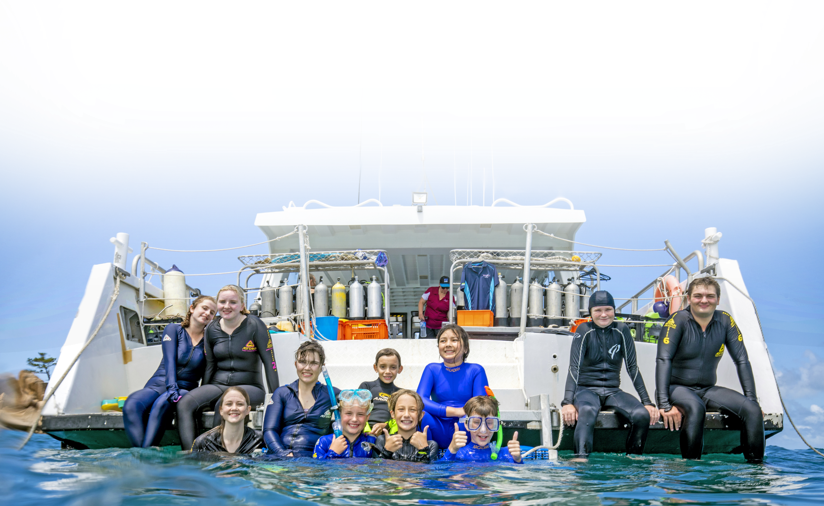


RAPID MONITORING
& BE A MARINE BIOLOGIST FOR A DAY
Notes:
Rapid Monitoring and Be a Marine Biologist for a Day (BAMBFAD)
Based on the Rapid Monitoring survey.
Aligned with the Australian Curriculum and scaffolded for different year levels.
Primary & middle school: typically complete the timed swim component.
Senior students (15+): usually undertake the full Rapid Monitoring survey.
Simplified survey slates are available for younger students as an alternative to the Rapid Monitoring slate.
While working through the presentation students / guests should have:
a Rapid Monitoring Survey slate - Rapid Monitoring [snorkel slate]
or a Be a Marine Biologist for a Day (BAMBFAD) slate - Rapid Monitoring: be a marine biologist for a day [snorkel slate]
or a paper version of a slate.

Slide 2
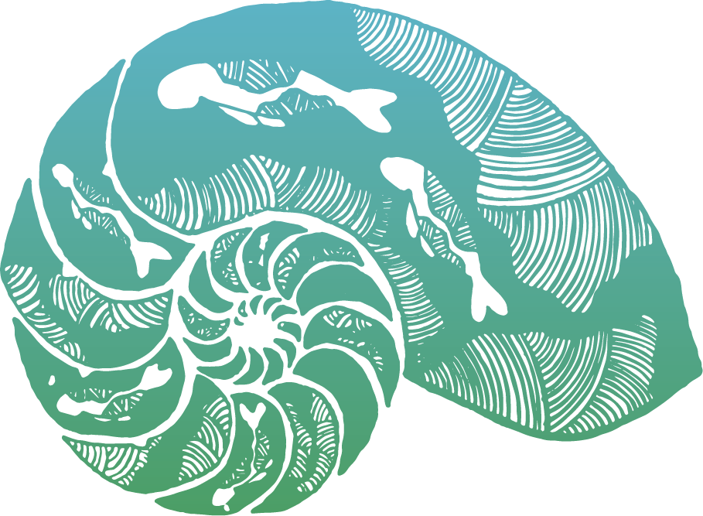
Acknowledgment of Country
We acknowledge the expertise, wisdom, and enduring connections that have informed the guardianship of the Reef for millennia.
We pay our respects to the Traditional Owners as the first managers of this Land and Sea Country, and value their traditional knowledge, which continues to inform the current management and stewardship of the Reef for future generations.
Notes:
Acknowledgment of Country
(You are welcome to use your own wording).
We acknowledge the expertise, wisdom, and enduring connections
that have informed the guardianship of the Reef for millennia.
We pay our respects to the Traditional Owners as the first managers of this Land and Sea Country,
and value their traditional knowledge, which continues to inform the current management
and stewardship of the Reef for future generations.

Slide 3
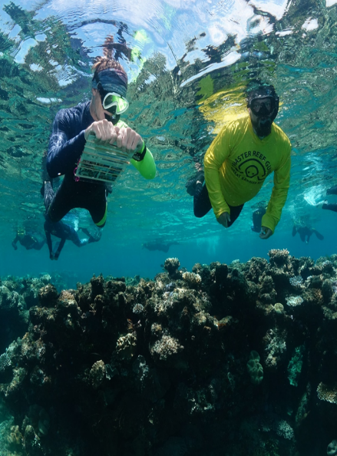
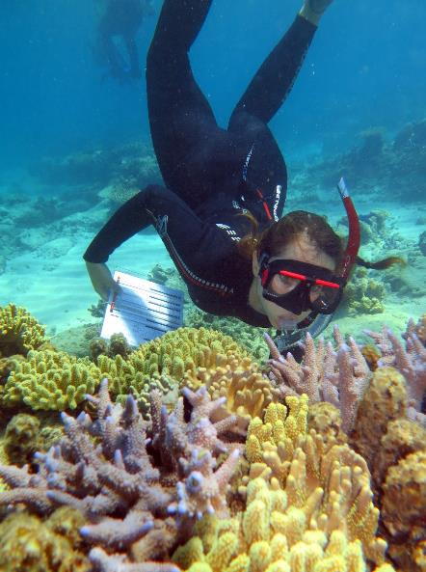
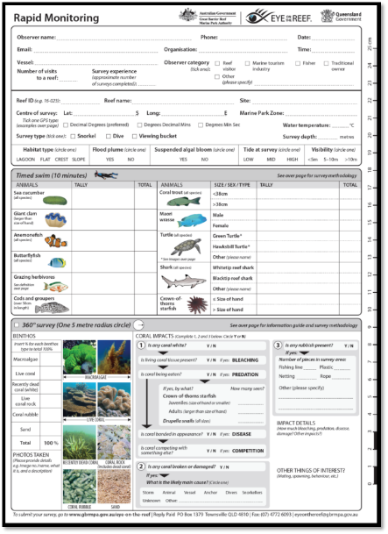
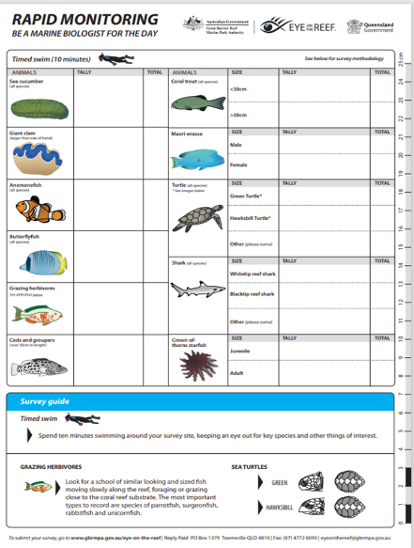

EYE ON THE REEF
The Reef Authority’s Eye on the Reef program enables anyone who visits the Great Barrier Reef to collect and contribute data that will help inform how it is managed.
You can help by:
Collecting citizen science data as part of a Rapid Monitoring survey.
Uploading your collected survey data to the Eye on the Reef.
You can also contribute by submitting sightings in the Eye on the Reef App.
Notes:
Eye on the Reef – Citizen Science
The Reef Authority’s Eye on the Reef program enables anyone visiting the Great Barrier Reef to collect data that helps inform Reef management.
Download the free Eye on the Reef App to:
Record reef health observations
Submit animal sightings
Report incidents
Visitors can also contribute through the Rapid Monitoring survey, designed for anyone to participate.
Survey data can also be submitted through the Eye on the Reef App.

Slide 4
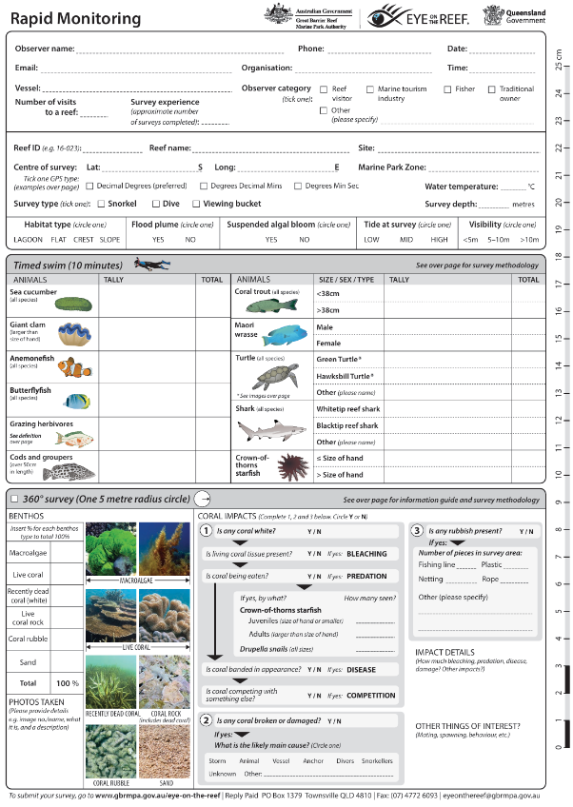
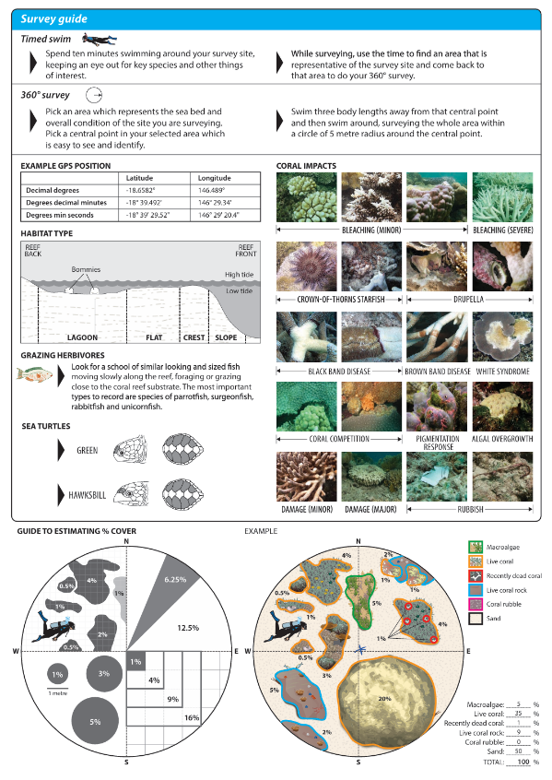
RAPID MONITORING SURVEY
Collects information on:
Reef health indicators.
Protected and iconic species.
Emerging reef health issues.
Used to:
Monitor the same site regularly to identify trends and changes over time.
Provide a snapshot of reef health at less frequently visited sites.
Notes:
The purpose of the Rapid Monitoring survey is to collect information about:
reef health indicators,
protected and iconic species,
emerging reef health issues.
It can be used to monitor the same site regularly and get an idea of trends or changes to that site over time.
Or it can be used to get a basic snapshot of reef health at less frequently visited sites.

Slide 5

RAPID MONITORING SURVEY
Observer and site information.
A 10-minute timed swim.
A 360º benthic survey.
Coral impacts and other things of interest.
Notes:
RAPID MONITORING SURVEY
The Rapid Monitoring survey includes several sections:
Surveyor and site information.
A 10-minute timed swim.
A 360^{O} benthic survey.
Coral impacts and other items of interest.
Be a Marine Biologist for a Day program (BAMBFAD):
Primary school students usually complete only the 10-minute timed swim.
This introduces target species identification and how to record observations.
If only doing the timed swim, skip ahead to
Part 2: 10-minute Timed Swim.

Slide 6
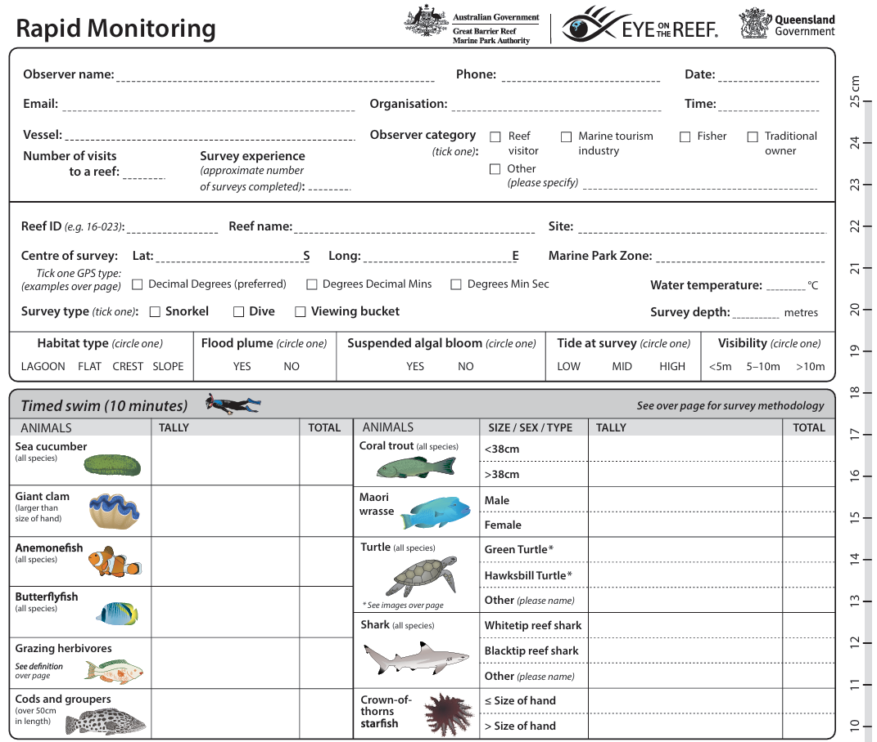
PART ONE: OBSERVER AND SITE INFORMATION
Fill out information about:
Observer details (yourself).
Organisation (if applicable).
Survey experience.
Reef and survey site.
Environmental conditions at the site.
a
PART TWO:
TIMED SWIM (10-MINUTES)
Record the presence of target species by tallying how many you see in 10 minutes.
Notes:
PART ONE: OBSERVER AND SITE INFORMATION
The first part to complete is the observer and site information. Fill out information about:
Observer (yourself), organisation (if applicable) and your survey experience.
The reef and site you are surveying, and the environmental conditions at the site.
PART TWO: 10-MINUTE TIME SWIM
During the timed swim you will record the presence of target species by tallying how many you see in 10 minutes.
There are simplified survey slates for Be a Marine Biologist for a Day (BAMBFAD).
Young primary students: record one target species per group using the BAMBFAD single-species slate. Combine class results to capture all indicator species.
Older primary & middle school: record all target species using the full BAMBFAD slate.
Senior students (15+ years): record all target species and complete the 360° benthic survey using the Rapid Monitoring slate.
Choose an option of slate:
Rapid Monitoring survey slate.
BAMBFAD slate – all indicator species.
BAMBFAD single species slate.
Support for Survey Completion:
*Assist students or guests by providing relevant information where needed. Use available resources to identify survey details, including:
Great Barrier Reef Marine Park Zoning Map
Eye on the Reef App
Vessel skipper (for Reef ID, Reef name, and Marine Park Zone).

Slide 7
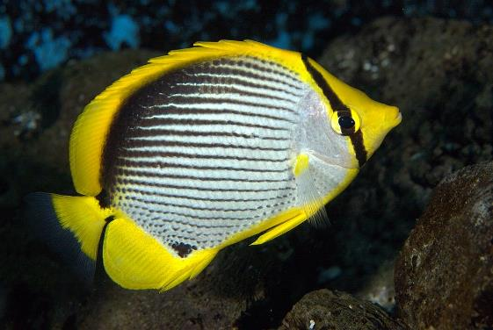
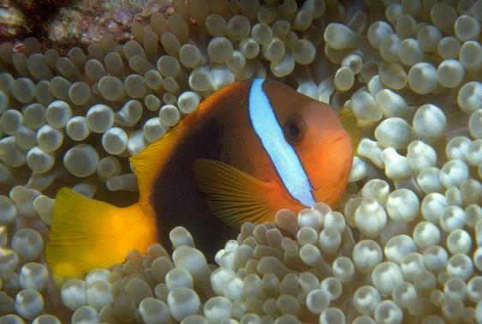
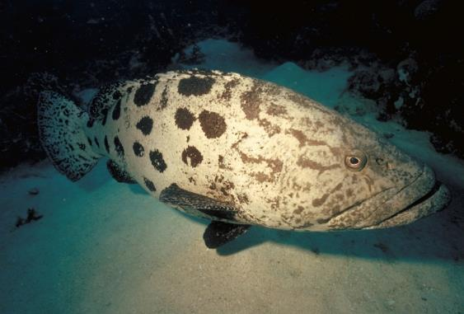
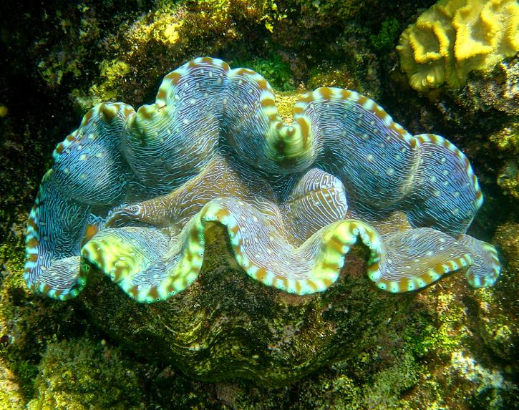
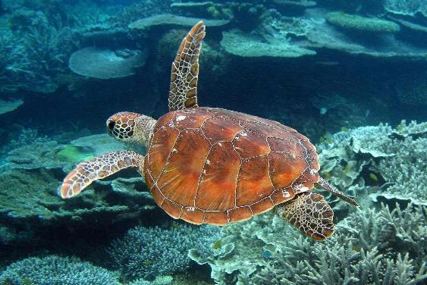
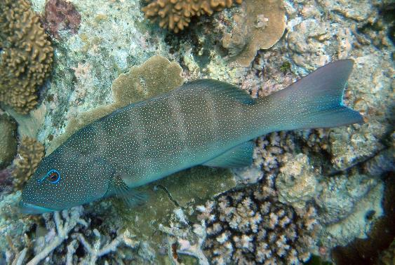
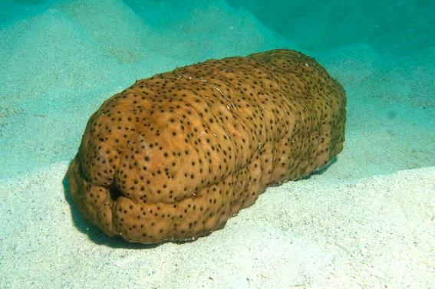
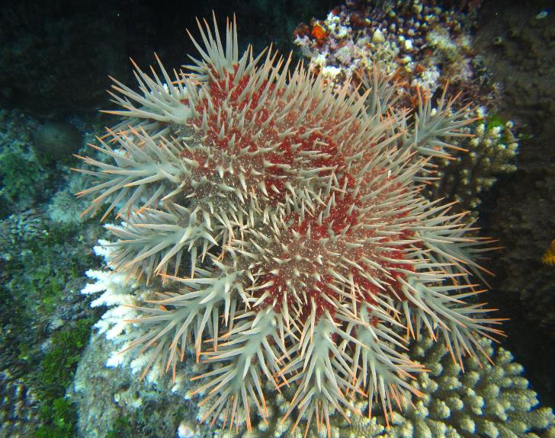
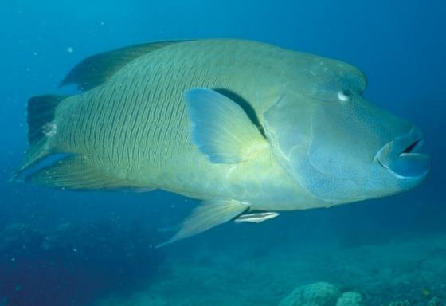
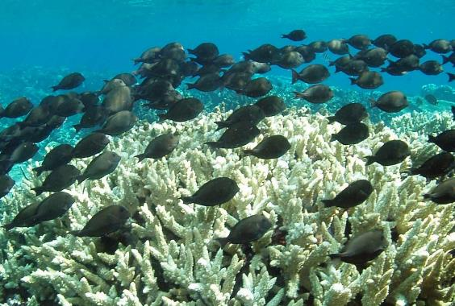
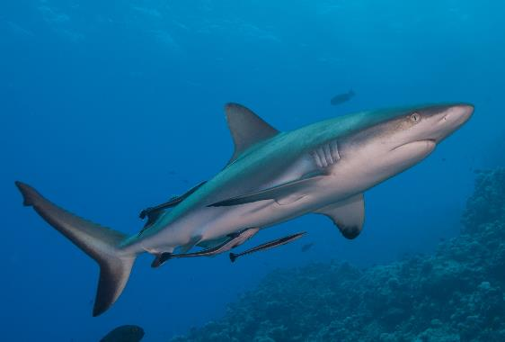
Animals to count during the 10-minute timed swim
Butterflyfish
Anemonefish
Cods and groupers
Giant clams
Turtles
Coral trout
Sea cucumbers
Māori wrasse
Grazing herbivores
Sharks
Crown-of-thorns starfish
Notes:
Animals during the 10-minute timed swim
These are the target species that we record during the10-minute timed swim:
Butterflyfish
Anemonefish
Cods and groupers
Giant clams
Turtles
Coral trout
Sea cucumbers
Māori wrasse
Grazing herbivores
Sharks
Crown-of-thorns starfish
You are unlikely to see all 11 target species during the 10-minute timed swim.
You may only observe a few of the indicator groups.
Do not include animals seen after the timed swim in your count.
Record these sightings in the “Other Items of Interest” section at the bottom of the survey.
Why do we count these species?
Reef health indicators.
Endangered status.
Contribute to reef health.
Iconic species.
Commercial value.
Popular with tourists.

Slide 8
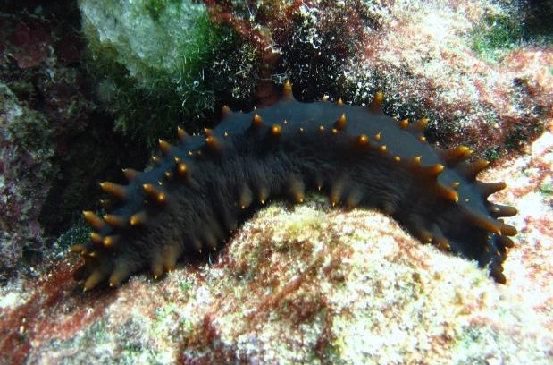
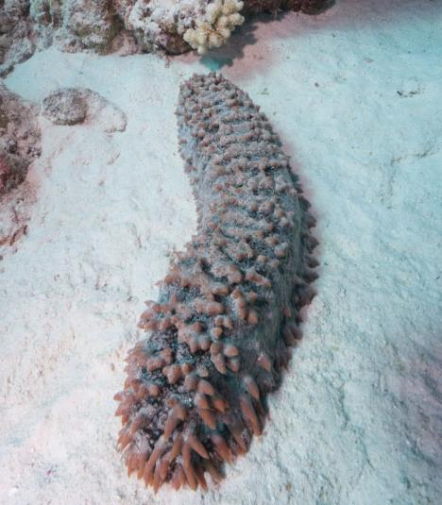
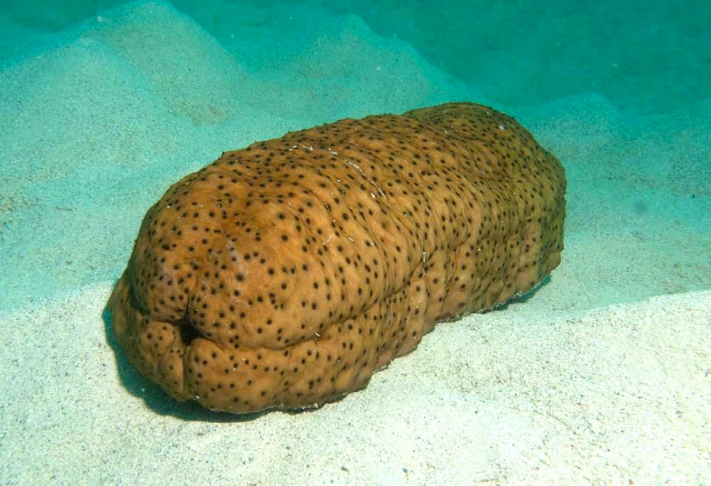
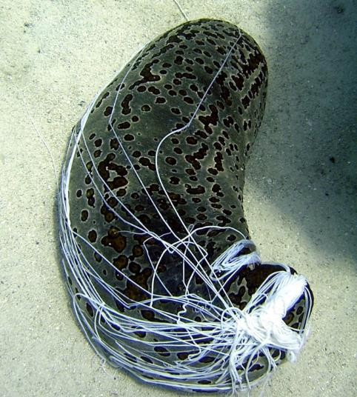
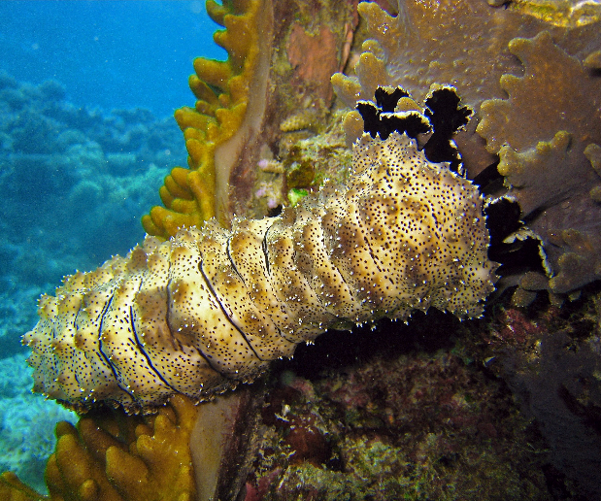
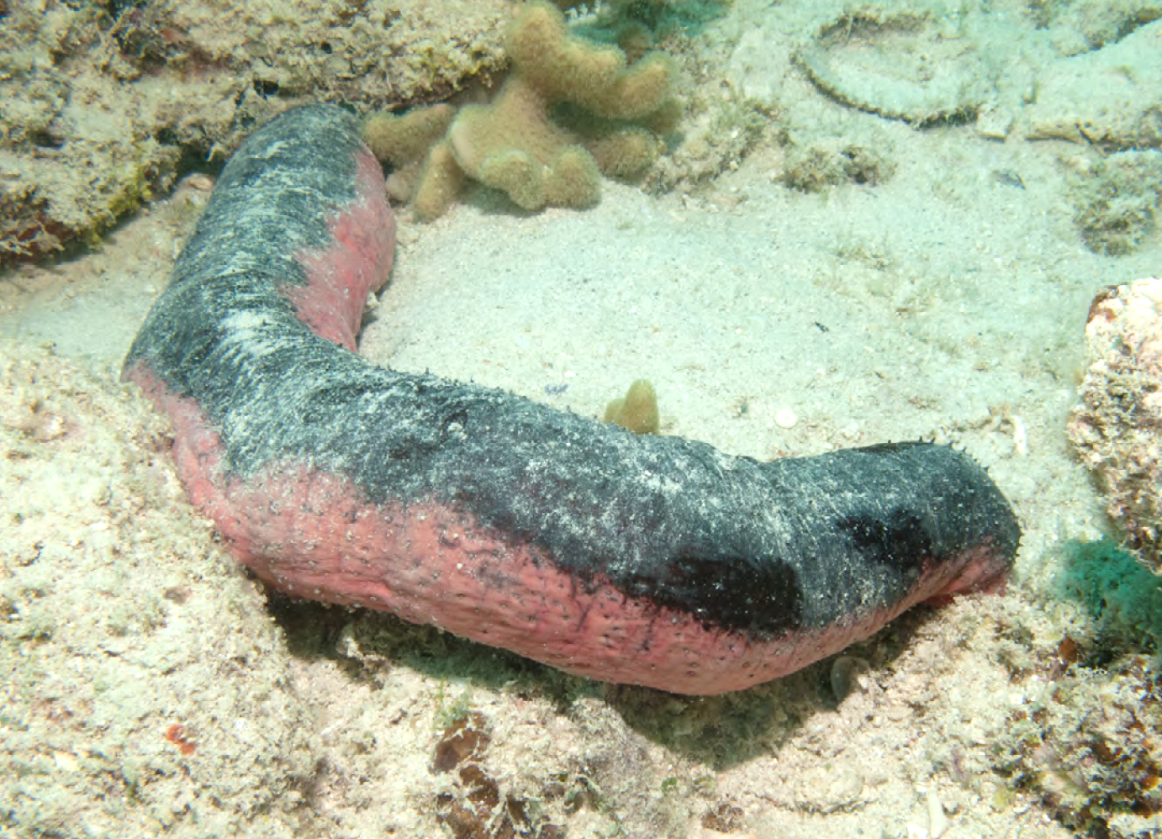
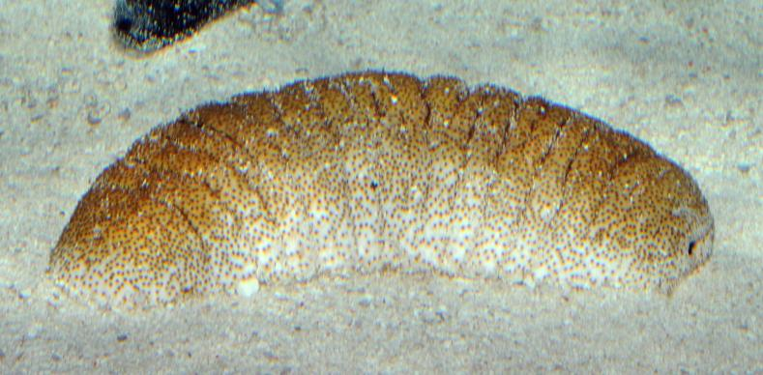
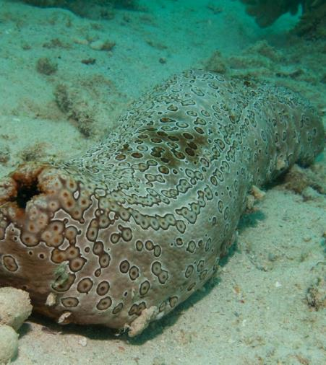
SEA CUCUMBERS
Soft cylindrical body. Most look-like large worms or caterpillars.
Move using tube feet and rhythmic contractions.
Size: up to100cm
Typically: 30 cm
Breathe by taking in water through their anus.
Feeding tentacles
Anus
Cuvierian tubules
Notes:
Why do we count them?
Sea cucumbers act like the vacuum cleaners of the sea.
They digest organic matter from sand, helping remove nutrients and keep the seabed clean.
They don't migrate, so if they go missing, it tells us something is wrong.
Where to look:
Usually found on the sandy seafloor.
Sometimes on coral rock and coral crevices.
Some burrow under the sand and are difficult to spot.
Look for a cylindrical caterpillar-like animal.
If there is little or no sand at your site, you might not see many.
Additional information:
They come in a variety of colours and sizes.
Some species can grow over 1 metre, but most are around 50-60 cm in length.
Record all that you see.
Fun Facts:
Sea cucumbers are echinoderms, related to sea stars and sea urchins.
They occupy an ecological niche like earthworms on land, helping to recycle nutrients.
They breathe by drawing water in and out of their anus using an organ called a respiratory tree.
For defence, they can eject sticky tubules or internal organs to deter predators.
Some species are commercially harvested for food (trepang or bêche-de-mer).

Slide 9
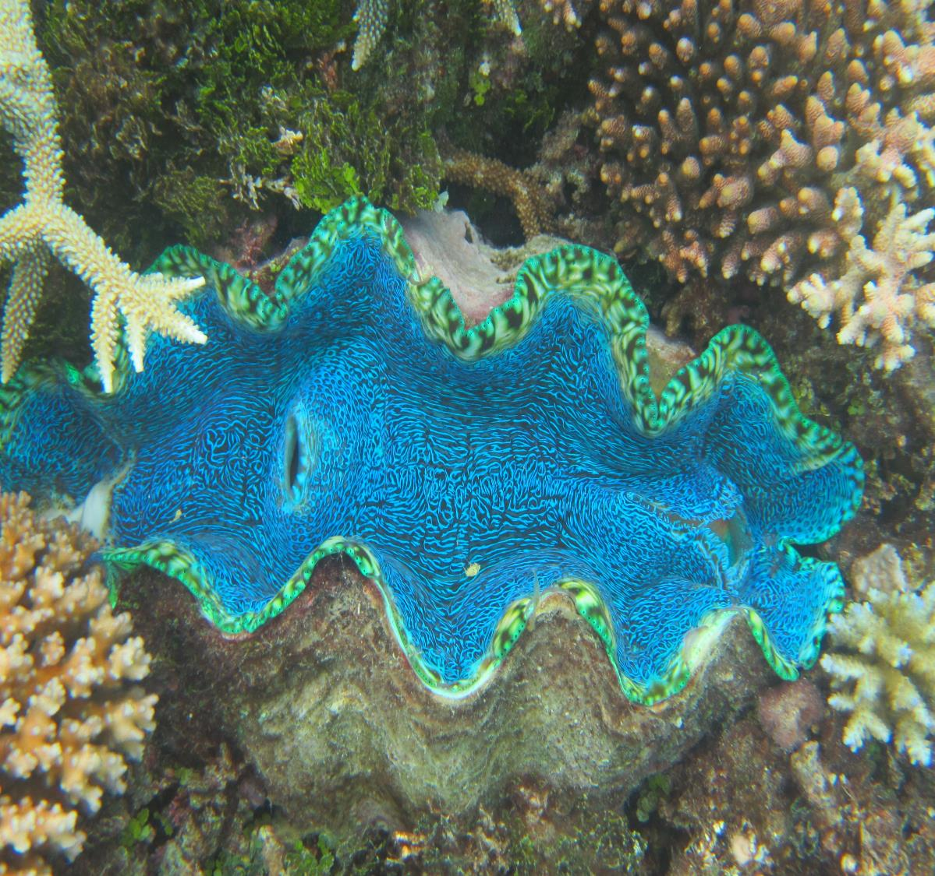
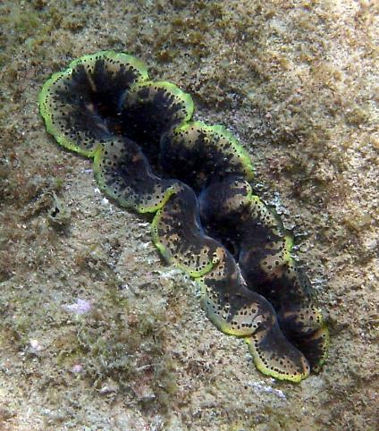
GIANT CLAMS
Colours and pattens are produced by symbiotic algae and light refraction in iridocyte cells.
Symbiotic algae in the mantle produce nutrients through photosynthesis.
Inhalant siphon draws in water to filter for food and oxygen.
Exhalent siphon expels filtered water.
Size: up to140 cm
Weight: up to 250kg
Age: 70 years+
Record all giant clams larger than the size of your hand.
Do not count burrowing clams.
Shell is made of two thick wavy valves.
Notes:
Why do we count them?
Giant clams are protected and iconic reef species.
They filter water and remove excess nutrients, helping limit algal growth.
Giant Clams can bleach when stressed.
Because they are long-lived and don’t move, declines may indicate reef health issues.
Empty shells can signal past stress events such as bleaching, flood plumes or extreme weather.
Where to look:
Found on the hard reef or sandy seafloor to a depth of up to
20 metres.
Additional information:
Reminder: only count giant clams larger than your hand.
Don’t count the burrowing clams in coral or coral rock. They are much smaller than giant clams and only grow to around 20 cm.
Fun Facts:
Giant clams are molluscs, related to sea snails, octopus and squid.
They are the largest species of bivalve (meaning “two-doors” shells).
Most of their energy comes from symbiotic algae (Symbiodinaceae) in their tissues that produce sugars through photosynthesis.
They also filter feed, drawing water in through an inhalant siphon and expelling it through an exhalant siphon.
A single giant clam can filter hundreds of litres of water each day.

Slide 10
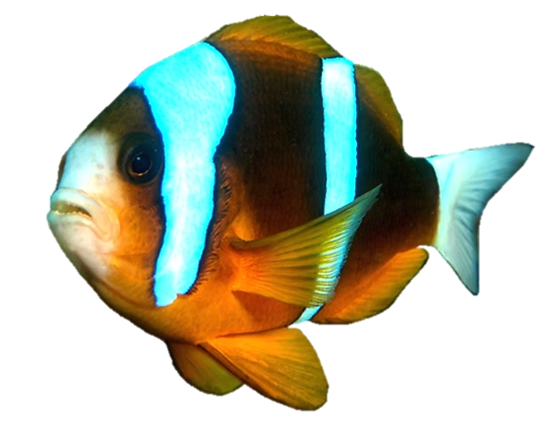
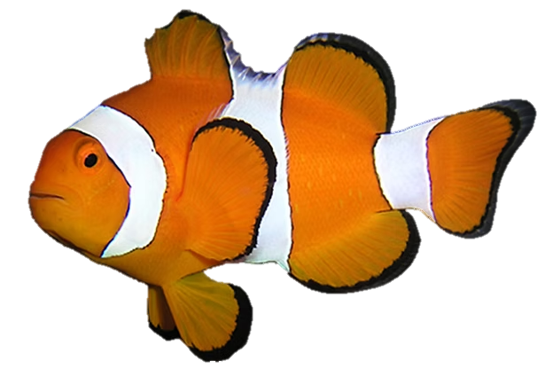
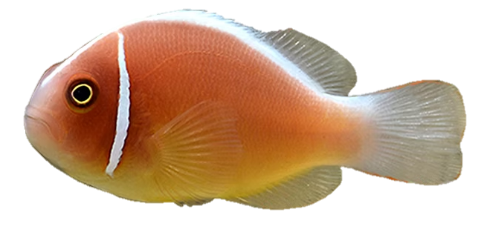
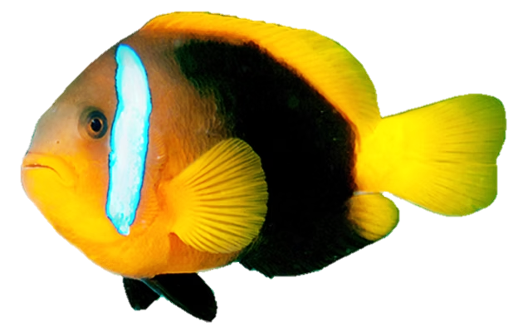
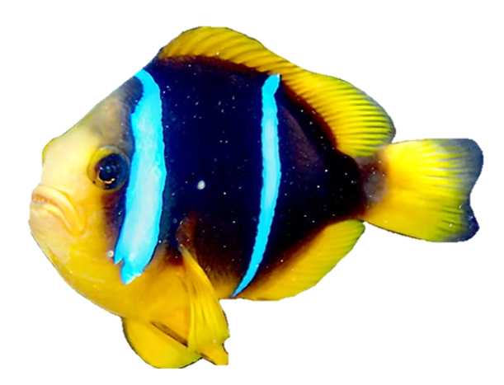
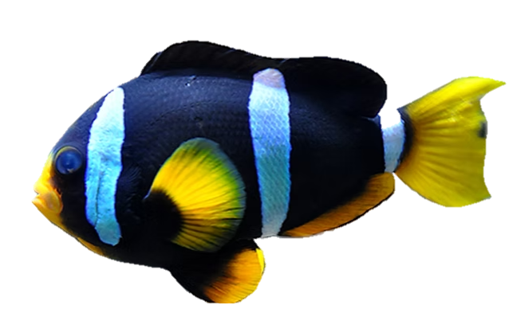
ANEMONEFISH
Only live in
sea anemones.
Their protective mucus prevents the anemone from stinging them.
Pink anemonefish
Great Barrier Reef anemonefish
Clown anemonefish
Often live in pairs, or with several juveniles.
Red and black anemonefish
Yellow-finned anemonefish
Clark’s
anemonefish
The female is the largest fish.
Have one, two, or three, white stripes.
Notes:
Why do we count them?
Anemonefish only live in sea anemones.
They are an iconic reef fish (e.g. Nemo from Finding Nemo).
Anemones are long-lived and are susceptible to bleaching. If anemones go missing or die, anemonefish will have nowhere to live.
Seeing anemonefish can be a sign that the reef is not heavily impacted by human activity or environmental stressors.
Where to look:
Anemonefish are territorial, usually found within 1m of their host anemone, often hidden amongst the coral and coral rock.
When threatened, anemonefish will hide in the anemone for protection.
Additional information:
Remember to count the anemonefish (not the anemone).
There are 7 species of anemone fish found on the Great Barrier Reef.
Count all species that you see.
Fun Facts:
Anemonefish and anemones have a symbiotic (mutually beneficial) relationship.
The anemone provides protection with its stinging tentacles.
The anemonefish cleans, defends, and provides food to the anemone.
Each anemone hosts a family group of non-related anemonefish.
The largest fish is the female, followed by the breeding male; others are immature males.
If the female dies, the dominant male changes sex to become the female (within about a month).

Slide 11
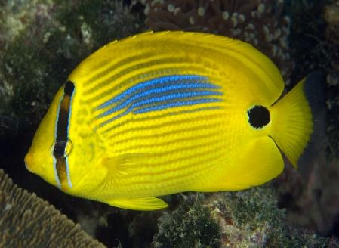
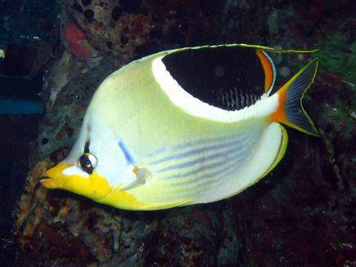
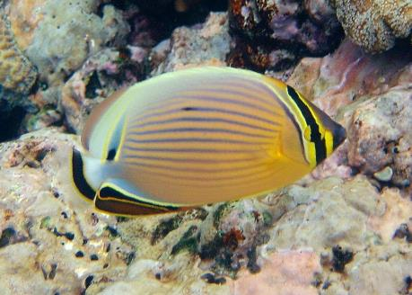
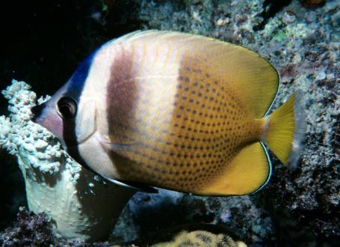
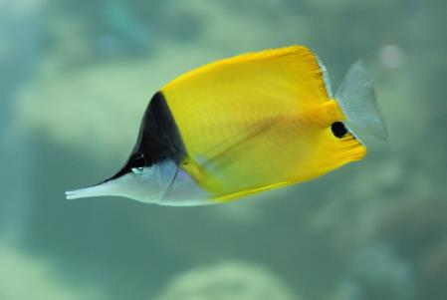
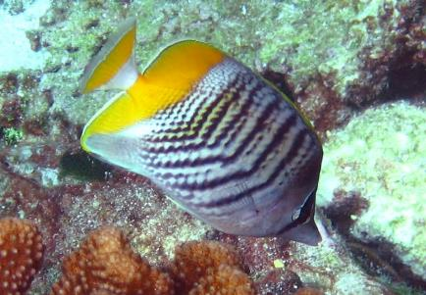
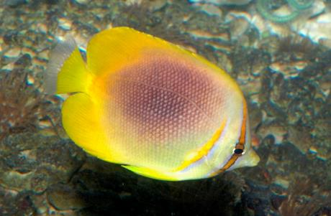
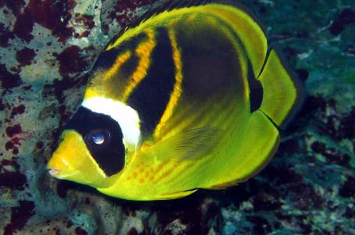
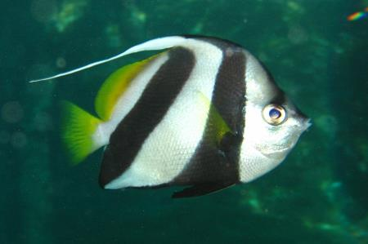
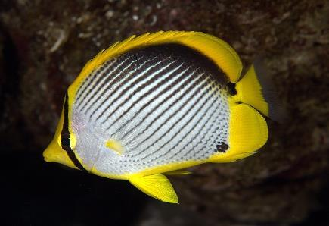
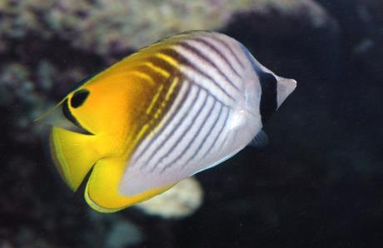
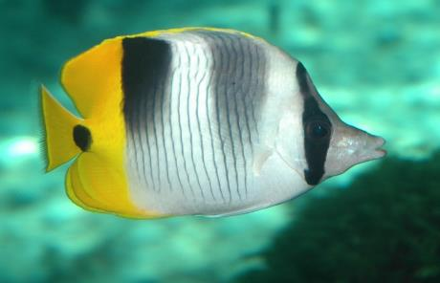
BUTTERFLYFISH
Most have an eye-stripe, and many have a false eye-spot near their tail to confuse predators.
Have a flat, disc-shaped body, pointed nose, and small mouth.
Most are black, white, and yellow.
Patterns of lines, dots and dashes.
Size: < 30 cm
Bluespot butterflyfish
Saddled butterflyfish
Redfin butterflyfish
Klein’s butterflyfish
Usually in pairs, or small schools
Long-nosed butterflyfish
Merten’s butterflyfish
Golden-striped butterflyfish
Racoon butterflyfish
Most eat coral (corallivores).
Schooling bannerfish
Black-backed butterflyfish
Threadfin butterflyfish
Double-saddle butterflyfish
Notes:
Why do we count them?
Most butterflyfish eat coral (corallivores).
Over one-third are ‘obligate corallivores’ - relying on coral for food – with a diet >80% coral.
A high abundance of butterflyfish can indicate a high abundance of coral.
Some butterflyfish only eat certain species of coral.
High butterflyfish diversity can indicate high coral diversity.
Where to look:
Look for pairs or small groups, swimming close to or feeding on coral.
Additional information:
They are easy to identify - flat disc-shaped bodies, a pointed nose and small mouth.
Most are black, white and yellow with a variety of stripes and patterns.
Often have a black stripe over the eye and/or a black spot near the tail.
Fun Facts:
Most species patrol a home range by the day.
At night they sleep in reef crevices, and their colours fade to blend with the reef.
Some species communicate using sounds such as tail slaps, fin flicks and jumps.
Their swim bladder and lateral line help detect and amplify these sounds.
Many butterflyfish form lifelong pairs.

Slide 12
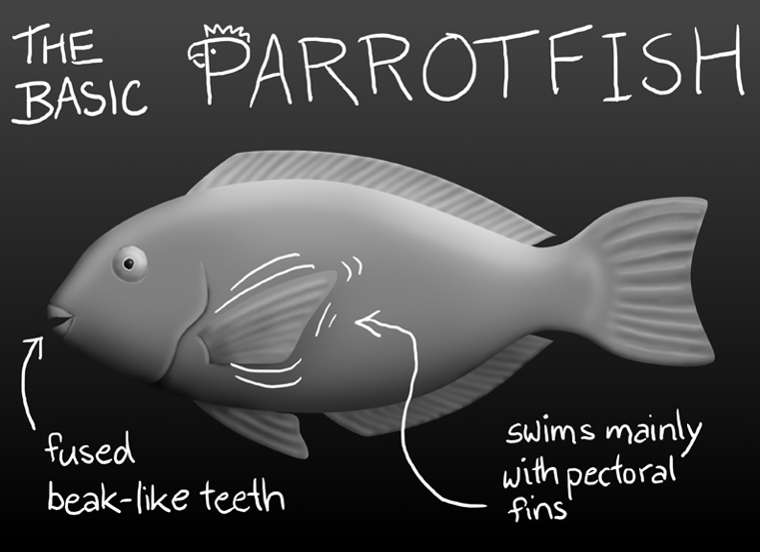
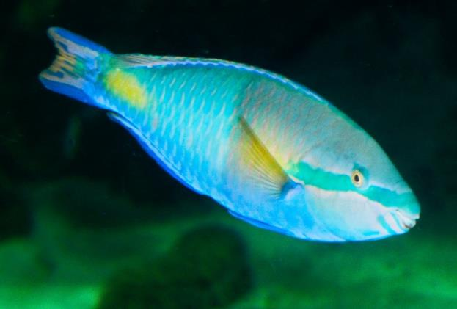










GRAZING HERBIVORES
Yellowfin parrotfish
Steephead parrotfish
Spotted unicornfish
White-cheek surgeonfish
Coral rabbitfish
Foxface rabbitfish
Notes:
Why do we count them?
Grazing herbivores act like the Reef’s lawnmowers by grazing on algae, helping to keep it under control.
They reduce algae-coral competition, such as algae overgrowth, to keep reefs healthy and resilient.
By removing algae, they increase the availability of space and light for coral growth and recruitment.
Where to look:
Look for schools of fish, often of similar size and appearance, moving slowly along the reef.
Often seen face down, grazing, scraping and biting at algae growing on the coral rock.
They include Parrotfish (Labridae / Scarinae), Rabbitfish (Siganidae) and Surgeonfish (Acanthuridae).
Record all that you see.
Additional information:
Listen for the sounds of parrotfish’s beaks scraping on the rocks as they feed.
Fun Facts:
Parrotfish can:
Swim by flapping their pectoral fins in a flying motion.
Their beak-like fused teeth.
Bright parrot-like colours (in males)
Can change gender from female to male and change colour during the transition.
Surgeonfish have a sharp scalpel-like blade at the base of their tail used for defence.
Rabbitfish are named for their downturned, rabbit-like mouth and use venomous fin spines for protection.

Slide 13




CODS AND GROUPERS
Camouflage colours of black, brown, grey, tan and white.
Pattens of spots, blotches and irregular bars.
Size: up to 300 cm
Weight: up to 300 kg
Record all over 50 cm
Most have a
C-shaped tail.
Large upturned mouth, big lips, and multiple rows of small teeth.
Medium to large, torpedo-shaped body.
Notes:
Why do we count them?
They are protected species.
Slow growing and long lived.
Important predators that help maintain balanced food webs.
Where to look:
This group includes barramundi cod, potato cod and the Queensland grouper.
They are often solitary and territorial.​
Look for them resting on the bottom or hiding under ledges or large plate corals.​
Additional information:
Reminder only record cod and grouper >50 cm.
Many are ambush predators, their colours help them to blend in with their surroundings as they wait for prey to come by.
Some are residents on a particular reef for a long time, ​sometimes for over 20 years.
Fun Facts:
Barramundi cod, potato cod and Queensland grouper were once overfished but are now protected on the Reef.
They start life as females and later change to males.
Most are solitary, except during spawning aggregations.
In areas outside of the Great Barrier Reef Marine Park, where they are not protected, they are often taken in large numbers during spawning.
The Queensland grouper is the largest bony fish on the Reef.

Slide 14







CORAL TROUT
Colours vary: blue, brown, red, pink, black and white.
Small blue spots all over the body.
Straight tail
Canine teeth protrude
from the lower jaw.
Blue ring around eyes.
Record fish < 38 cm
and > 38cm separately.
Notes:
Why do we count them?
They are targeted by recreational and commercial fishers.
We record different sizes to calculate sustainable catch limits from accurate estimates of population size.
Size < 38cm = under legal catch size.
Size > 38cm = minimum legal catch size.
Where to look:
Look for them hiding under ledges or amongst the coral crevices.
Additional information:
The name “Coral trout’’ includes different species:
Common coral trout or Leopard trout (Plectropomus leopardus).
Blue-spot trout (Plectropomus leavis).
Footballer trout – a different colour morph of the blue-spot trout.
Bar-cheeked trout or Island trout (Plectropomus maculatus).
Passionfruit trout or leopard trout (Plectropomus areolatus).
Count all that you see.
Record fish less than 38 cm and more than 38 cm separately.
* See ruler on side of slate.
Fun Facts:
Coral trout are solitary and territorial, usually staying on one reef.
They change gender from female to male at 42 cm.
Adults are fish-eating predators (piscivores).
They hunt by ambushing prey or slowly prowling before a fast attack.
Coral trout have been observed hunting cooperatively with moray eels.
Tail shape helps identify them:
Coral trout: flat or T-shaped tail
Coral cod: C-shaped tail

Slide 15


MĀORI WRASSE
C-shaped tail.
Males have a large hump on head.
www.freeimageslive.co.uk
Female
Male
Females are grey-brown in colour with a barred pattern.
Big fleshy lips
Scribbled patterns on face
Black lines behind eye
Males are blue-green in colour.
Notes:
Why do we count them?
Māori wrasse are listed as endangered.​
Once overfished, they are now protected on the Reef.
They are iconic and popular with tourists.​
They help corals by feeding on Crown-of-thorns starfish.​
Recording males and females separately can be used as an indicator of recruitment.
Where to look:
Look for them around the edges of reefs.
Males are blue-green in colour with a large hump on the head.
Females are grey-brown in colour, with no hump.
Additional information:
They are also called Napolean wrasse.
They are territorial and can be found on the same reef for decades.
Some are friendly and may approach you, but please do not touch.
Fun Facts:
Named for the wavy facial markings resembling Māori facial tattoos of New Zealand people.
Start life as females; some change to males at ~9–15 years, also changing colour and developing a larger head hump.
One of the largest reef fishes, growing up to 2.3 m and 190 kg.
Feed on snails, sea urchins, sea stars, brittle stars and crustaceans.
Have pharyngeal jaws in their throat to help crush prey.

Slide 16






SEA TURTLES
Hawksbill
Green
Loggerhead
Leatherback
Olive Ridley
Flatback
Notes:
Why do we count them?
All sea turtle species are protected in Australia.
Their numbers have declined due to climate change, marine debris, hunting and habitat loss.
They are threatened species and iconic.
Where to look:
Six of the seven sea turtle species are found on the Reef; Hawksbill, Green, Loggerhead, Leatherback, Olive-Ridley and Flatback.
Green and Hawksbills are the most often seen.
Look for them moving between the surface, where they breathe, to the reef substrate where they rest and feed.
Additional information:
Record all sea turtles that you see.
But record Green and Hawksbill turtles separately.
Fun Facts:
Sea turtles are air-breathing reptiles that must surface to breathe.
They can rest or sleep underwater for several hours on one breath.
Most reach sexual maturity at 20–50 years and may live over 100 years.
Females lay eggs in nests above the high-tide mark.
Sand temperature determines the hatchlings’ sex:
Cooler nests (<25°C): males
Warmer nests (>31°C): females
27–29°C: mix of males and females.

Slide 17






SHARKS
Record all sharks that you see.
Record blacktip and whitetip reef sharks separately.
Benthic sharks use spiracles to breathe.
White tips on fins
Black tips on fins
Spiracle
Whitetip reef shark
Blacktip reef shark
Leopard shark
Spiracle
Spiracle
Whale shark
Wobbegong shark
Epaulette shark
Notes:
Why do we count them?
Sharks are apex predators at the top of the food chain.
They are a keystone species that help regulate prey numbers and maintain ecological balance.
Without sharks, food webs quickly become unbalanced.
Many shark species are endangered.
Sharks are iconic species and important to tourism.
Where to look:
Leopard sharks often rest on sand at the reef slope.
Whitetip reef sharks may rest on the seafloor during the day.
Wobbegongs, epaulette and carpet sharks often rest among coral.
Blacktip reef sharks are usually seen swimming.
Additional information:
Record all sharks that you see.​ But record blacktip reef sharks and whitetip reef sharks separately
Fun Facts:
Reef sharks range from small epaulette sharks to large migratory species like whale sharks.
Some pelagic species (e.g. blacktip reef sharks) must keep swimming to breathe. If they stop swimming, they will drown.
Bottom-dwelling sharks (e.g. leopard sharks) use spiracles to pump water over their gills, allowing them to rest on the seafloor.
Sharks have multiple rows of teeth, which are continually replaced when lost.

Slide 18

CROWN-OF-THORNS STARFISH (COTS)
Surface covered
in toxic spines.
Mouth on the underside of body.
Eats live coral tissue leaving behind white feeding scars.
Adults can have up to 23 arms.
Size: up to 100cm Typical size: 40cm
Notes:
Why do we count them?
Crown-of-thorns starfish (COTS) are natural predators of coral.
In high numbers (during outbreaks), they can eat coral faster than it can grow.
All COTS sightings are recorded to monitor outbreaks.
Where to look:
COTS often hide during the day underneath the coral.​
If you see feeding scars (large white patches) on coral, look around as a COTS may be close by.
During an outbreak they may be seen feeding during the day.
Additional information:
Count the adults and the juveniles separately.​
Juveniles are smaller than your hand.​
Seeing several adults may indicate that a COTS outbreak is occurring at that site.
Seeing several juveniles may indicate that an outbreak is about to occur.
Fun Facts:
Crown-of-thorns starfish (COTS) eat coral, preferring branching and plate corals, but will eat most types when hungry.
They push their stomach out through their mouth to digest coral tissue and can consume an area about their own size each day.
Feeding leaves large white patches of exposed coral skeleton.
COTS outbreaks have been a major cause of coral decline on the Reef over the past 40 years.
A dedicated COTS control program operates on the Great Barrier Reef.

Slide 19

CONDUCTING THE 10-MINUTE TIMED SWIM
Set a timer for 10 minutes and snorkel slowly in one direction
Use a tally system to record numbers.
Use whole numbers to record fish in schools.
If unsure: ask, take a photo, or don’t record it.
For large schools of fish, estimate numbers.
Move quietly and slowly to avoid scaring animals.
Talk quietly, use hand signals, and avoid splashing.
Only record what you see during the 10-minutes.
Record other sightings in “Other things of interest.”
Do not touch animals.
Notes:
CONDUCTING THE 10-MINUTE TIMED SWIM
Use a timer, or someone with a watch, to start timing the 10 minutes.
Swim slowly in one direction (no backtracking); look up occasionally so you know where you are.
Stay on one habitat type (reef flat, lagoon, crest, slope).
Use tally system to record what you see, (four lines + diagonal = 5).
After the 10 minutes, total the numbers for each target species.
This can be done back on the boat.
For large schools of fish, estimate numbers.
Record numbers as accurately as possible.
If you’re not sure, point it out and ask, take a photo or don’t record it.
Move quietly and slowly to avoid scaring animals.
Talk quietly, use hand signals, and avoid splashing.
Only record what you see during the 10-minute survey.
If you see something interesting outside of this time, you can record it in the other items of interest section at the bottom of the form.
Do not touch the animals.
Additional information:
Complete safety, buddy, and equipment checks before entering the water.
Some groups may only do the timed swim component.
Next is the 360º Benthic Survey.
This is recommended for 15+ year olds.

Slide 20

360⁰ BENTHIC SURVEY
Notes:
Be a Marine Biologist for a Day (BAMBFAD)
Based on the Rapid Monitoring survey.
Aligned with the Australian Curriculum and scaffolded for different year levels.
Primary & middle school: typically complete the timed swim component.
Senior students (15+): usually undertake the full Rapid Monitoring survey.
Simplified survey slates are available for younger students as an alternative to the Rapid Monitoring slate.
While working through the presentation students / guests should have:
a Rapid Monitoring Survey slate
or Be a Marine Biologist for a Day (BAMBFAD) slate available.

Slide 21


360⁰ BENTHIC SURVEY - AN ESTIMATE OF % COVER
Swim around the habitat to select a representative survey area.
Use a 5m radius circle for the survey area.
Do a quick presence / absence check.
Record the largest / most obvious category first, then down to the smallest.
Use whole numbers only, e.g. 10, not 10.5
Do a final swim around to adjust estimates.
Benthic categories must total 100% across the six (6) categories.
5m
Notes:
360⁰ BENTHIC SURVEY - AN ESTIMATE OF % COVER
The 360º benthic survey is an estimate of what the benthos (bottom of the seafloor) is made up of.
Swim around the site to choose a representative area.
Remember this needs to be representative of the site, not just a ‘best bit’.
Use a 5 m radius circle for the survey. Use your body length to help you estimate 5 metres.
Do a quick presence / absence check.
Mark down anything that you don’t see as zero.
Record the largest / most obvious category first, down to the smallest.
Use whole numbers only (e.g., 10%, not 10.5%).
Do a final swim-around to adjust estimates.
Benthic categories must total 100% across the six (6) categories.

Slide 22


MACROALGAE
Seaweeds can be green, brown or red.
They have many forms – filamentous, leafy, bushy, etc.
Found naturally on most reefs attached to the substrate.
The presence and abundance of macroalgae can be used as an indicator of certain environmental factors (e.g. water quality) and the overall health of the Reef.
Slime
Entangled / mat-like
Filamentous
Leafy / fleshy
Tree / bushy
Unidentified
Unidentified
Hydroclathrus sp.
Chlorodesmis sp.
Padina sp.
Caulerpa sp.
Colpomenia sp.
Sargassum sp.
Notes:
Macroalgae are photosynthetic organisms in the phylum Protista. They are not plants.
Common colours include green, brown and red.
They are naturally found on reefs, attached to the substrate.
Their presence and abundance can indicate water quality and overall reef health.
How to identify Macroalgae:​
General rule: algae longer than your thumbnail.
Large, leafy, or bushy growth – (unlike short turf algae).​
Look for visible structures – stems, blades, fronds, or branches.​
Sways freely in water.
Not encrusting or rigid like coralline algae.
Record all macroalgae observed (species ID not required)
Why monitor Macroalgae?
Macroalgae occur naturally on reefs, but high levels can indicate an imbalance – linked to a low abundance of herbivores (fish, urchins) or high nutrient levels).
Macroalgae may:
It can compete with corals for space, overgrowing coral and preventing coral larvae from settling.
It can also shade (reducing light needed for corals to perform photosynthesis) and smother corals, trapping sediments and reducing coral health.

Slide 23


LIVE CORAL
Corals form essential habitats on coral reefs.
Group all types of living coral that you see as Live Coral.
Estimating live coral cover is important for assessing reef health.
Notes:
Corals form the structure and habitats of coral reefs.
Estimating live coral cover is important for assessing reef health.
Group all types of living coral that you see as live coral.
You don't need to record which type of coral it is for this survey.
How to identify Live Corals:​
Visible texture: bumps, ridges, valleys, cups.​
Visible tissue: polyps or tentacles may be extended.
Coloured: brown, tan, orange, green, red, pink, purple or blue. ​
Hard corals: rigid and unmoving in the current.
Soft corals: sway or bend in the current.​
Surface appears clean and free of algae.
Why monitor Live Coral?
Corals are the basis of a coral reef. They:
Create the physical reef framework.
Provide shelter and food for reef species.
Support biodiversity and healthy ecosystems.
Help protect coastlines from waves and storms.

Slide 24

RECENTLY DEAD CORAL
If the coral skeleton is still visible beneath a light algal layer, record it as recently dead coral.
Recently dead coral turns cream, green or brown as algae begins to grow over it.
Recently dead coral can indicate early signs of environmental stress.
Notes:
How to identify recently dead coral:
White to pale skeleton with a thin film of algae starting to grow.
Original coral shape still clear — branches, plates, ridges unchanged.
Solid, hard skeleton with no living tissue.
Begins turning green or brown as algae lightly coats it.
Structure remains intact, not eroded or crumbling (unlike old dead coral).
Why monitoring recently dead coral is important:
Signals early reef stress (bleaching, disease, heat, crown-of-thorns).
Helps track coral mortality trends before algae fully overgrows.
Indicates changes in reef health and potential recovery needs.
Guides management and rapid response actions.

Slide 25

LIVE CORAL ROCK
Solid, stable substrate (bare rock, old coral skeletons, or cemented rubble).
Substrate available for coral settlement and recruitment.
Tip:
If algae is shorter than your thumbnail, record it as live coral rock.
If algae is longer than your thumbnail, record it as macroalgae.
Notes:
How to identify Live Coral Rock:
Solid, hard substrate made of ancient coral skeleton.
Mostly bare rock with limited algae cover.
May have small patches of live coral, sponges, or encrusting life.
May have a covering of short, fuzzy algae.
Natural texture: holes, grooves, and rough surfaces.
Why monitoring Live Coral Rock is important:
Provides stable habitat for corals, algae, and invertebrates.
Acts as a foundation for new coral growth and reef recovery.
Supports biodiversity through cracks, holes, and surfaces used by reef species.
Indicates healthy reef structure and resilience after disturbance.
Helps track shifts in benthic cover (e.g., coral vs. algae dominance).
Tip
If algae is shorter than your thumbnail, record it as live coral rock.
If algae is longer than your thumbnail, record it as macroalgae.

Slide 26


CORAL RUBBLE
Broken up pieces of dead coral that are loose and can be moved by wave action.
Coral rubble is natural, just like the branches of trees on the forest floor.
Tip:
When Coral Rubble is cemented together with calcareous algae, it is categorized as Live Coral Rock.
Notes:
How to identify Coral Rubble:
Loose, broken pieces of dead coral lying on the seafloor.
Fragments are moveable, not attached or cemented together.
Shapes resemble old coral skeleton but are worn or irregular.
Often piled or scattered, not forming a solid reef structure.
May have light algae, but the structure looks broken rather than intact.
Why monitoring Coral Rubble is important:
May indicate recent physical damage (storms, anchors, cyclones, COTS).
Coral rubble does not provide a good settlement substrate for coral larvae to support reef recovery, but has the potential to become consolidated Live Coral Rock over time.
Tip:
When coral rubble is cemented together with encrusting coralline algae it is categorized as Live Coral Rock.

Slide 27


SAND
Fine, loose particles of rock and limestone (from coral skeletons, molluscs, calcareous algae and crustaceans).
Formed by erosion of rock, coral and shells by wave action.
Also created by bioerosion from parrotfish and burrowing organisms.
Notes:
How to identify Sand:
Loose, fine grains that move easily with currents.
Light-coloured, usually white or pale beige.
Lacks structure: no hard surface, no coral shapes.
Found in pools, channels, and between reef structures.
Does not support coral tissue and is easily displaced when touched.
Why monitoring Sand is important:
Indicates sediment movement and changes in reef conditions.
Helps detect erosion or deposition that may smother corals.
Shows shifts in habitat availability for bottom-dwelling species.
Useful for tracking disturbance impacts such as storms or dredging.

Slide 28

360⁰ SURVEY 5m radius circle
Estimate the % cover of each category in the picture shown.
Remember:
total = 100%
Notes:
360 SURVEY 5m radius circle
Survey area is a 5m diameter circle.
It should be representative of the habitat type at that reef.
Don’t pick the best or worst spot.
Reef habitats are:
Reef slope
Reef crest
Reef flat
Reef lagoon
Have participants try and estimate the % cover of each of the 6 benthic categories. Answers are found in the next slide.
Discuss the answers and highlight that a difference (+/-) of 5% is ok.
Remember: the total must add up to 100%

Slide 29

360⁰ SURVEY 5m radius circle
Estimated % cover of each category in the picture shown.
Notes:
360 SURVEY 5m radius circle
Survey area is a 5m diameter circle.
It should be representative of the habitat type at that reef.
Reef habitats are:
Reef slope
Reef crest
Reef flat
Reef lagoon
Have participants try and estimate the % cover of each of the 6 benthic categories.
Discuss the answers and highlight that a difference (+/-) of 5% is ok.
Remember: the total must add up to 100%

Slide 30
CORAL IMPACTS
Notes:
Coral Impacts:
NOTE: This section is recommended for Year 12 students, adults, and professionals.
The coral impacts can be completed during the 360⁰ benthic survey and can be done as a group.
Extension: you can download a Coral Impact Training Manual for advanced training or participants from the Reef Guardian School portal: Public Resources | Reef Guardian School

Slide 31





CORAL IMPACTS - BLEACHING
Notes:
Bleaching:
Coral appears white or very pale, but living tissue remains
Often affects whole colonies or large sections, not small patches.
Polyps are still present - coral is alive but stressed.
May show fluorescent blue, pink or yellow before turning white.
Not predation: no clean feeding scars or missing tissue.
Not disease: no discoloured edges, mucus, or patchy tissue loss.

Slide 32




CORAL IMPACTS - PREDATION
There are two main coral predators to monitor.
Drupella snails
Crown-of-thorns starfish
  Drupella snail (pink) with recently eaten coral (white)
  Drupella snail (dark brown)
  Crown-of-thorns starfish (COTS)
Notes:
The two coral predators we monitor are Crown-of-thorns starfish (COTS) and Drupella snails.
Crown-of-thorns starfish (COTS)
Large starfish, up to 60 cm, with venomous spines.
They feed by pushing their stomach out of their mouth to digest living coral tissue.
Record juveniles and adults separately.
Predation indicators:
Look for white feeding scars where coral tissue has been removed.
Scars often have scalloped edges.
Scars are spread across large coral areas, not small clusters.
COTS are often found near fresh scars, especially on branching or plate corals.
Seeing an adult COTS may indicate an outbreak; juveniles may signal a potential outbreak.
Drupella snails
Small, nobbily, spiral-shaped snails 1-5cm in length.
Often covered in pink encrusting coralline algae.
They feed on coral tissue using a rasp-like tongue.
Predation indicators:
Look for fresh white patches of exposed skeleton with clean edges (recent tissue loss).
Often multiple clustered scars, not large uniform areas like bleaching.
Typically feed on coral tissue from the base upwards.
They often hide in crevices or between coral branches.

Slide 33




CORAL IMPACTS - DISEASE
If a coral shows tissue loss (white or recently dead) and there are no coral predators visible, this may indicate the presence of disease. ​
You don’t need to identify the specific disease, just distinguish it from bleaching or predation.
  Black Band Disease
  Brown Band Disease
  White Syndrome
Notes:
CORAL IMPACTS - DISEASE
If the white coral shows tissue loss and no coral predators are visible, this may indicate the presence of a disease. ​
You don’t need to identify the specific disease, just distinguish it from bleaching or predation.
Black Band Disease
Cause: A microbial infection dominated by cyanobacteria.
Key visual sign: Dark black or reddish-black toxic band that separates healthy coral tissue from exposed white skeleton.
Location: Often begins on the upper surface of coral colonies.
Impacts on the Reef:
Significant tissue loss and colony mortality.
Slows reef recovery and reduces coral cover.
Creates bare substrate, enabling algae takeover and altering reef structure.
Brown Band Disease
What it is: Coral disease caused by ciliates feeding on living coral tissue.
Key visual sign: A distinct brown band (often slimy) that moves slowly across healthy tissue, leaving white skeleton behind.
Location: Usually starts at the base or edge of a coral colony.
Impacts on the Reef:
Reduced coral cover and structure.
Slows reef recovery and reduces biodiversity.
Increased vulnerability to secondary infections.
White Syndrome
What it is: A group of coral diseases causing rapid tissue loss, often linked to bacteria and heat stress.
Key visual sign: Sharp boundary between healthy tissue and bright white, freshly exposed skeleton.
Location: Can start at the base, edge, or centre of a colony depending on the species.
Impacts on the Reef:
Major driver of coral decline during warm-water events.
Reduces colony resilience and growth.
Increases susceptibility to secondary stressors and slows reef recovery.

Slide 34





CORAL IMPACTS - COMPETITION
Can be identified by:
A coloured band between two coral colonies.
An even gap separating two coral colonies.
  One colony may show a coloured edge where it is being stung by sweeper tentacles from the other colony.
  1
  2
  Sweeper tentacles in action
  Sweeper tentacles in action
Notes:
CORAL IMPACTS - COMPETITION
Corals compete with other corals, algae, sponges and invertebrates for space, light, and nutrients.
Competition is most noticeable in fast-growing species.
Often seen as a coloured band between two coral colonies.
Key visual sign: Clear interaction zones where two organisms
meet - may show tissue recession, sweeper tentacles, or overgrowth.
Common interactions:
Coral vs. coral: Margins touching, dead patches where one outcompetes another.
Coral vs. algae: Algae overgrowing or shading coral.
Coral vs. invertebrates: Sponges or tunicates encroaching on coral tissue.
Impacts on reefs:
Reduced growth and colony health.
Increased risk of tissue loss and disease entry points.
Limits space for coral recruitment and slows reef recovery.

Slide 35





CORAL IMPACTS - DAMAGE
Where any part of a coral is broken, or the coral is displaced or overturned.
  Animal damage - Parottfish
  Storm damage
  Diver damage
  Snorkeller damage
  Anchor damage
Notes:
CORAL IMPACTS - DAMAGE
What it is: Breakage or injury to coral from human activity, animals, or natural events.
Key visual signs:
Fresh, white break points on branches or plates.
Scarring or scraped tissue.
Dislodged or overturned colonies.
Common sources:
Divers/snorkellers: Fin kicks, touching, standing on coral.
Anchors/boats: Large breakage, crushed areas, sediment plumes.
Storms: Fragmentation, sand abrasion, overturned corals.
Impacts to reef:
Reduced structural integrity and colony survival.
Increased vulnerability to disease and algae overgrowth.
Slower reef recovery and loss of habitat complexity.

Slide 36





CORAL IMPACTS- RUBBISH (MARINE DEBRIS)
Plastics, fishing line, nets, and other debris can become entangled on coral colonies.
Notes:
CORAL IMPACTS- RUBBISH (MARINE DEBRIS)
What it is: Plastics, fishing line, nets, and other debris that become entangled on coral colonies.
Key visual sign: Foreign objects resting on or caught within coral branches or surfaces.
Common signs of impact:
Tissue abrasion where debris rubs against coral.
Breakage of delicate branches.
Shading that limits light for photosynthesis.
Impacts on the Reef:
Slower growth and reduced health.
Higher risk of infection at damaged sites.
It can cause colony mortality if not removed.

Slide 37

IMPACT DETAILS - OTHER THINGS OF INTEREST
IMPACT DETAILS
Examples:
Half the area was affected by bleaching;
The whole area was affected by COTS.
OTHER THINGS OF INTEREST?
Example: Sightings of protected species, mating or spawning behaviours.
Notes:
Impact Details and Other things of intertest:
Impact details: Record of impacts for example
Half the area was affected by bleaching.
The whole area was affected by COTS.
Other things of interest: Relevant site information
Site conditions, storms, sightings of protected species, mating or spawning behaviour.
Reminder: Submit the data from your survey into Eye on the Reef

Slide 38





REMINDER – ENTER DATA INTO EYE ON THE REEF
Enter your data via the QR Code
New users will need to register for an account.
From home toggle across to Surveys then add Survey on top right corner
Add Rapid Monitoring Survey
Sign into your account.
Eye on the Reef is also available on desktop (preferred way of submitting your data).
Mobile App.
Desktop
Notes:
ENTER DATA INTO EYE ON THE REEF
Enter your data via the QR Code
New users will need to register for an account.
From home toggle across to Surveys then add Survey on top right corner
Add Rapid Monitoring Survey
Sign into your account.
Eye on the Reef is also available on desktop (preferred way of submitting your data).
Additional information:
This is arguably the most important component.
The data you collect and contribute can be used to inform how the Great Barrier Reef is managed.
The data goes into the Eye on the Reef system, the official Reef management system for the Great Barrier Reef Marine Park Authority, the Australian Government’s lead agency for managing the Great Barrier Reef.
Based on reviews, data entry scores high for value, well-being, and sense of contribution.
The difference between Primary and Citizen Science data is how it is shared.
Citizen Science data is entered into a collective dashboard, whilst Primary data is not.

Slide 39


Questions?
Male Māori wrasse

Slide 40

www.reefed.edu.au
reefguardians@gbrmpa.gov.au

