Slide 1
Catchments: What are they and why are they significant?
Phil Laycock
Regional Liaison Officer – Far Northern
Great Barrier Reef Marine Park Authority
Notes:
Good Morning. Today I will be discussing with you what is a catchment and why are catchments significant. To make sense of the second question we are going to look at this from the perspective of the Great Barrier Reef.

Slide 2
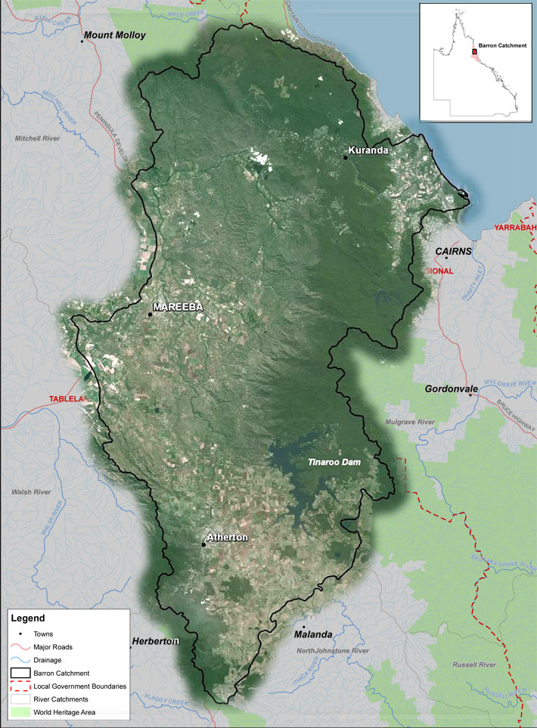
Definition: A catchment is an area of land where all the water flows to a common point.
Notes:
What is a Catchment? Just take a moment to read this definition.
I like this definition because it lets us look at any area where water flows to common point and think of it as a catchment. This image is of the Barron Catchment, a geographic area of mountains, rivers, streams, forests, farm lands, towns and cities that funnels all of the water that falls upon it to a common point being the Barron River delta.
But within this catchment there are many smaller catchments each funnelling water to a common point. As an example think about your school and where it is.
The street outside your school and the gutters that capture the water are a catchment. This feeds a larger catchment formed by the land and drainage network of the suburb of where your school is located. This land and drainage network forms part of the catchment of the nearest stream to your school which forms part of the catchment of the nearest creek which is part of the larger catchment in which your school is located.
So when we are thinking about catchments and trying to understand them we need to remember that a catchment is made up of many smaller areas (called sub catchments) that link together to form the larger catchment.

Slide 3
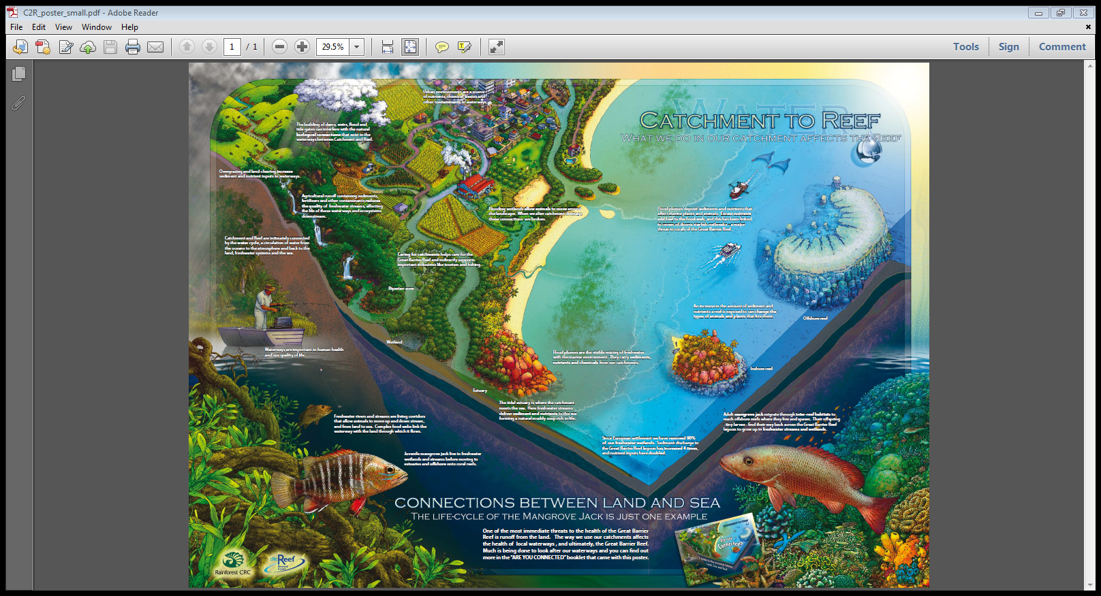
Notes:
Why are catchments significant?
Catchments are significant to our communities and industries such as farming because they provide us with water, land, resources, recreational opportunities, environmental values and a place to live. The sustainability of all of these services is dependent on the health of the catchment.
To us at the Great Barrier Reef Marine Park Authority catchments are significant because they link the land to the sea and the reef. So if the catchment is unhealthy this can impact the health of the Great Barrier Reef. It is not just the water emerging from the catchment that creates this connection to the Great Barrier Reef but also the ecosystems supported by the rivers, streams and wetlands as many animals spend different parts of their lifecycle in both the catchment and the Reef. We refer to this as the catchment providing ecosystem services to the Reef.
I will come back to this later in this presentation and look at this in more detail. But for this to make sense we need to explore the Barron catchment and discover more about it.

Slide 4




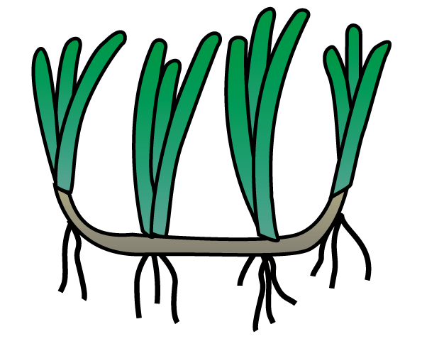
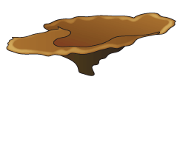

Mangrove jack life history
Notes:
Connectivity, including from land to sea
Importance of coastal ecosystems

Slide 5
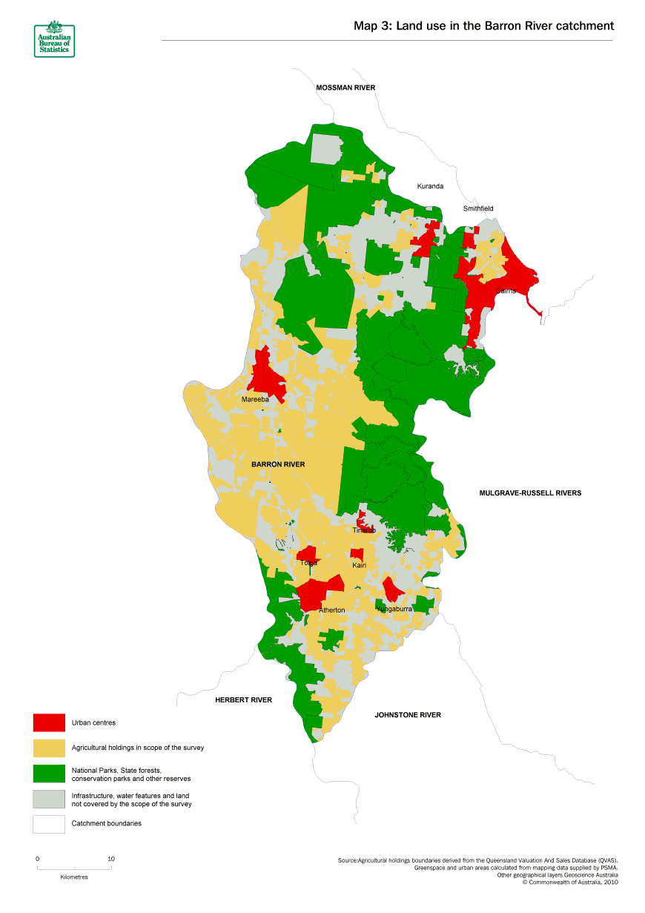
Land use in the Barron Catchment
Notes:
Lets now look closely at the Barron Catchment.
Many people think of the Barron Catchment as just being the streams, creeks and rivers that flow within it. These are the natural channels through which the water flows but it is the whole of the land surface, as well as all of the man made elements that forms the catchment.
Here is a break down of land use in the Barron Catchment. The Red areas are urban areas, the Green areas are National Parks, the Yellow areas are agricultural areas and the grey areas are not specifically defined but would include state forests, commercial land leases (eg Airport) , water reserves and mining leases.
As we can see much of the land area within the Barron Catchment is potentially quite different to the natural state that we saw in the previous slide. Almost half of the land in the Barron Catchment is covered by urban and agricultural areas.

Slide 6
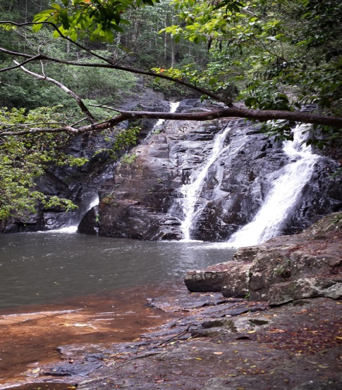
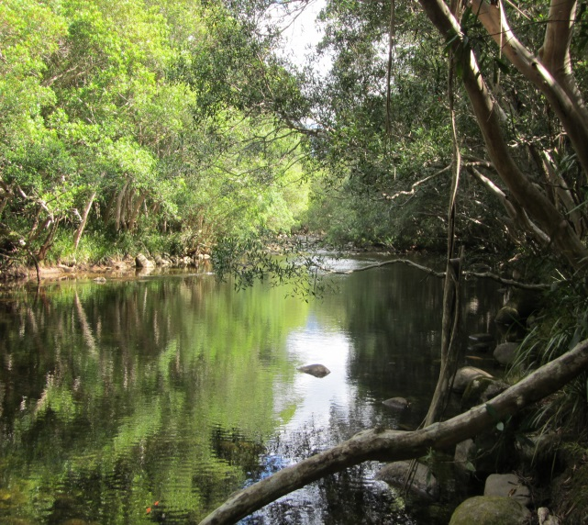
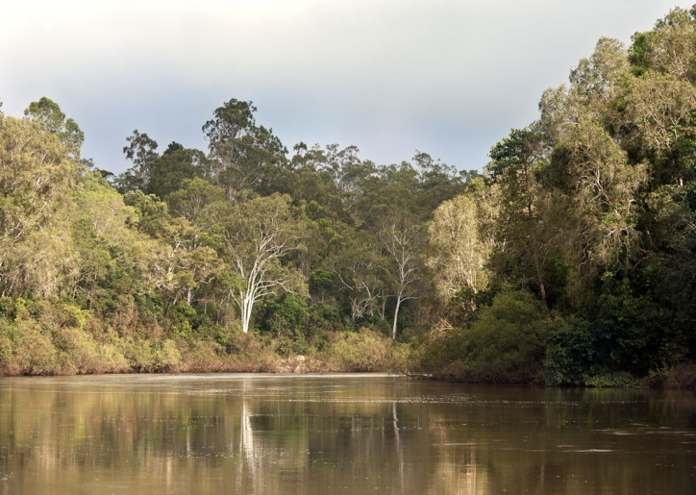
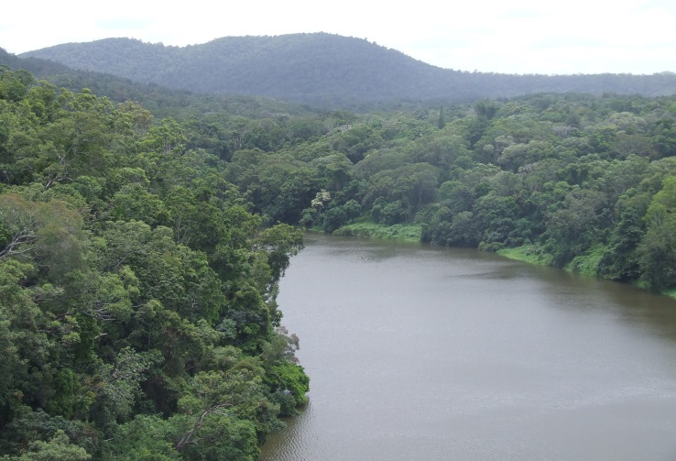
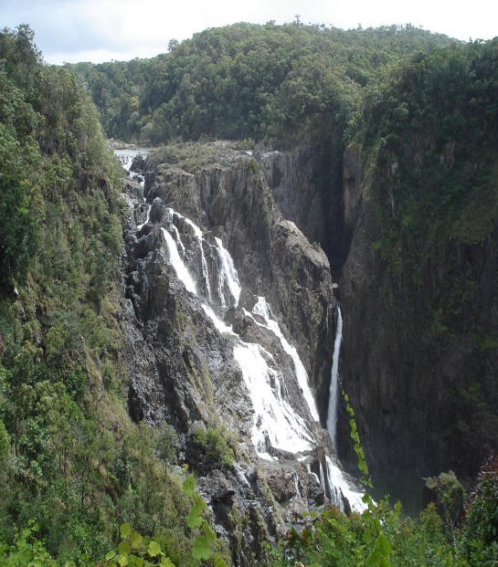
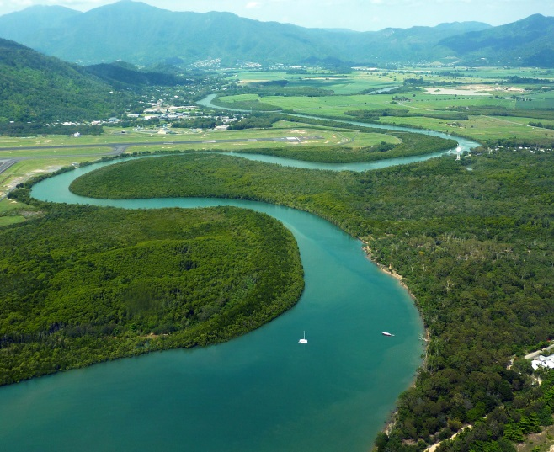
The Barron catchment includes many different landscapes and habitats.
Notes:
Here are some examples of the natural elements of the Barron Catchment. Remember that the catchment is also formed by the man made urban areas and the farming areas

Slide 7
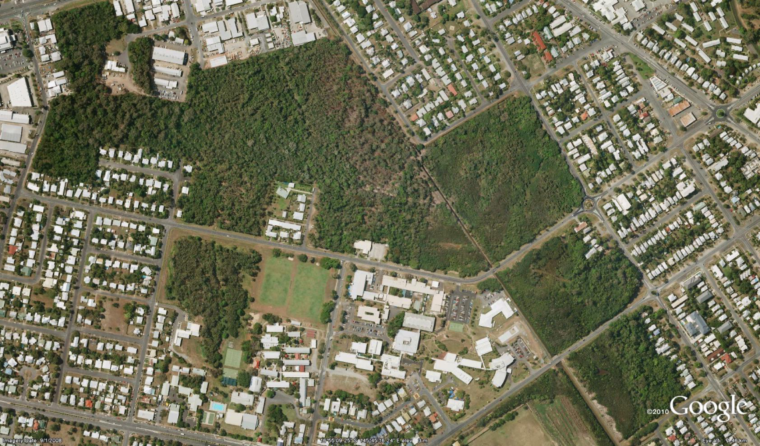
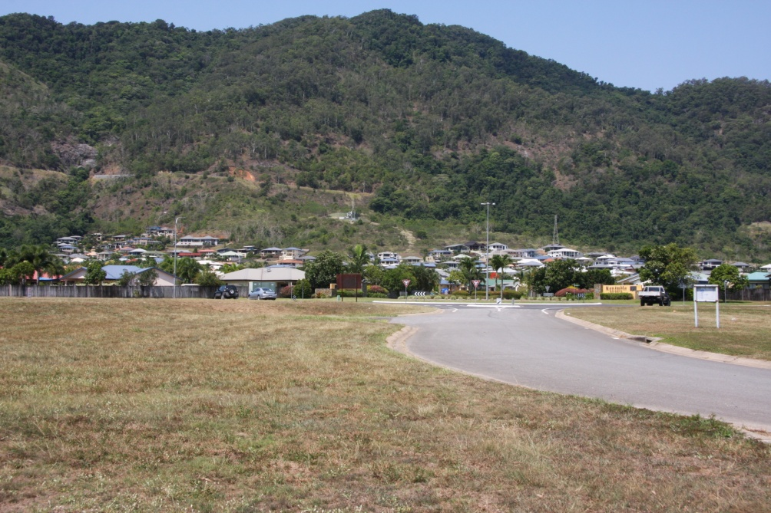
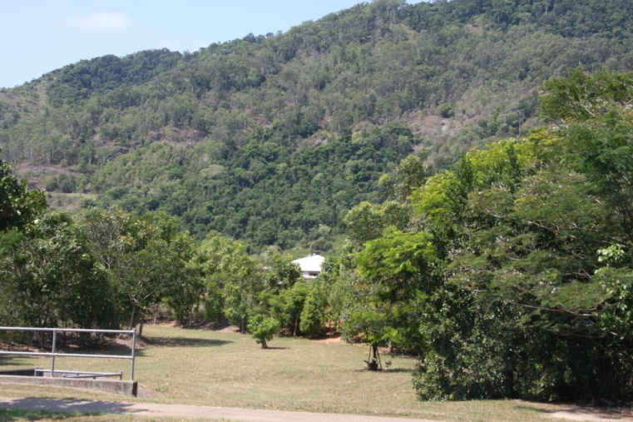
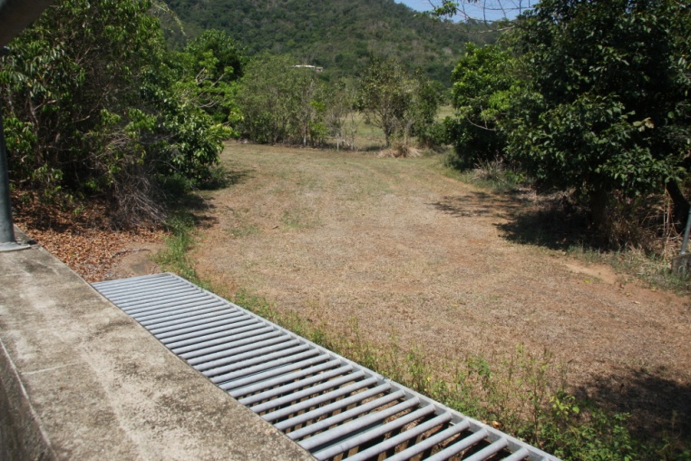
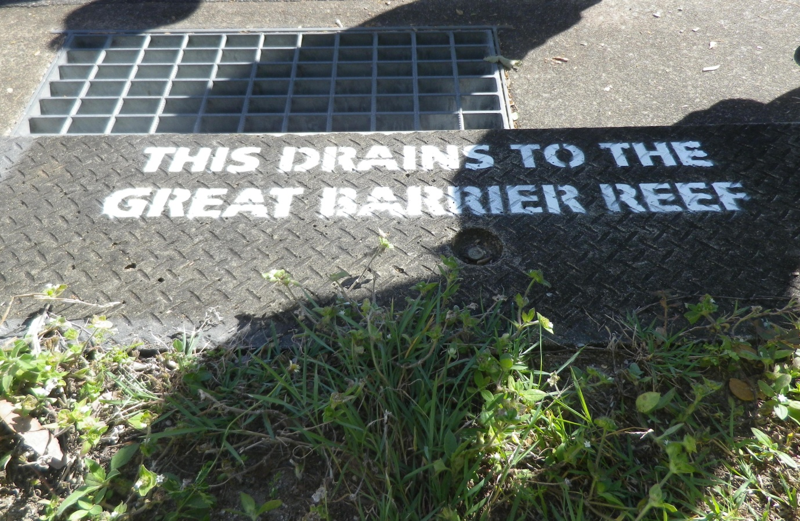
Our urban areas are part of the catchment
Notes:
So when you are thinking about the catchment remember that our urban areas are part of the catchment. Our industrial areas are part of this as well.
Water flowing through our urban areas influences water quality leaving our catchment.
Water quality leaving our urban areas is most likely to be influenced by our waste management strategies but we must also remember that many day to day activities and behaviours that our community undertakes can influence water quality.
The modifications we make to the natural waterways and wetlands in our urban areas affect the services these provide to biodiversity. They also affect where and how water flows and this may also affect water quality and ecosystem services.
Talk to slide

Slide 8
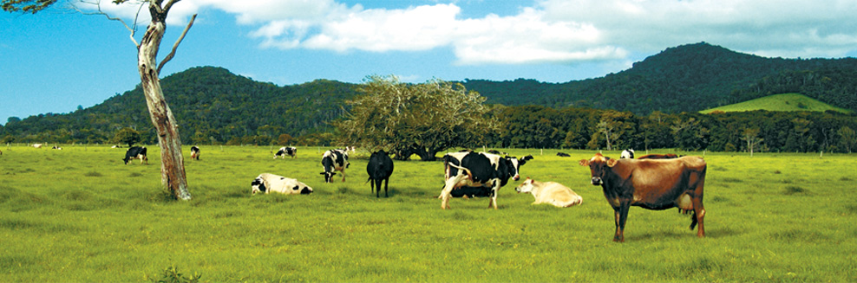
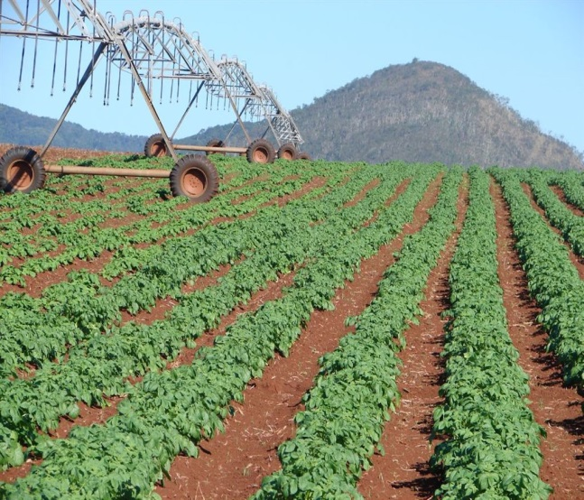
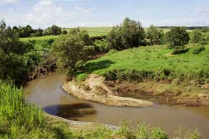
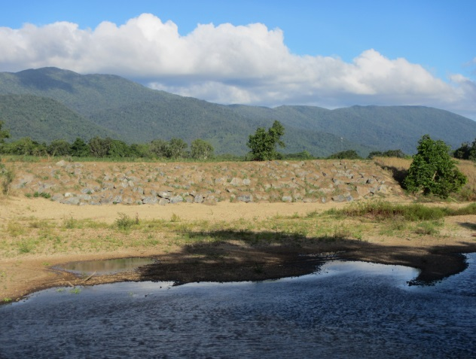
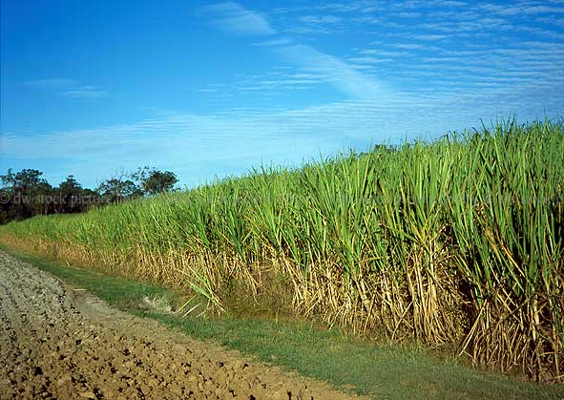
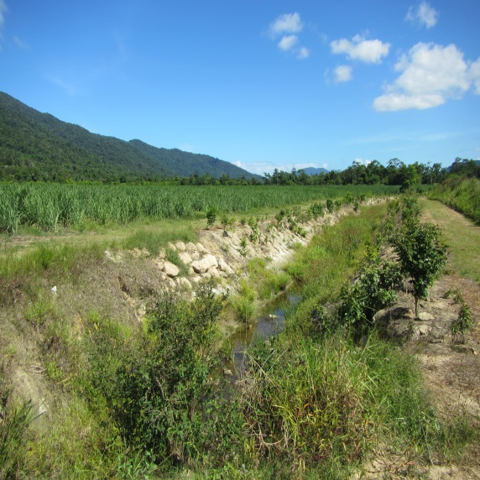
Our farm lands are part of the catchment
Notes:
Agricultural land forms a large part of the Barron river catchment. In a farming area it is the farming practices as well as modifications to the land and waterways that influence water quality and ecosystem services within the catchment.
Talk to slide

Slide 9
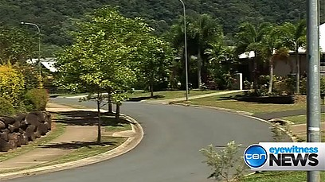

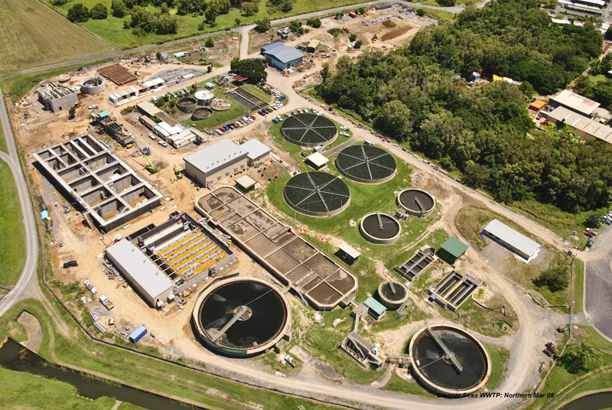
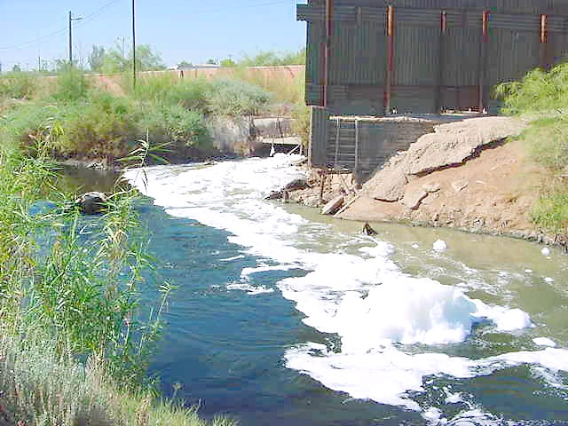
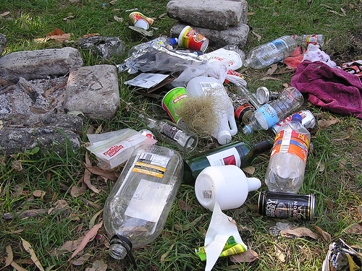
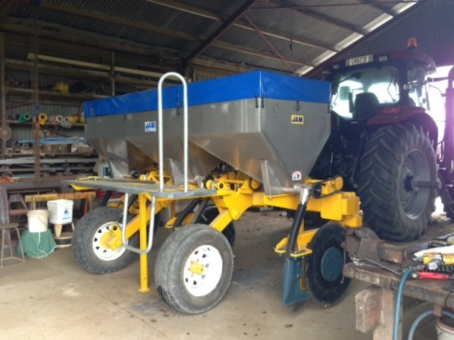
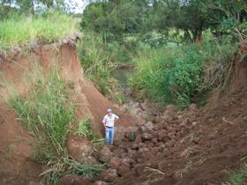
Sources of pollution.
Notes:
So thinking about our urban and agricultural areas here are some of the potential sources of pollution that may occur within the Barron Catchment and affect water quality in the catchment.
Talk to slide

Slide 10
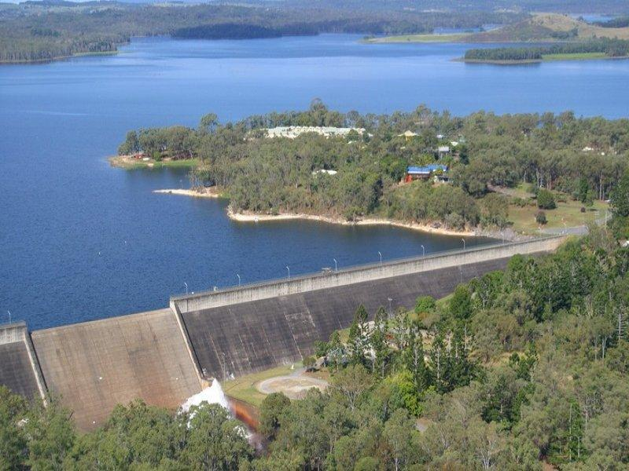
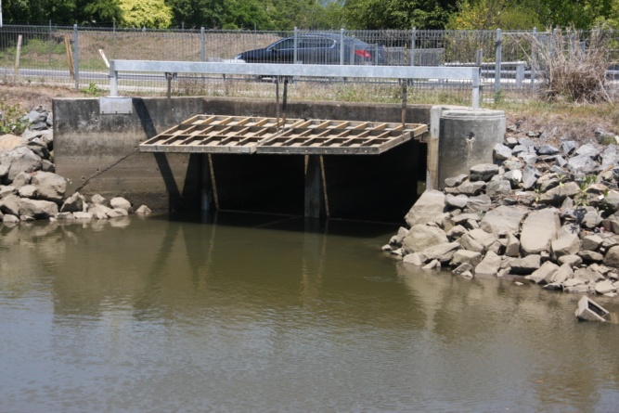
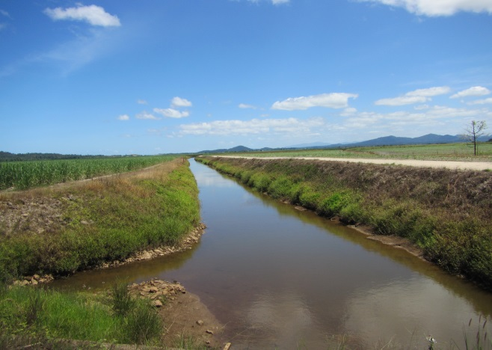
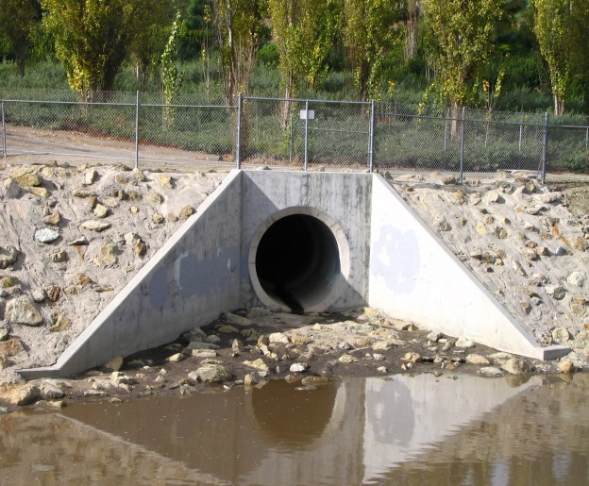
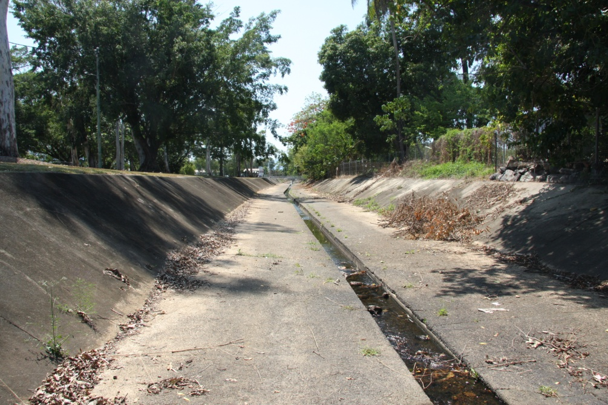
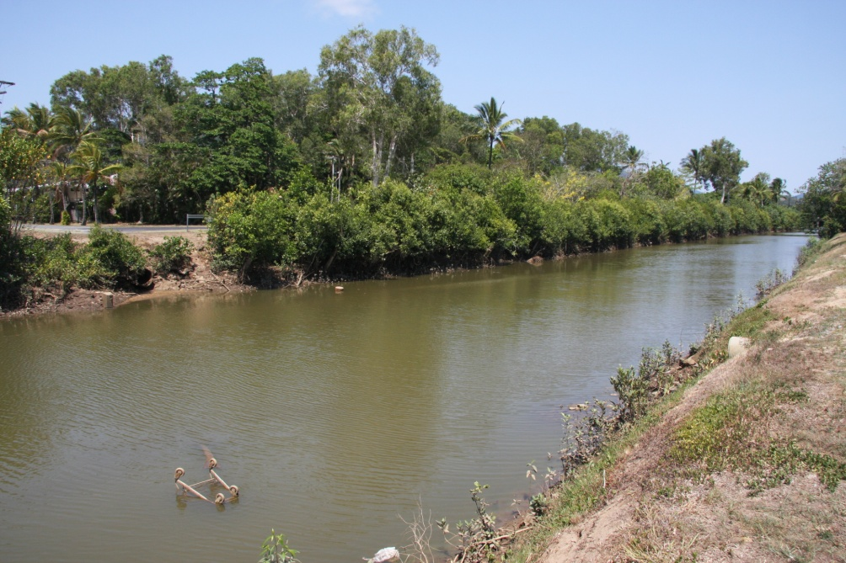
Modifications and barriers
Notes:
Again think about the man made structures in our urban and agricultural areas that we use to manage water. Here are some of these structures that may occur within the Barron Catchment and may affect how the catchment functions and the ecosystem services the catchment provides.

Slide 11
Notes:
So let us now revisit this idea the catchment connects the land and the sea and that the health of the catchment influences the health of the reef. The two elements of catchment health that are most important to the reef are:
Water quality – includes clarity (suspended sediments), chemistry (includes the nutrients and chemicals carrier by the water)
Ecosystem services – the capacity of the catchment to sustain and support biodiversity within the catchment and within the reef ecosystem.

Slide 12
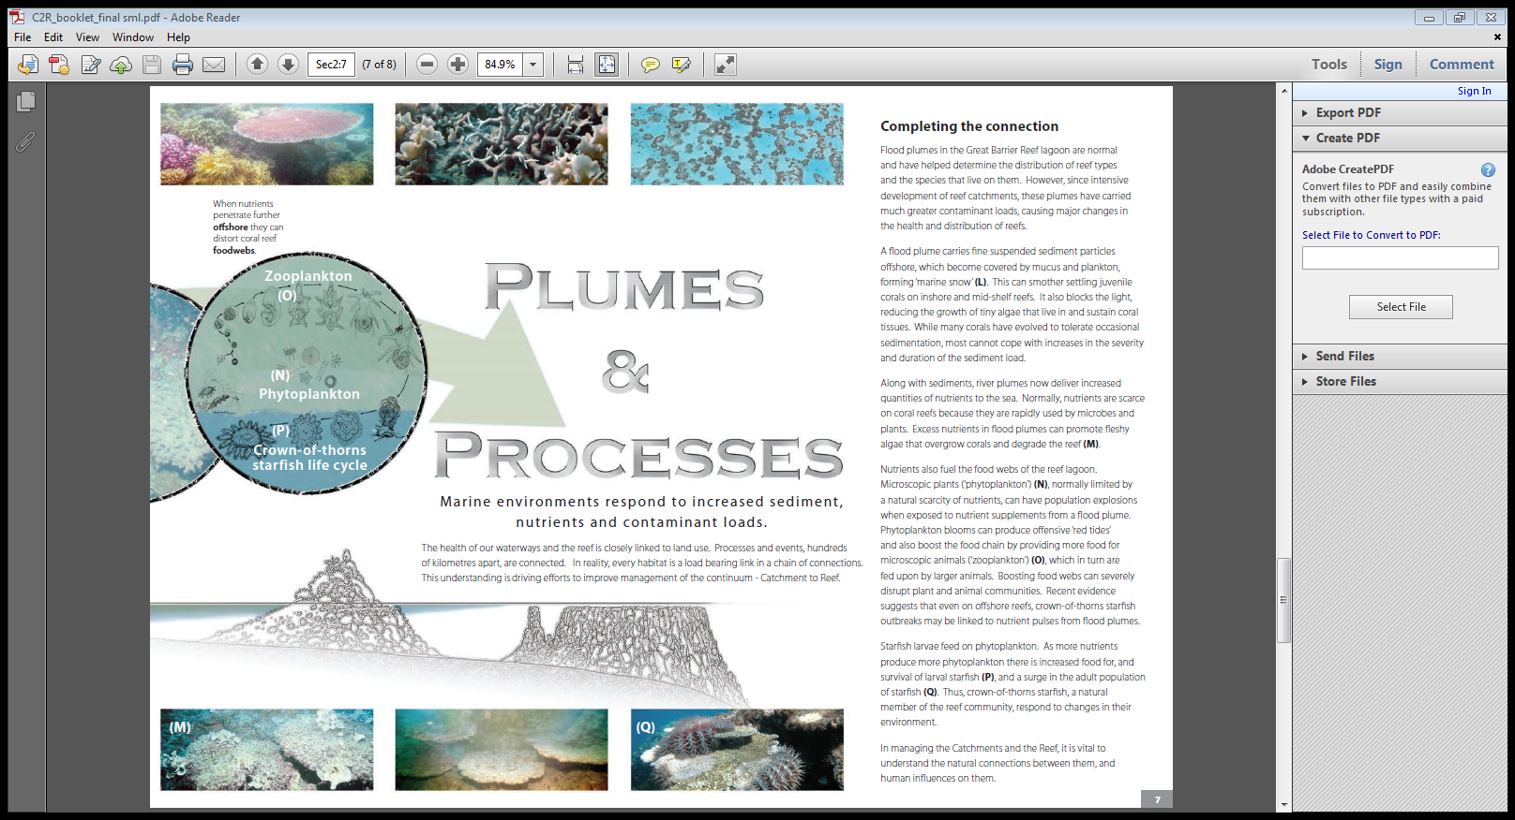
Notes:
Lets look at water quality first.
Water draining from the land of the catchment is referred to as Run Off. Run Off carries with it naturally occurring nutrients and sediments that are important to the health of River and Reef ecosystems. During floods the run off is visible off our coastlines as we can see the muddy river water pushing out to sea. We call this a Plume.
As we modify and change our catchment the levels of the sediment and nutrients in Run off and Plumes can increase and with the addition of chemicals to the run off this can damage the ecosystems and biodiversity they support in the Rivers and the Reef. So we need to do things in our catchments that keep the levels of sediments, nutrients and chemicals at levels that minimise the impact on the river and reef ecosystems and biodiversity.
Sediment is generated from land clearing, overgrazing, river bank clearing, farm cultivation and urban development. Excess sediment in the rivers and streams of the catchment and in the waters of the reef can cut light penetration affecting the growth of aquatic and marine plants. On the reef seagrass in the inshore water is most vulnerable to this. Loss of sea grass can affect the health of turtles and dugongs and many other reef organisms. Excess sediment can also smother animals living on stream beds or the sea floor. On the reef baby corals on inshore coral reefs are most vulnerable to this.
Nutrients occur naturally in the catchment but excess levels can occur in run off from the excessive use of fertilizer, poor grazing practices and poor management of urban and industrial waste. Excess nutrients can promote excess plant growth. In streams this can see plants choke waterways impacting the biodiversity. On the reef this may see excess algae growth that can smother corals. We now know that excess nutrients are contributing to Crown of Thorn Starfish population explosions. Excess nutrients transported to reef waters by flood Plumes produce more phytoplankton for the starfish larvae to feed on meaning more young starfish survive at these times causing population explosions on the reef.
Chemicals - we all use chemicals daily to wash cars, clean our houses or kill pests and weeds in our gardens and on our farms. Like nutrients if we are not careful in the way we use chemicals they can be carried by run off and flood plumes and have impacts to the ecosystems supported by the catchment and the reef. Chemicals can disrupt biological processes. An example of this is that some herbicide chemicals have been shown to affect the ability of baby coral ( larvae) to detect suitable surfaces on which to settle They need to be able to find the right surface if they are going to grow into coral colonies.

Slide 13
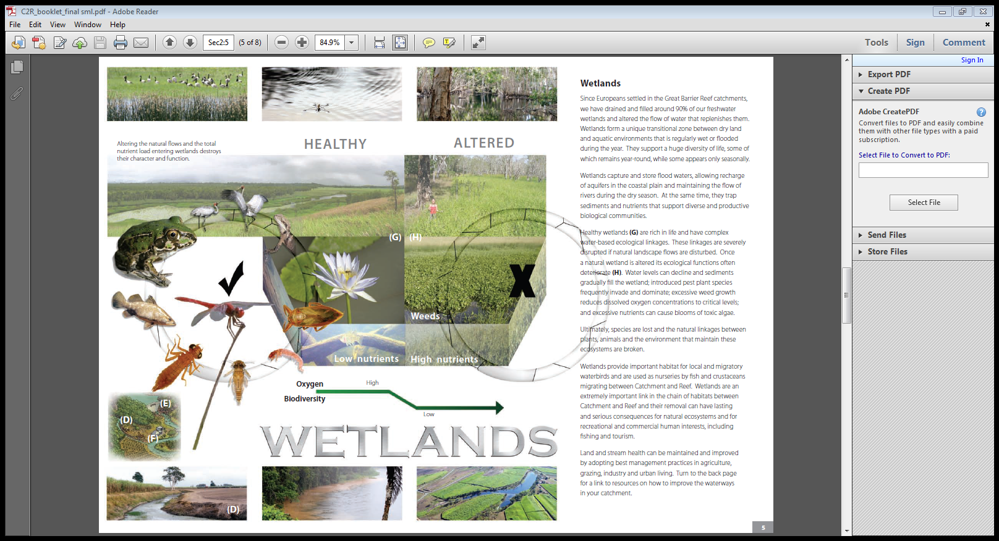
Notes:
Wetlands play an important role in the catchment. They capture and store flood waters, recharging ground water systems and help maintain flow in rivers and streams. We have lost 90% of our wetlands from the Queensland catchments that flow in to the Great Barrier Reef.
In terms of water quality Wetlands are very important as they slow down the flow of run off allowing sediments and nutrients to be trapped and recycled.
They also provide important ecosystem services providing important habitats for migratory water birds and are important nurseries for fish and crustaceans some of which have links to the Reef. I will now look at ecosystem services in greater detail in the next few slides.

Slide 14
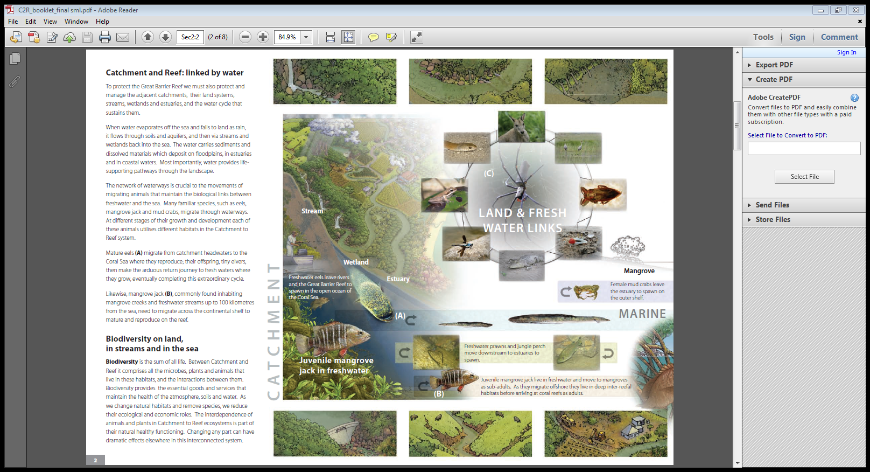
Notes:
To understand what we mean by ecosystem services we will look at the life cycles of two animals that you should all be able to recognise.
The Mangrove Jack and the Freshwater Eel, have life cycles that straddle the ecosystems of the catchments waterways and wetlands and the reef. The Adult eel migrates from the fresh water streams and rivers to the deep water beyond the reef to reproduce. The larvae produced then drift with the prevailing currents and winds towards the coast while they develop into the baby eels that then migrate up through the estuaries and into the fresh water systems (they can actually climb water falls) to mature and grow in freshwater systems through out the catchment. The Mangrove Jack adults live on the reef and spawn in this environment. The baby Mangrove jacks swim to the coast and make their way up through the estuaries in to the freshwater sections of the coastal streams. As they grow they tend to move back down to the estuaries where they live until just before they reach maturity at which point they leave the estuary and live the rest of their life on the Reef.
The ecosystem services that the catchment provides these animals are:
The stream and wetland habitats formed by the snags, aquatic plans and pools that provide refuge and shelter,
the biodiversity of the streams and wetlands that provide the food,
and the river and stream beds, pools and wetlands that provide the migratory pathways.
Other examples of ecosystem services – nutrients and sediments

Slide 15
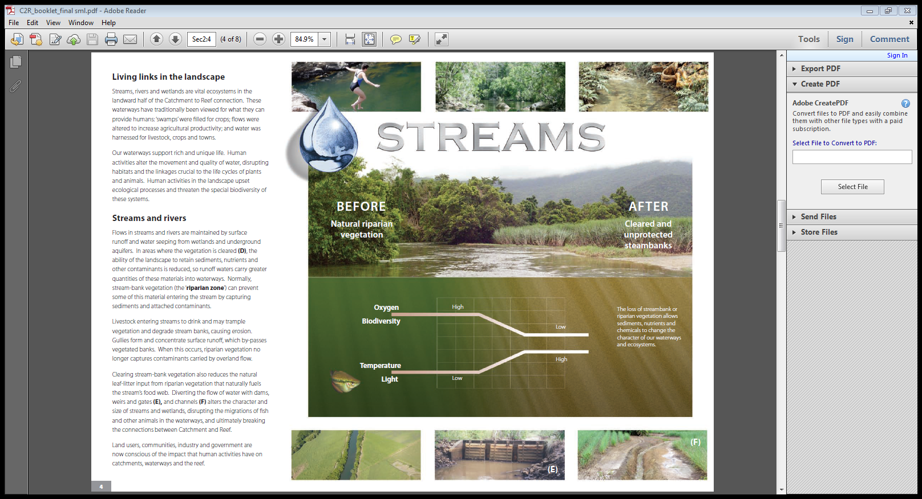
Notes:
While water quality is very important to both these animals neither animal would prosper if the habitats provided by the streams, rivers and wetlands were damaged or modified through the removal of bankside vegetation (riparian vegetation) and the loss of the natural formations such as pools, snags and rocky rapids. Not only would this affect the available food and habitat for these animal but also the available oxygen in the water.
We looked at and discussed barriers earlier. The presence of barriers is very significant for these two animals . Barriers can prevent them from accessing the range of habitats in the catchment they need to survive.
In the case of these animals and many others that migrated between the reef and the catchment a barrier can be formed in many ways and do not have to be dams, but could be:
tidal gates that are closed on high tides – limiting access beyond this point
Road crossing with narrow pipes that create currents that are to strong to swim against
creeks modified to be deep narrow channels that flow only during the wet season at high velocity
So barriers contribute to the loss of migratory pathways which is a vital ecosystem service for the Mangrove Jack and the eel.

Slide 16
Summary:
A catchment is an area of land where all the water flows to a common point.
A catchment includes all of the land and man made surfaces as well as the
streams and rivers.
Catchments connect the land to the sea and the reef.
Communities rely on catchments for their prosperity. A healthy catchment
means a healthy community.
The health of the catchment affects the health of the reef.
The water quality and the ecosystem services provided by the catchment are the things that have the greatest importance to the health of the reef and its biodiversity.
Notes:
So to summarise the story I have told you today we need to remember:

Slide 17
In managing the Catchments and the Reef it is vital to understand the natural connections between them,
and the human influences that can affect these connections.
Notes:
So when you are thinking about projects you might undertake it might be helpful for you to remember what I have here on this slide.
Connections is the key word.

